Slide 1
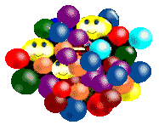
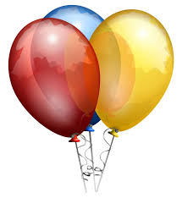
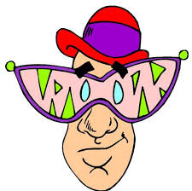
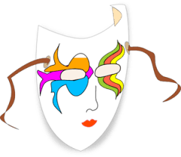
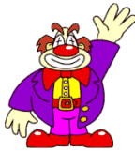
L
A
V
C
A
R
A
N
In
our
School!

Slide 2
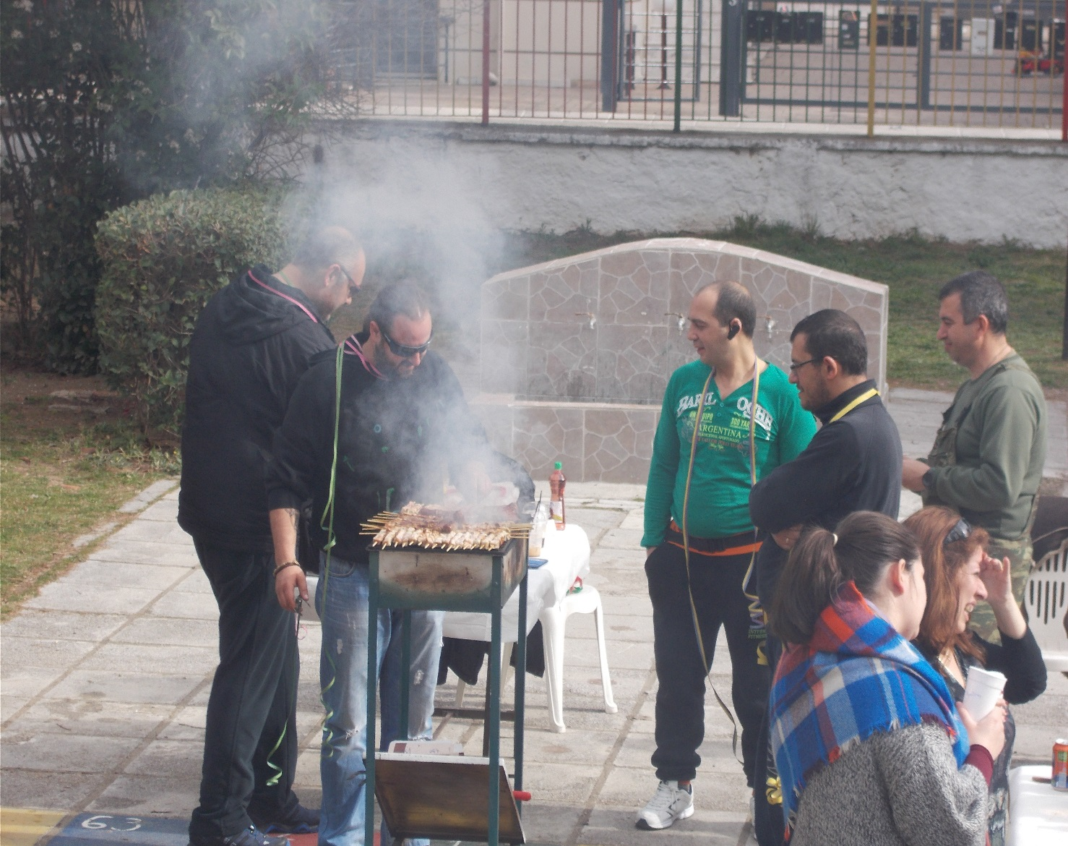
Carnaval in school, usually begins on Thursday that smells grilled meat (Tsiknopempti). That day school was opened to panents, who came and grilled the meat for everybody!

Slide 3
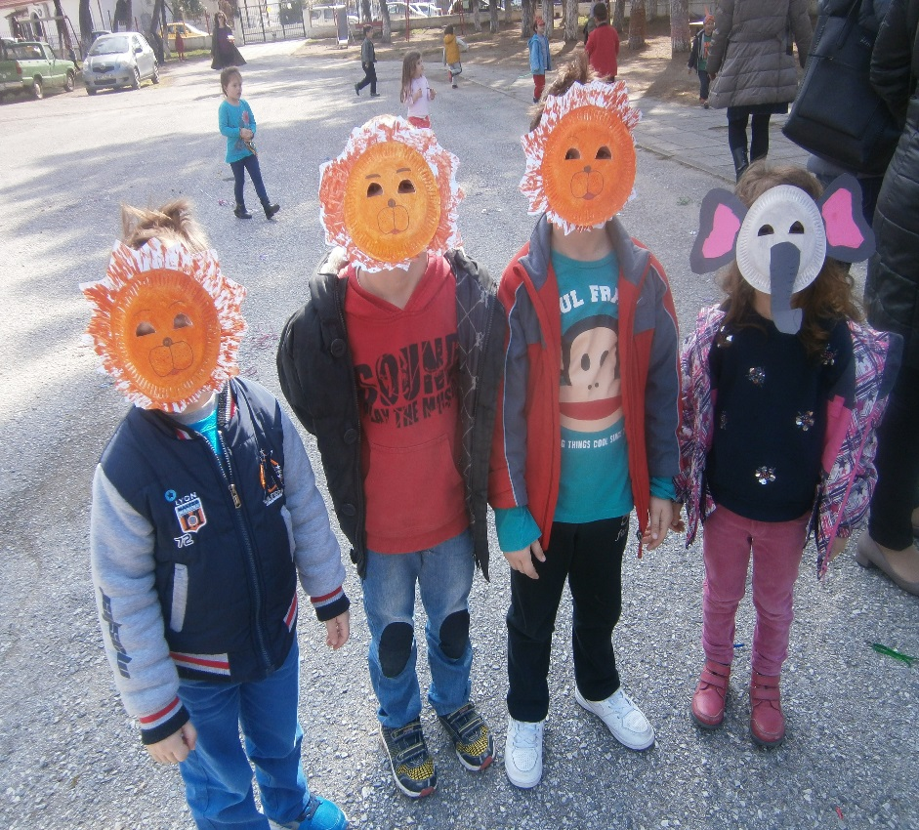
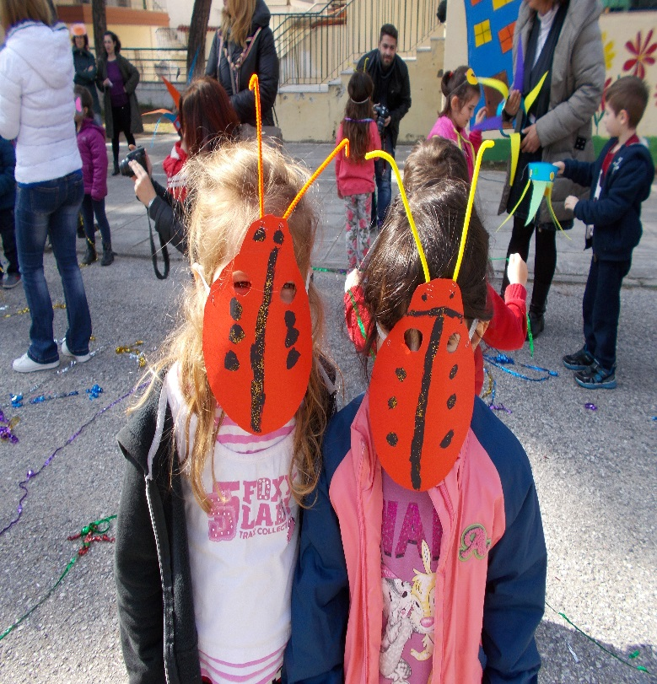
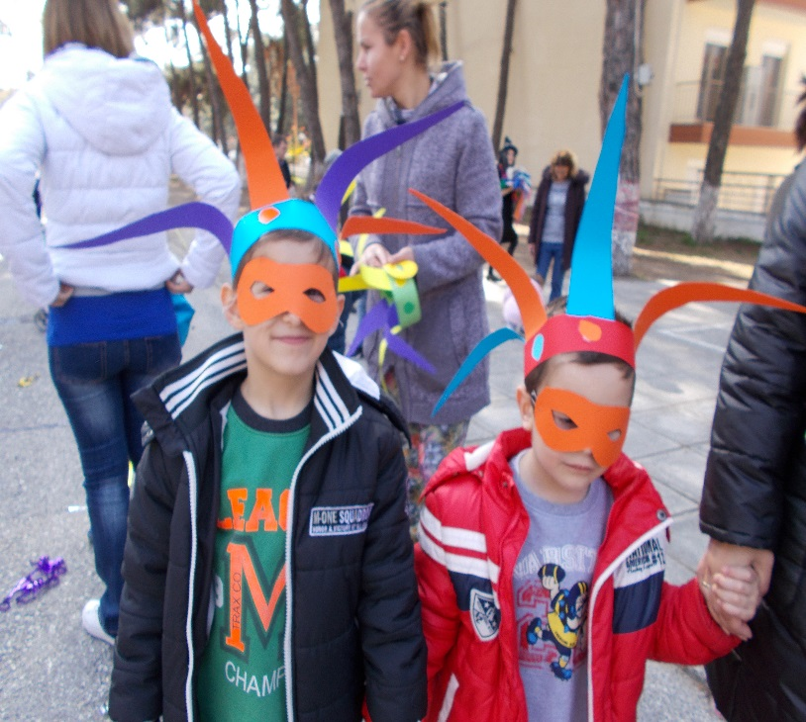
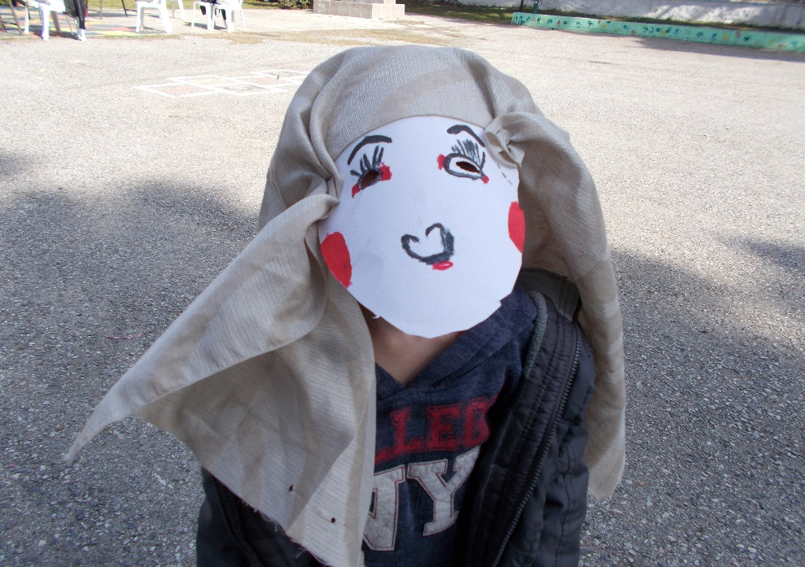
Children came out of their classes with masks …and the party begined!!!

Slide 4
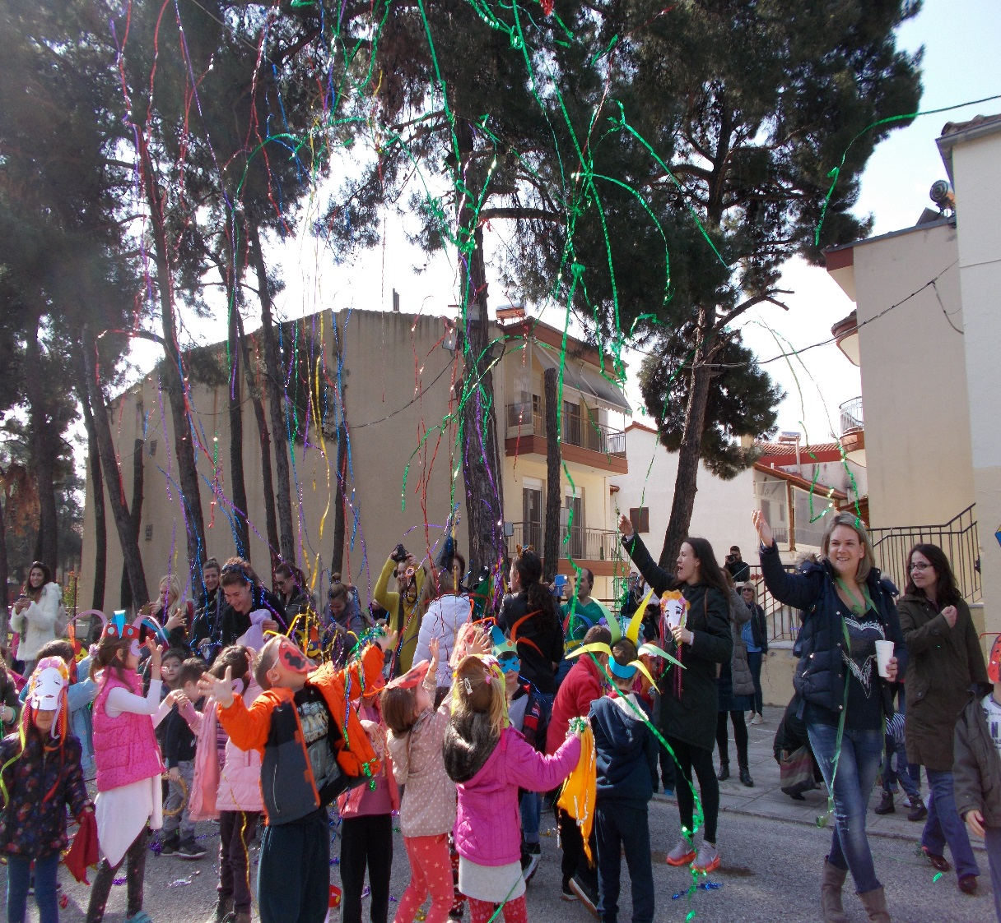
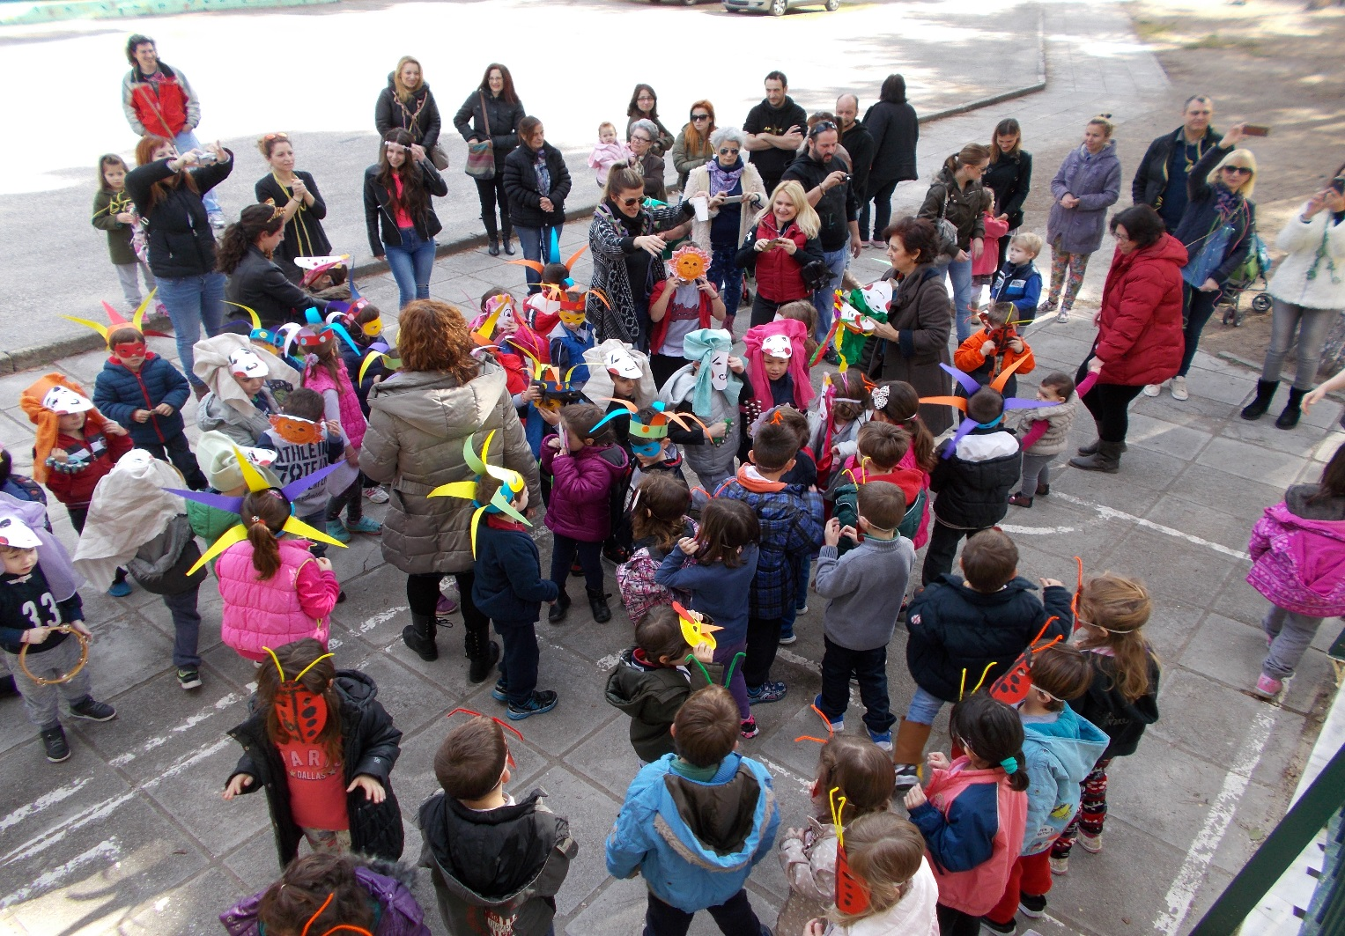

Slide 5
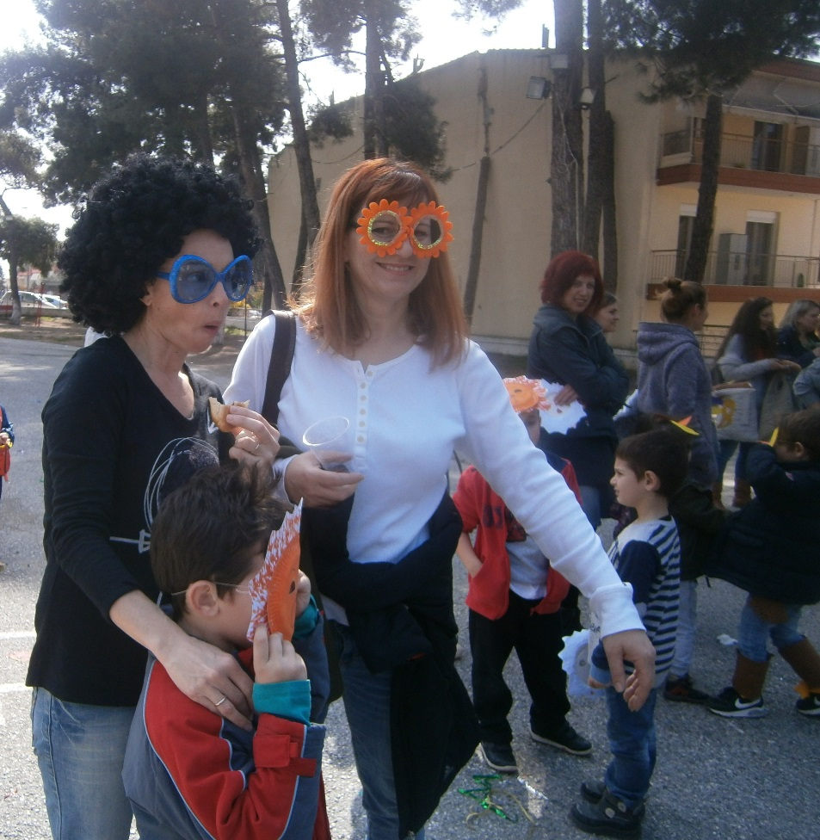
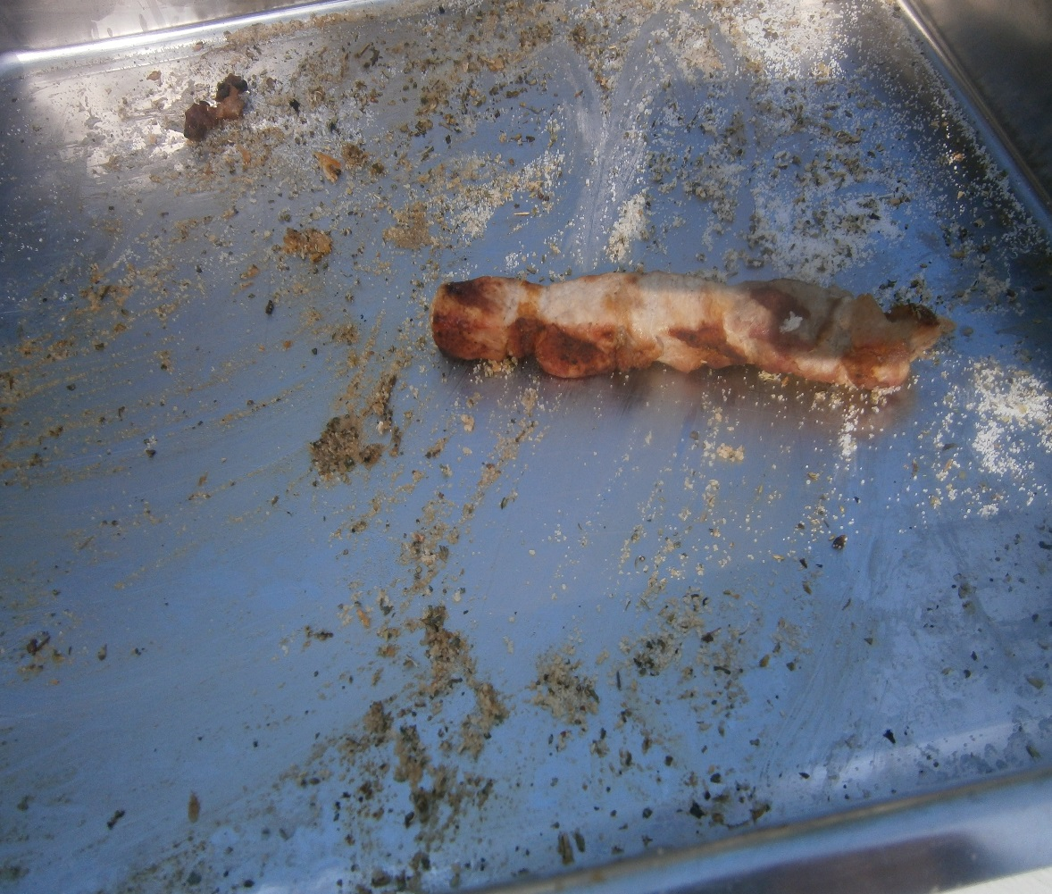
We sung, danced and ate …
This is me… with a wig of course!!!
Only one souvlaki left!!!

Slide 6
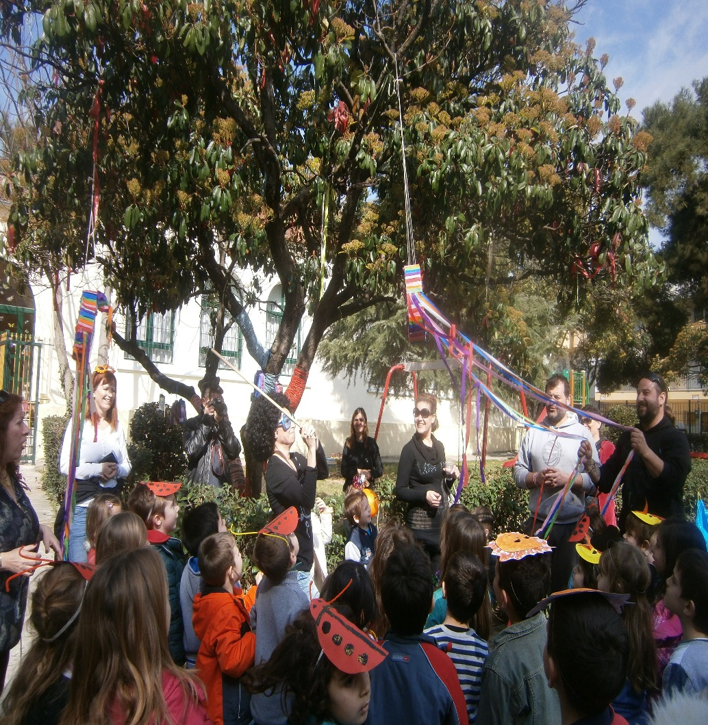
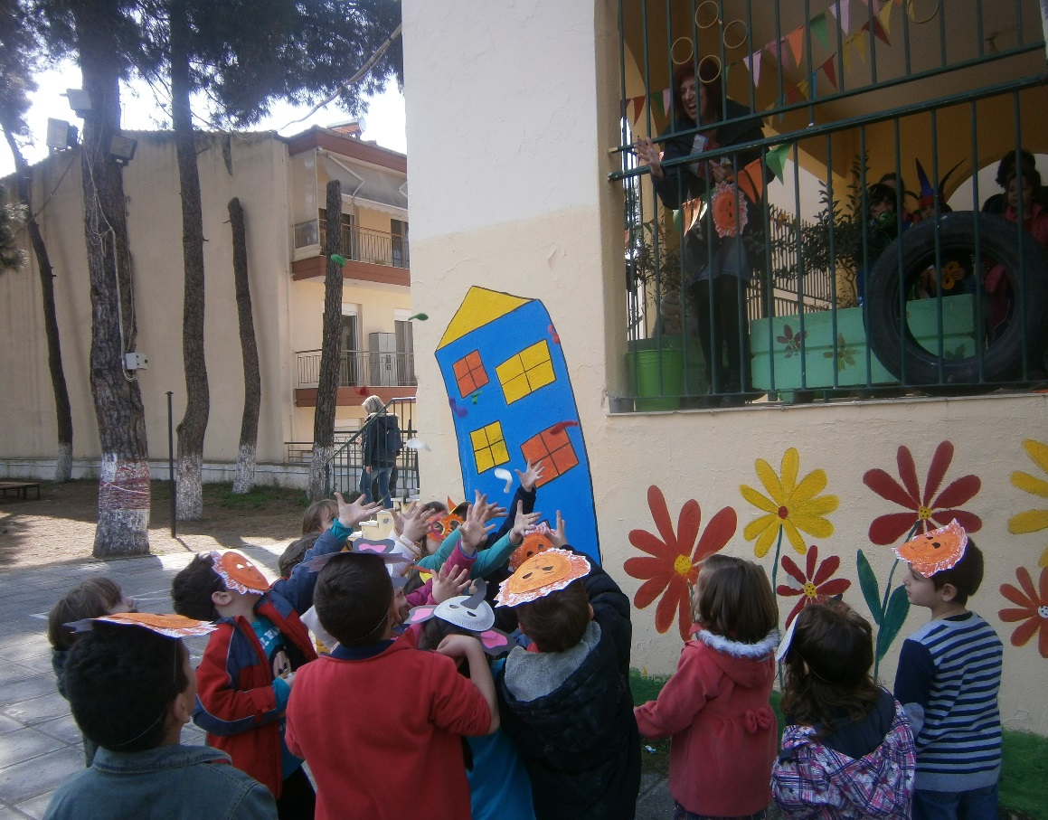
The duty to break the Pignata and free the candies was mine!
Children trying to catch balloons!!!

Slide 7
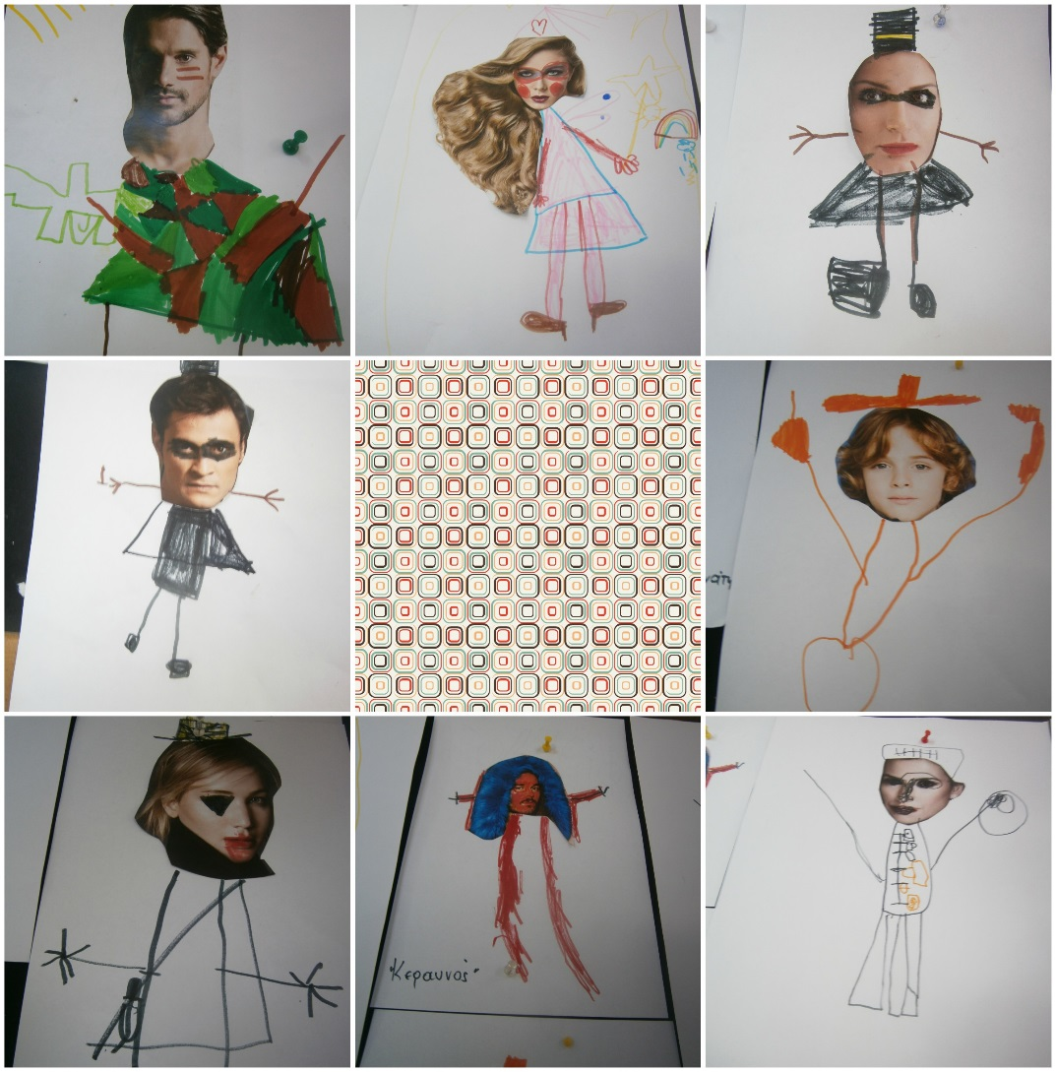
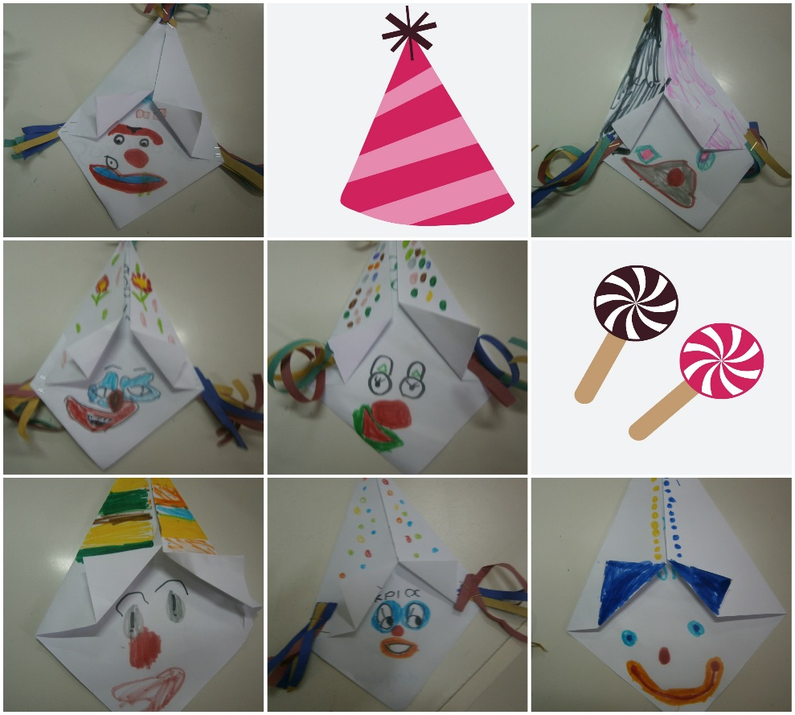
In class…
We made funny clowns!
We dressed up famous people!

Slide 8
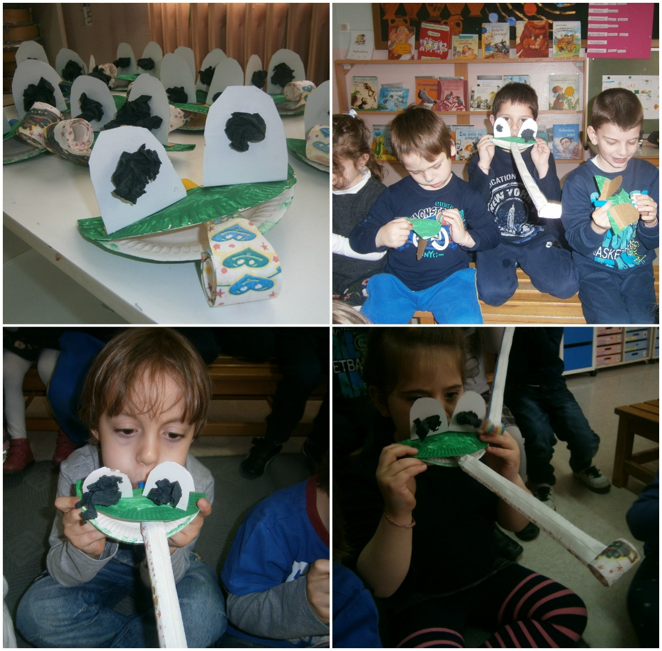
We made masks inspired from the “Animals’ Carnival”
And we made funny frogs!

Slide 9
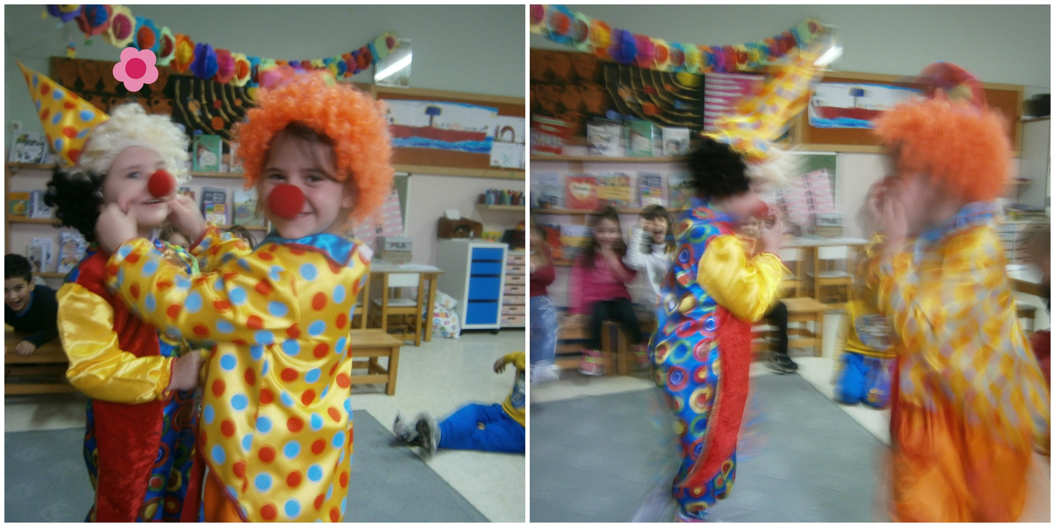
We played drama games!!!

Slide 10
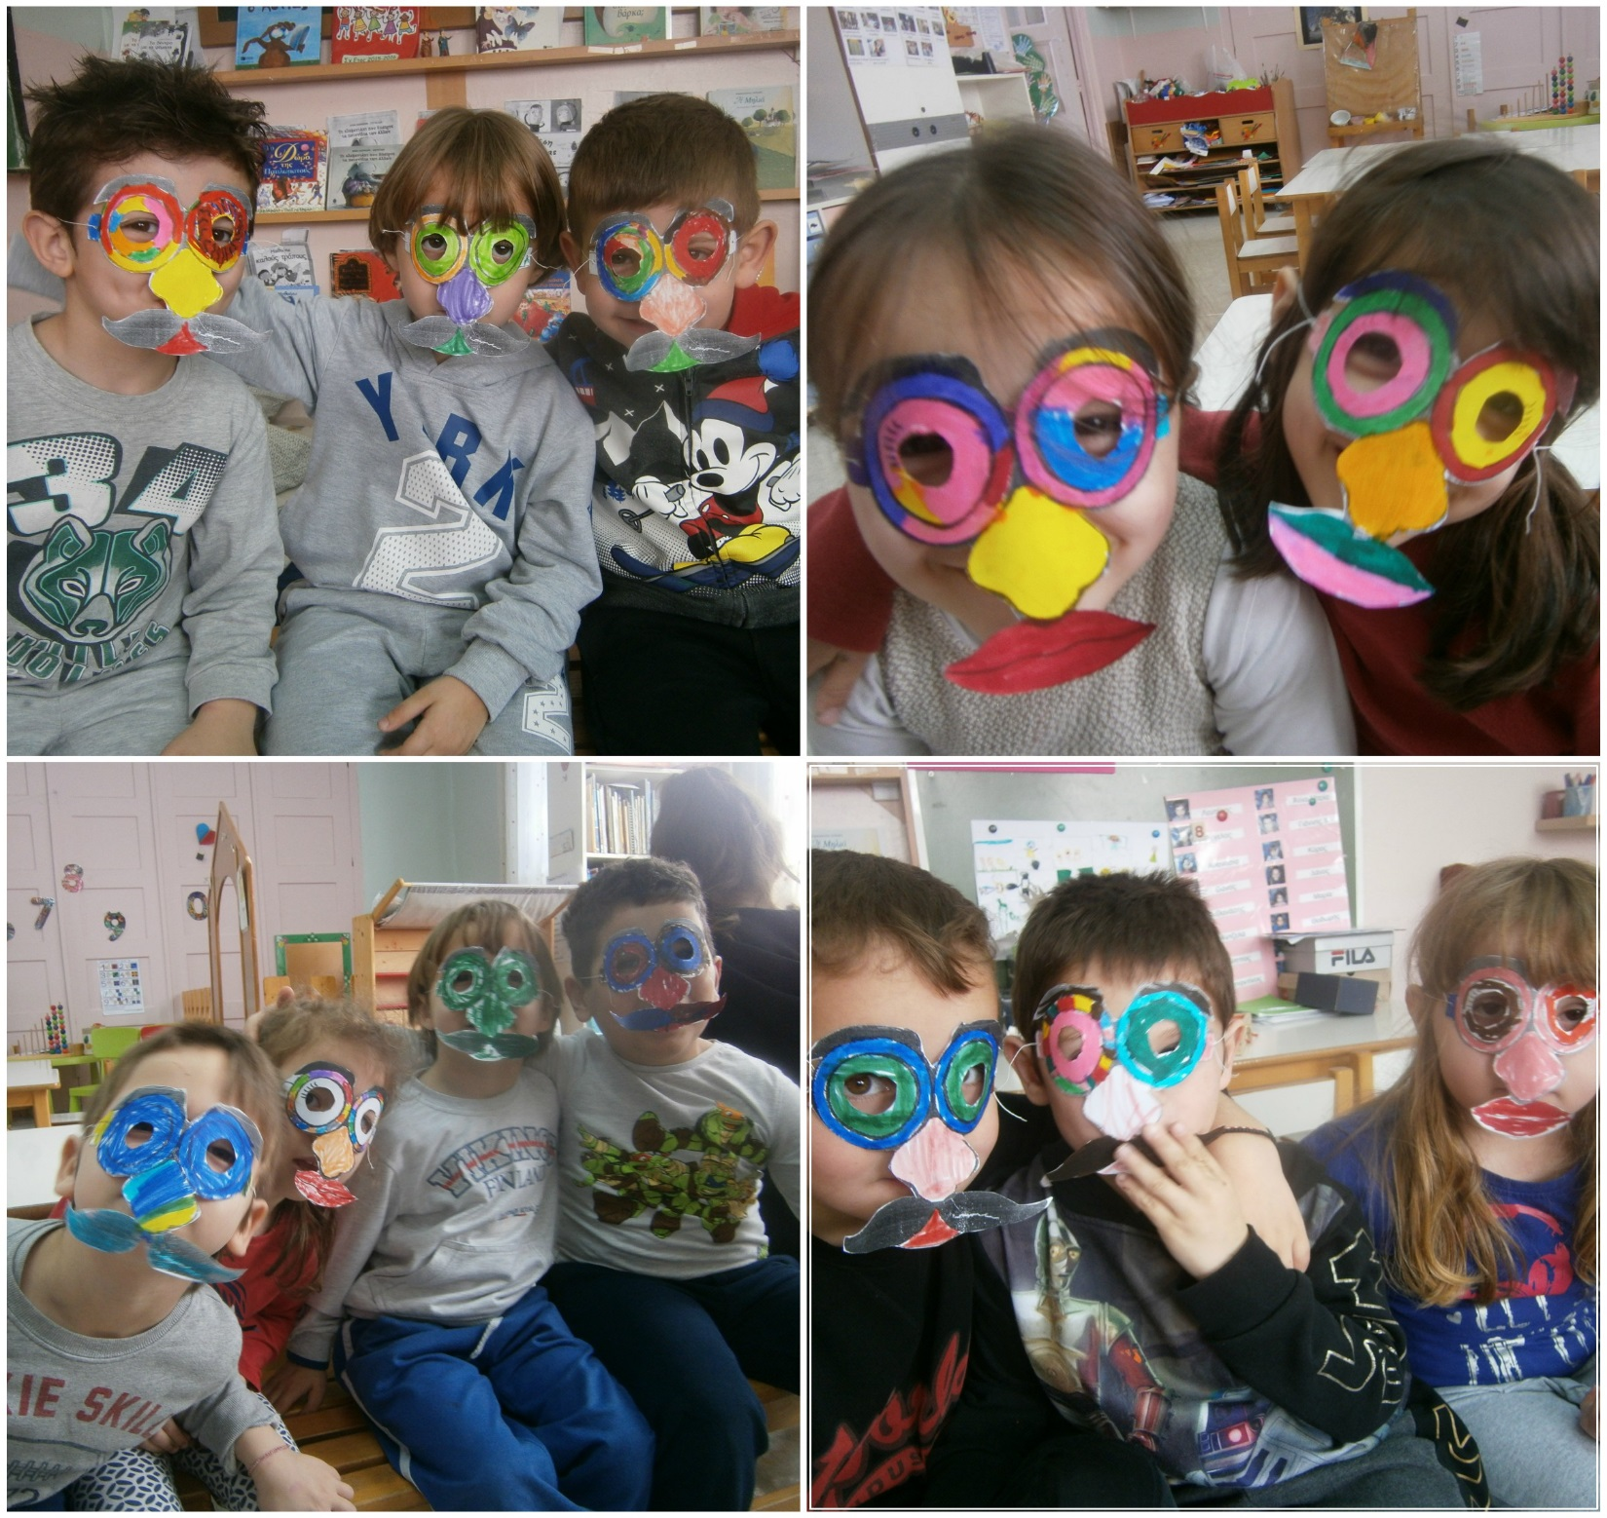
And we make silly faces!!!!

Slide 11
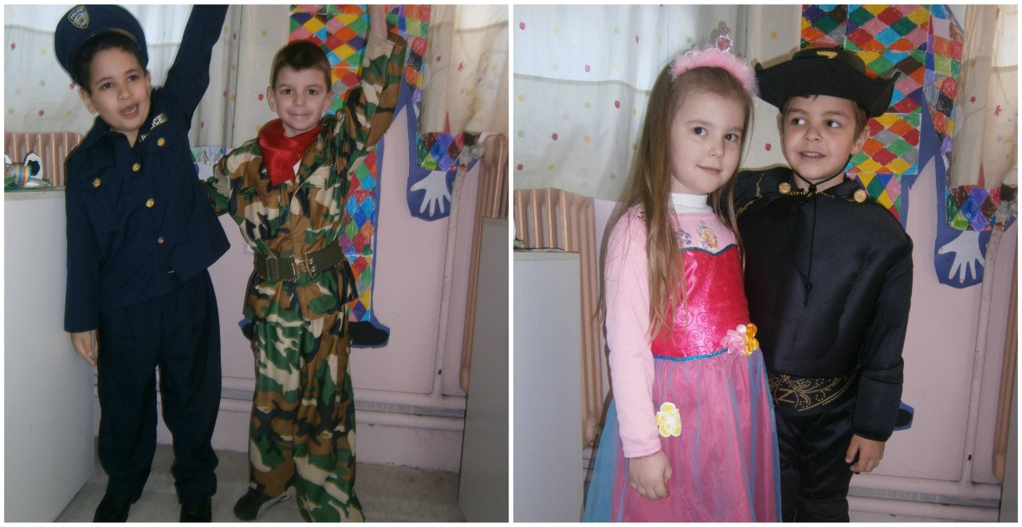
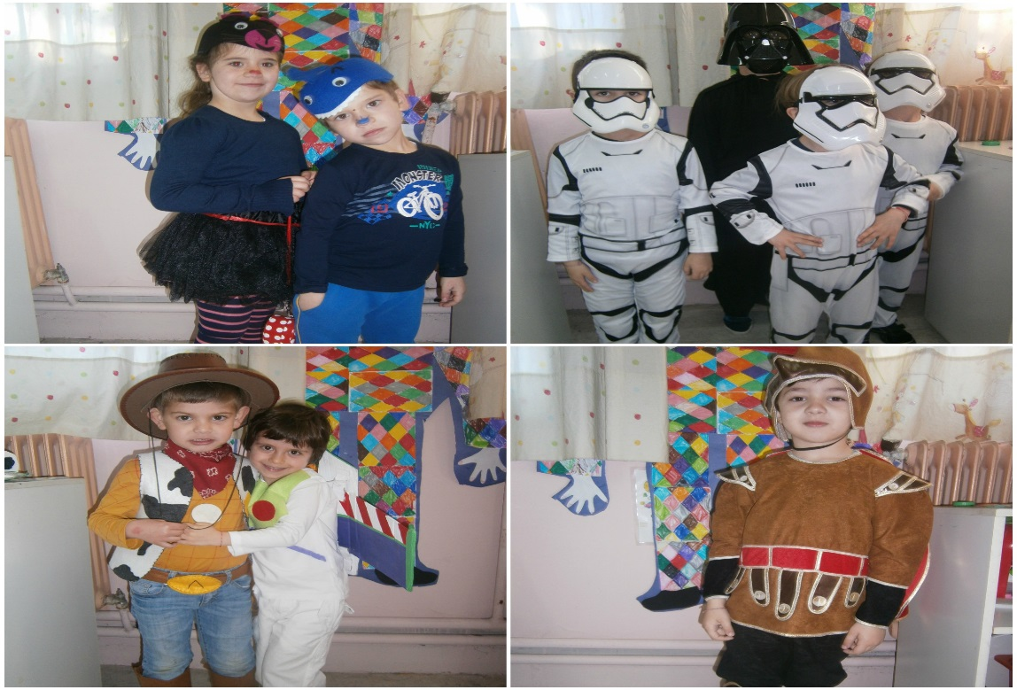
The last Friday of Carnaval children came to school dressed up.

Slide 12
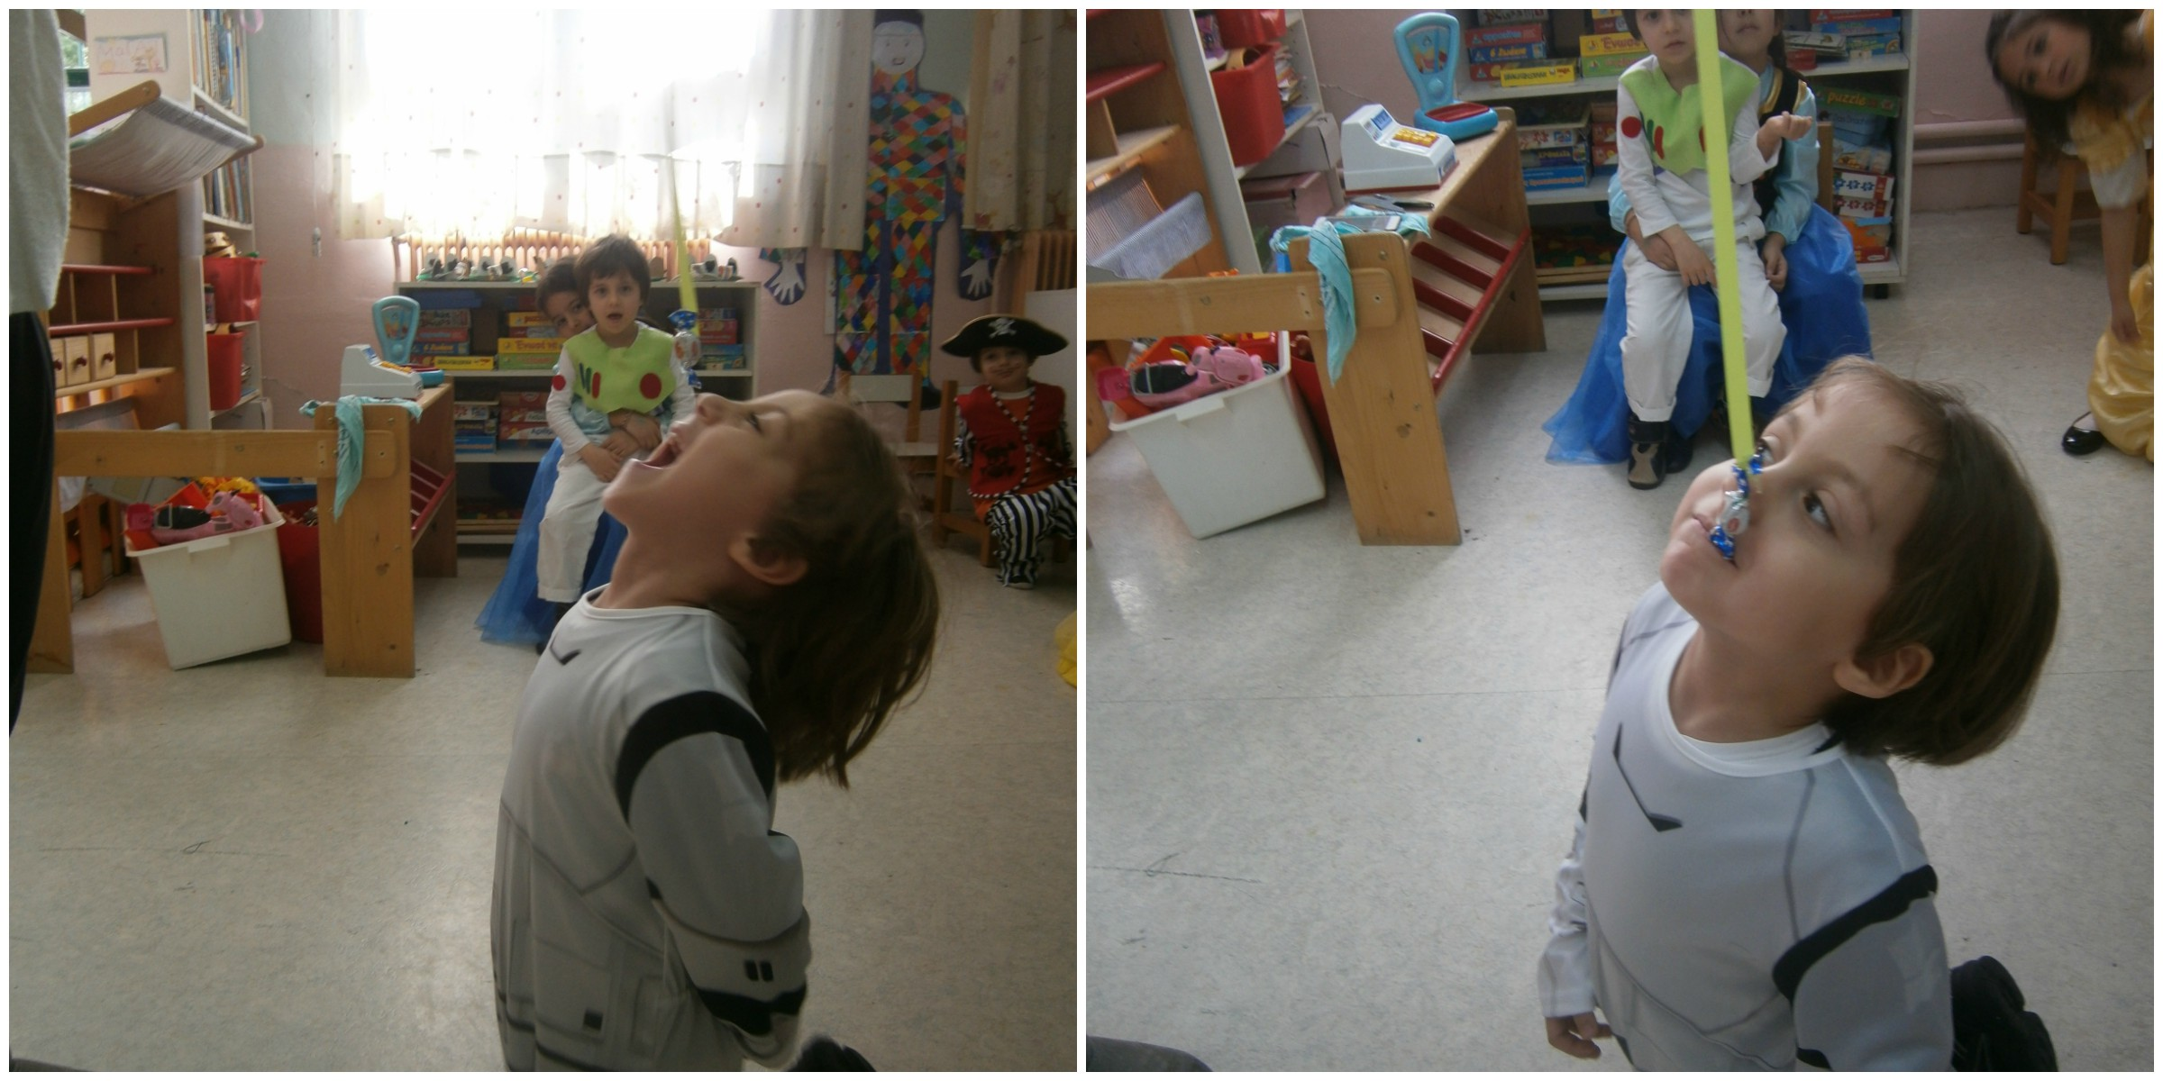
We danced, ate, sung and played traditional carnival games!!!Such as…
….”Catch the candy with the mouth”!

Slide 13
“Put the clown’s nose”

Slide 14
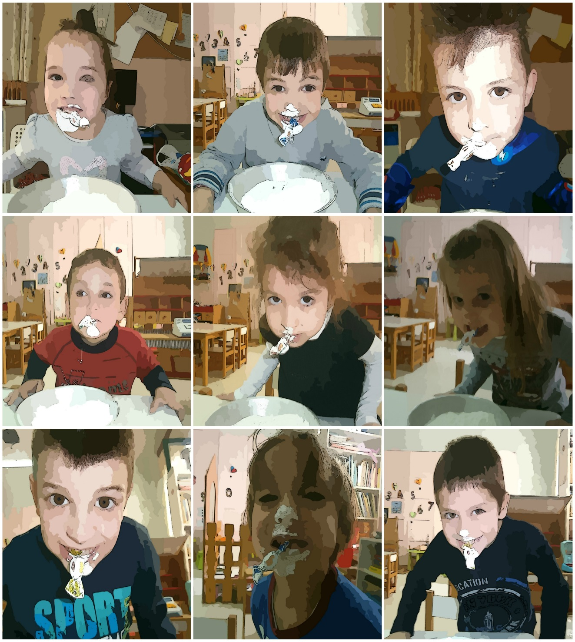
“Try to find the candy in the flour”!

Slide 15
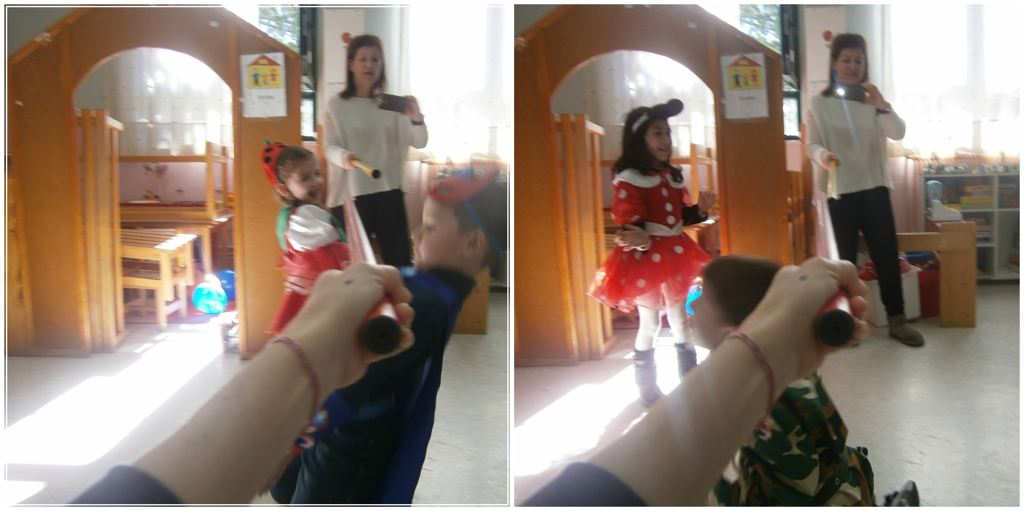
Limbo dance!!!!

Slide 16
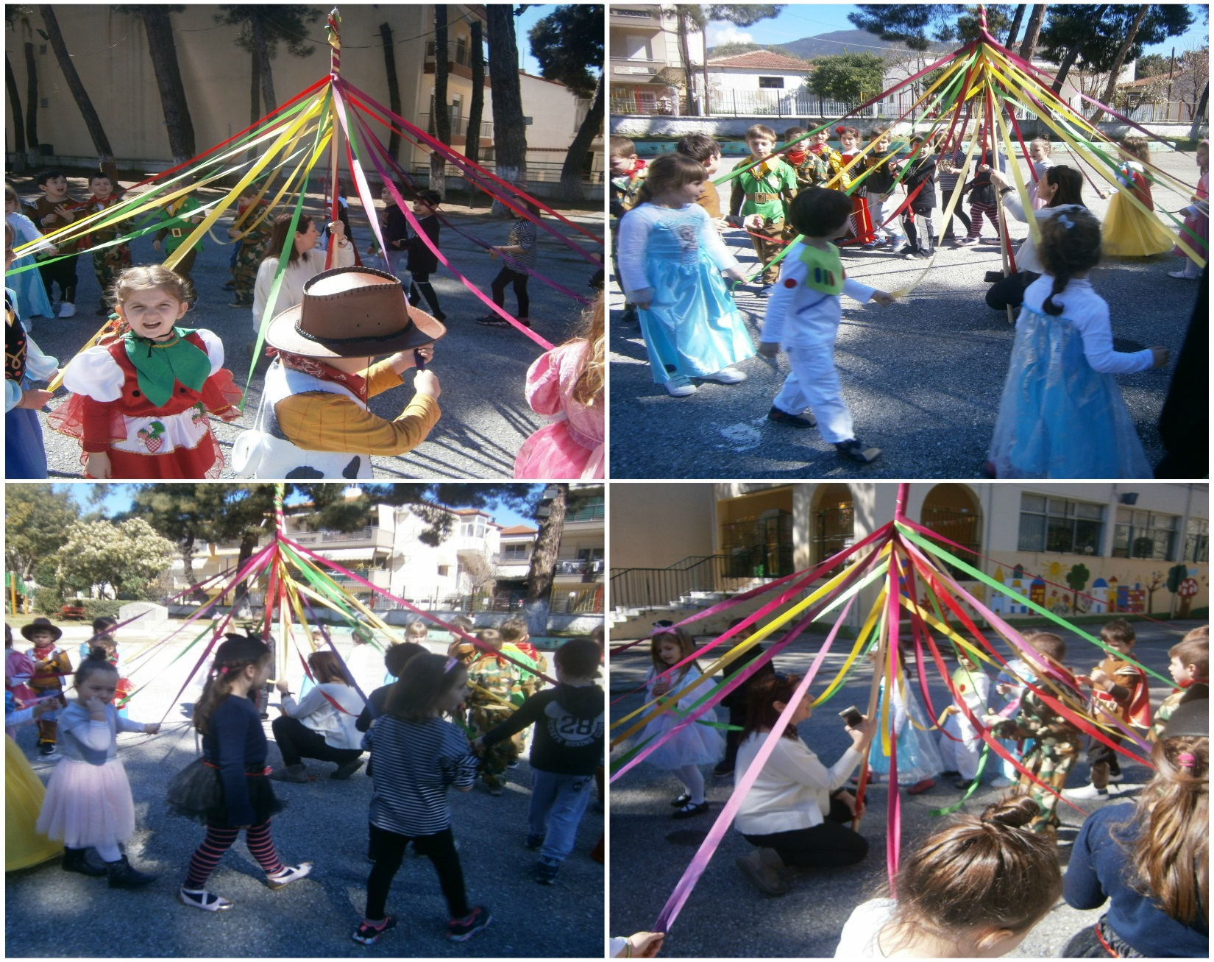
Outside we sung and rolled over the traditional “Gaitanaki”

Slide 17
…till next year!!!!

