Slide 1
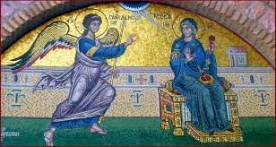
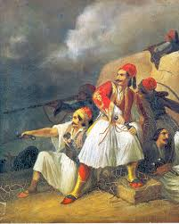
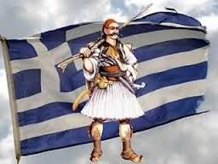
25 march
A double celebration

Slide 2
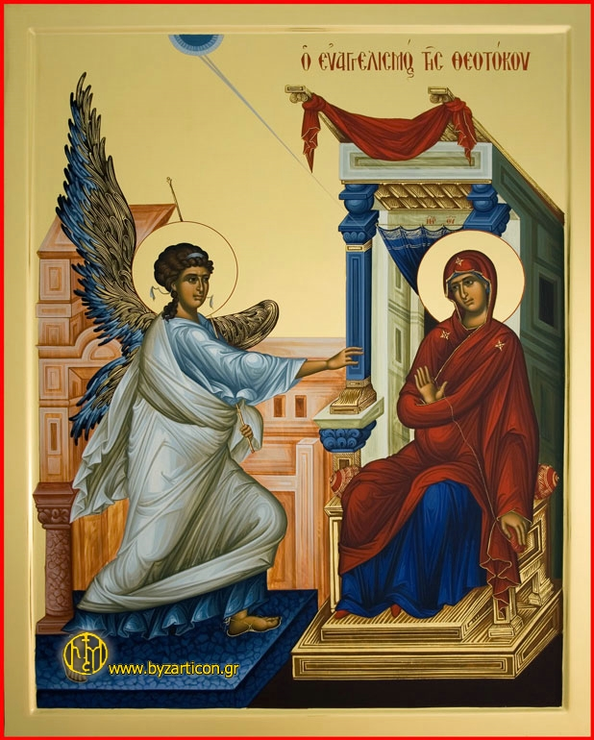
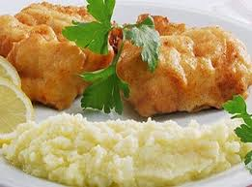
25th March is a double celebration. It’s a day that nobody works.
First, is a religion celebration. It’s the Annunciation of Madonna. And this day we eat dried salted cod with a garlic sauce.

Slide 3
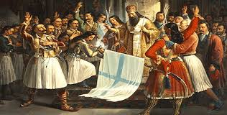
25th March is a national celebration too. 25th March 1821 greeks decided revolution against the Ottomans after 400 years of slavery!
That day they swore in the flag and in Madonna that they would fight for freedom. Their slogan was “Freedom or death”!

Slide 4
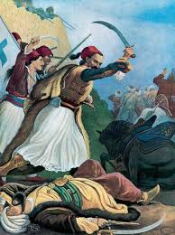
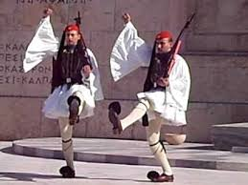
Men used to wear a kind of white skirt , a red hat, with a black tuft, a vest, and red wooden shoes with a black tuft.
We can see that skirt and all the costume today in the Evzones in front of the Greek Parliament

Slide 5
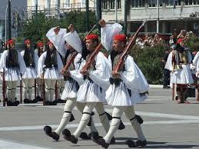
The color of the skirt –white- symbplizes the purity of the fight. It has 400 doubles, such as the the years of slavery. The black tuft that is hanging from the hat symbolizes the tear of Jesus. The black tuft on the the front of the shoes was a hideout for knives in case of fight body to body.

Slide 6
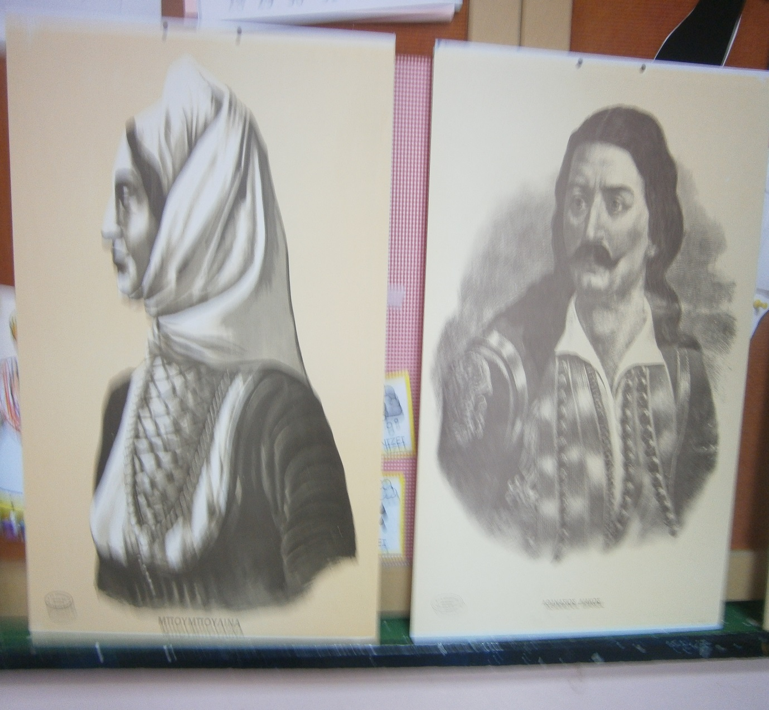
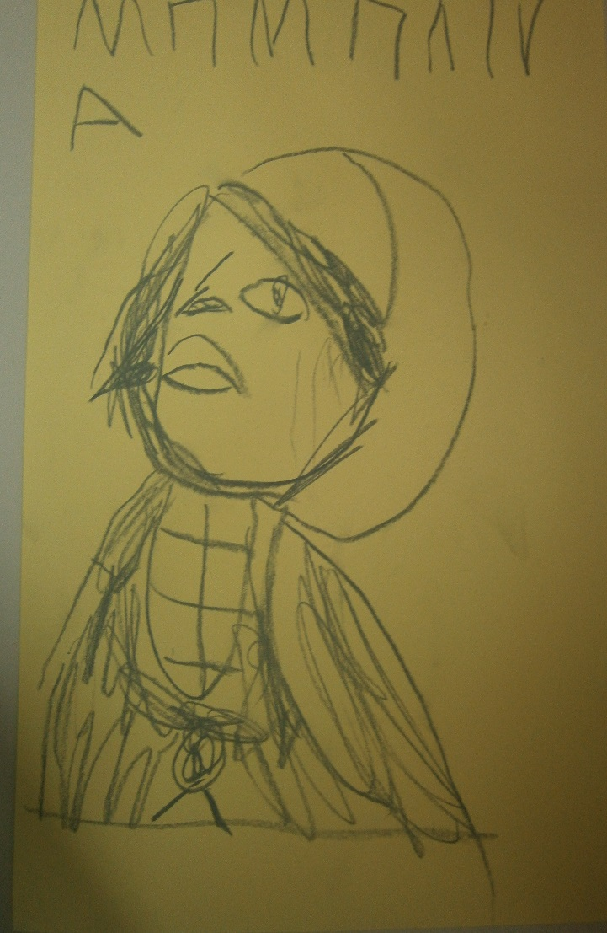
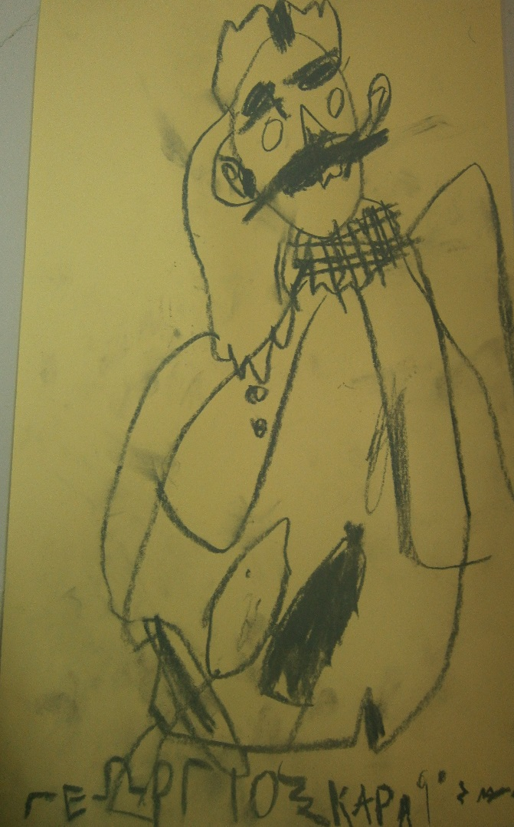
25th March was celebrated in our school.
Children draw the heroes of the revolution…

Slide 7
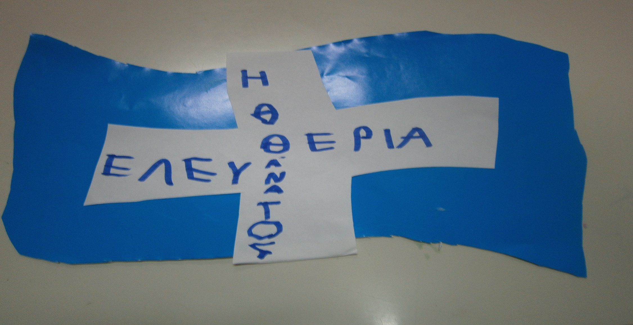
Children made the flags of that age and they wrote “Freedom or death”!

Slide 8
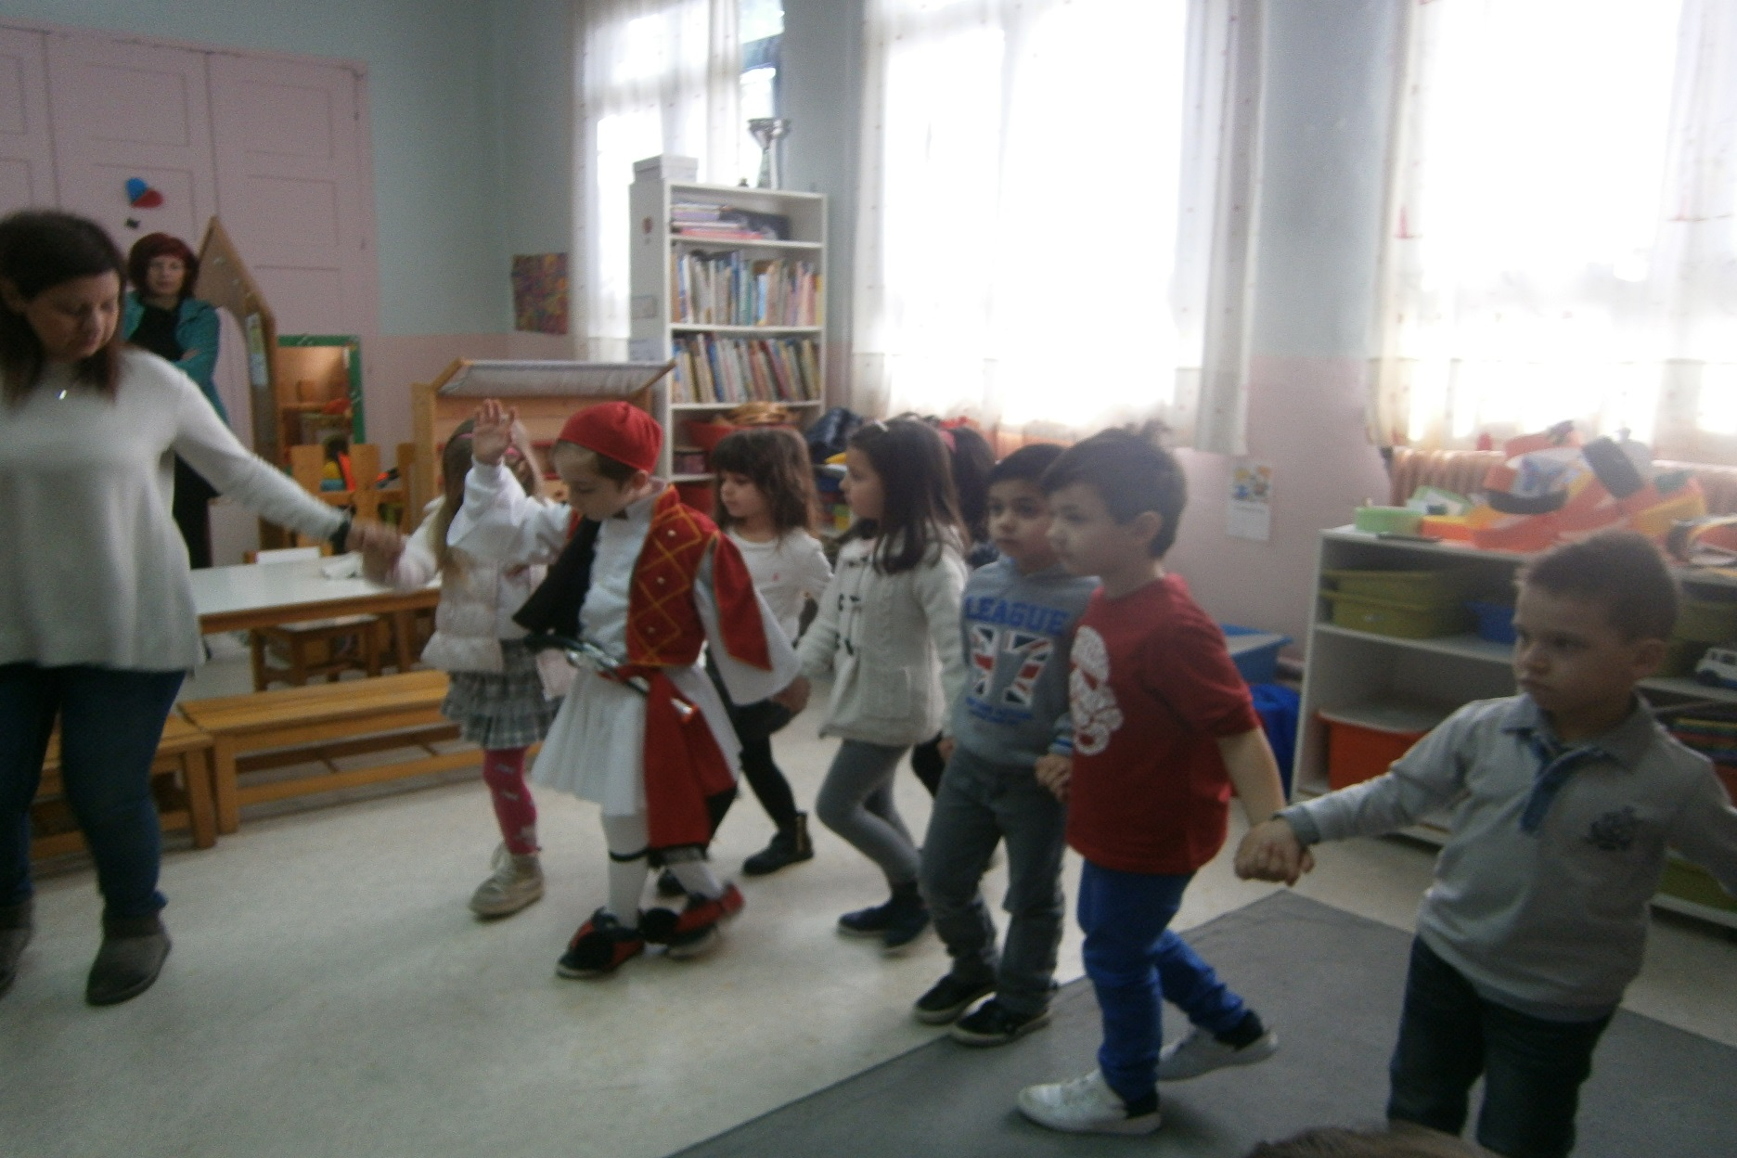
24th March some children came to school with the traditional dress! We danced traditional dances, we sang and we learnt a lot about historical events!

Slide 9
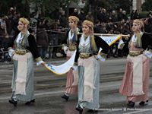
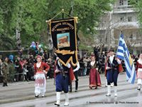
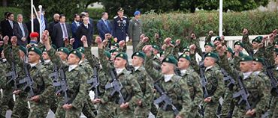
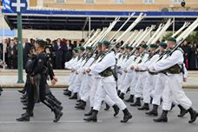
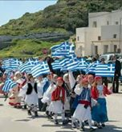
Every year all over Greece, in cities and neighbourhoods students soldiers, etc make parades!

Slide 10
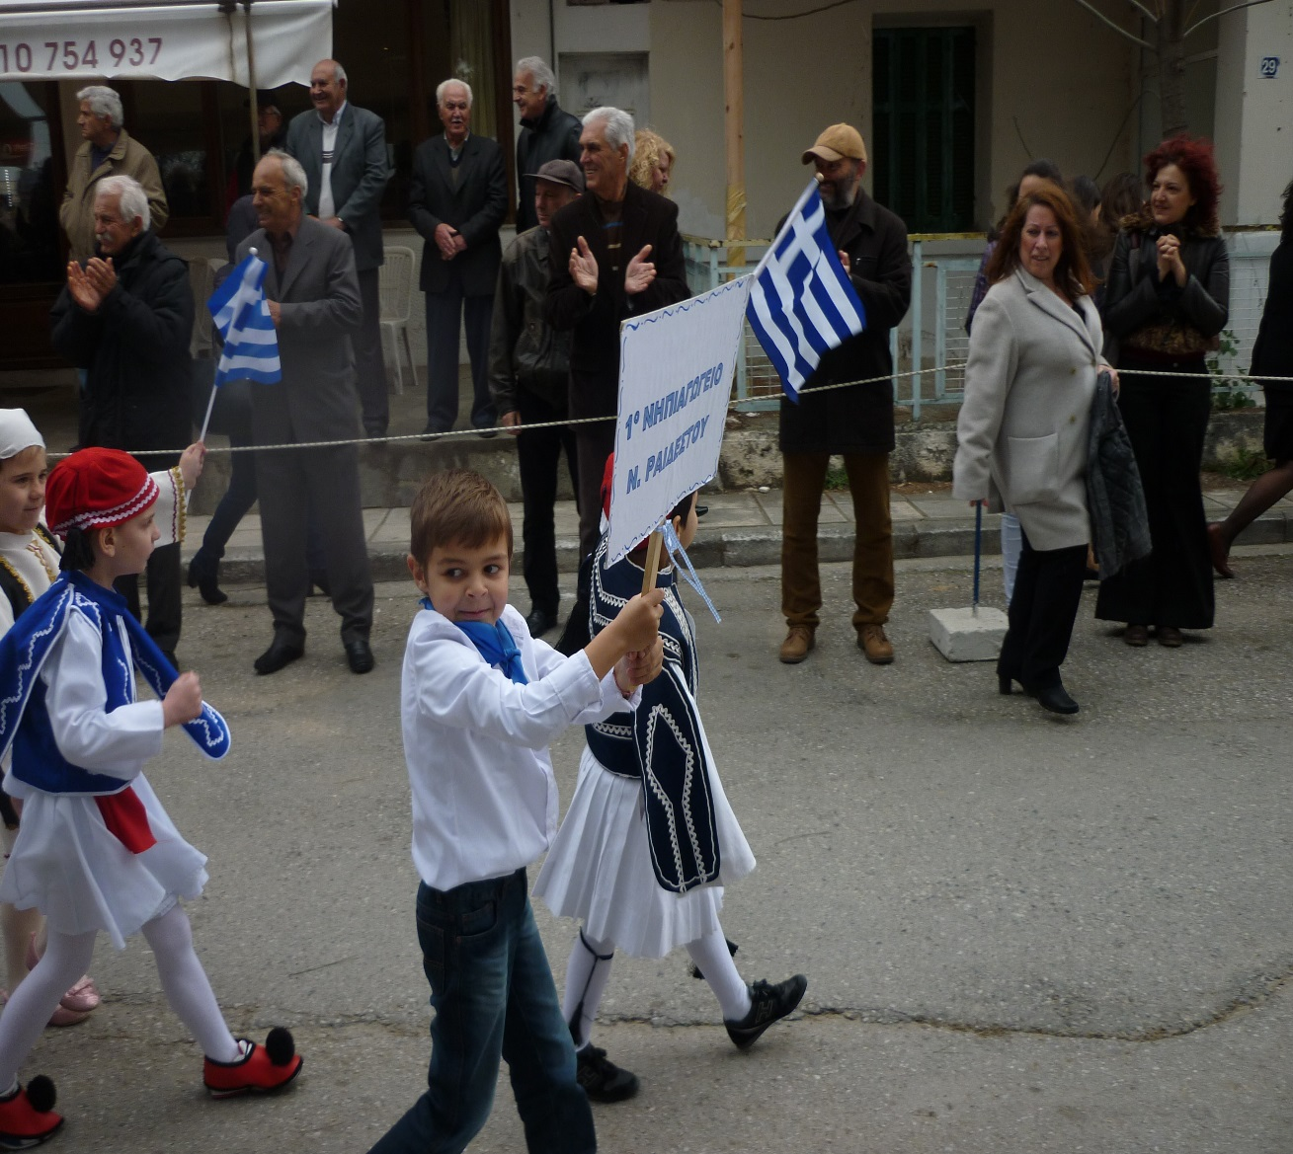
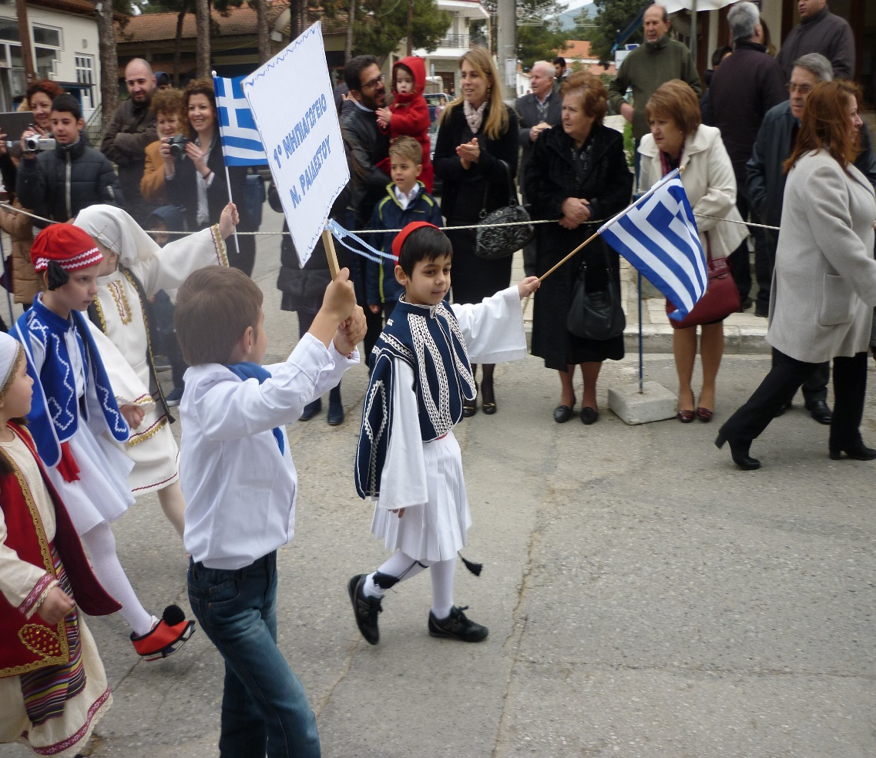
These are the pupils of our kindergarten, dressed in traditional costumes in the parade of Nea Redestos!!! It was so cold! I’m so proud of them!!!!

Slide 11
After the parade we all went home and ate …..
Bakaliaro me skordalia……..

