Slide 1
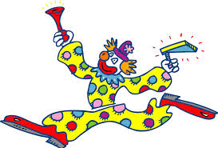
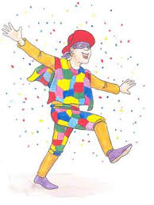
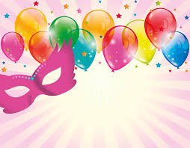
Greek Carnaval

Slide 2
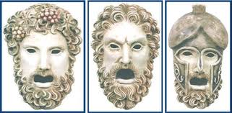
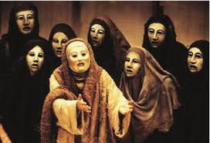
We find the origin of the carnaval in the Ancient Greece. The carnaval masks are the evolution of the ancient masks that actors wore during the theatrical shows dedicated to Dionisos!

Slide 3
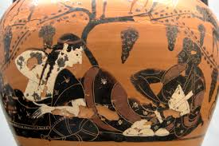
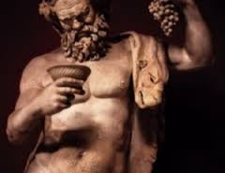
Dionisos was the god of the wine,and the feast. During the events dedicated to him, people used to wear twigs of vine on their head, dance, drink a lot of wine, sing funny songs and paint their faces with the dregs of the wine.
Since then till today in the days of carnival people wear masks, feast, drink a lot, dance, sing funny songs and paint its face!
Carnaval is the season of joy in the middle of the winter!!!!

Slide 4
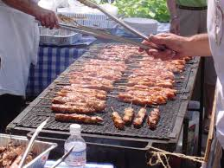
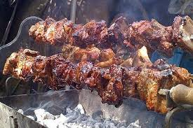
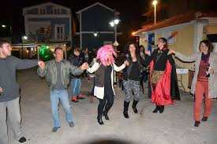
Carnaval lasts three weeks. The Thursday of the second week is called “Tsiknopempti”, a Thursday that smells grilled meat. People dress up,get out in the taverns and dance, drink, sing and eat grilled meat!

Slide 5
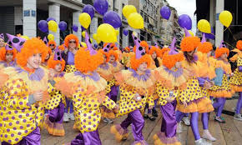
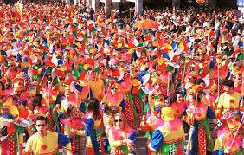
The most spectacular events happen in the last Sunday of Carnaval.
There are parades in many cities of Greece.

Slide 6
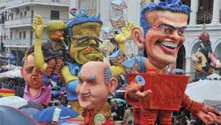
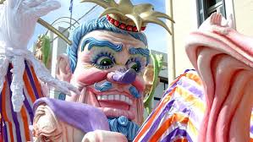
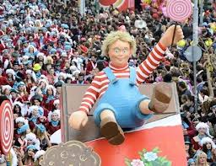

Slide 7
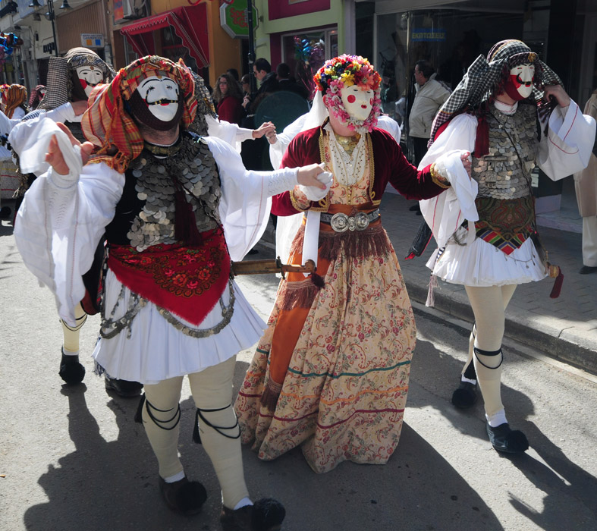
In Naussa, a city near Thessaloniki, takes place a custom that has its origins in the years of Turkish occupation. Then, young boys dressed up in girls in order not to be taken away by the Turkish army!

Slide 8
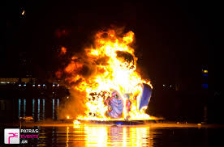
The burning of the “King of the Carnaval”, after the end of the parades means the end of Carnival!

Slide 9
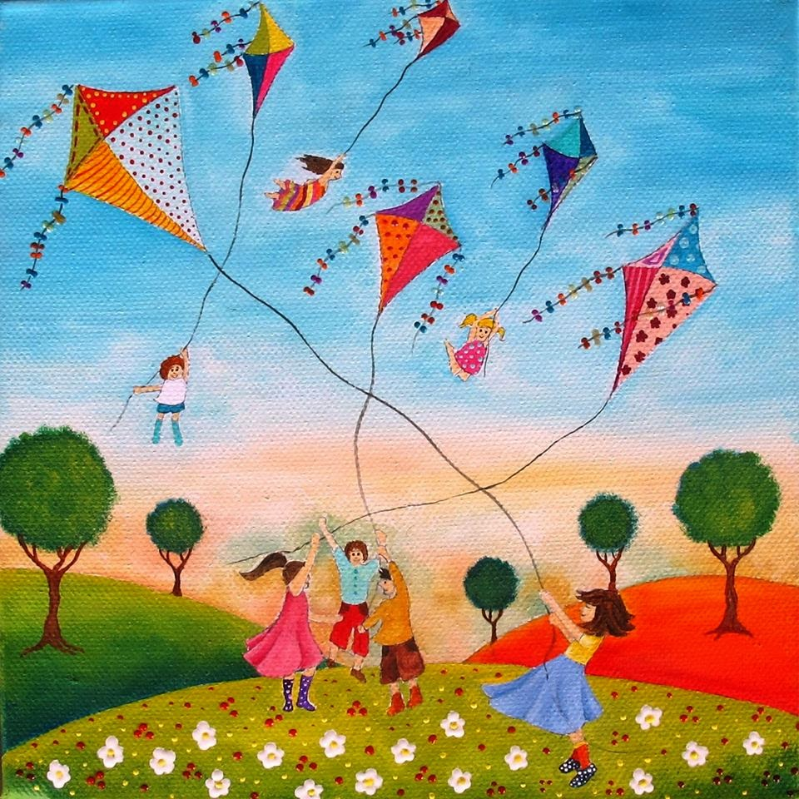
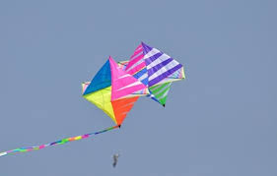
Τhe next Monday nobody works. Schools, shops, offices are closed. People can rest and the custom of Kite’s flying takes place!

Slide 10
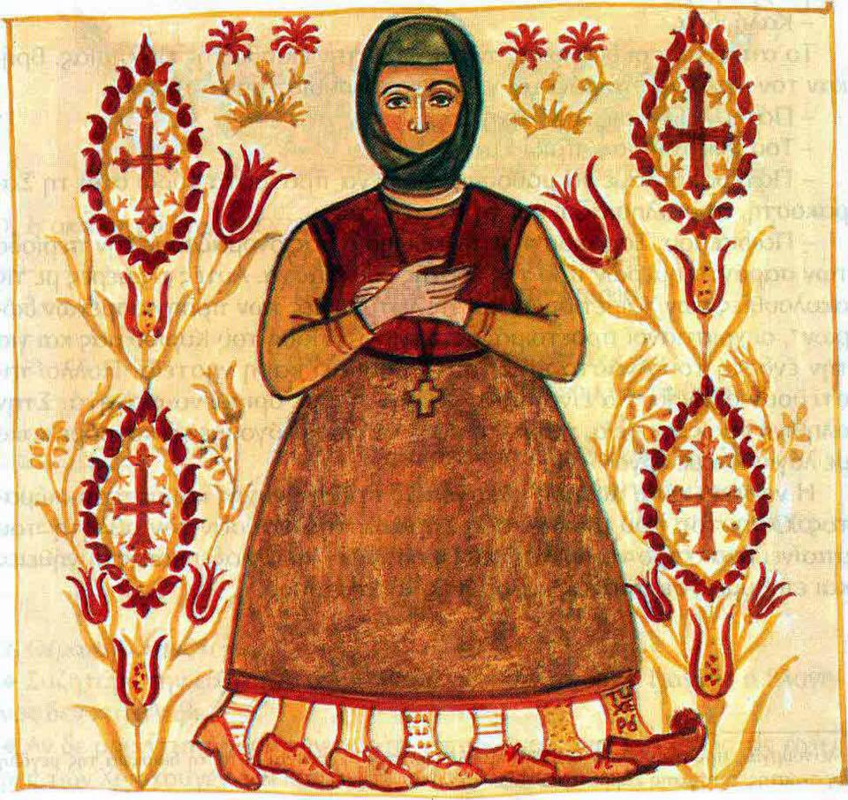
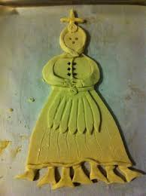
This Monday (The Clean Monday is called in Greece) begins the Lent (40 days to Easter). Mrs Lent, in our local tradition is presented like this:
A woman with 7 legs (seven weeks till Easter). Every Friday we fold a leg. Her hands are crossed because she is praying. She has no mouth because she must not eat food that comes from animals so her body will be clean to get the Holy Communion. She has no ears in order not to hear bad words!

Slide 11
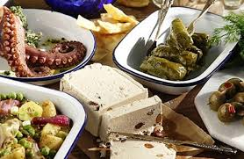
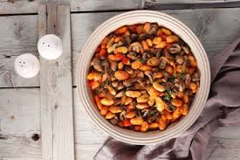
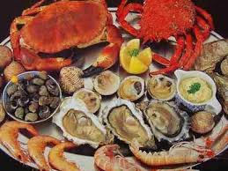
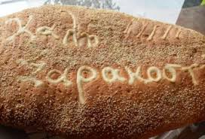
From “Clean Monday” till Easter we must not eat food that contains blood (meat, fish, etc) or comes from the animals (milk, butter, eggs, etc). The reason is that we must purify our bodies in order to have the Holy Communion before Easter. Only very religious people can follow this kind of diet (which is very healthy indeed because it is based on the Mediterranean diet).
These are some of the foods that we must eat during the Lent.

Slide 12
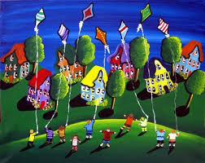
Click on the image!
Have a nice Easter!!!!!!!!!!
Καλή Σαρακοστή!!!

