Slide 1
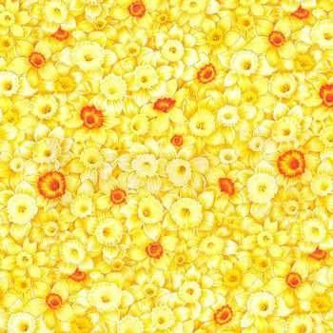
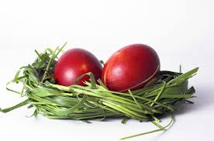
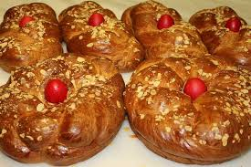
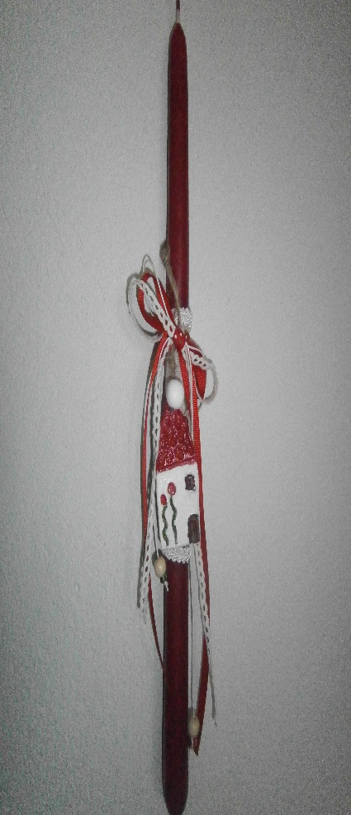
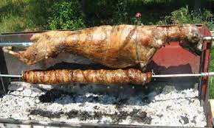
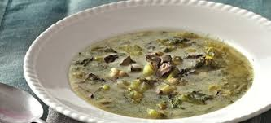
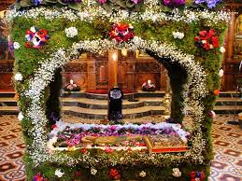
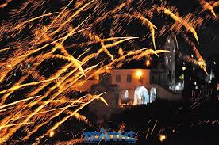
Greek Easter
(Pascha)

Slide 2
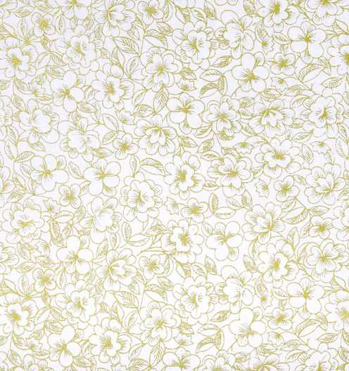
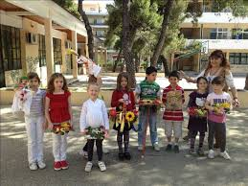
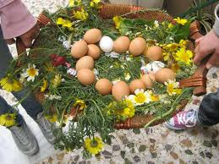
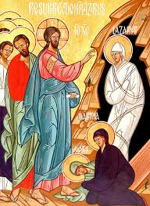
In Greece Easter is the most important celebration. It has a strong religious character and touches our lives and diet . The week before Easter is called “Holy”. The Saturday before the “Holy Week” we celebrate “Lazaru’s Resurrection. Lazaros was Jesu’s friend. In many places girls crowned with flowers, carrying baskets, with flowers too, sing Lazaru’s carols. People must give them eggs, in order to dye them on the HolyThursday!
Click on the image to hear the Lazaru’s Carols

Slide 3
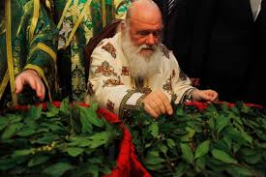
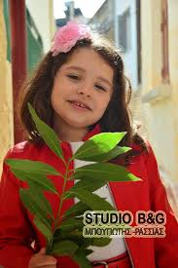
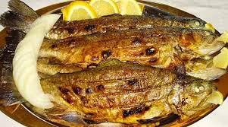
The Sunday of the Palms after the mess the priests give to people branches of palms. It is a tradition to eat fish this day! As the Lazaru’s Carols say “ The Sunday of the Palms we eat fish and the next Sunday (Easter) we eat the thick lamb”.

Slide 4
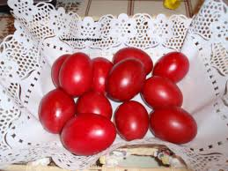
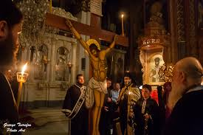
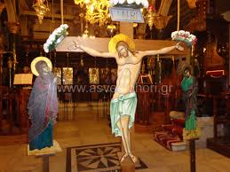
In the “Holy Week” almost everybody goes to church. The churches are decorated with black or purple ribbons.
The “Holy Thursday”, or “Red Thursday” is a day that mothers with their children dye eggs. The tradition says that the color of the eggs must be only red, like the blood of Jesus that died that day. Everybody hangs outside his house a red cloth. Also, mothers make “tsurekia”, a kind of cake (but we musn’t eat them until Easter).
tsurekia
The atmosphere in the church is very touching. We are in front of the climax of the Jesu’s drama.

Slide 5
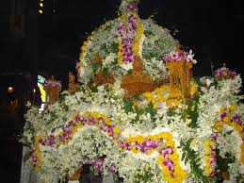
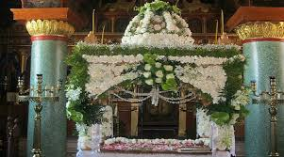
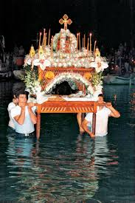
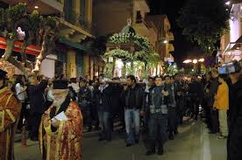
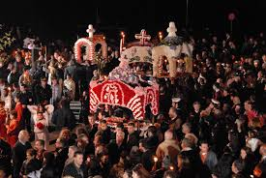
“Holy Friday” is the saddest day of the year. It is the day of Jesu’s funeral, so nobody works until 12 o’clock that the “Deposition” of his body takes place. The tradition says that this day we must eat lentils, not with olive oil but olny with vinegar. (That’s because when Jesus was on the cross and asked for water he was given vinegar in order to get more thirsty).
Every church (the people) makes and decorates with flowers its own “epitafio” (epi= on, tafo= tomb), where the body of Jesu lies down.
In the evening everybody goes to church and with candles lit follow the priests and the “epitafio” around the neighbourhoods. Priests and people chant the funeral song of Jesu’s mother, calling her son “My sweet spring time”.

Slide 6
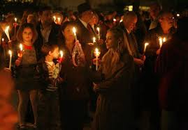
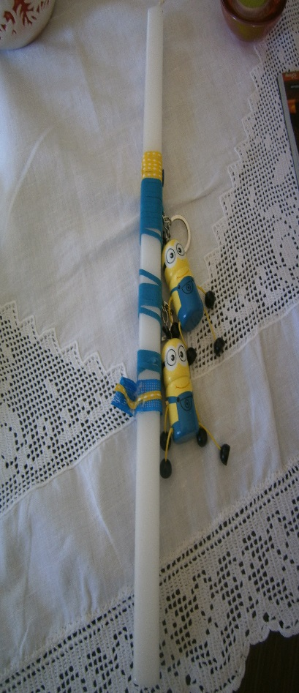
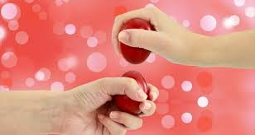
The Holy Saturday, in contrast, is a day of joy. Everybody make preparations for the resurrection dinner and the Easter lunch.
On the resurrection table traditionally there is a soup made from the viscera and the head of the lamp. The soup is called “magiritsa” and either you love it or you detest it (I detest it), but it is suitable for the stomach for those who have not eaten meat for 40 days! Of course there are the red eggs (now we can eat them) and the tsurekia!
This day we go to church at 11 at night, wearing our best clothes. We carry a red egg and our resurrection candle. For children the candle must be brought by the godmother or godfather. It must be joyous, like the meaning of resurrection. It can have toys on it , flowers, etc. For adults a white candle is ok. At 11.30, we get out of the church and we light our candles with the the “holy light” . At 12 o clock the priest chant “Jesus has risen”! The bells ring, and fireworks are all over the sky meaning the defeat of death and the the victory of life! Then we give to each other the kiss of love and we clink our eggs! Then we can eat them! Then we return home, and we all sit together around the table to have the resurrection dinner, even if it is almost 1 after midnight!
magiritsa
Attending the mess, holding the “holy light”,
Fireworks, meaning the defeat of death!
My son’s resurrection candle, brought from his godmother!
Eggs’ clinking!

Slide 7
The Sunday of Easter is a day of rest. Everybody gets up late….except of those who are on duty to impale the lamb. Easter, like Christmas, is a family celebration, so the whole family gathers together. They eat, drink, sing, dance! Monday is a day of rest too. Schools are closed for two weeks, the Holy, and the next!

Slide 8
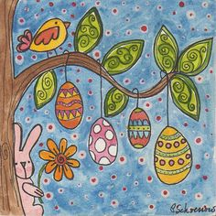
Let us all be healthy, live in peace and serenity and fell the meaning of the resurrection!

