Slide 1
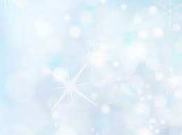
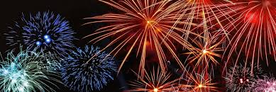
Happy New Year

Slide 2
Content
How we celebrate New Year
Fireworks
Food
New Year’s Dive
Donut /oliebol
Quiz

Slide 3
How we celebrate New Year
At 12 o'clock, we give each other a kiss.
Hugging each other.
Lighting fireworks.

Slide 4
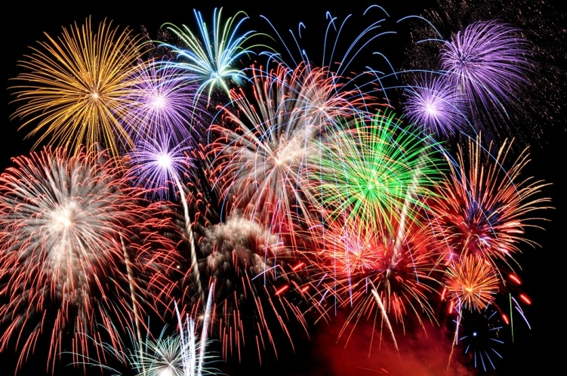
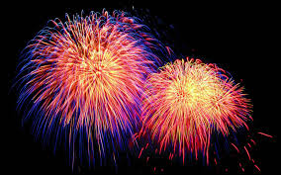
Firework
Firework shooting and gives very beautiful colors.
You need a pair of glasses for safety.
You start firework at 12 o’clock.

Slide 5
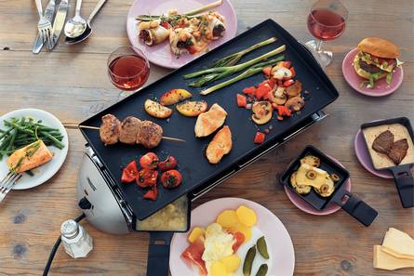
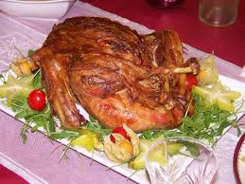
Food
We eat turkey,
We gourmet,
And drink champagne.

Slide 6
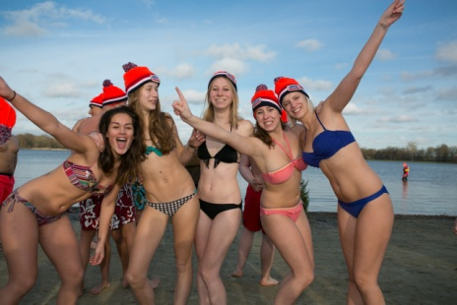
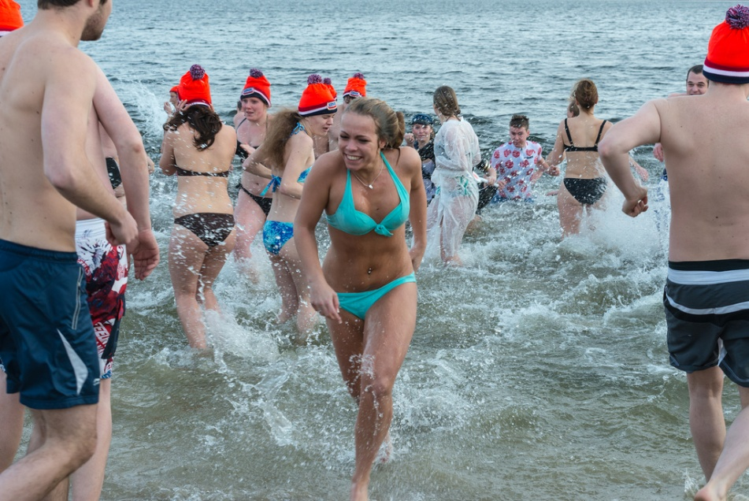
New Year’s dive
A New Year's Dive is a Dive you do in the winter in very cold , icy water.

Slide 7
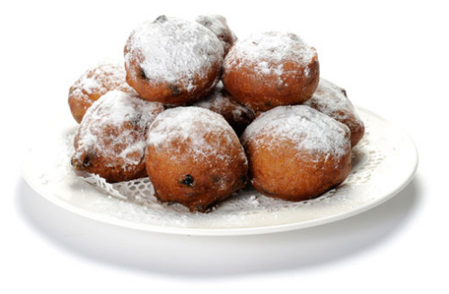
“Oliebol “
The oliebol is a donut with no hole in it, and there are raisins in it, we eat it mostly at New Year.

Slide 8
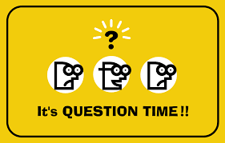
Quiz
What does protect your eyes against firework ?
At what time we light fireworks ?
It is not just a donut but a ....?
What do we eat at Christmas and New Year ?
Answers next page

Slide 9
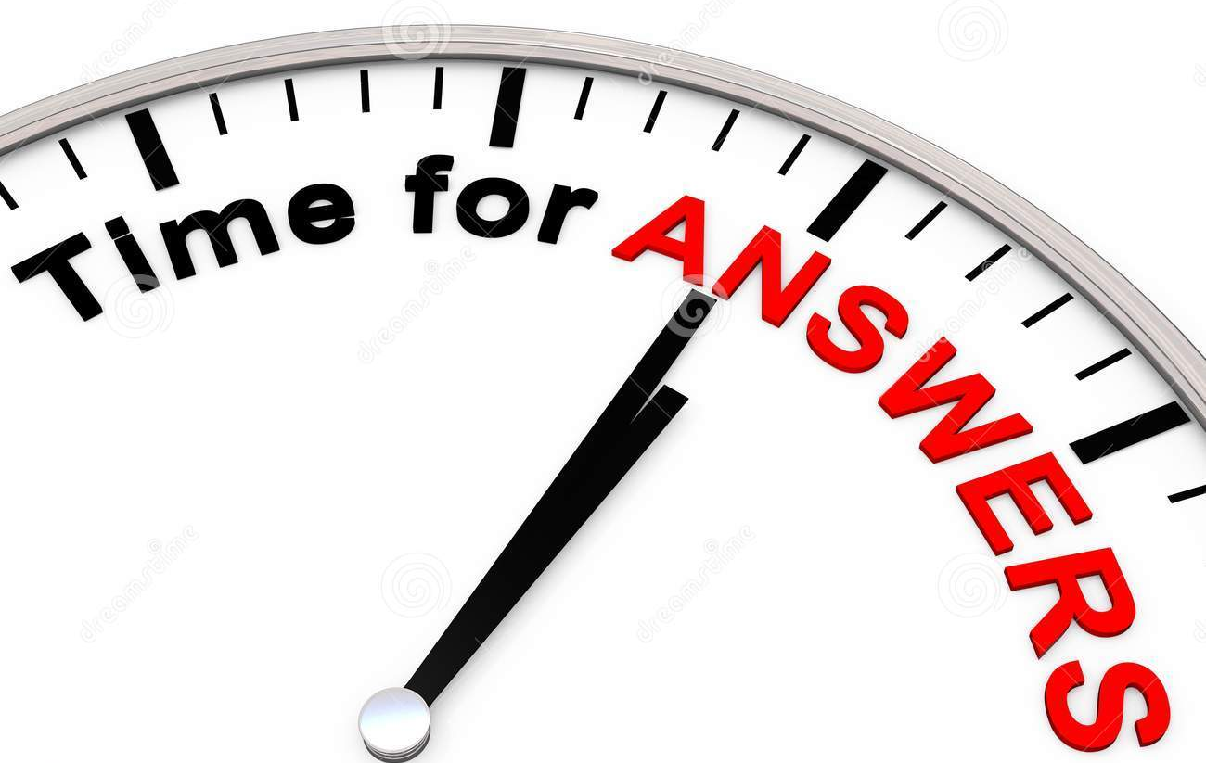
Quiz answers
Safety glasses
12 o'clock
Oliebol
Gourmet

Slide 10
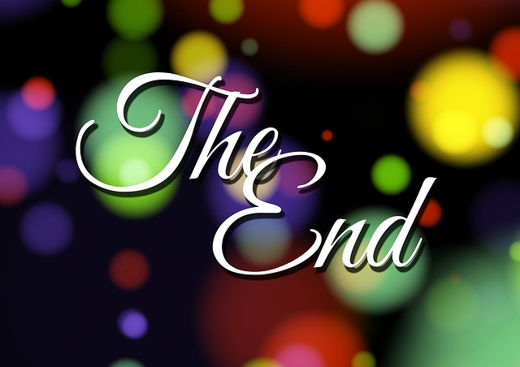
The end

