Slide 1
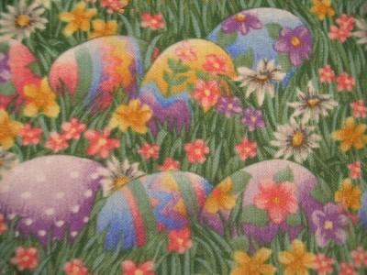
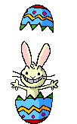
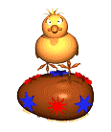
Εaster Preparations at school

Slide 2
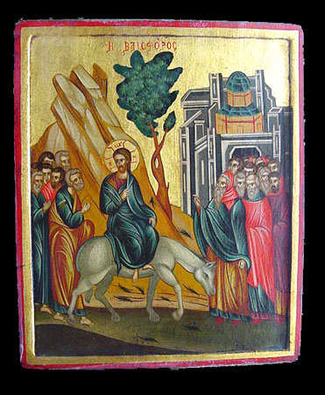
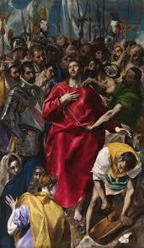
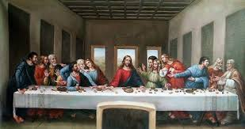
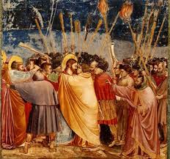
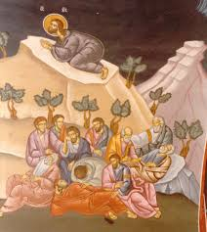
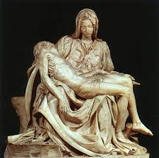
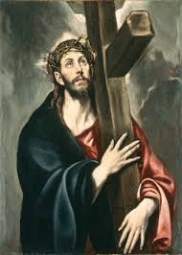
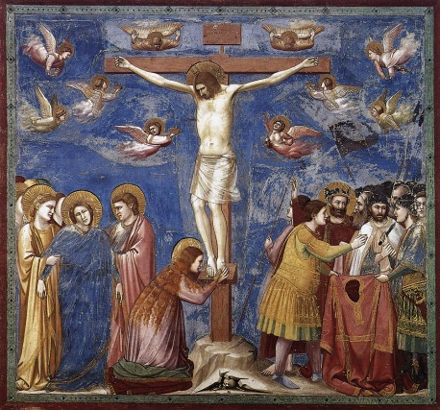
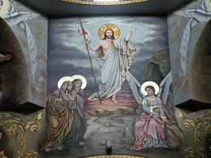
First of all we learnt about the story of the Holy Week. I used byzantine paintings and famous works of of art. Then we did math and oral language activities, putting the drawings in the right order, or giving titles to the drawings, or retelling the story!
“L’ ultima cena” Leonardo Da Vinci
The prayer
Juda’s kiss
Despoiling Jesu’s clothes. El Greco
The Sunday of the Palms
“Pieta’”. Michelangelo (my favourite)
“The resurrection”
On the way to the top of the hill . El Greco
“The crucifixion”. Giotto

Slide 3
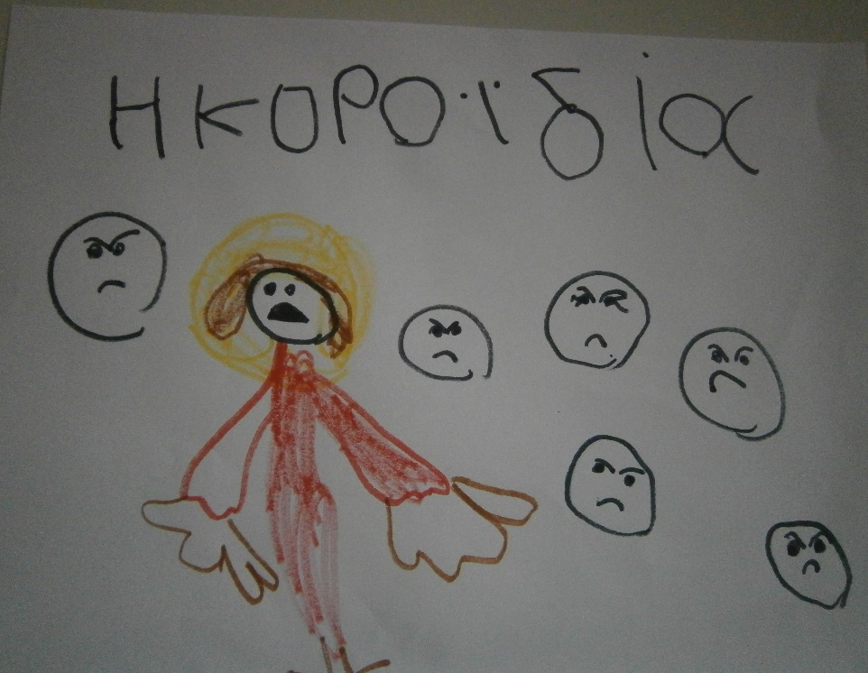
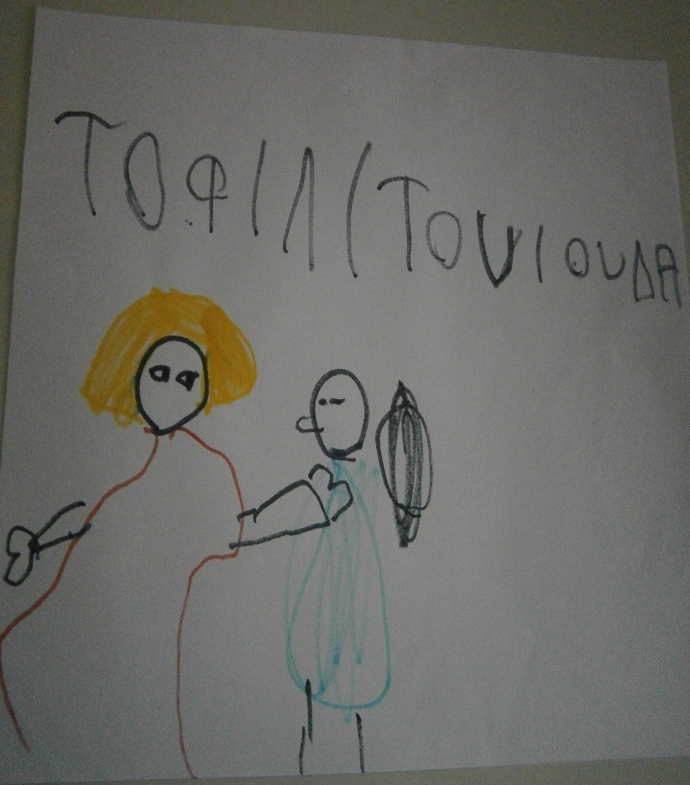
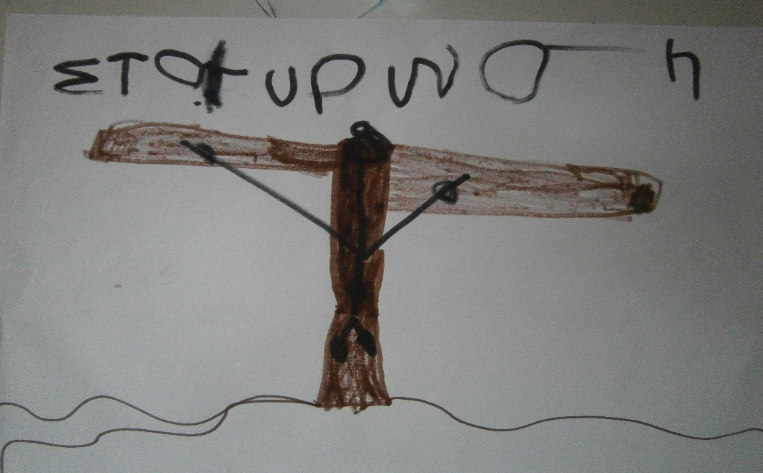
Children draw scenes…
Despoiling Jesu’s clothes
Juda’s kiss
The crucifixion

Slide 4
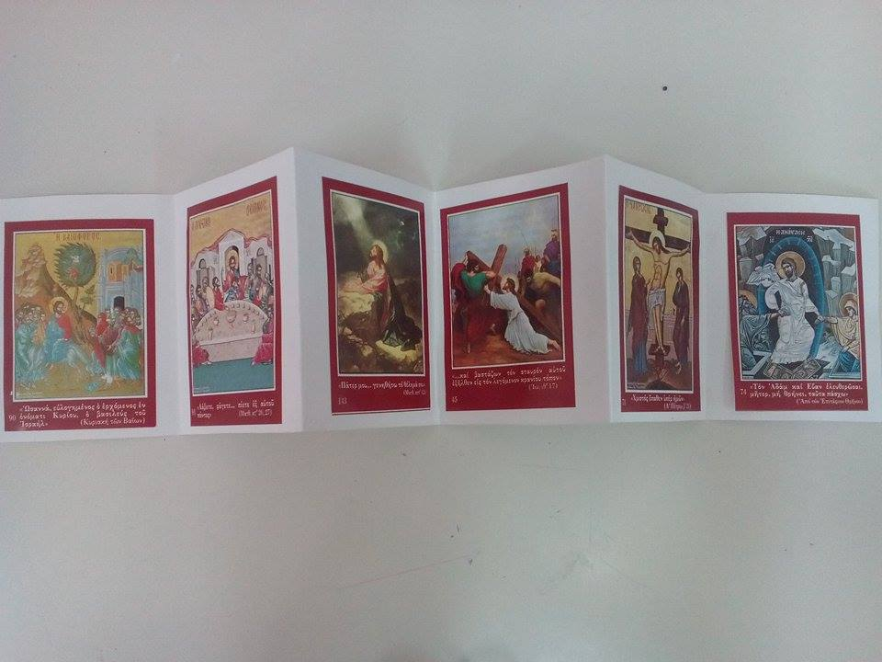
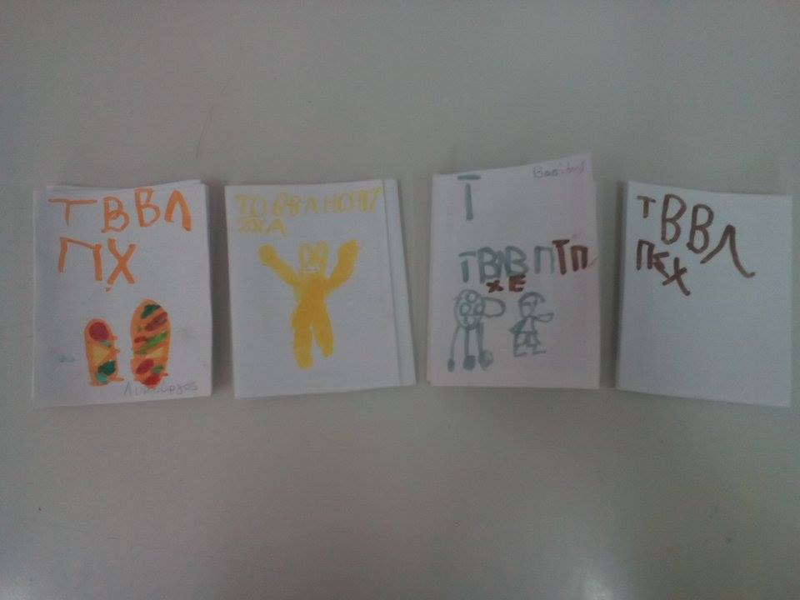
Then every child made its own flap book with the story of the Holy Week.
On the back each child tried to write and draw!

Slide 5
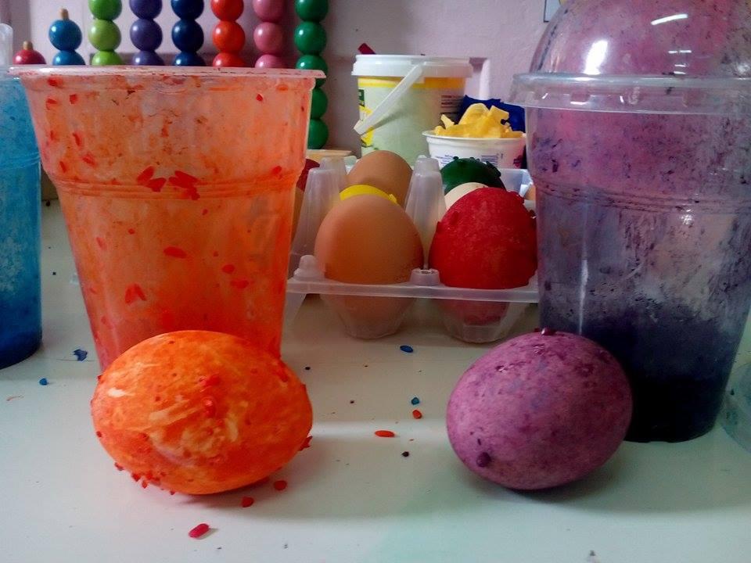
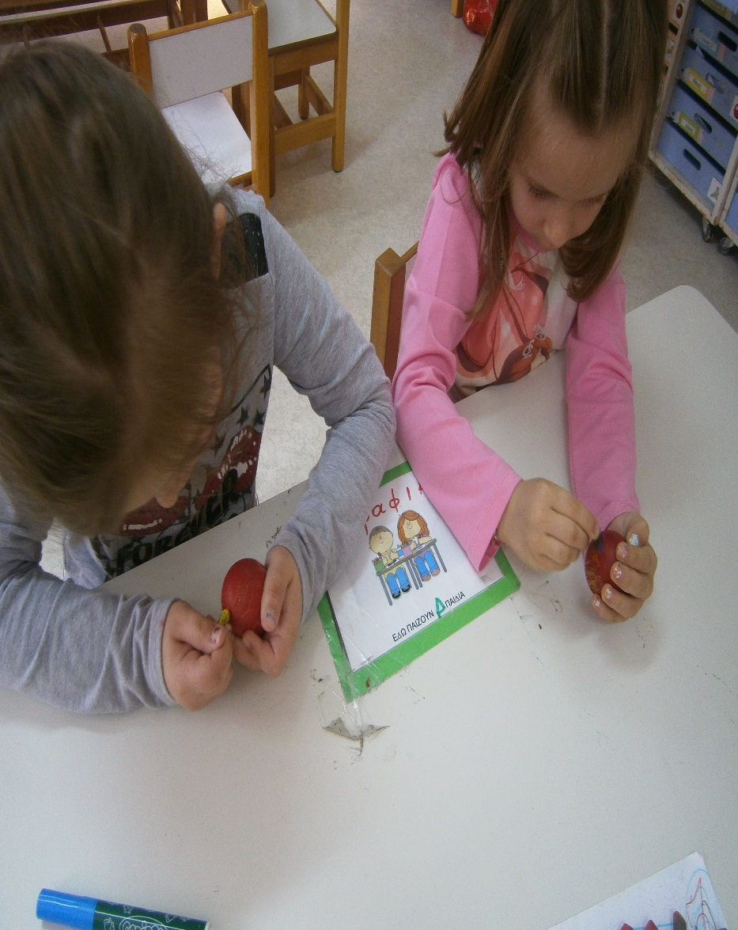
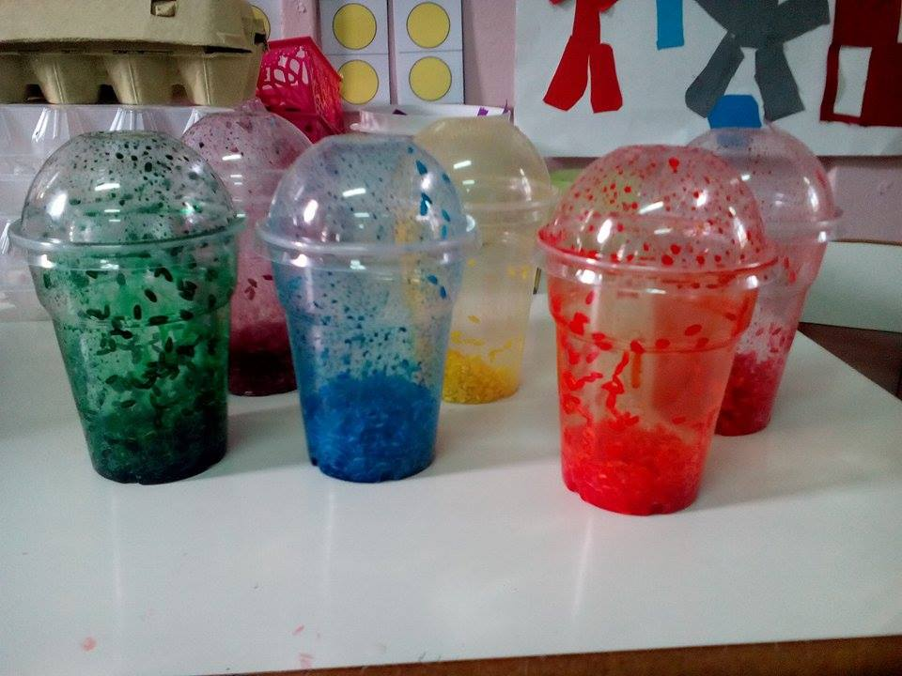
The red eggs must be dyed on the Holy Thursday. So, at school, we try technics and we “play” dying our eggs. Every child brings at school two boiled eggs. This year we tried dying the first with rice and food color, shaking it in a plastic glass.
We dyed the other egg red and we we decorated with oil pastels

Slide 6
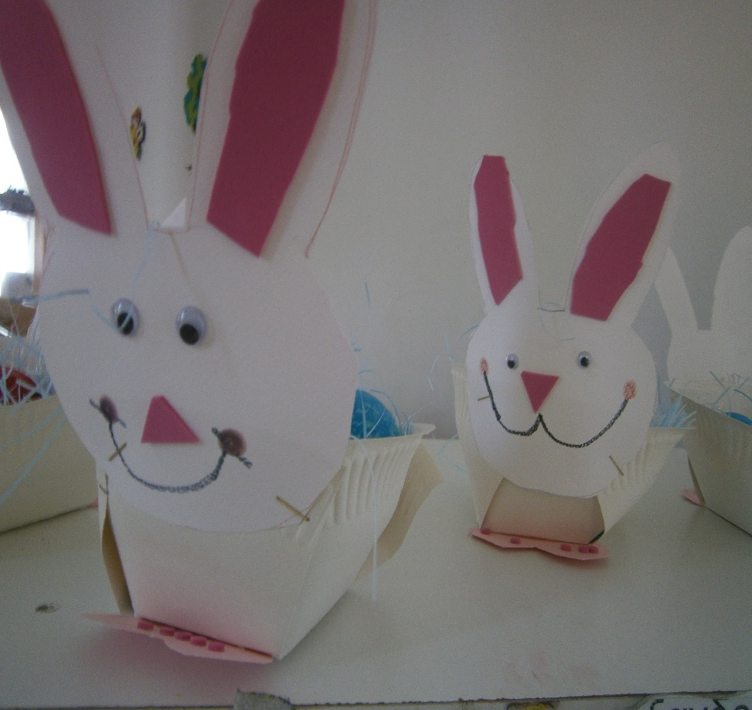
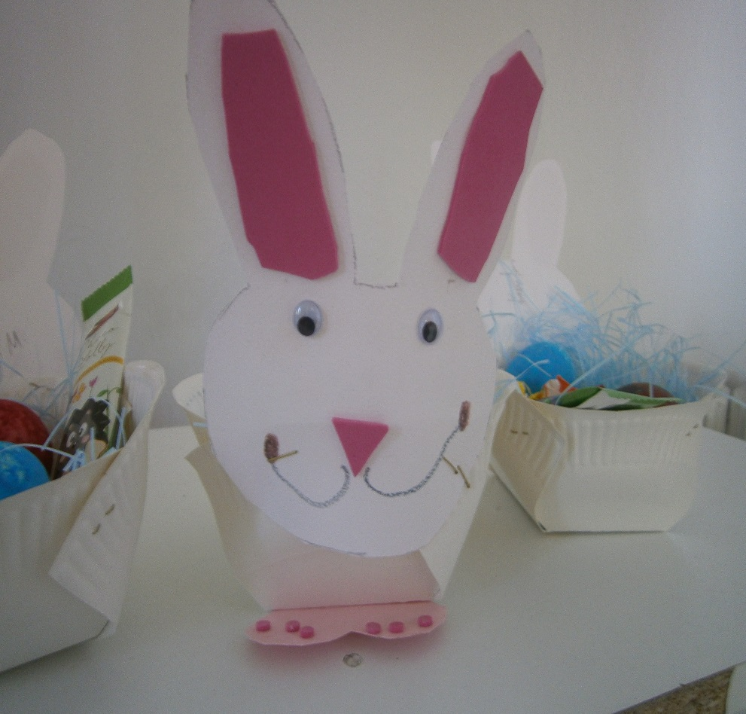
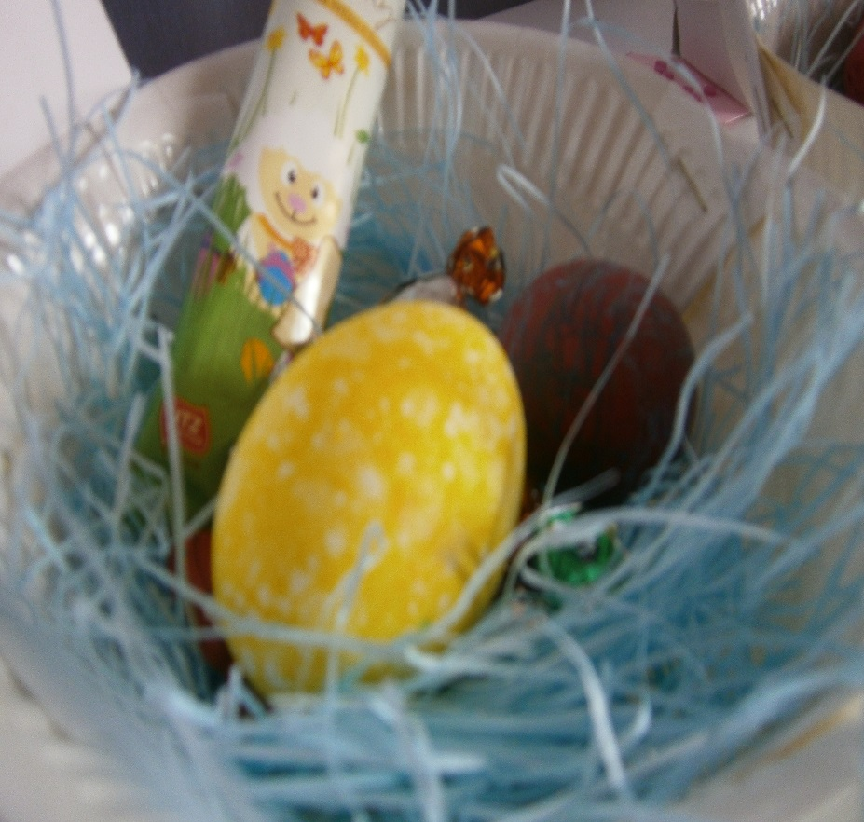
The eggs, chocolate eggs, candies, and chocolate lollipops filled the bunny baskets we made with the kids.

Slide 7
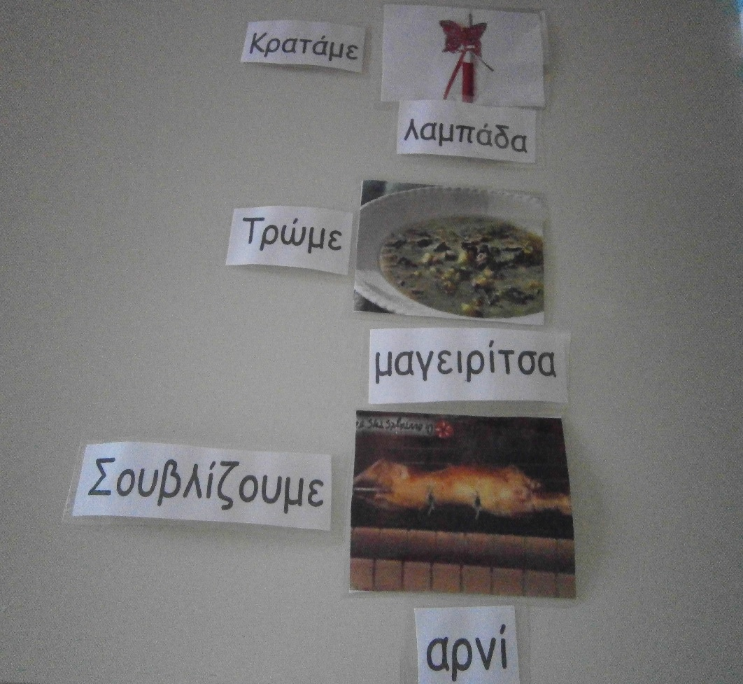
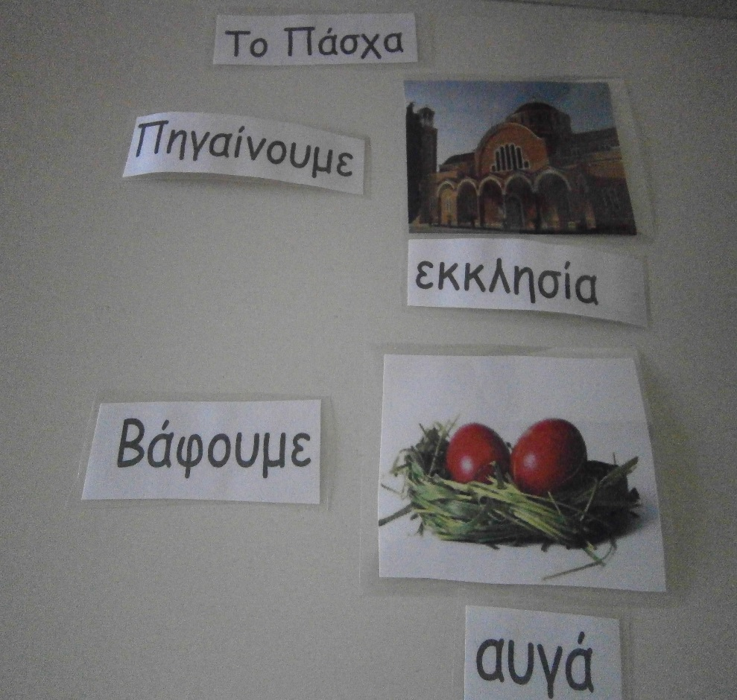
We played with our tradition in oral, written and matching activities

Slide 8
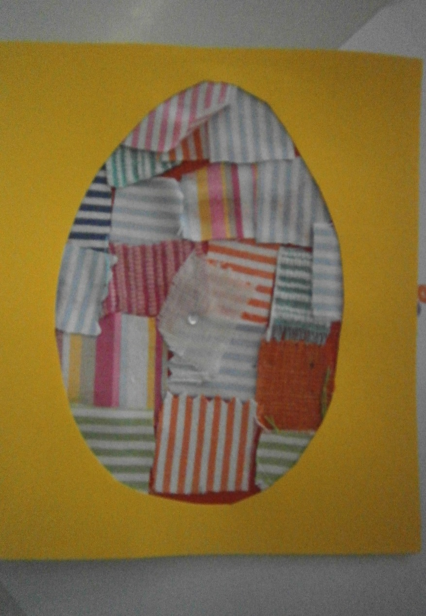
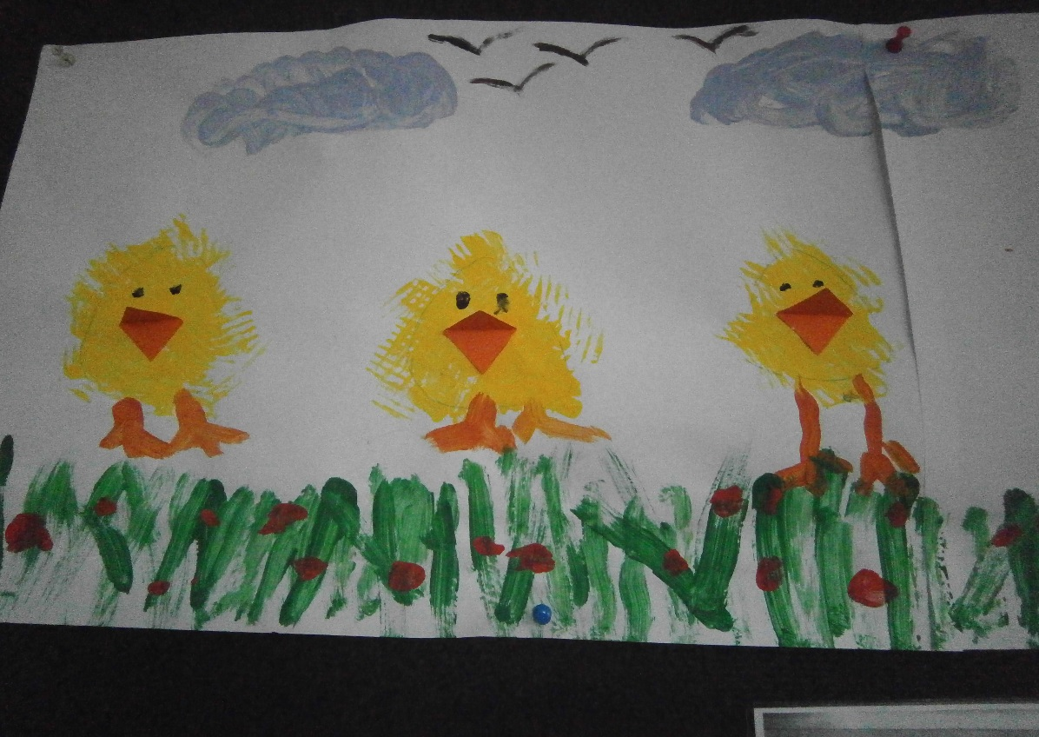
We used forks to draw little chickens….
…and we made Easter Cards using textilles!

Slide 9
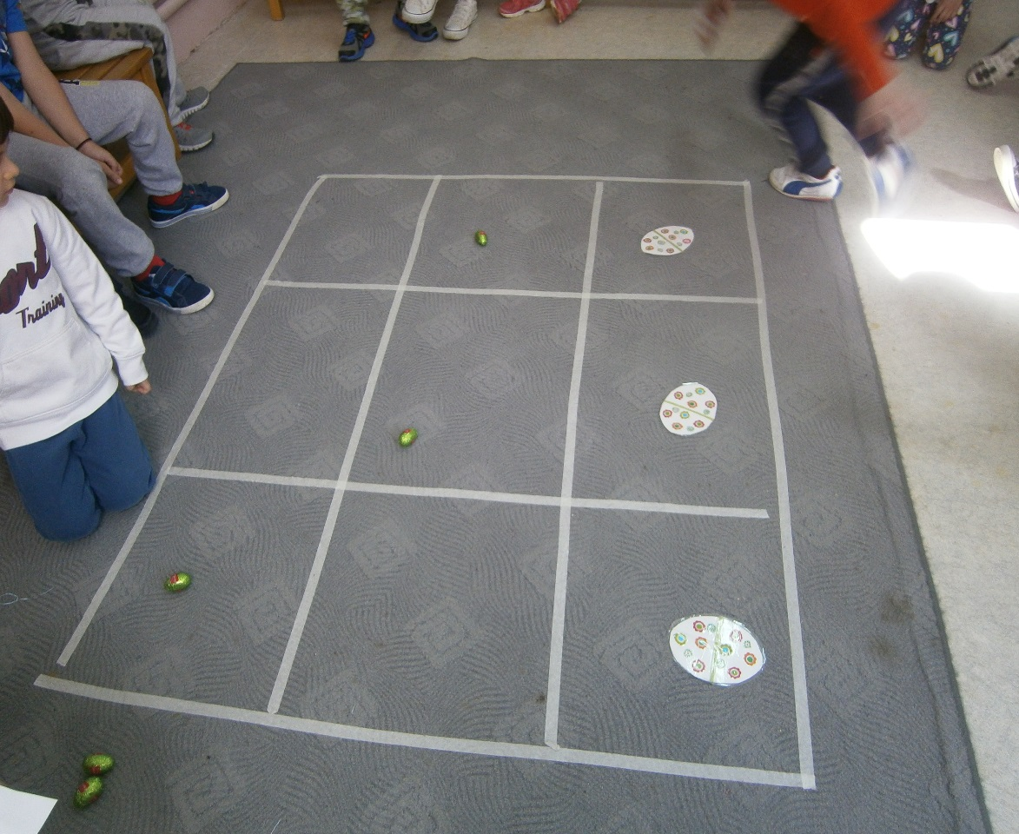
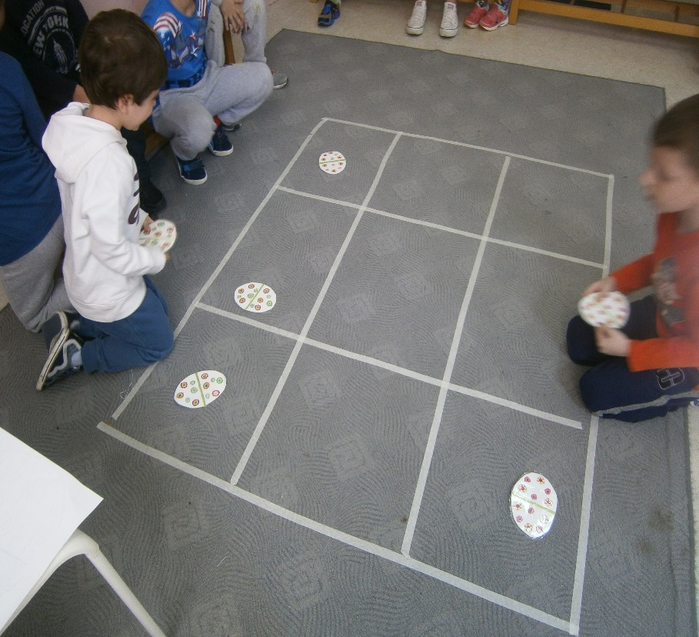
We played “Tic-tac- -toe” with eggs….from chocolate and paper….

Slide 10
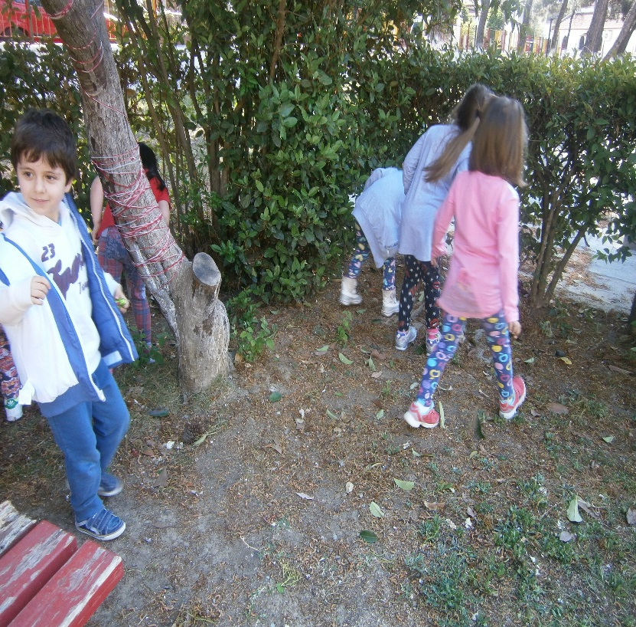
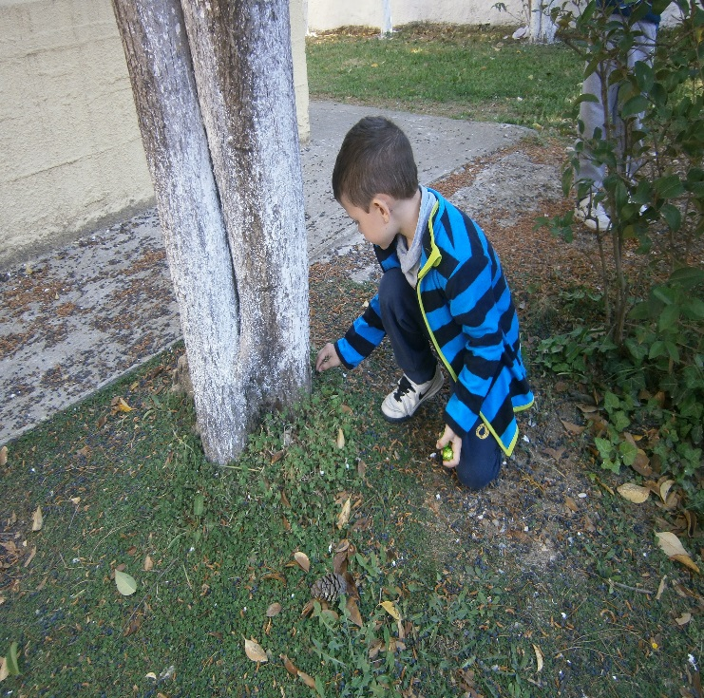
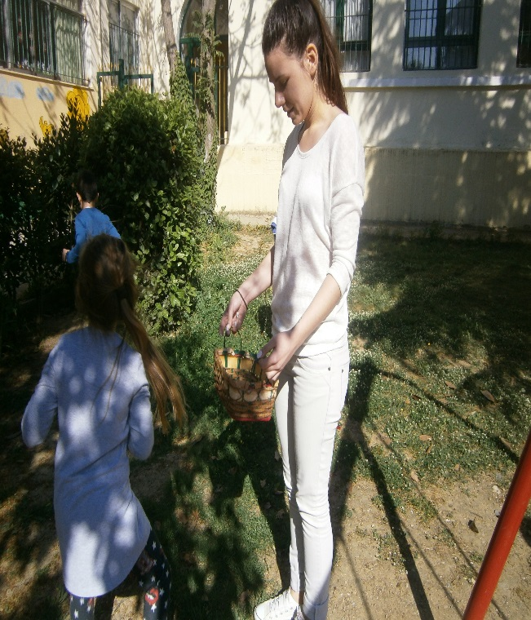
We played “The Egg hunting”. In our playground , although it is not a greek tradition.
Searching for chocolate eggs in our yard.

Slide 11
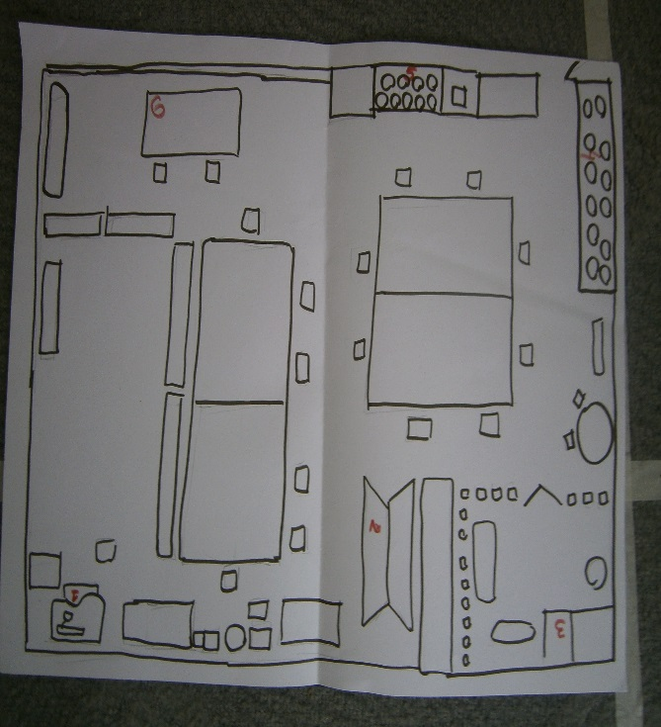
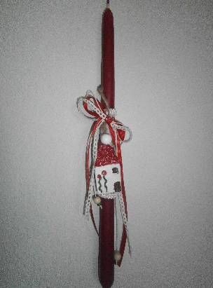
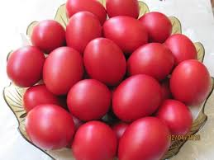
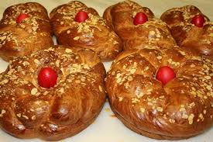
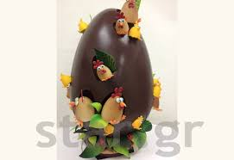
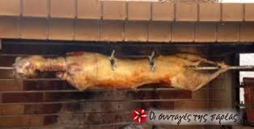
Children separated in groups had to use our class’s map (top view), in order to locate easter riddles (regarding to our tradition) . When each group located, found and solved his riddle the next group could begin. The last group found the treasure: The chocolate eggs!!!!
Our Easter riddles
We are made from eggs, yeast, milk, flour and butter. Traditionally we are made on the Holy Thursday. What are we?
Our godmother brings it for us every year. We must light her only on the Holy Saturday night. What is it?
The dye us, they put us together and in the Easter they clink us and they eat us! What are we?
We eat every Easter traditionally. Either in the oven but we prefer it impaled. What is it ?
It is black or brown, empty or filled. It can be small or large, but it is definitely sweet. Sometimes godmother brings it with the resurrection candle. What is it?
This was the treasure!!!!

Slide 12
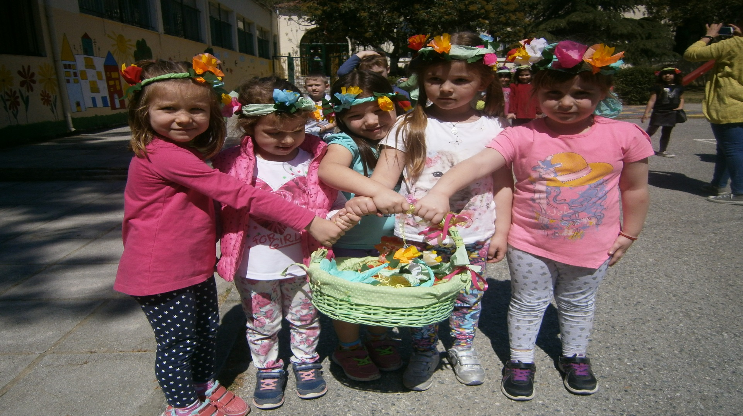
Since Saturday of “Lazaru’s resurrection we had no school, the last Friday, the girls of our school with flowers on their heads and a basket full of flowers are ready to sing “The Lazaru’s Carols” all over our neighbourhood. All the others are following.

Slide 13
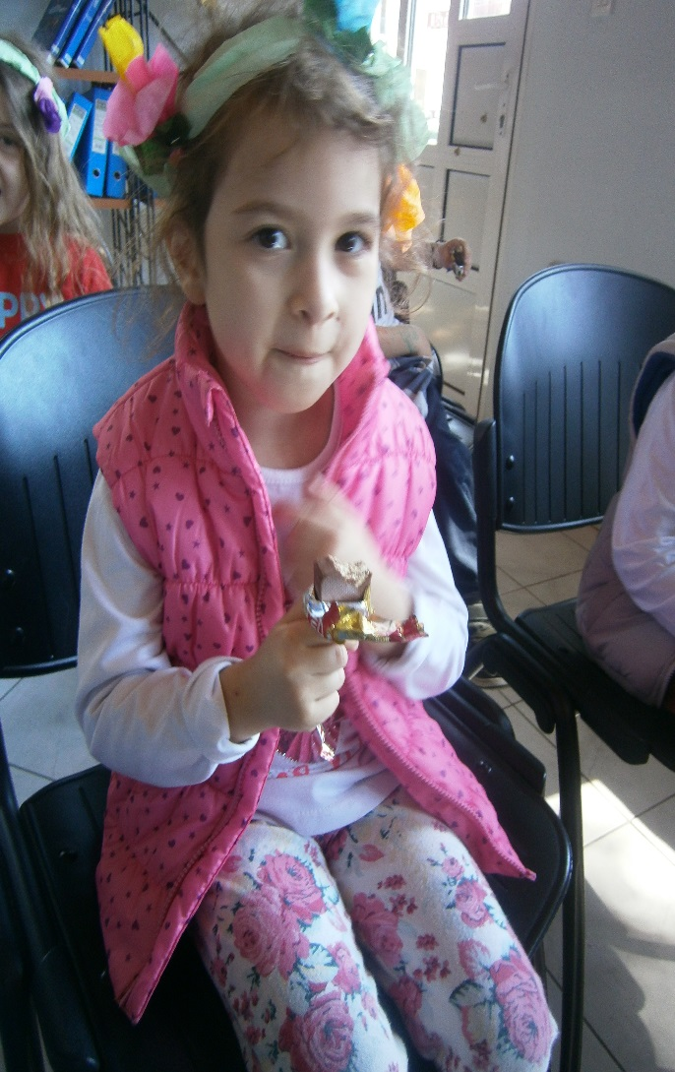
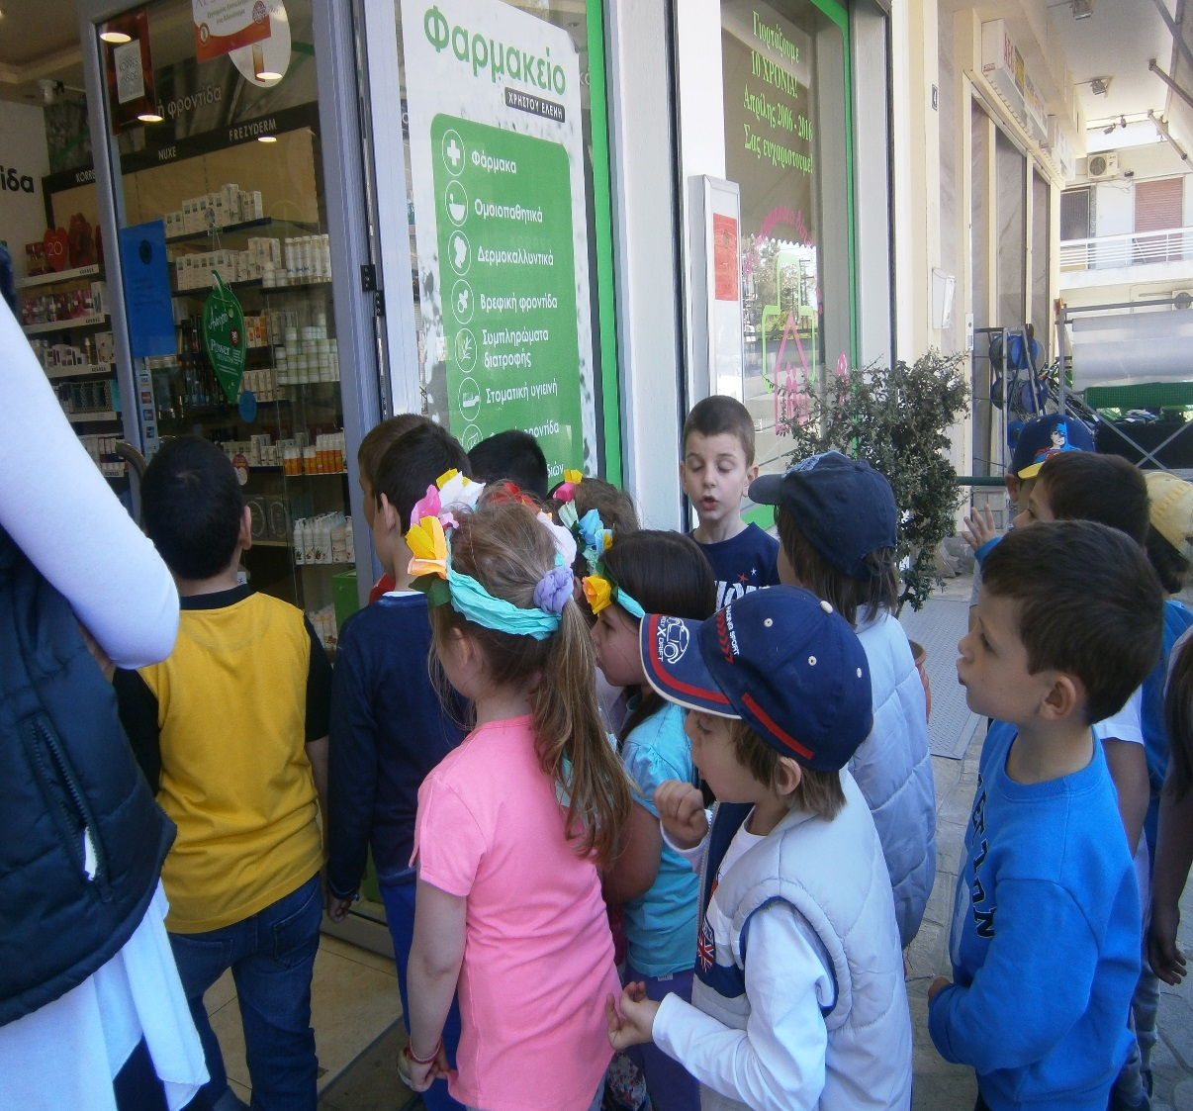
We got a sweet treat from our community office!
Singing in front of the drug store

Slide 14
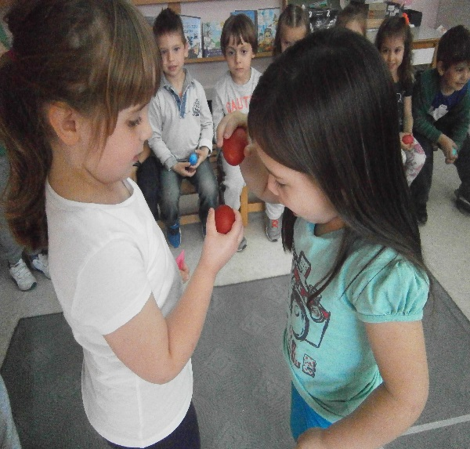
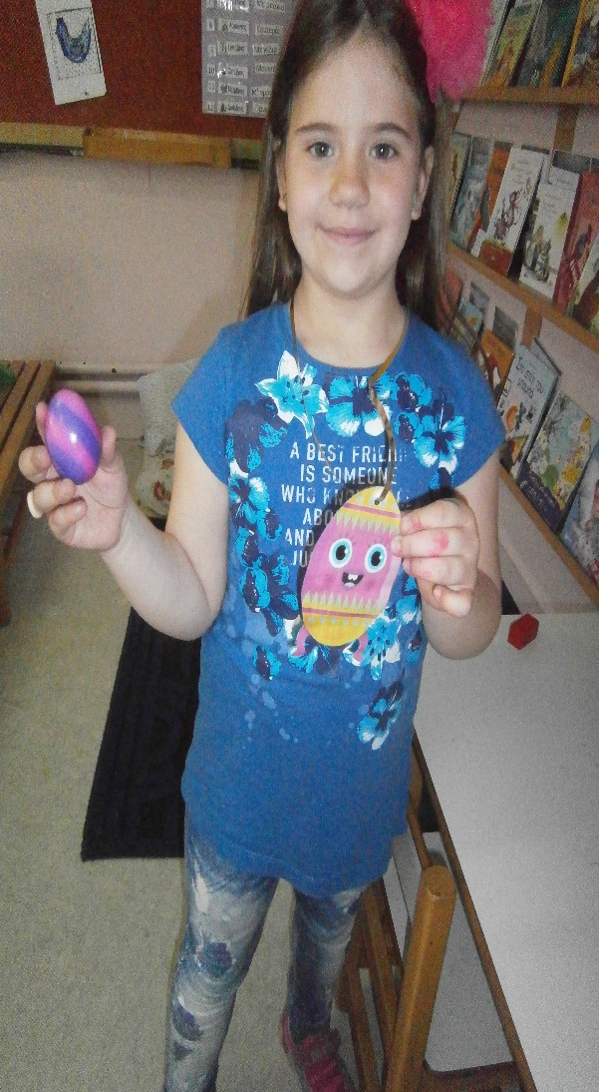
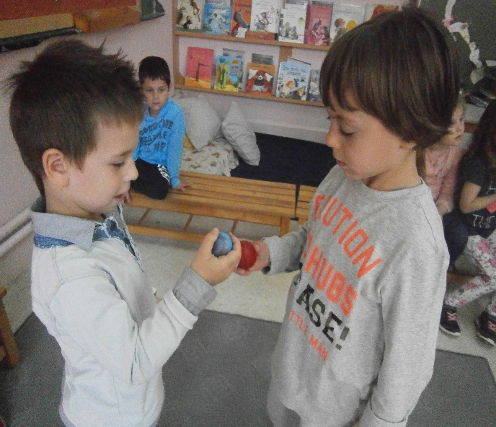
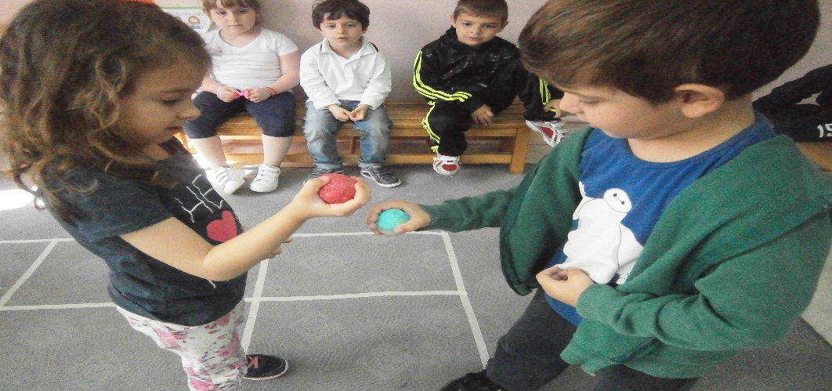
Our basket wasn’t full of eggs in order to dye them on the Holy Thursday because we went to sing the carols in shops and not in houses! Our basket was full of candies, money, smiles and wishes for a peaceful Easter! With the money we are going to buy books for our school library!
When we returned to school we were ready for “Clinking egg contest” !
Anna-Maria had the strongest egg! She broke with her egg others!

