Slide 1
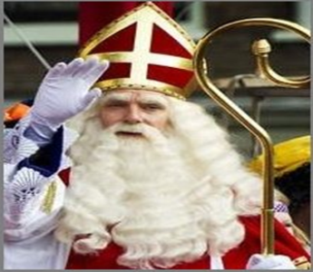
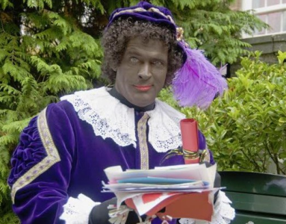
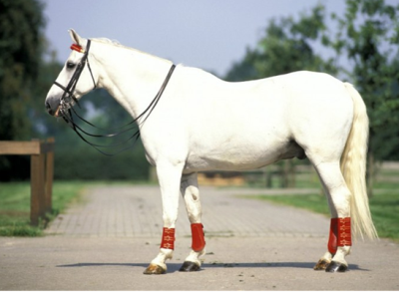
Sint Nicolas
Black Pete
Amerigo
Horse of St. Nicolas

Slide 2
Gingerbread nuts recipe
Ingredients:
250g self-raising flour
125g soft brown sugar
100g butter or margarine
50 ml of milk
1.5 tablespoon speculaaskruiden
Preparation: 30min> Preparation: 15min> Ready in: 45 minutes
Preheat oven to 170 ° C
Mix the butter in a mixing bowl soft.
Knead with your hands or with the mixer (dough hook) flour, sugar, spices, salt and milk into the butter until well blended. The last part goes best with your hands.
Form small balls of dough and place them on a baking tray lined with baking paper. Press the balls a little bit, so that they take the shape of gingerbread.
Bake the gingerbread cookies for about 15 minutes in the preheated oven.

Slide 3
Here are pictures of Sint Nicolas entry Boxmeer

Slide 4
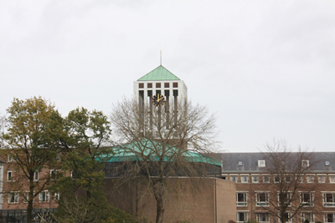
at 2 pm Sint Nicholas came in to Boxmeer

Slide 5
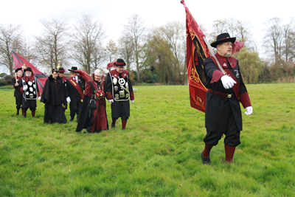
First came a guild

Slide 6
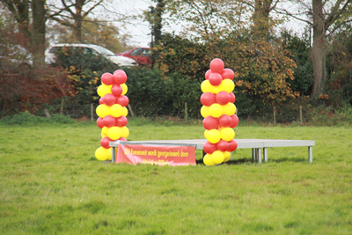
this is the stage of Sint Nicholas

Slide 7
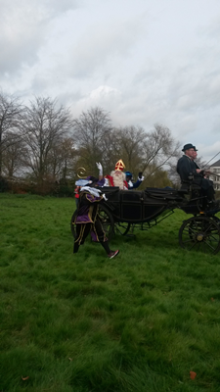

Slide 8
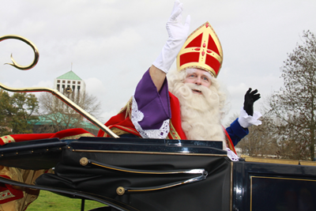

Slide 9
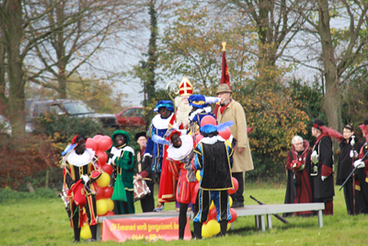

Slide 10
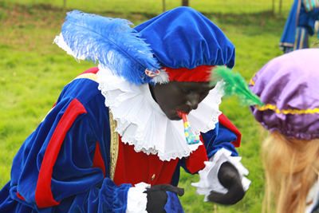

Slide 11
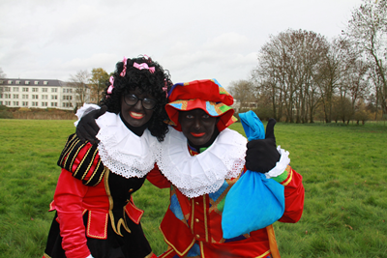

Slide 12
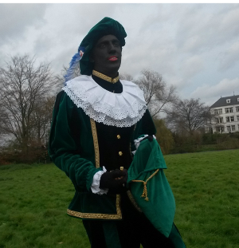

Slide 13
Now here are coming
photos from the Internet

Slide 14
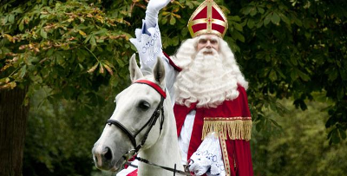

Slide 15
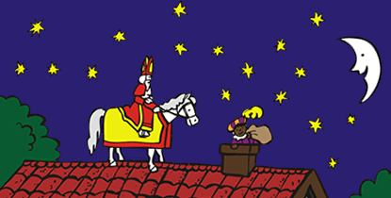
Here's a Black Pete that fills the shoes of the children.

Slide 16
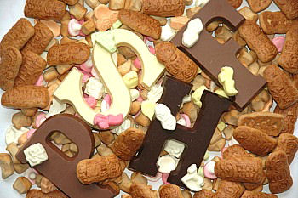
Here you see the candy Sinterklaas

Slide 17
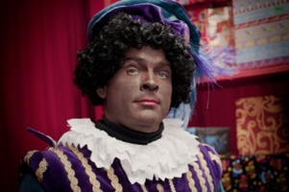

Slide 18
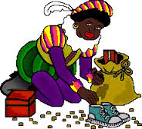

Slide 19
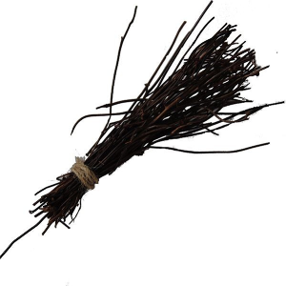
This is the roe. if you've been bad, you get a roe

Slide 20
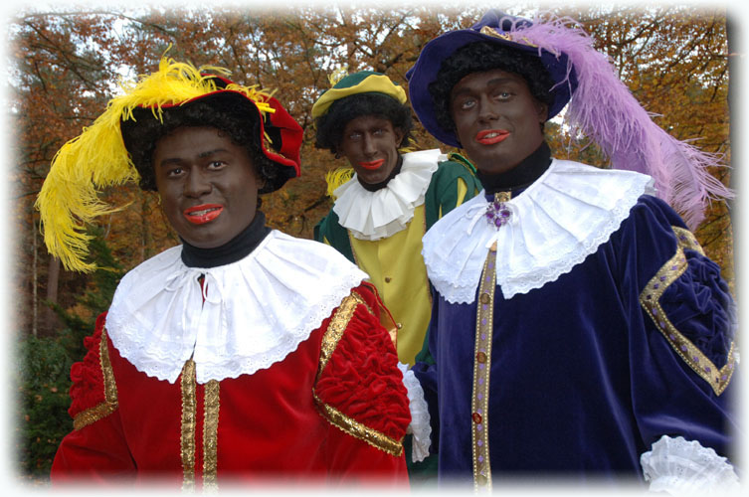

Slide 21
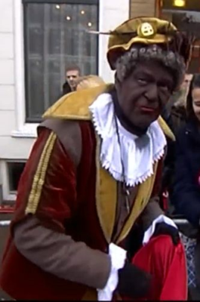
grandfather pete

Slide 22
Made by
Kim Michiels
Nena de Kievit

