Slide 1
MICHAELMAS
We celebrate it on 29th of September

Slide 2
Thanks for your time!
Made by 4th class students in Anna Brigadere`s primary school
2015

Slide 3
There is a belief in Latvia, that you have to finish the harvesting until Michaelmas. To honour it we organize fair at school. Students can sell homemade or handmade goods: cakes, cookies, picklings, juices, jams, honey, trinkets etc.
Children have refreshments and play games
School is decorated with small vegetables and coloured leaves.

Slide 4
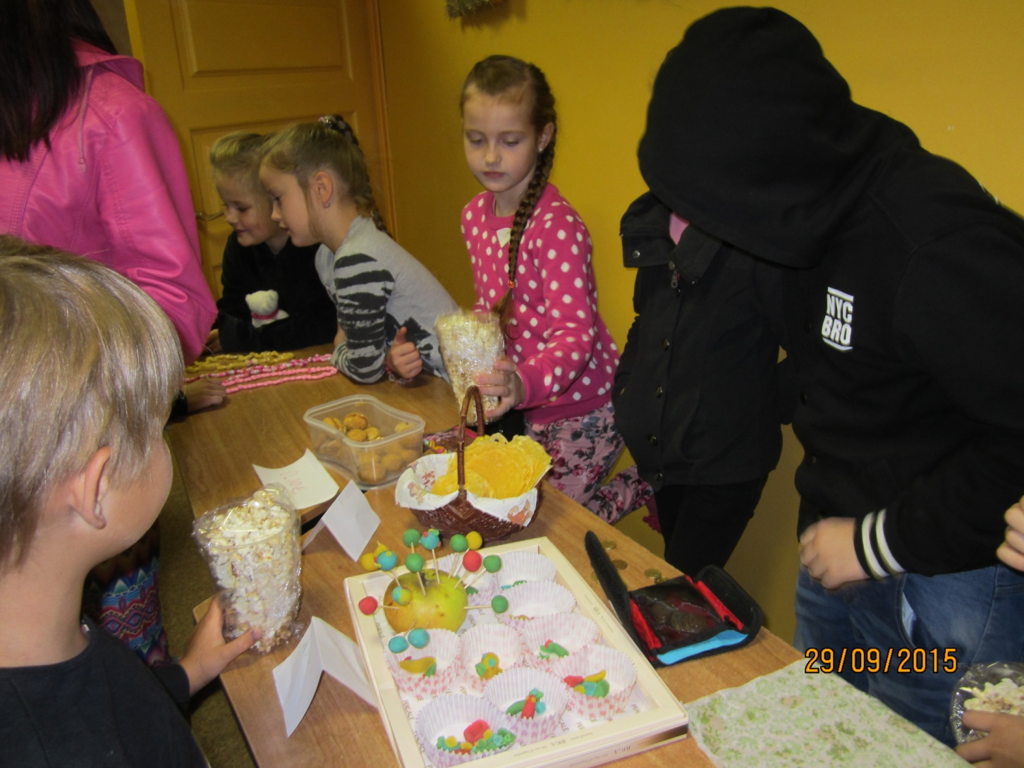
Sellers and purchasers

Slide 5
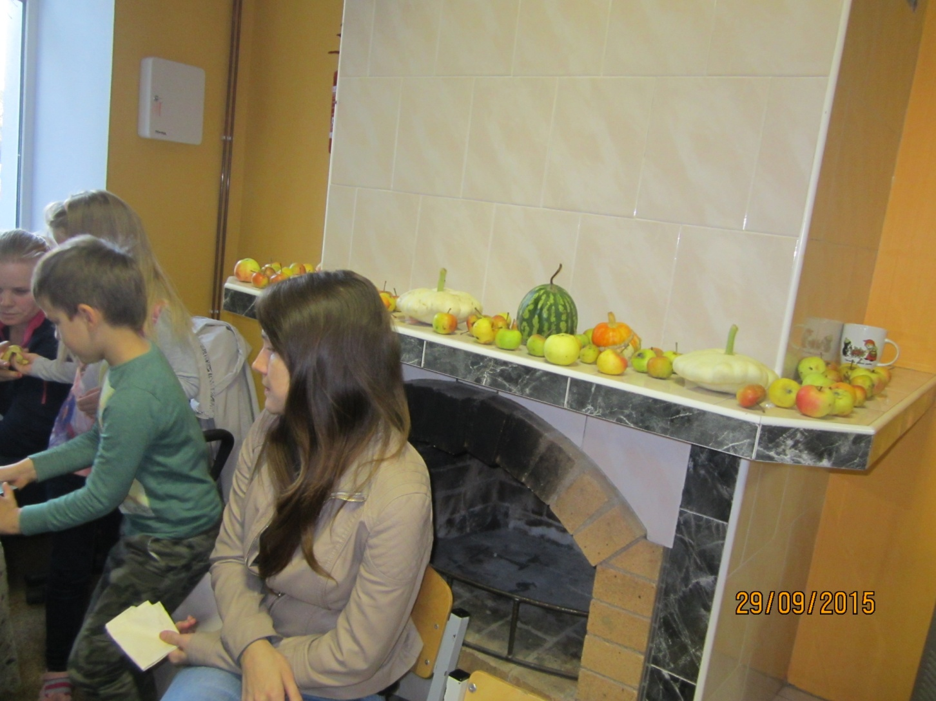
Decorated mantelshelf

Slide 6
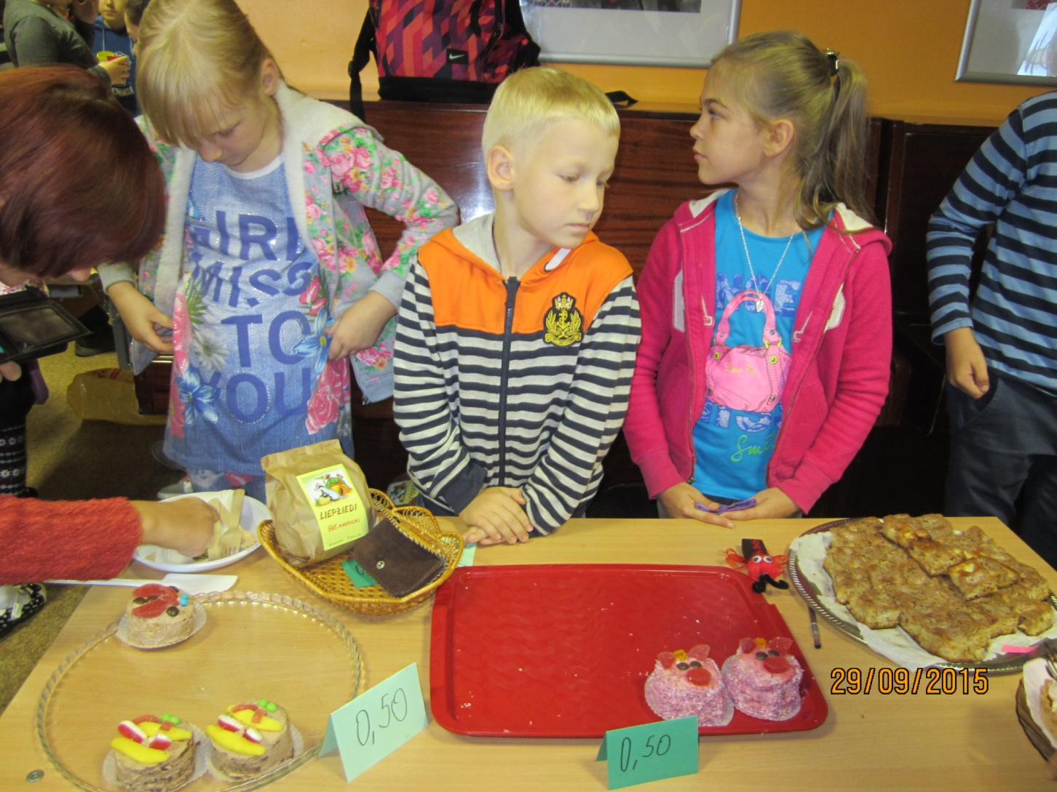
Different delicasies

Slide 7
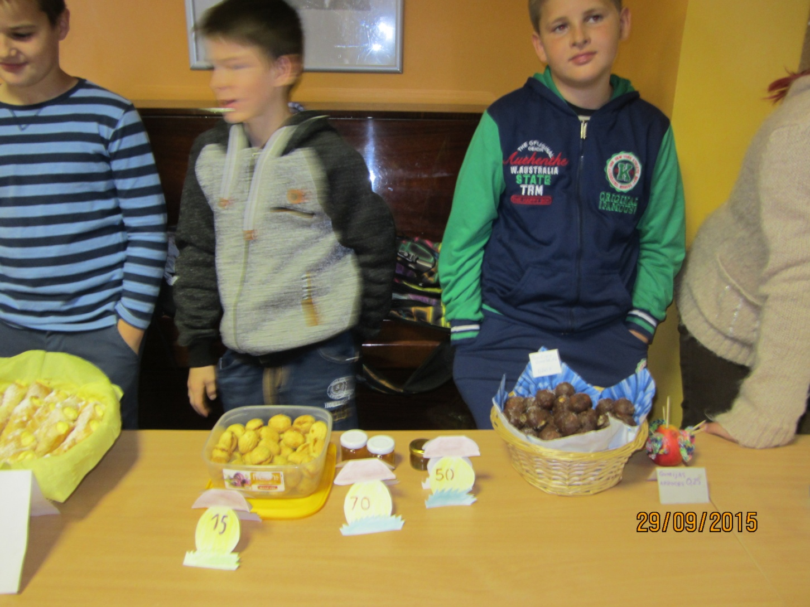
Boys are waiting rich buyers

Slide 8
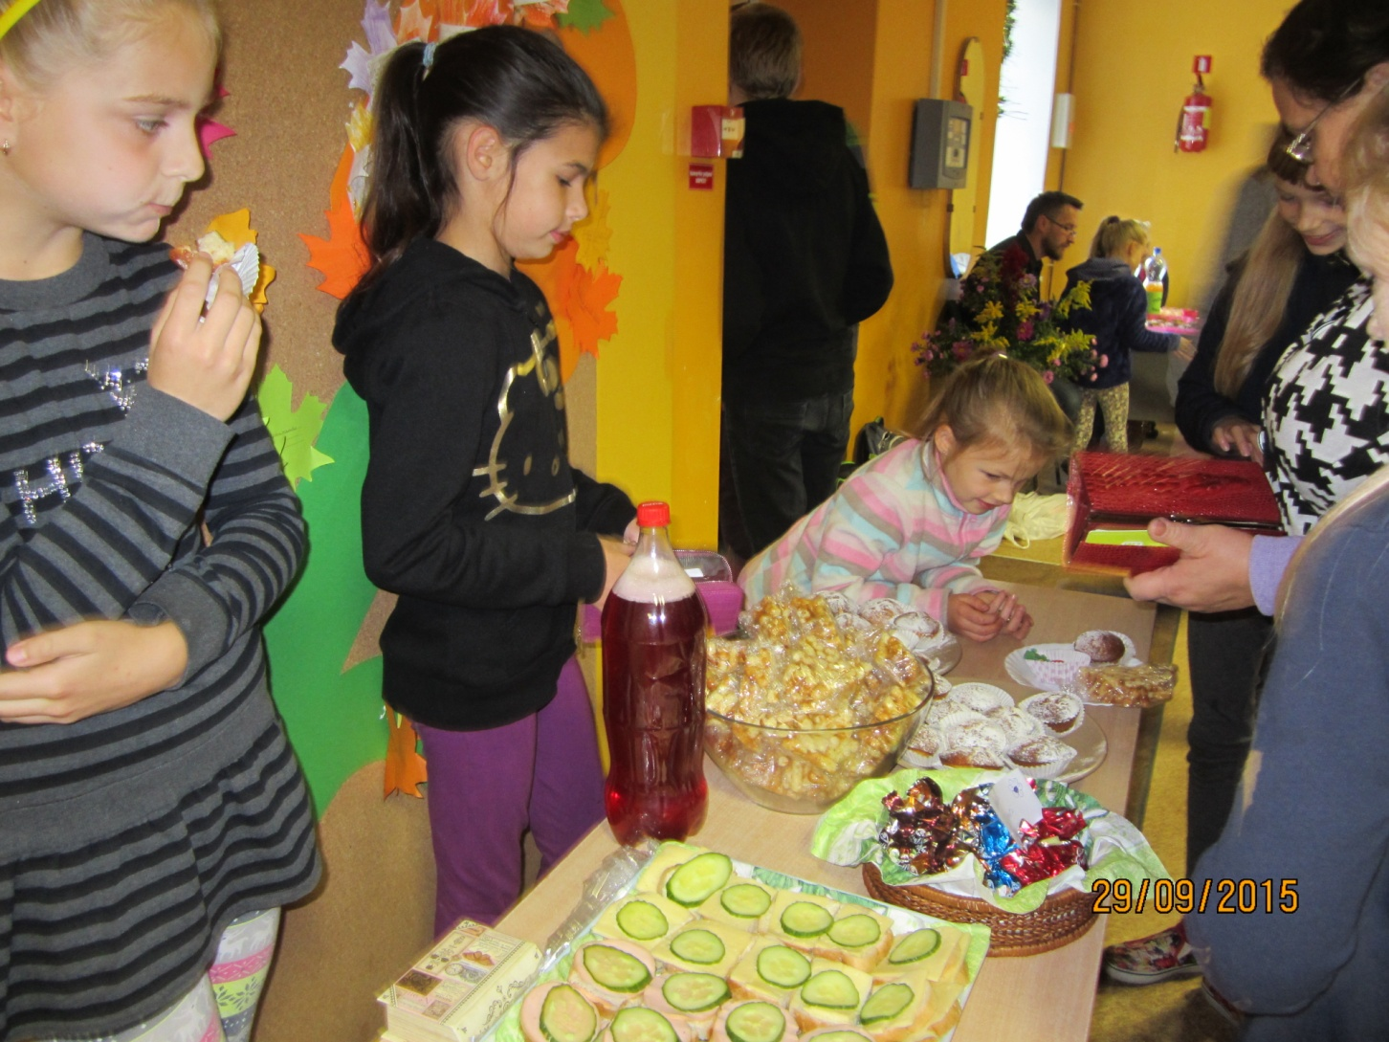
All thing are going well

Slide 9
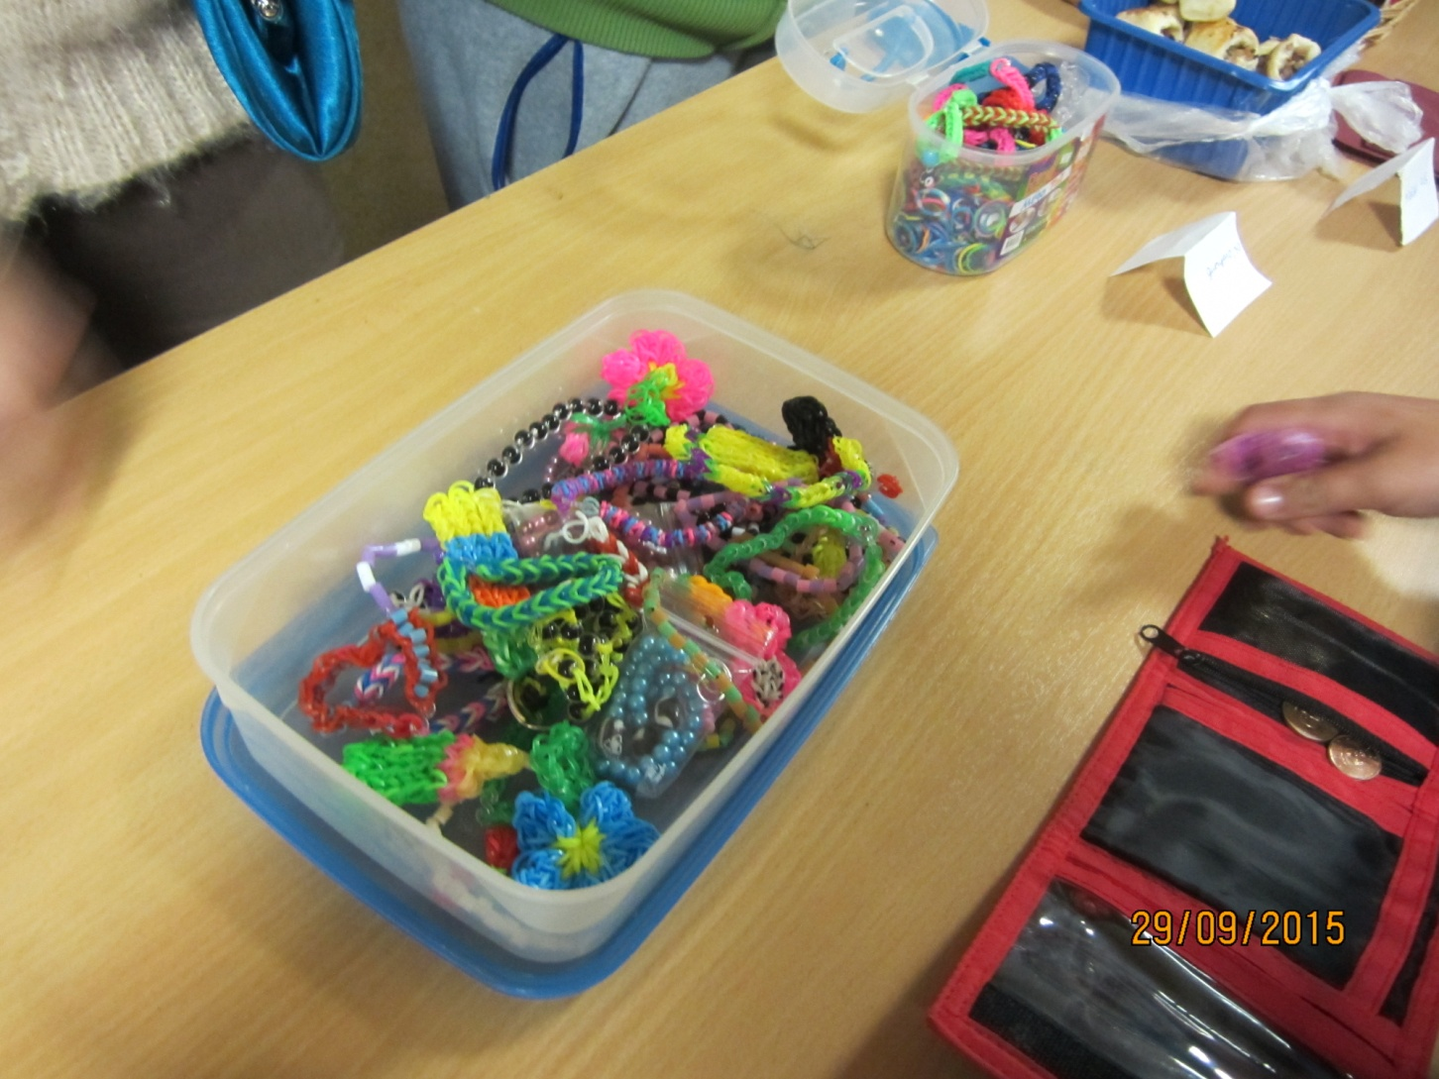
Some handmade trinkets

