Slide 1
PRESENTATION OF OUR SCHOOL

Slide 2
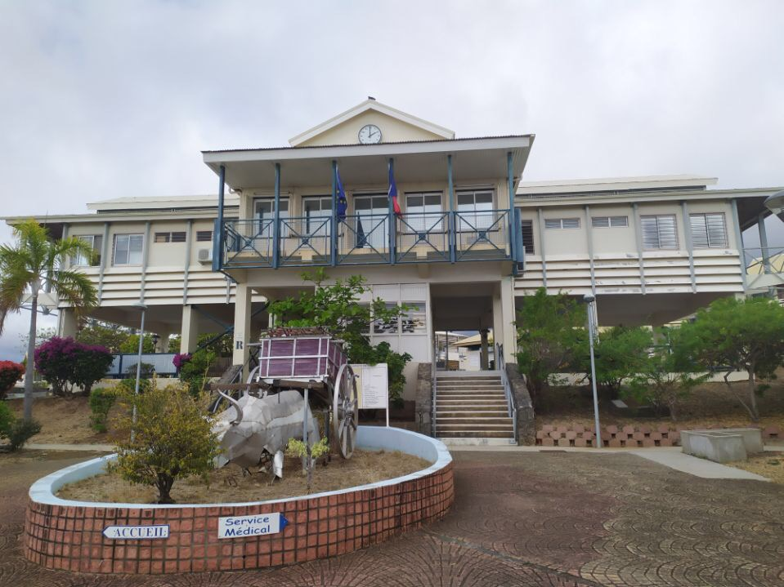
Welcome to Evariste De Parny

Slide 3
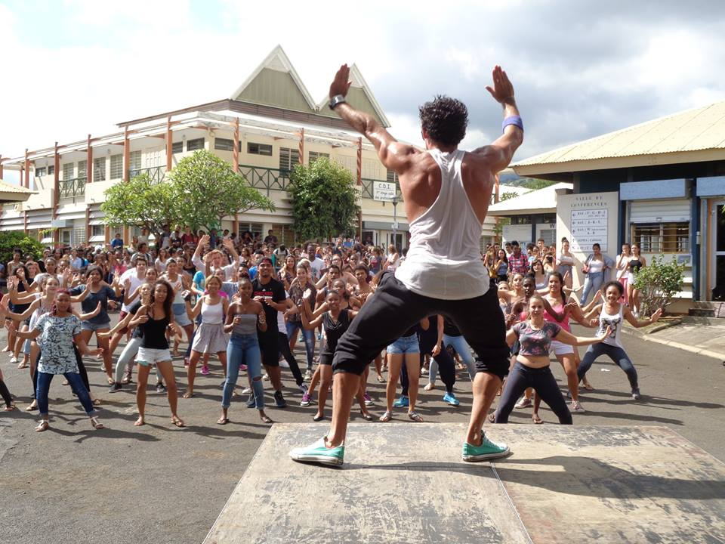
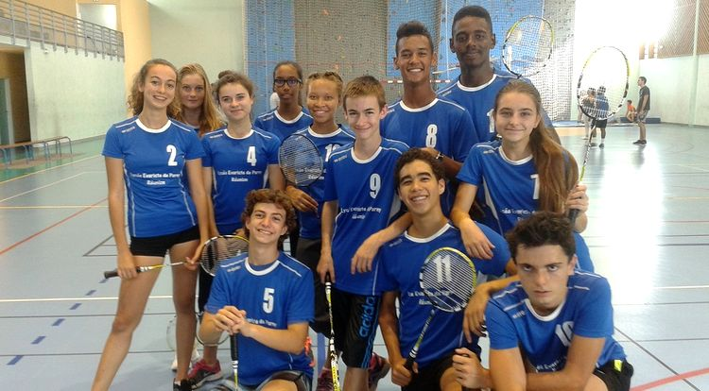
Our school was founded in 1989.
The size of our school is of 4,5 hectares.
Today our school could host more than 1600 students.
It’s known for being a clean and green school.
Divers clubs like UNSS(sports club), « le foyer » our cafeteria , theatre , dance , musique , trips to the cinema etc…

Slide 4
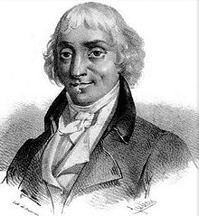
Evariste De Parny is the name of our school but also a knight then a viscount and also a famous Franch poet.
He was born here on our Island the 6th of Februrary 1753.
He left our Island at the age of 9 with his two brothers.
He was very famous thanks to his poetry at the XIXeme century.

Slide 5
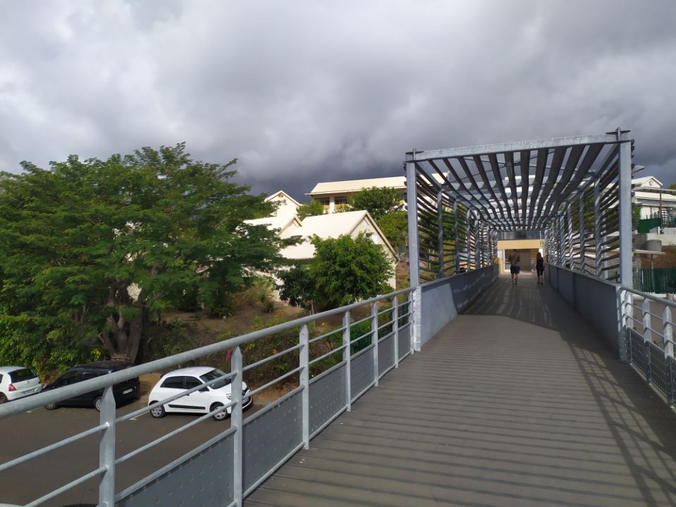
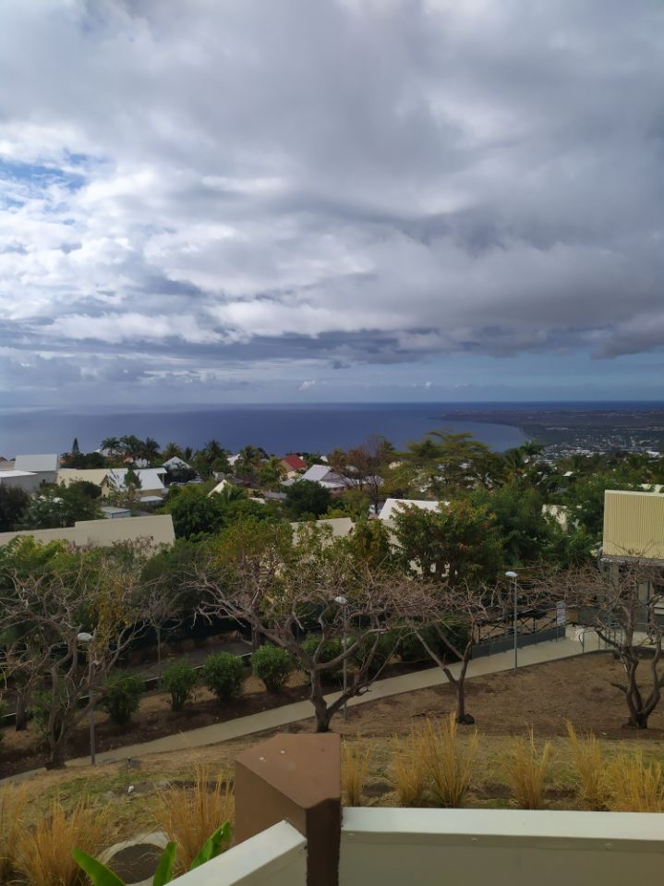
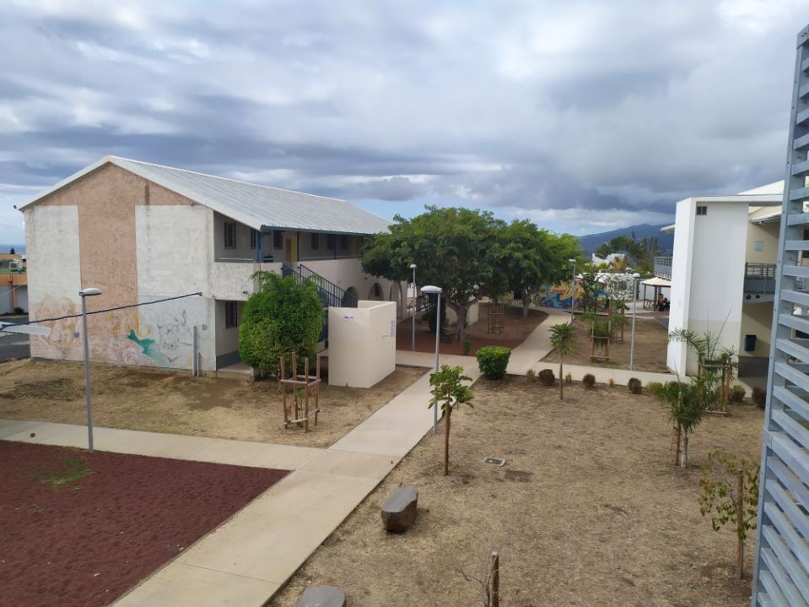
-We have a beautiful view on the sea.
-People are nice,
-There’s a cafeteria.
-Big school.
-Sunny and hot weather.
-Green environnement.
-There is a good vibe.

