Slide 1
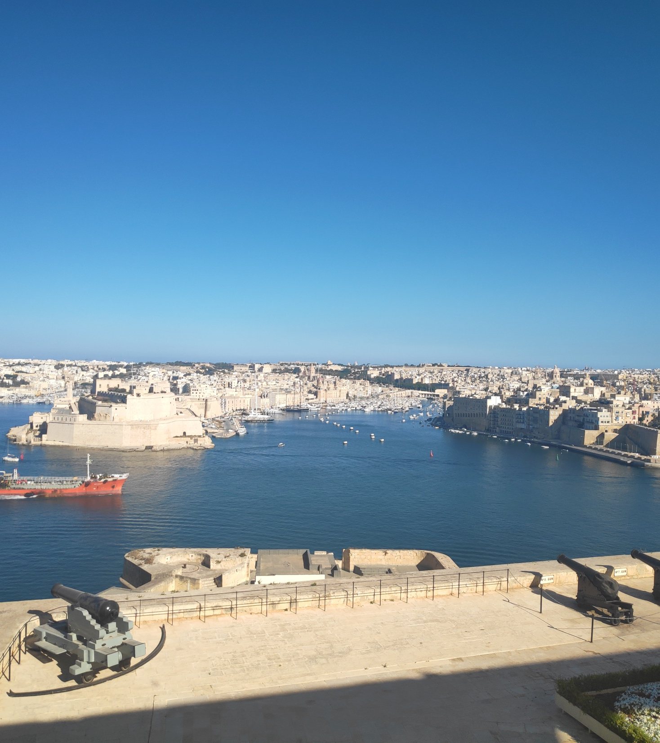
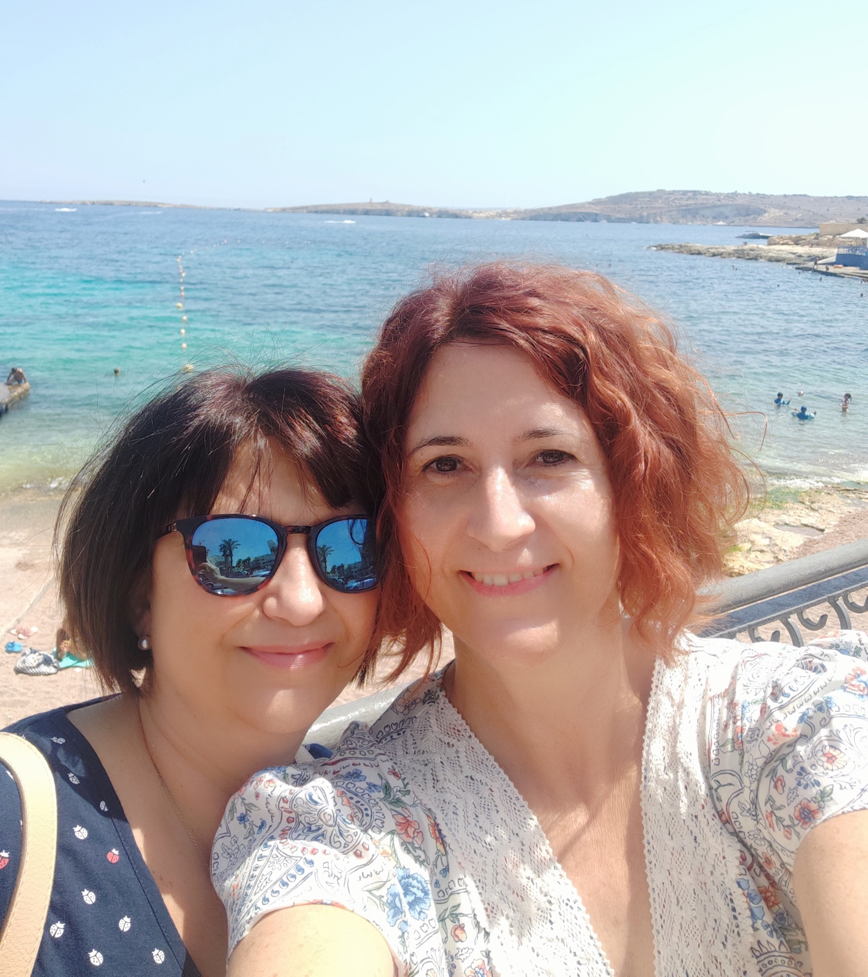
Erasmus + in Malta Soledad y Remedios
5-9 Julio 2021

Slide 2
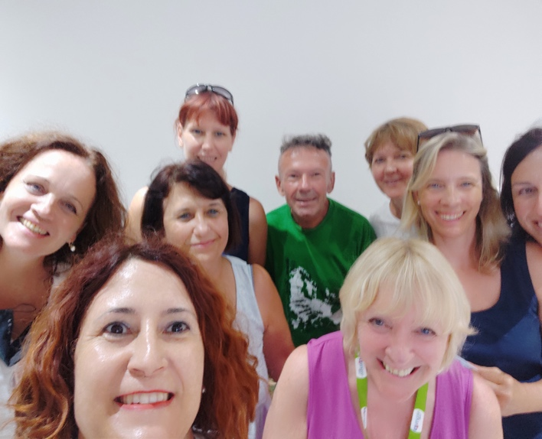
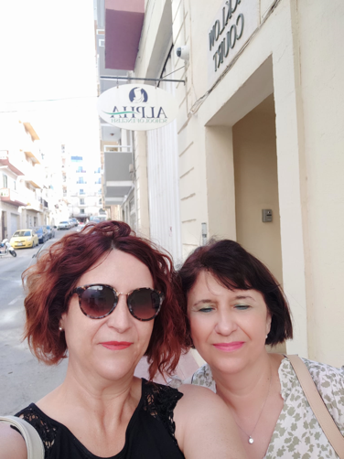
From 5th to 9th of July we follow a course in Malta, we were in St. Paul´s Bay. Our academy´s name was Alpha school Academy.
In this photo we are with our teacher Christine, a wonderful and lovely teacher.
In the photo our classmates, they were from Polland, Hungary, Czech Republic, Romania and our teacher from Walles

Slide 3
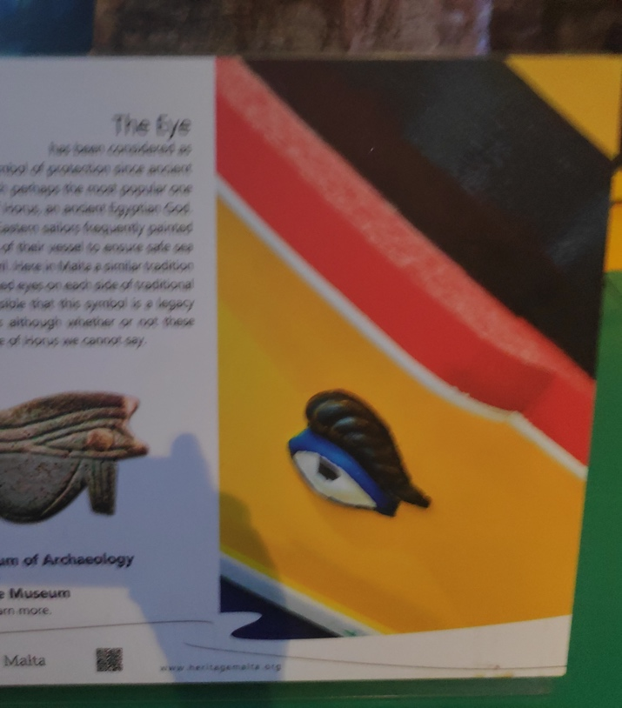
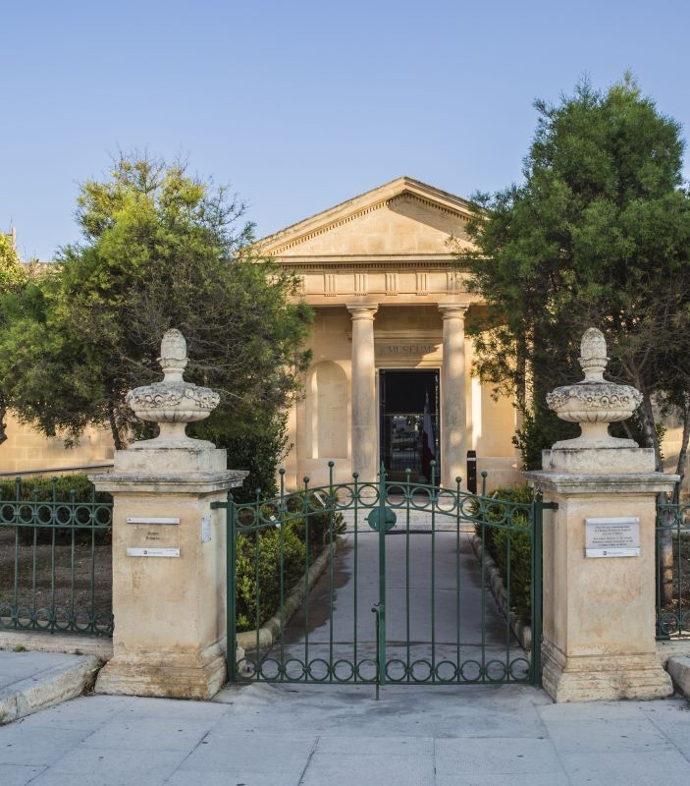
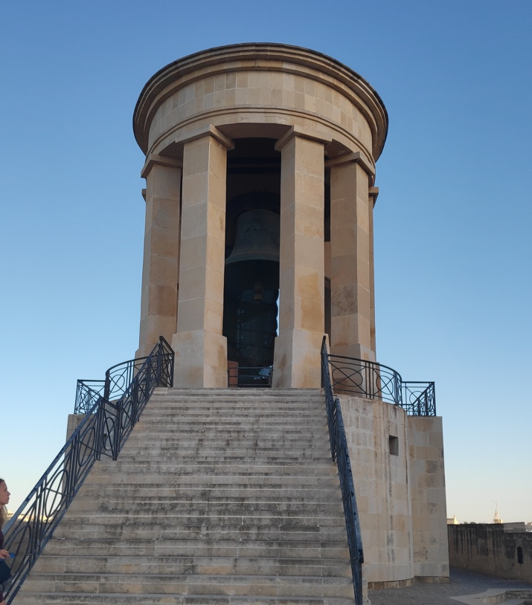
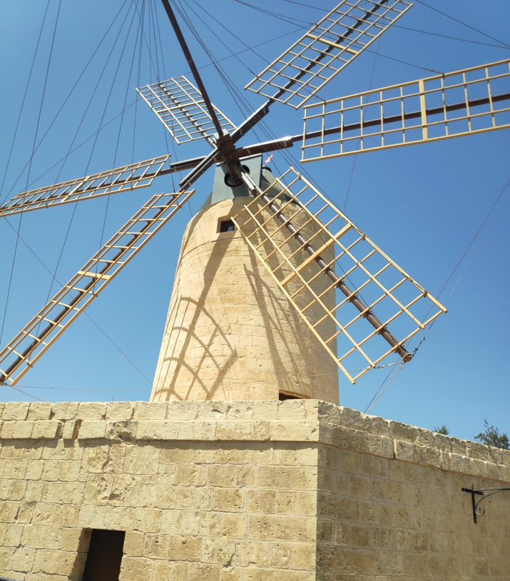
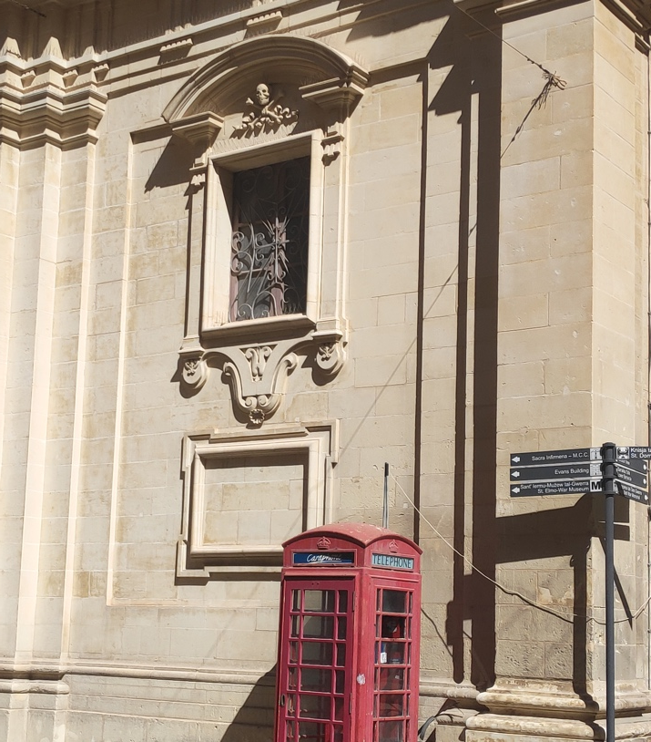
1st day -Topic: The past . Before starting with the lessons, we introduced ourselves in order to know a little bit our classmates.
We studied relevant moments in the history of Malta. Due to its great strategical position in the Mediterranean sea, this country has been invaded for many countries and empires from the Neolithic to its independence in 1964 (Phoenician, Carthaginian, Greek and Roman, Byzantine, Muslim Empires, Spain French, Britain....Malta is a crossroad of cultures. In 1974 it was declared as a Republic and in 2004 entry in the EEC.

Slide 4
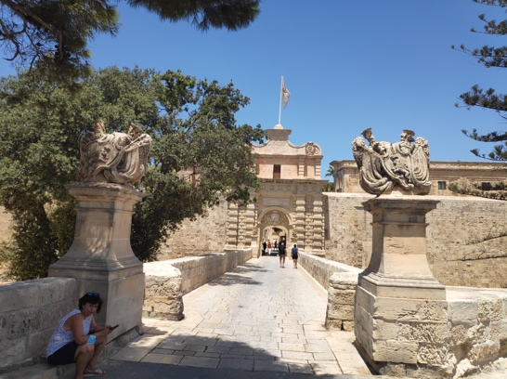
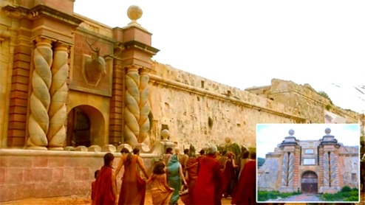
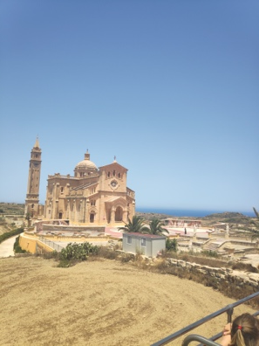
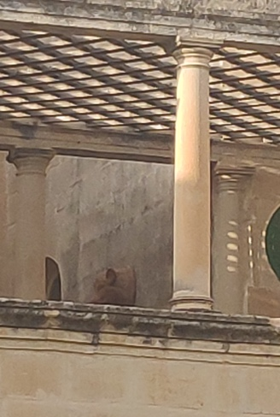
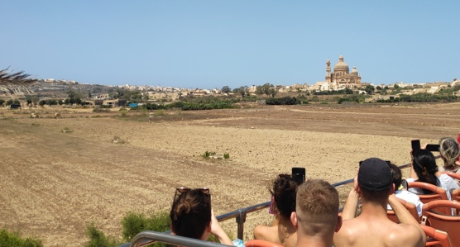
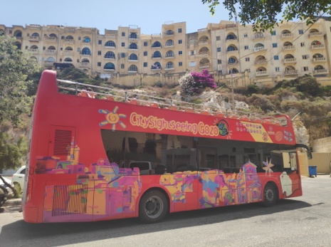
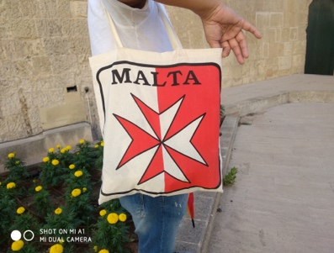
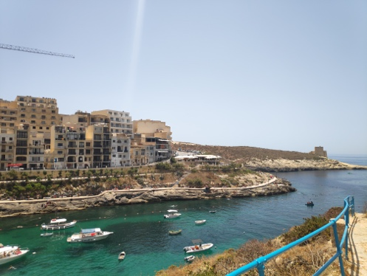
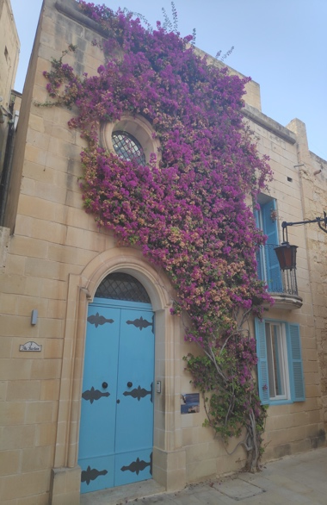
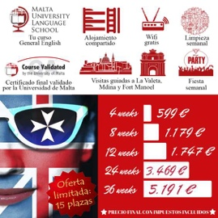
2nd day- Topic, the present and the future.
We worked in pairs reading different texts about interesting facts about Malta nowadays. And then we had to answer a quiz about Malta.
The main economic resources are the study of English, lots of students from different countries come here to study English because it is the second language, due to the British domain for many years.
The tourism is an important source of the country.
It is unknown as The Rock", but its name came from the greek word μέλι (honey)
There aren´t lakes and rivers in any island of the archipelago (Gozo, Malta and Comino). Water is very precious.
Its capital is Valetta and is the smallest capital city in Europe. Before Valetta the firs capital was Mdina, The capital of silence"
The most common names are José and María.
There are 365 churches in Malta, 98 % of maltesse people are catholics.
It has been and is stage of many films, Game of thrones" is a good example
The Maltese flag has an eight pointed cross.

Slide 5
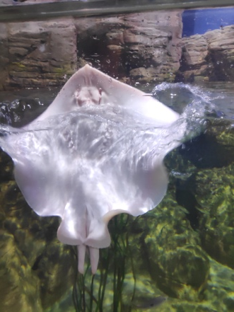
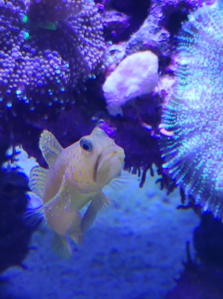
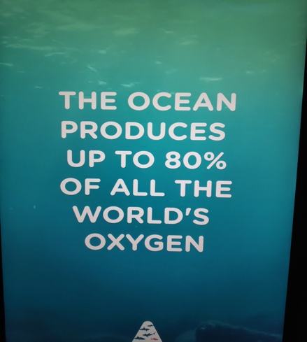
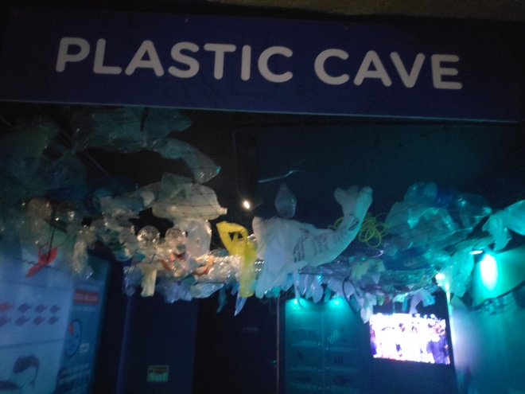
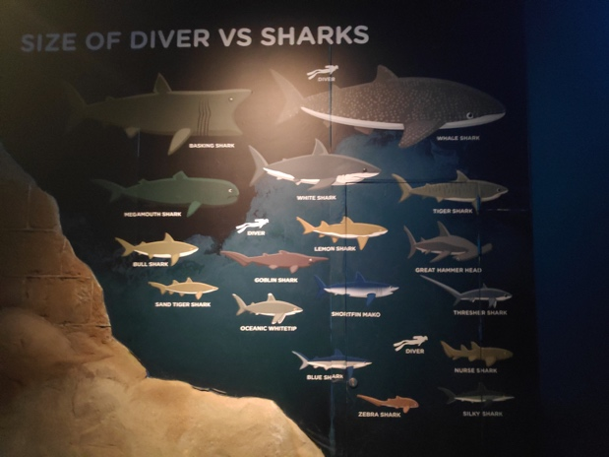
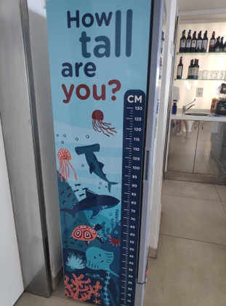
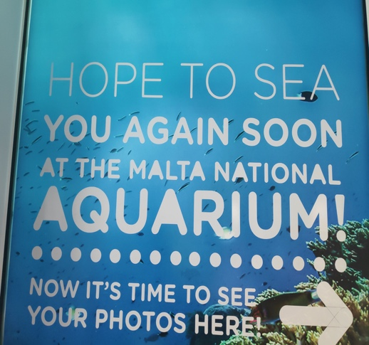
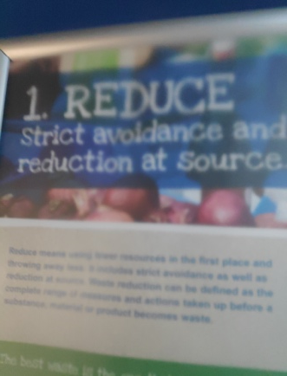
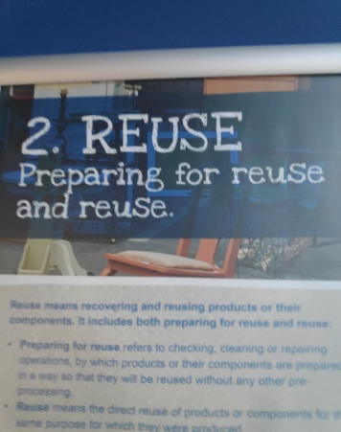
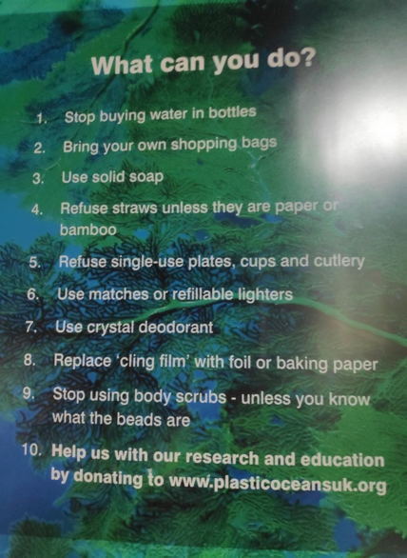
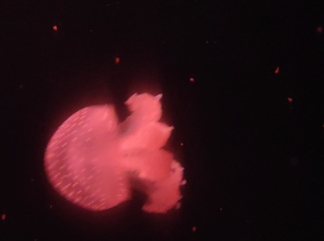
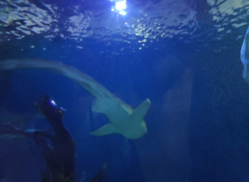
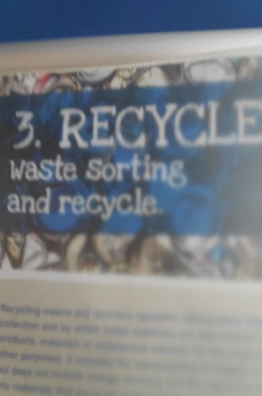
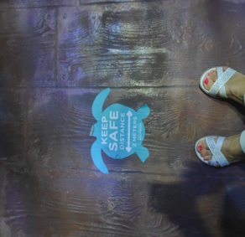
3rd day- Topic;Cultural activity. Excursion to Malta Aquarium. Explore and discover the culture of St.Paul´s Bay´. We can use the information, images and realia in our classes at school.
Natural Science
Take care our environment
Arts and design
English

Slide 6
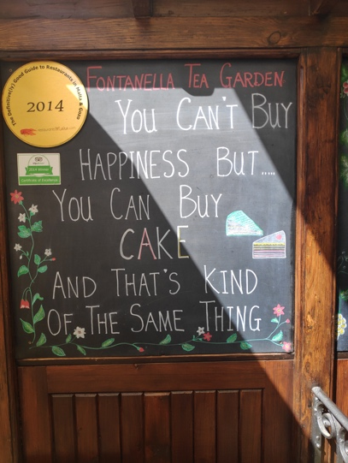
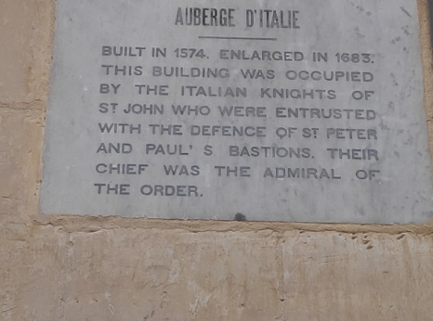
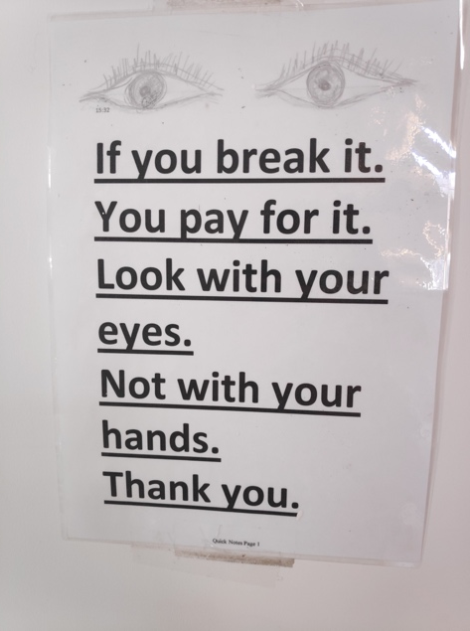
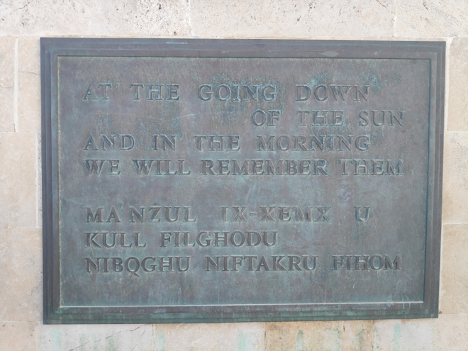
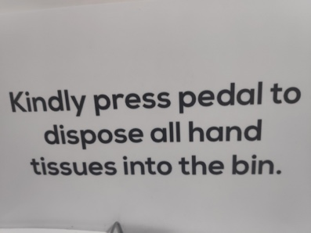
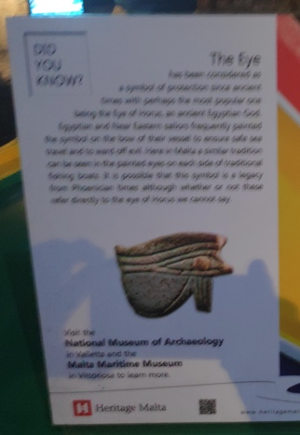
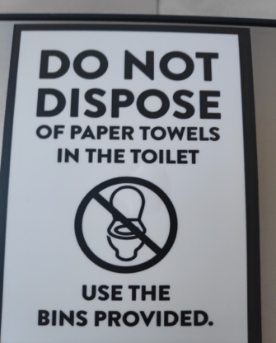
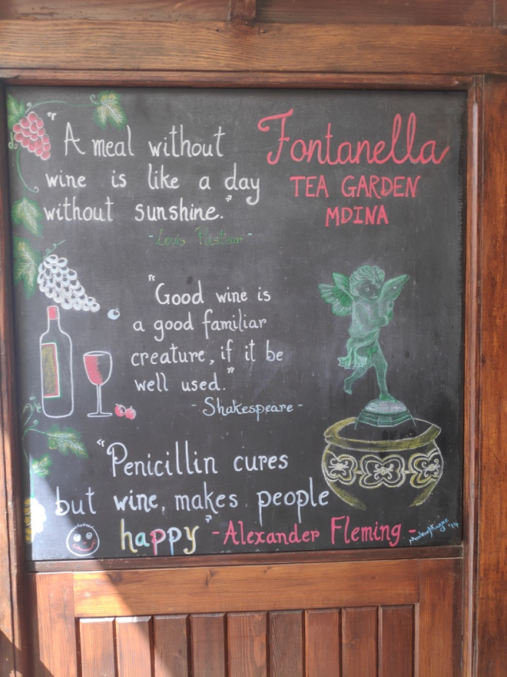
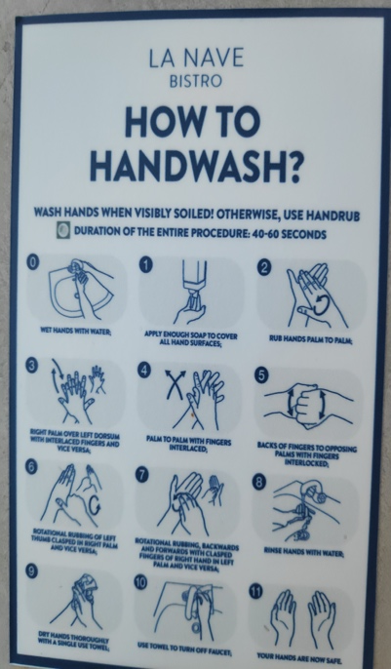
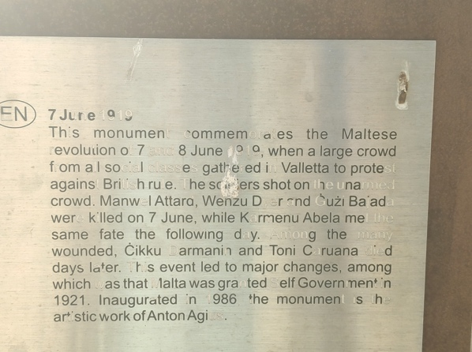
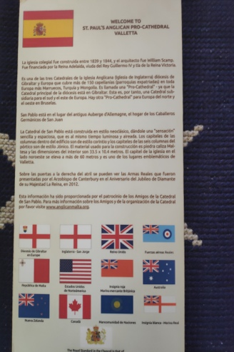
4th Day-Topic: The power of English. Working the four skills, listening, reading comprehension using different texts and watching videos in order to express opinions and share information.
Sometimes we felt like an elephant in the room

Slide 7
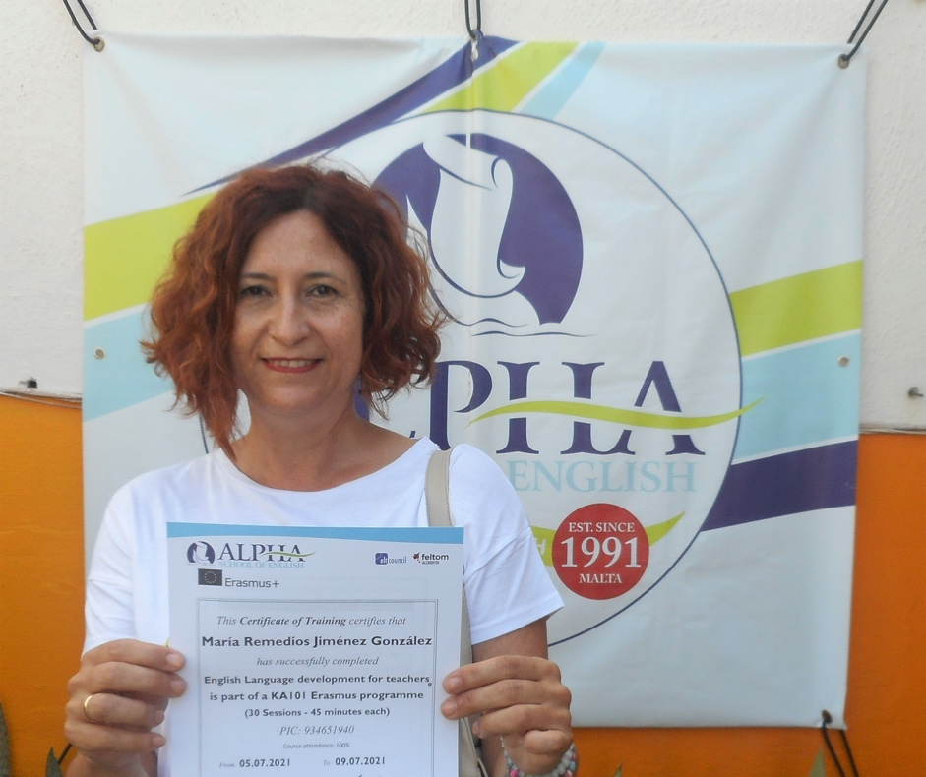
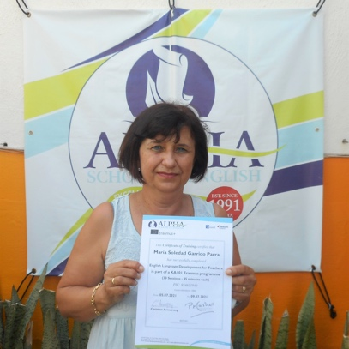
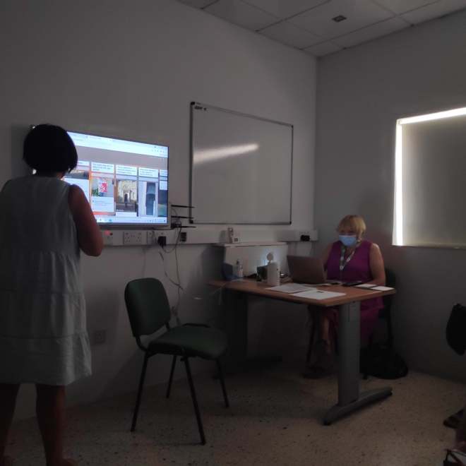
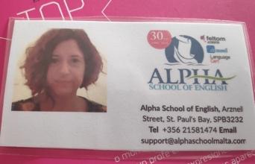
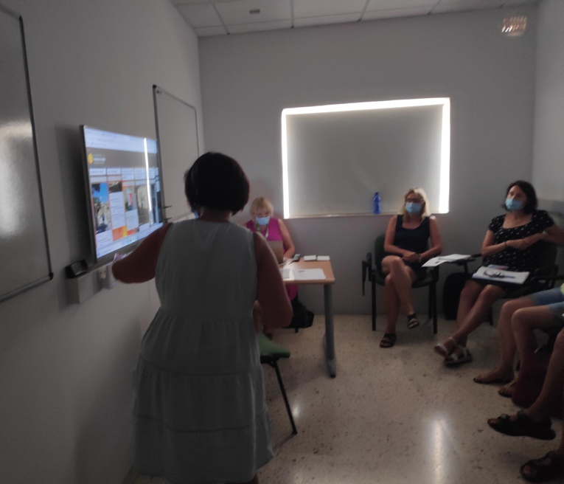
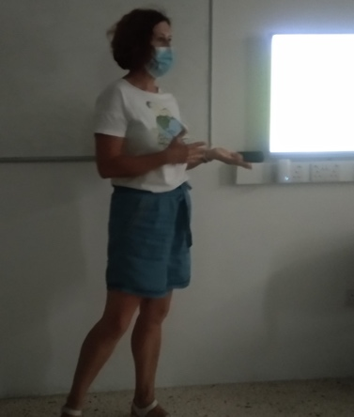
5th day- Topic: The power of words.
This day we presented our last projects about our experience in Malta. We prepared some activities that we can use in our school with our pupils

Slide 8
THANKS FOR WATCHING, HOPE YOU LIKE IT!
Arrival to Albacete´s train station. It has been a pleasure to participate in this Erasmus together. I went with a classmate and I arrived with a friend.

