Slide 1
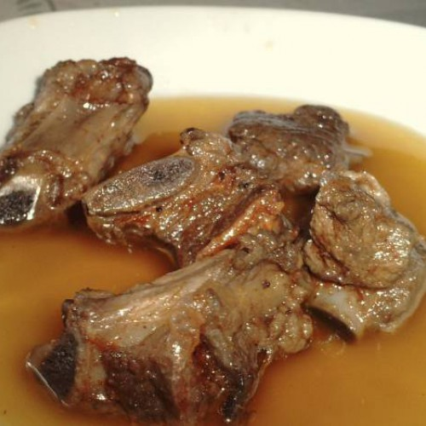
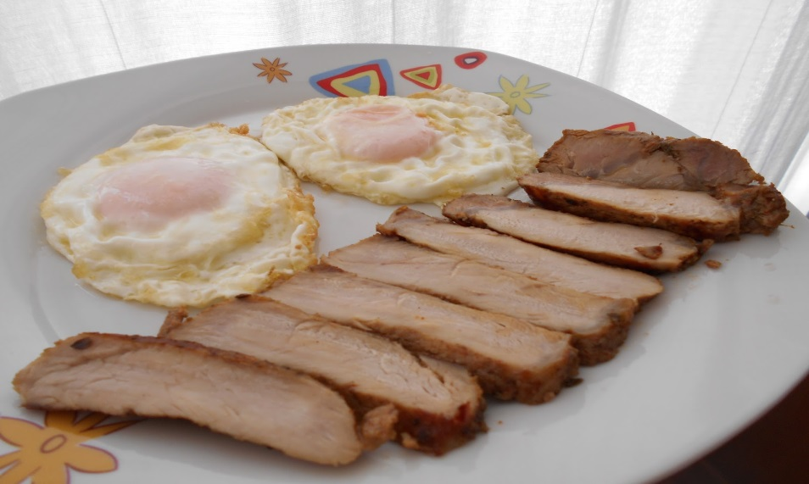
Lomo de orza y costilla en adobo

Slide 2
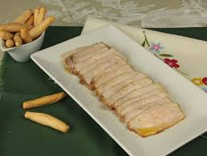
Ingredients
- 1 kg of pork ribs ½ female pork tenderloin in one piece ( it tastes much better and better on the ugly part, which is juicier).
4 cloves of garlic.
1 tablespoon peppercorns.
Oregano to taste.
Cloves to taste.
½ teaspoon cinnamon.
3 tablespoons of sweet paprika.
1 tablespoon of hot paprika.
½ lemon.
Some water.
1 teaspoon of olive oil.
Salt .

Slide 3
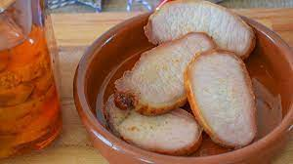
Preparation
1.in the mortar we crush the garlic, pepper, oregano, cloves and cinnamon.
2.Add the paprika, add the juice of half a lemon, a little water and a little olive oil.
3.Cut the loin into thick slices without reaching down, with a sharp knife. Salt and put together with the ribs in a saucepan or large source.
4.With a brush, smear the loin and ribs with the mortar mash. Give it good for the folds, with patience.
5.let it dry for two or three days in a cool place. I put it on my terrace — this recipe is only made in winter. If you do not have a terrace and you put it in the refrigerator, it should be covered well, since the smell permeates the rest of the food.
6.When this time passes, take out the marinated tenderloin and ribs and leave a night to air — in the air. If you like it with less color, remove the paprika with a kitchen paper.
7.Separate the fillets to fry them in abundant oil over medium heat so that they are well done inside, without being dry.
8.With the ribs follow the same procedure.
9.Put in an earthenware board or a large glass jar, and cover with the frying oil.

