Slide 1
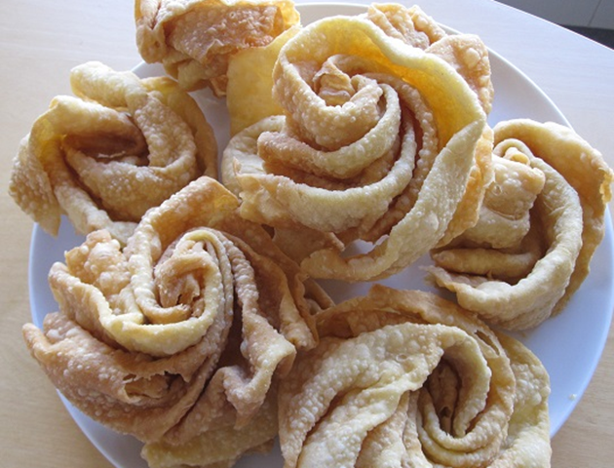
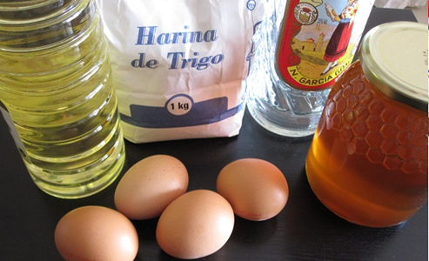
HOJUELAS MANCHEGAS
INGREDIENTS:
- 4 Eggs
- Anise cup
- 85 Gr. Of sunflower oil
- 350 gr. Of flour
- Honey or icing sugar as a topping

Slide 2
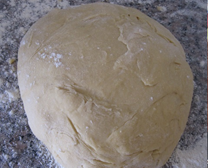
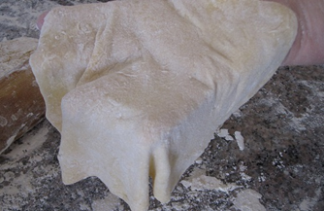
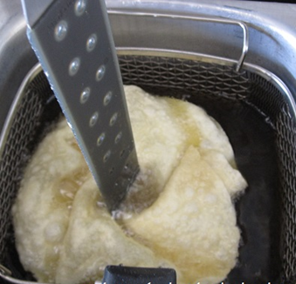
PREPARATION:
We beat the eggs well, add the anise and sunflower oil, continue mixing everything. We incorporate the flour little by little and we knead, working the dough for a long time.
The dough will be of a consistency like that of bread. Keep in mind that we are going to spread it with the roller. We make a ball with it, we pour a little flour on top, cover it with a cloth and let it rest for about 2 hours.
We flour the work table and the roller well so that it does not stick to us. We take a pinch of the dough and make a ball the size of a walnut. We stretch it with the roller, leaving it as thin as possible, always with flour on top so that they do not stick or break when you pick them up.
We prepare a deep fryer with plenty of mild olive oil. We heat it to 180º and we introduce the flake, then we put a thin palette or similar in the center and we turn it so that a kind of flower is formed.
As soon as it takes the shape, we let it brown a little, a few seconds, we turn it over, we leave it a few seconds, it looks golden and we remove it well drained. We deposit it on absorbent kitchen paper so that they lose the excess oil.
When they are done we can add honey or icing sugar.

