Slide 1
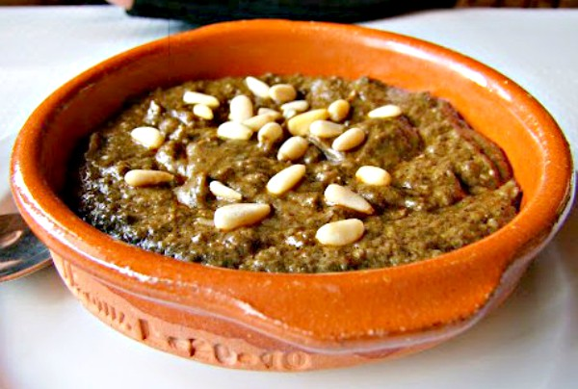
Ajo MATAERO

Slide 2
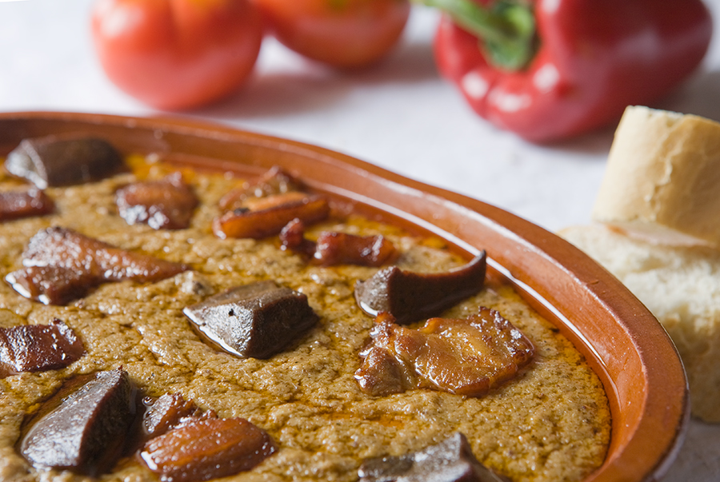
Ajo mateaero or ajopringue is a typical dish of La Mancha cuisine, basically made with liver and bread. It is one of the dishes that was traditionally made in the slaughterhouses.

Slide 3
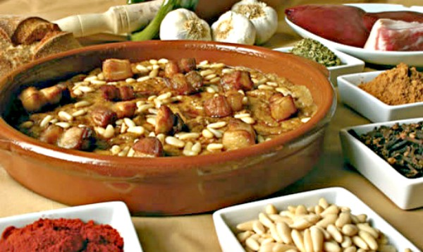
ingredients:
350 gr clean pork liver
150 gr stale bread
2 cloves of garlic
30 gr of lard
1/2 tablespoon of paprika
50 gr of pine nuts
1/2 glass of almonds
1 tablespoon of nutmeg
2 bay leaves
1 tablespoon black pepper
1 teaspoon cinnamon
400 g of bacon, cut into strips

Slide 4
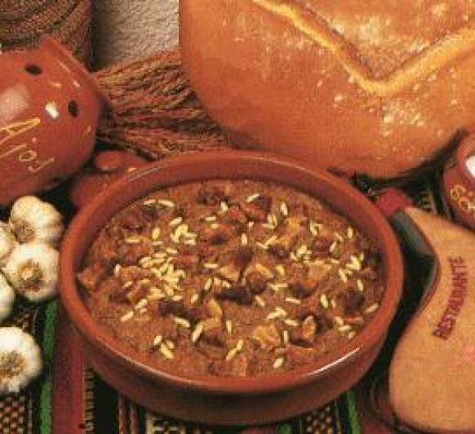
Instructions:
Heat the olive oil in a large skillet and fry the bacon. Once fried, reserve separately.
In the same oil, make a sauce with the garlic, remove and crush in a mortar.
Fry the previously cleaned and sliced ​​liver over medium heat. Reserve a few slices. The rest chop well together with the crushed garlic. Fry very well in the same oil and add the paprika.
Add water and bring to a boil. Add the pepper and cinnamon to taste. Let it boil one more time.
Add the bread crumbs, stir until it thickens and the oil separates.
Serve in clay pots, garnish with reserved liver, pine nuts and that's it.

