Slide 1
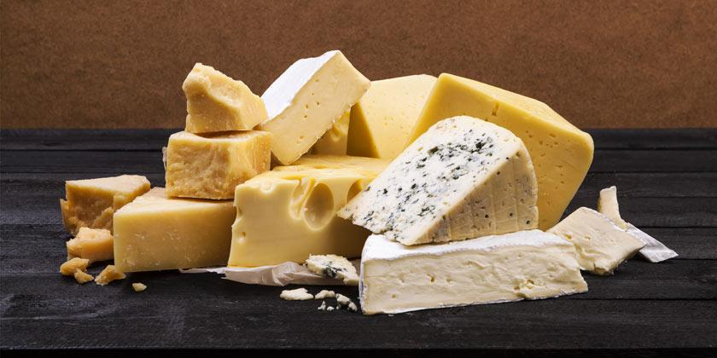
CHEESE

Slide 2
INGREDIENTS
4 Gallons of Milk (Not Ultra Pasteurized)
3/8 tsp MA 4002 Culture.
1/2 tsp (2.5 ml) Single strength liquid rennet.
Salt.
Calcium Chloride (for pasteurized milk)

Slide 3
ELABORATION
The first thing is to transfer the milk to the production tanks where it is heated to temperatures that can vary from 28ºC to 34ºC, and depending on the type of cheese, lactic ferments and coagulants of an animal or vegetable type (rennet) will be added, which will make the milk solidify, going from a liquid to a solid or semi-solid state. In pasteurized milk it is necessary to add calcium chloride since we have lost part in the given treatment.

Slide 4
Once the coagulation time has elapsed, it is cut by means of a kind of stainless steel threads that are placed parallel to each other and we call them “liras”. By cutting we are going to obtain a grain, the size of which will depend on the type of cheese to be made; As a consequence of this cut there is a drainage of the serum (contained in the grain). Depending on the variety of cheese to be made, we will work the curd in a specific way by stirring and heating, further promoting the expulsion of the whey. The last step that will take place in the vat is de-draining (removing the whey from the curd).

Slide 5
The grain that we have obtained, we introduce it into molds and depending on the cheese to be made, it may require pressing, in one way or another the cheese will eliminate part of the whey and acquire the desired shape. The last step before maturing is salting, which can be done by immersion in brine (water and salt), by rubbing the bark or having added the salt to the milk at first. Finally we have the ripening phase, in which the cheese is introduced into the ripening chambers or caves obtaining its peculiar aromas, flavors and textures, at this stage the master cheesemaker pampers and whispers to turn them into eternal delicacies.

Slide 6
END

