Slide 1
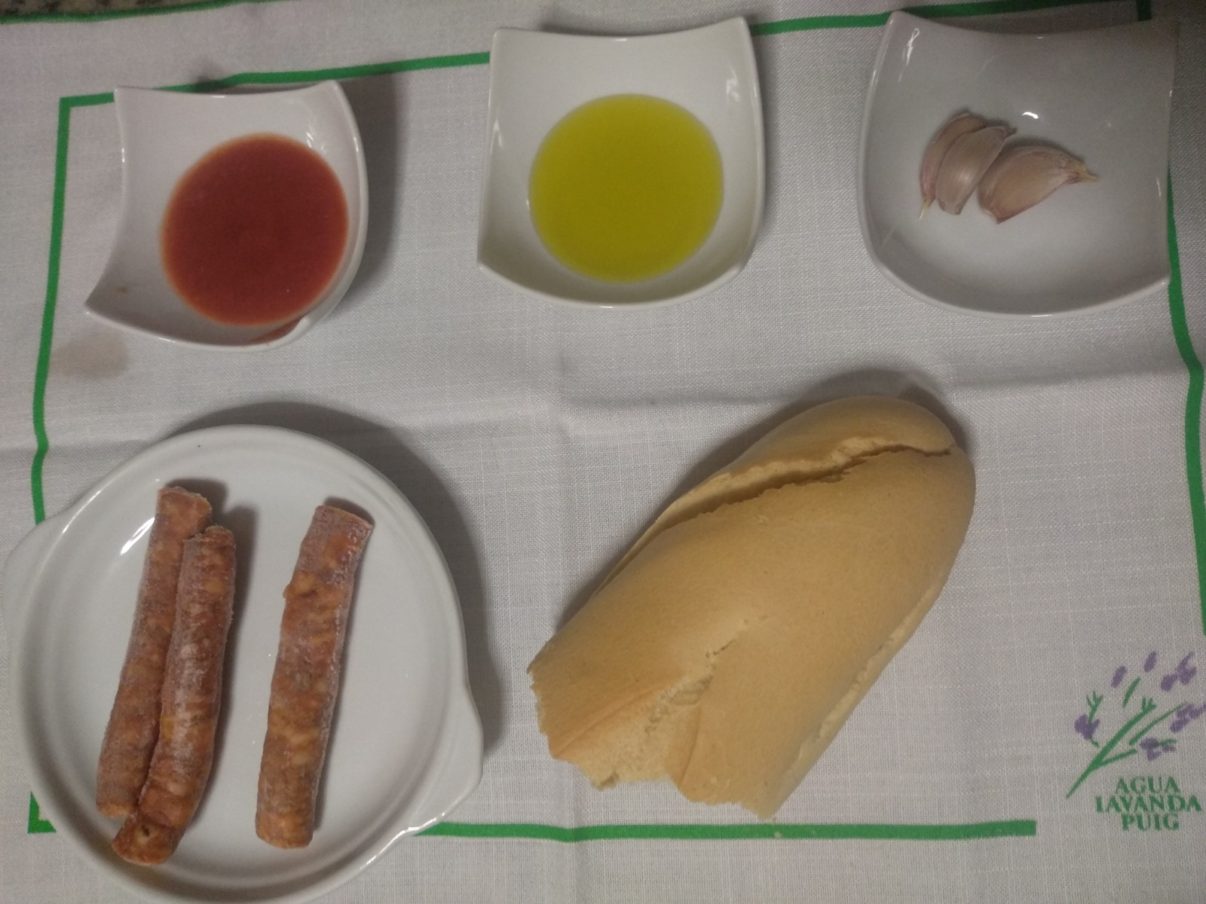
Roller breadcrumbs (Migas ruleras)
Ingredients
2 loaf of bread hard
6 sausages
2 strip of bacon
8 clove garlic
150g the olive oil
Salt
tomatoes

Slide 2
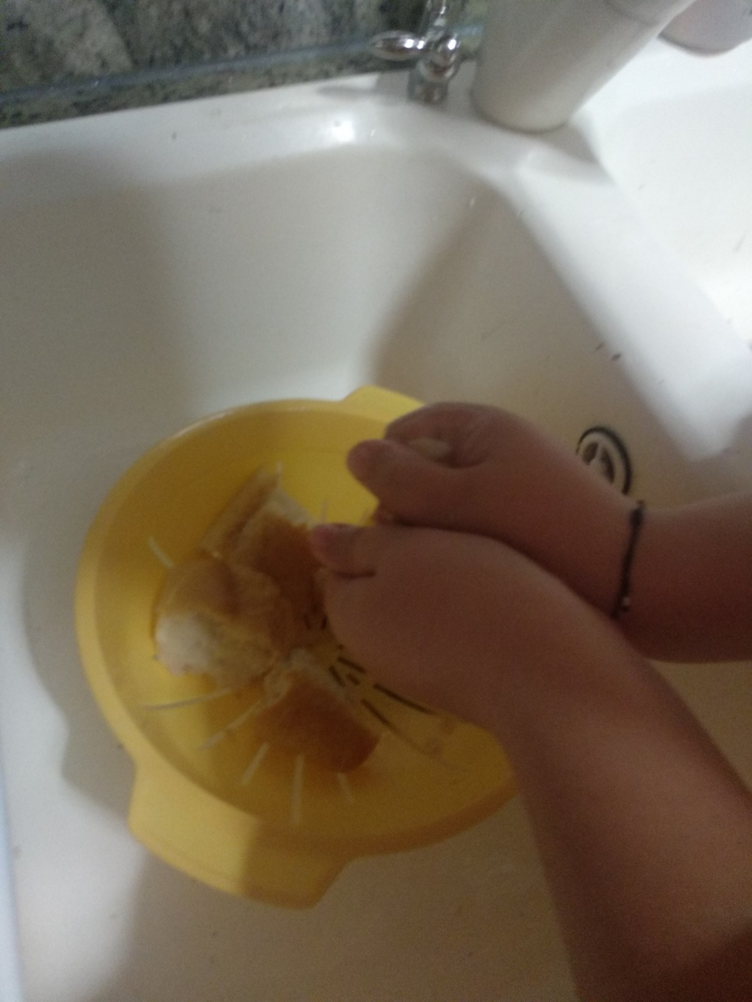
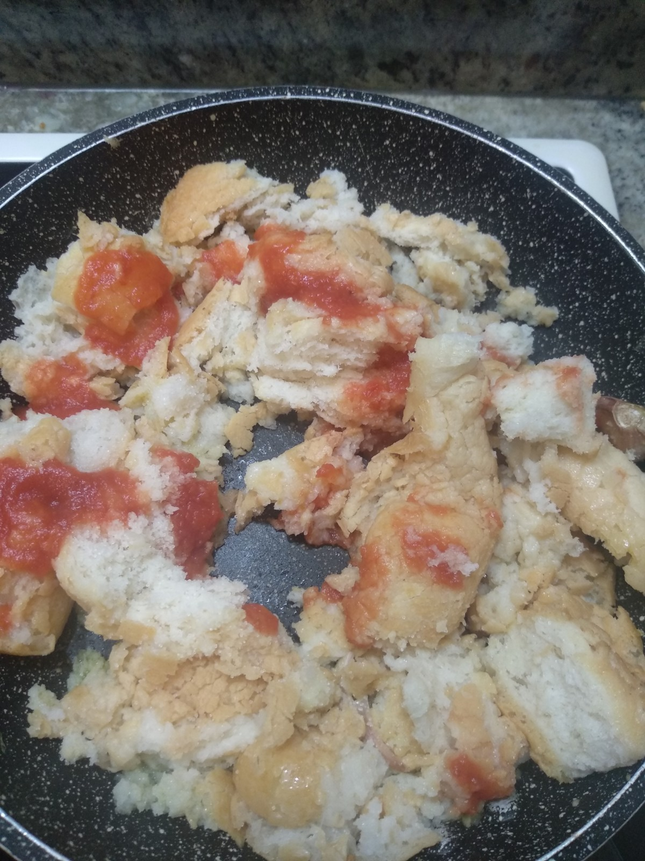
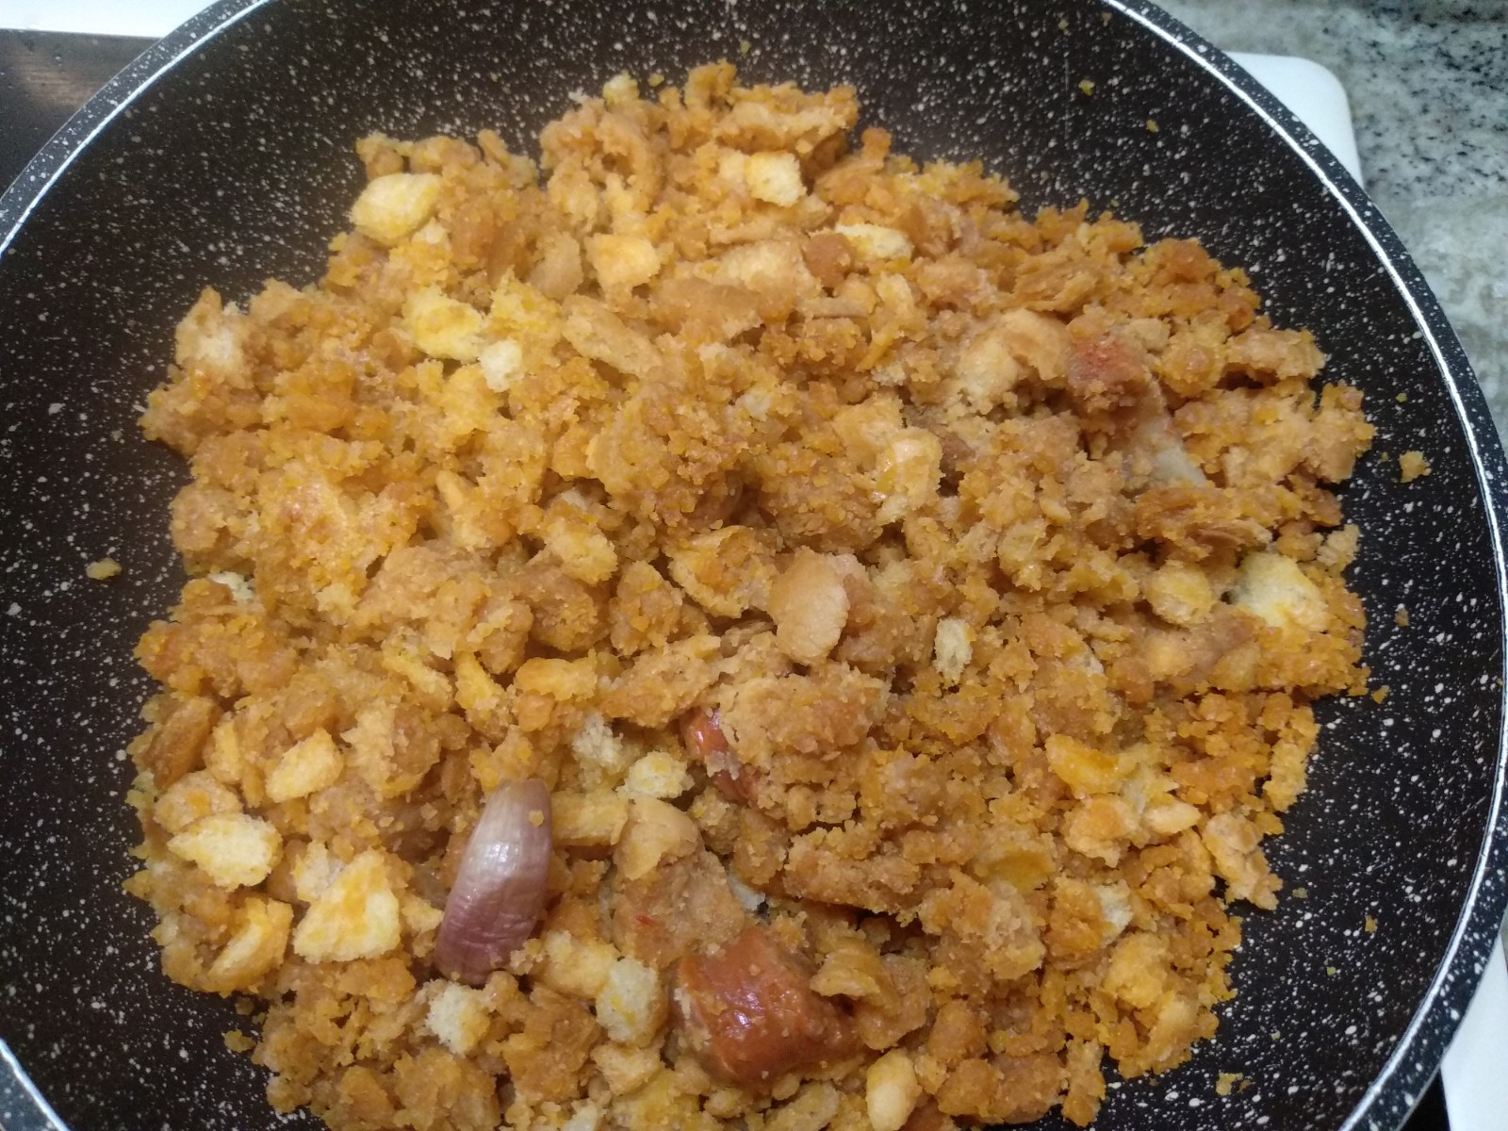
Preparation
Wet the bread with water and drain well.
In a frying pan put the oil and the garlic, when the garlic is golden add the sausages and the bacon into pieces.
Add the wet bread and stir without stopping when it is half way add the tomato.
Finish making non stop stirring until the bread crumbs are loose and rolling

Slide 3
Serve with grapes. enjoy your meal

