Slide 1
MANCHEGOS GAZPACHOS
INGREDIENTS TO MAKE MANCHEGOS GAZPACHOS
500 grams of chopped chicken
Half rabbit cut up
200 grams of Sardinian cakes
1 onion
1 clove garlic
1 red bell pepper
200 ml of homemade tomato sauce
1 tablespoon of paprika from La Vera
Nutmeg
1 bay leaf
Extra virgin olive oil
SaltBlack pepper

Slide 2
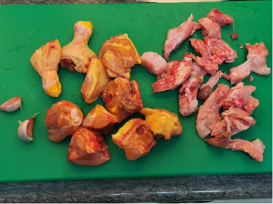
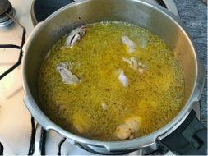
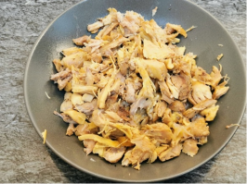
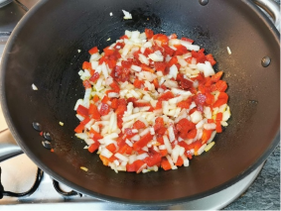
HOW TO MAKE GAZPACHO MANCHEGO
1.- We start by chopping the chicken and the rabbit. Season with salt and pepper and brown it in a high-speed pot, since once everything is cooked, we will crumble it to add it to the stew.
2.-We brown the meat.
3.- We cover with water, put a bay leaf and close the pot. Cook for about 20 minutes.
4.- Once cooked, we remove the meat and shred it. We reserve the resulting broth to later cook the ashen cakes.
5.- When I do it, I use a wok or a wide saucepan. Saute the garlic, onion and pepper for about 15 minutes.

Slide 3
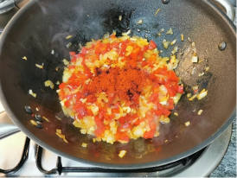
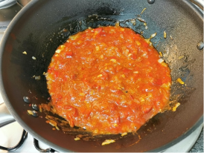
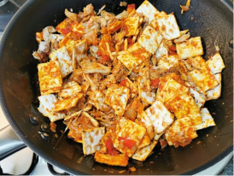
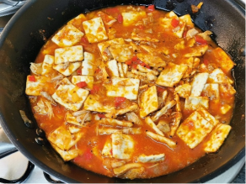
6.-Add paprika and sauté for a few seconds.
7.- Add the fried tomato sauce and cook for another 10 minutes.
8.- Add the packet of ashen cakes and the shredded chicken and rabbit.
9.- Cover with homemade broth or the resulting broth and let it cook for about 30 minutes over low heat until the cakes are soft.

