Slide 1
2nd meeting
Women who made a difference
Istituto Comprensivo Perugia 3, Perugia, Italy
24-28 February 2020

Slide 2
«Like a girl»
The long journey of women towards equality

Slide 3
«Like a girl»
‹#›

Slide 4
What does run «like a girl» mean?
“run in a ridiculous way”
or
“run as fast as you can”
Why are these two answers so different?
‹#›

Slide 5
‹#›

Slide 6
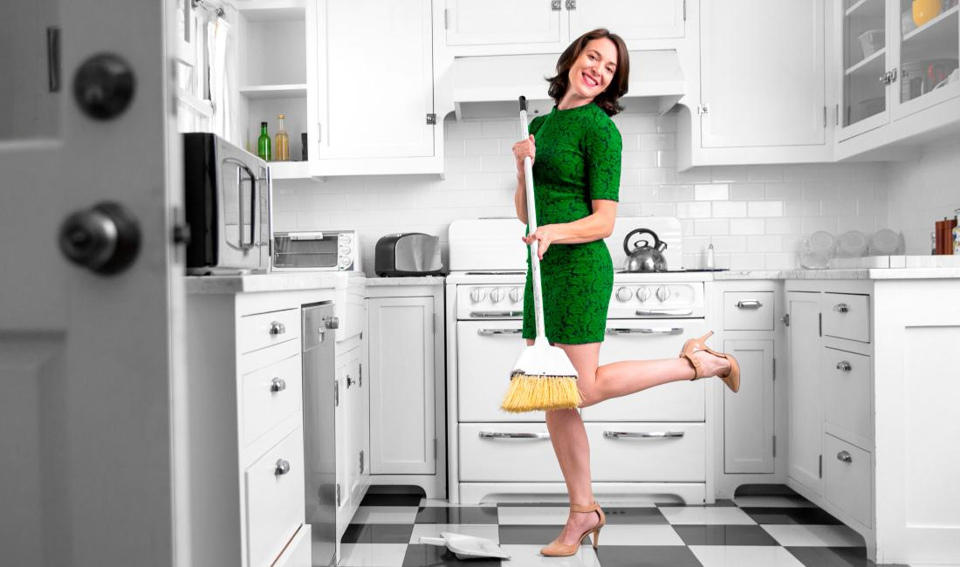
Stereotype
When, in the life of a person, does this stereotype appear?
Where does this stereotypical image come from?
‹#›

Slide 7
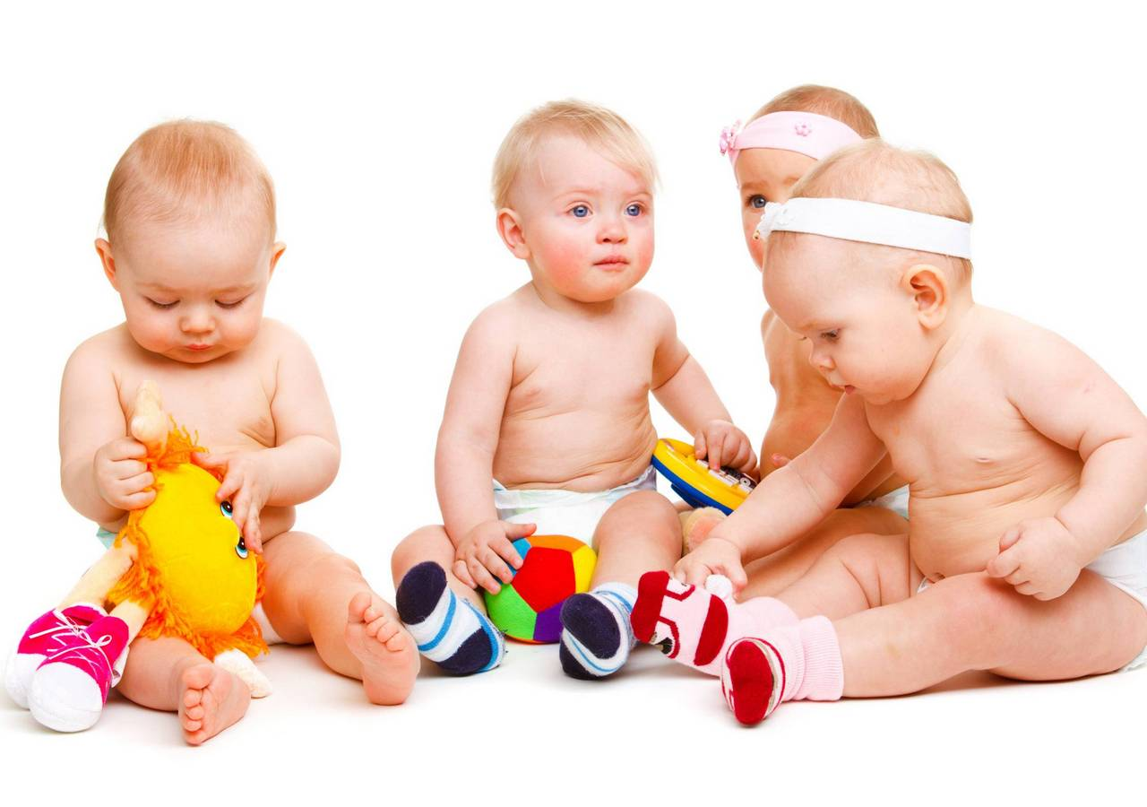
Stereotypes everywhere around
‹#›

Slide 8
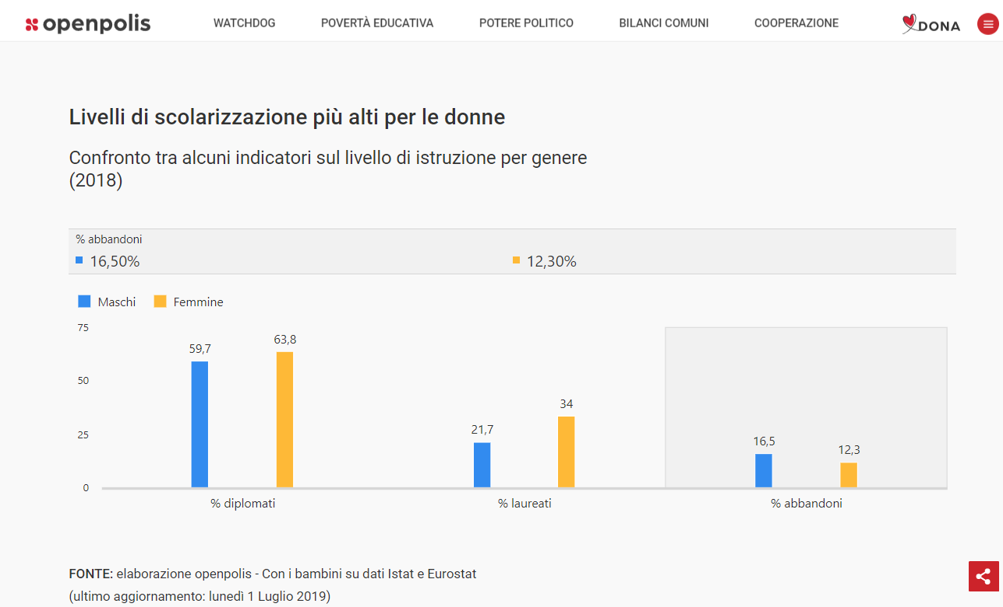
Stereotype vs Reality
‹#›

Slide 9
Reality is
According to recent international studies, regarding the overall achievement in reading, mathematics and science literacy, girls outperformed boys in 70% of participating countries.
Even in those countries with political and economical inequality.
In a few words, at school, on average, girls have better results than boys.
So what?
‹#›

Slide 10
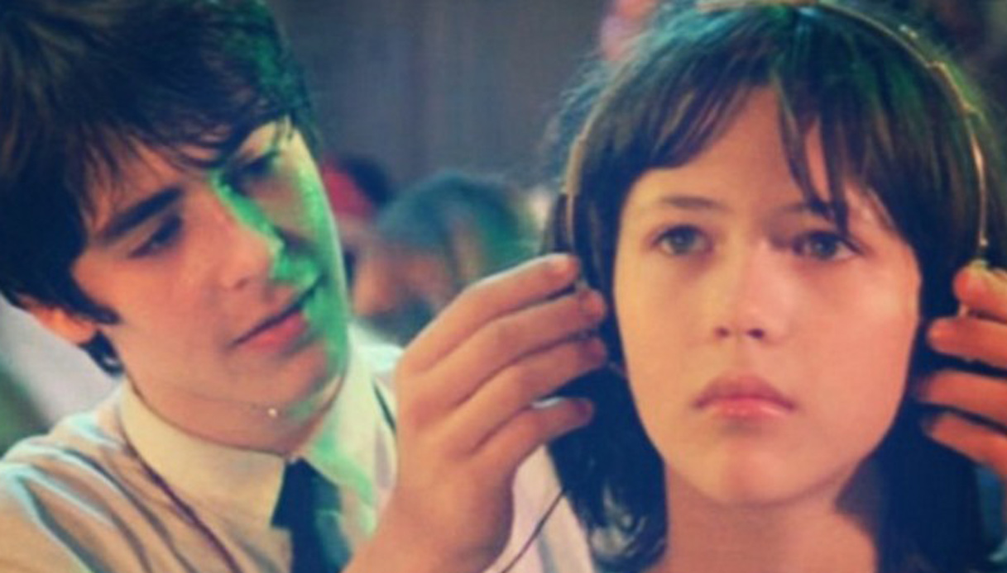
La Boum - The Party - Il tempo delle mele
‹#›

Slide 11
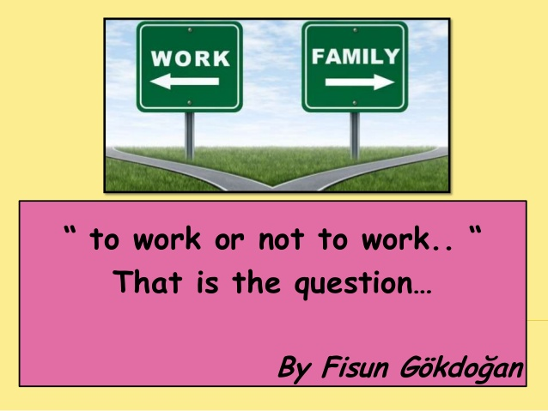
Crossroads
‹#›

Slide 12
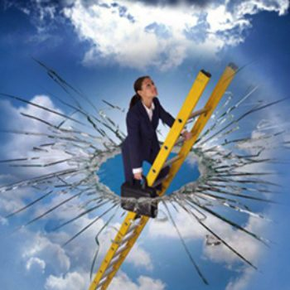
There’s still a glass ceiling: let’s shatter it!
‹#›

Slide 13
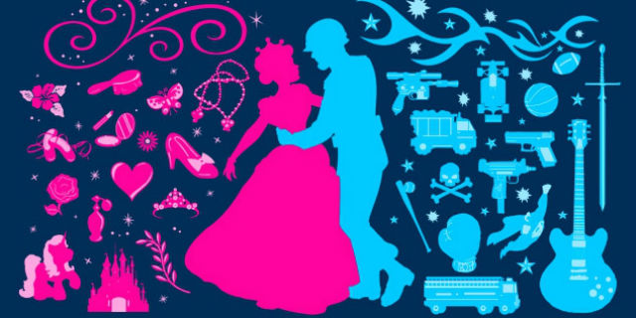
Where does this stereotype come from?
‹#›

Slide 14
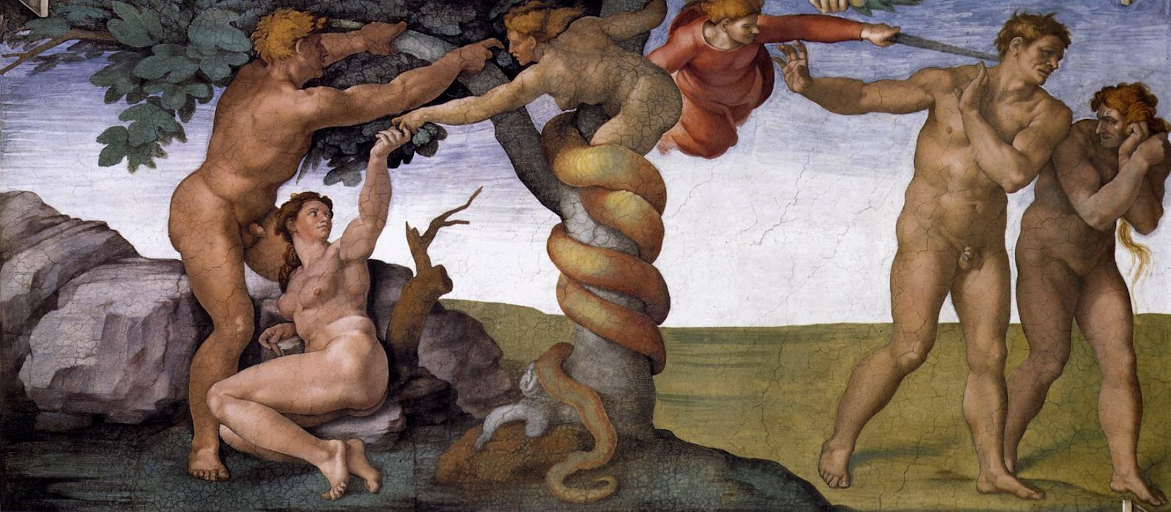
Michelangelo, Cappella Sistina, La cacciata dal Paradiso
‹#›

Slide 15
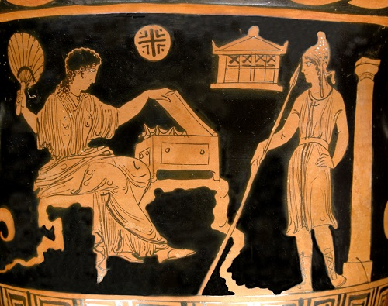
The myth of Pandora
‹#›

Slide 16
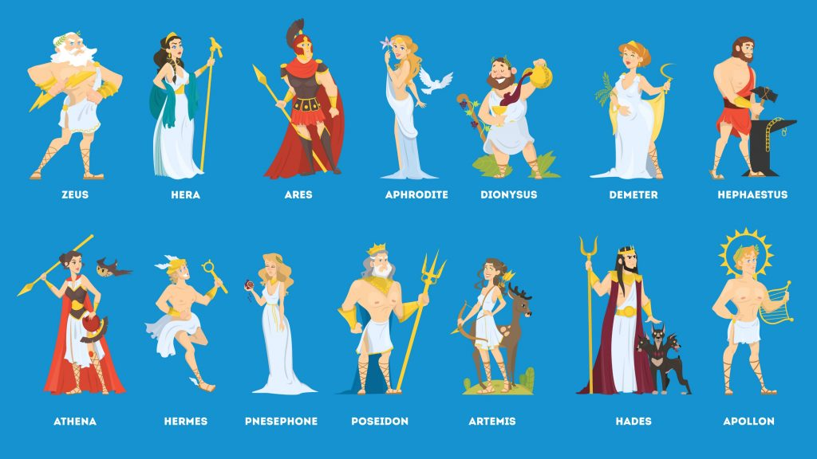
Characters
PROMETHEUS: «THE CLEVER BROTHER»
PANDORA: «FULL OF EVERY GIFT»
EPIMETHEUS: «THE DUMB BROTHER»
‹#›

Slide 17
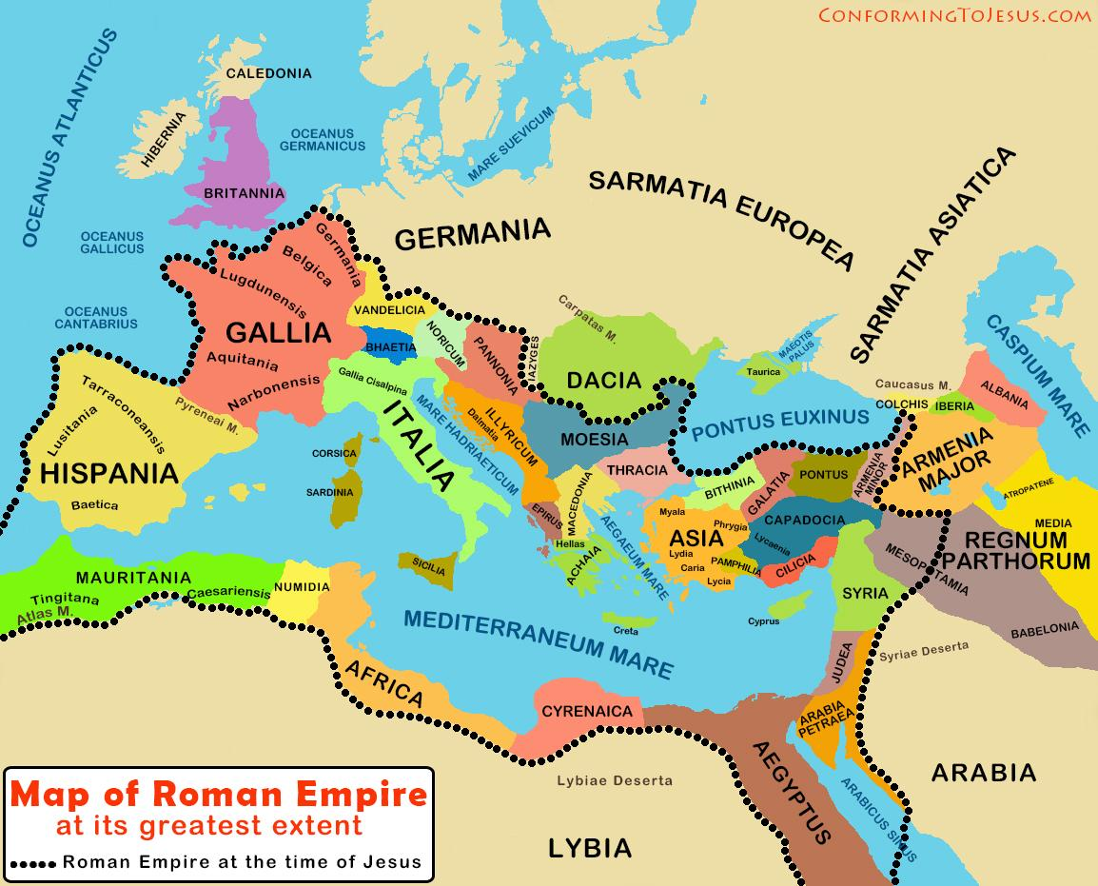
Our common ancient past
‹#›

Slide 18
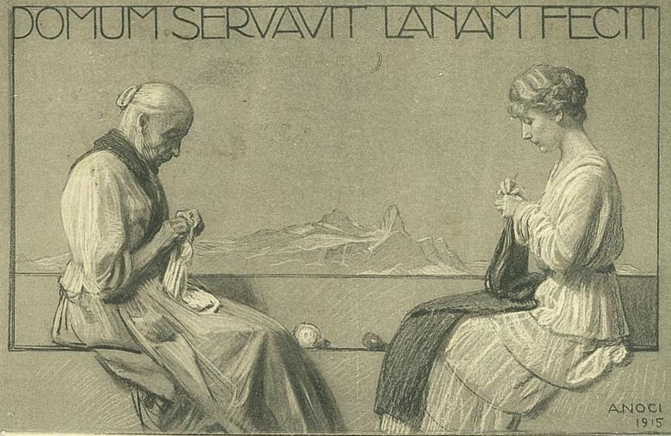
The best awards on her gravestone
DOMI MANSIT, CASTA VIXIT, LANAM FECIT
‹#›

Slide 19
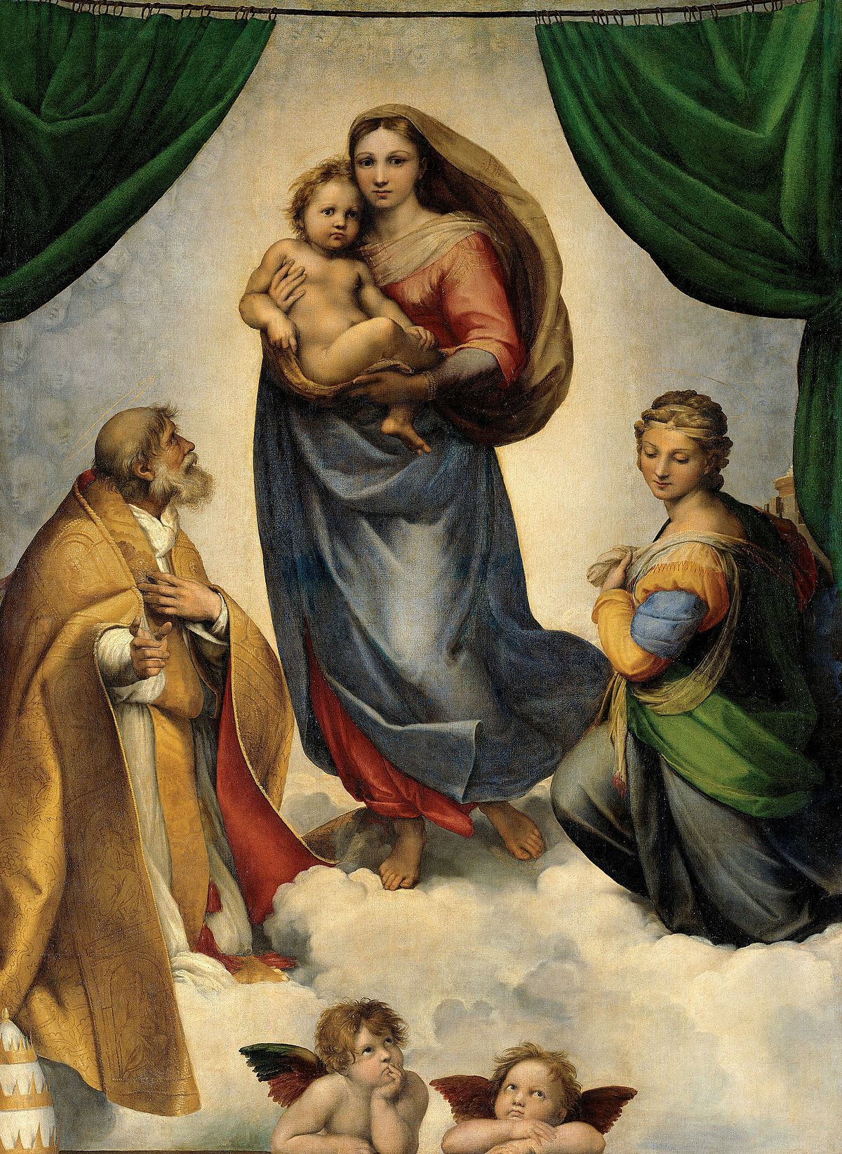
Raffaello, Madonna Sistina (Dresda)
‹#›

Slide 20
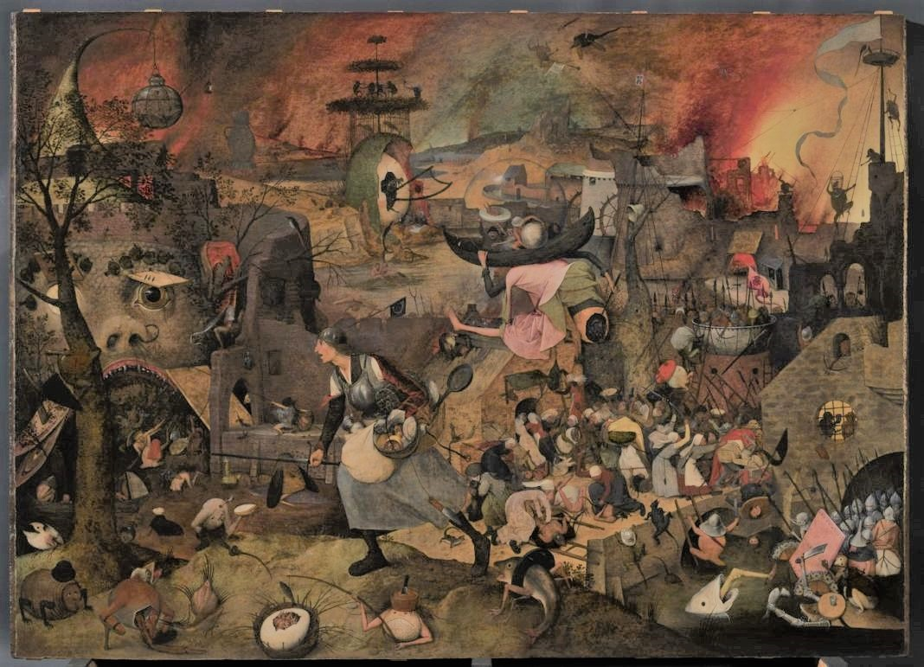
Pieter Bruegel, Dulle Griet (Antwerp)
‹#›

Slide 21
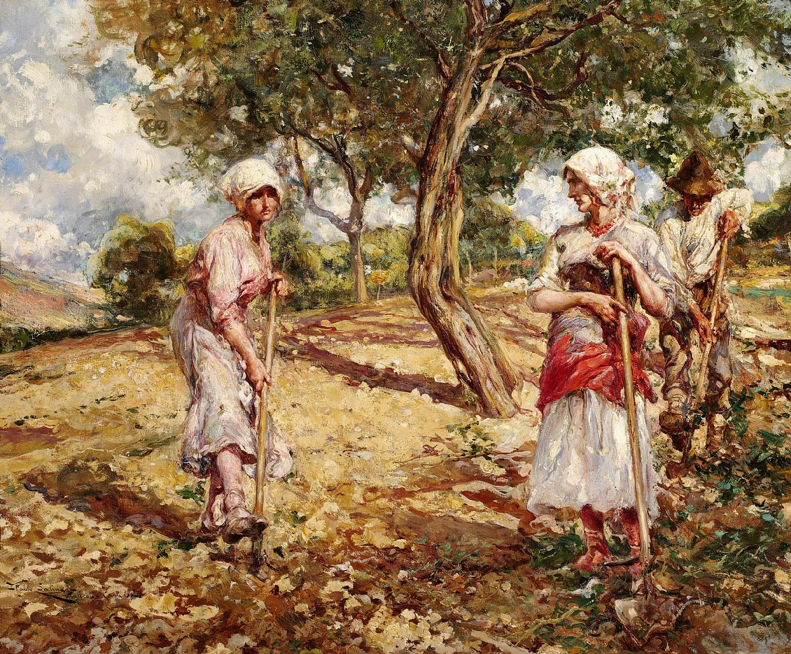
What was everyday life like?
peasants
‹#›

Slide 22
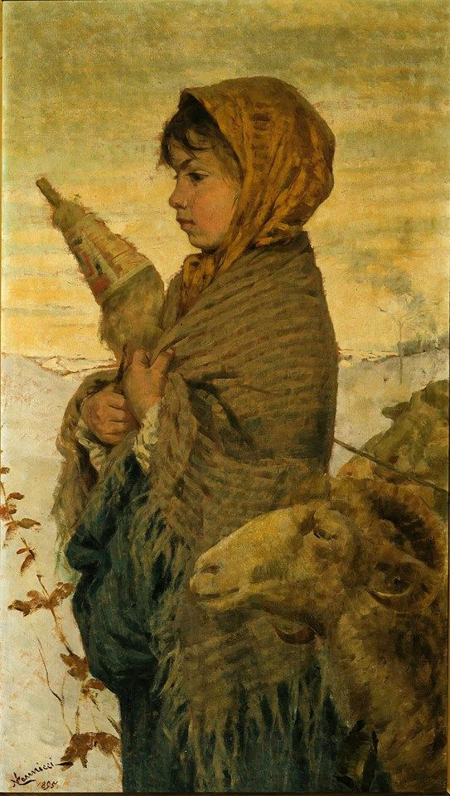
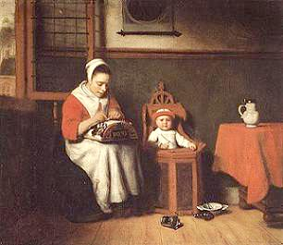
What was everyday life like?
spinners
lacemakers
‹#›

Slide 23
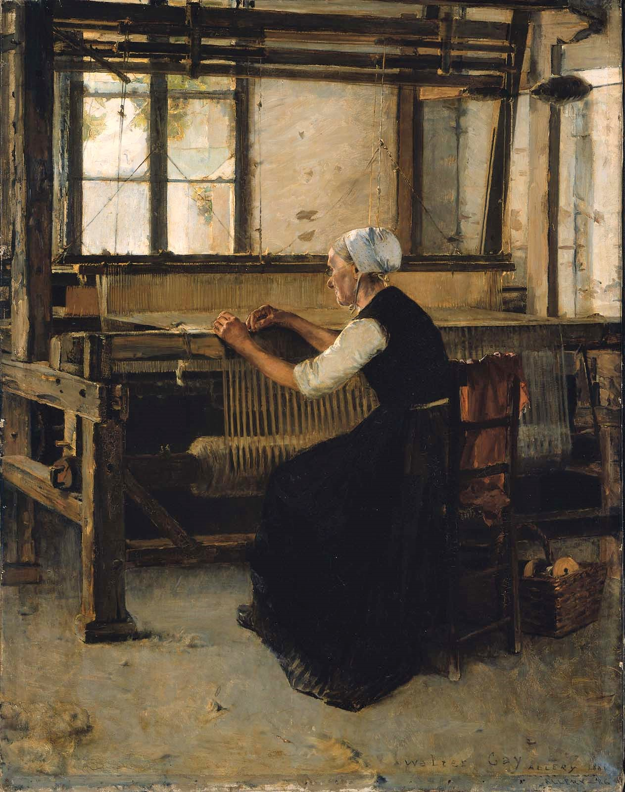
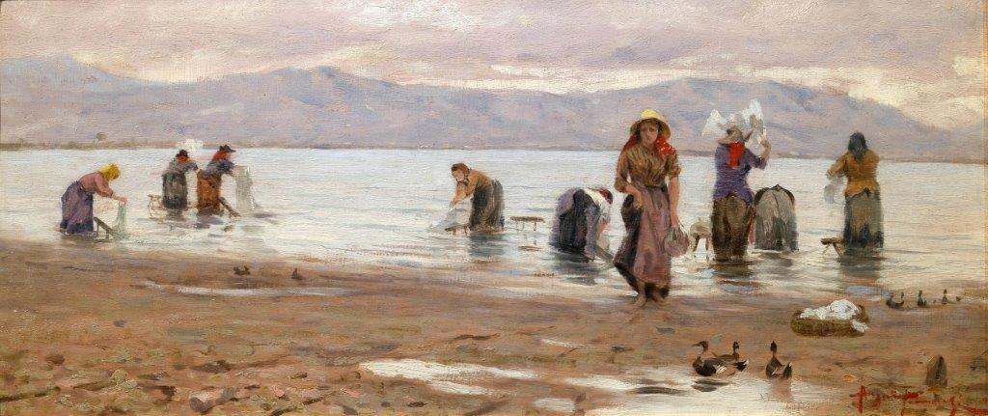
What was everyday life like?
washerwomen
weavers
‹#›

Slide 24
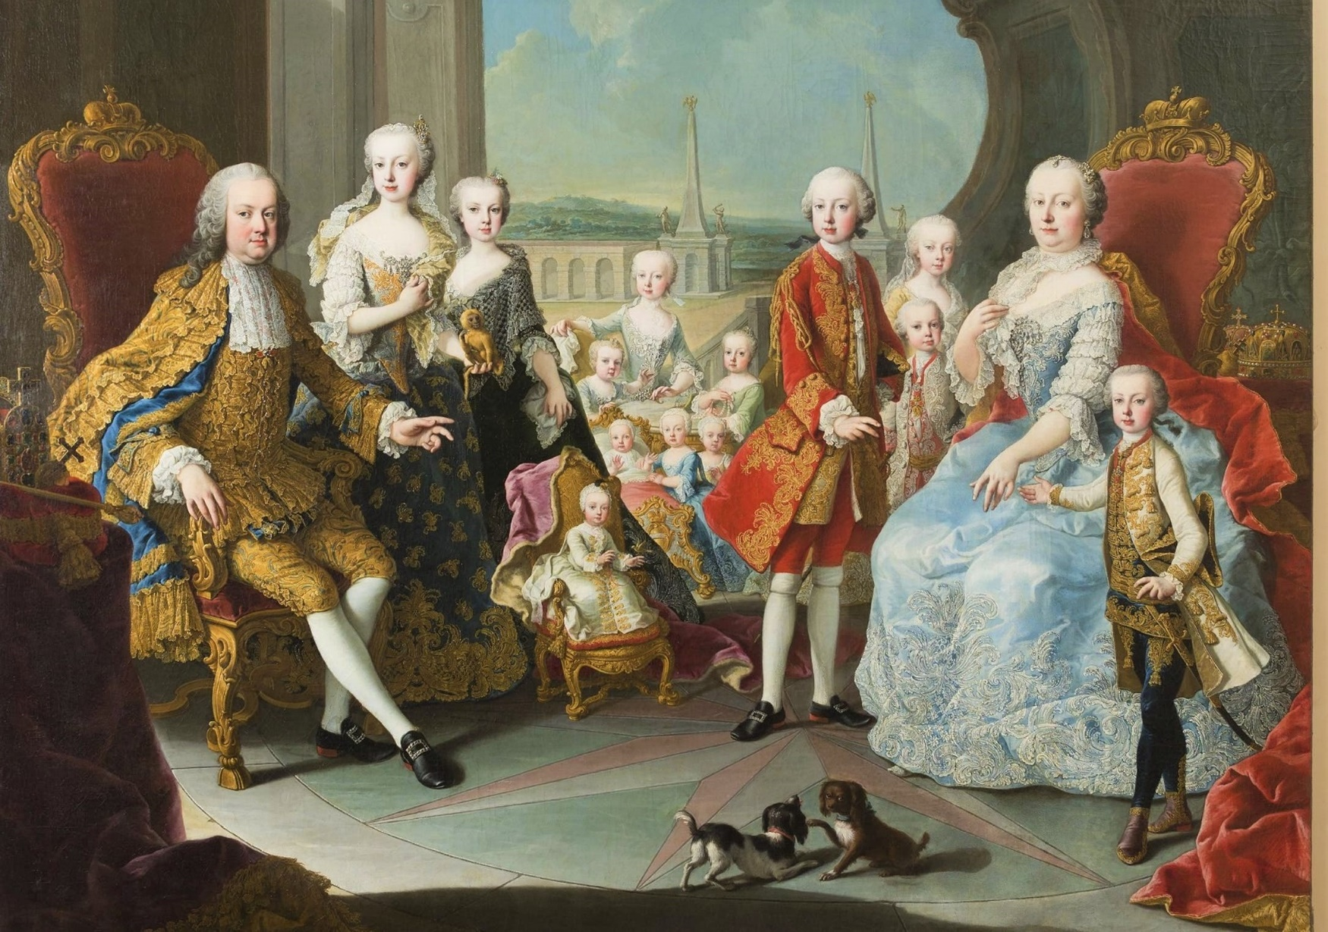
What was everyday life like?
mothers
‹#›

Slide 25
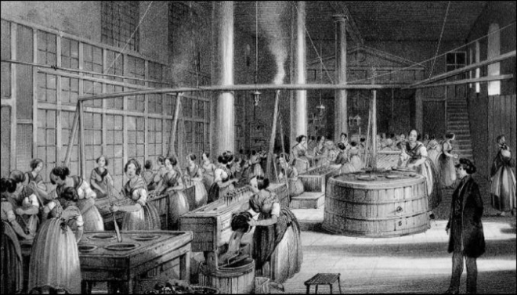
Industrial Revolution
‹#›

Slide 26
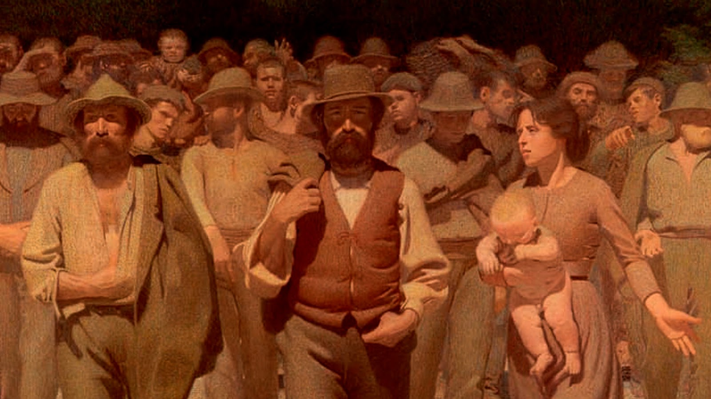
Fighting for rights!
‹#›

Slide 27
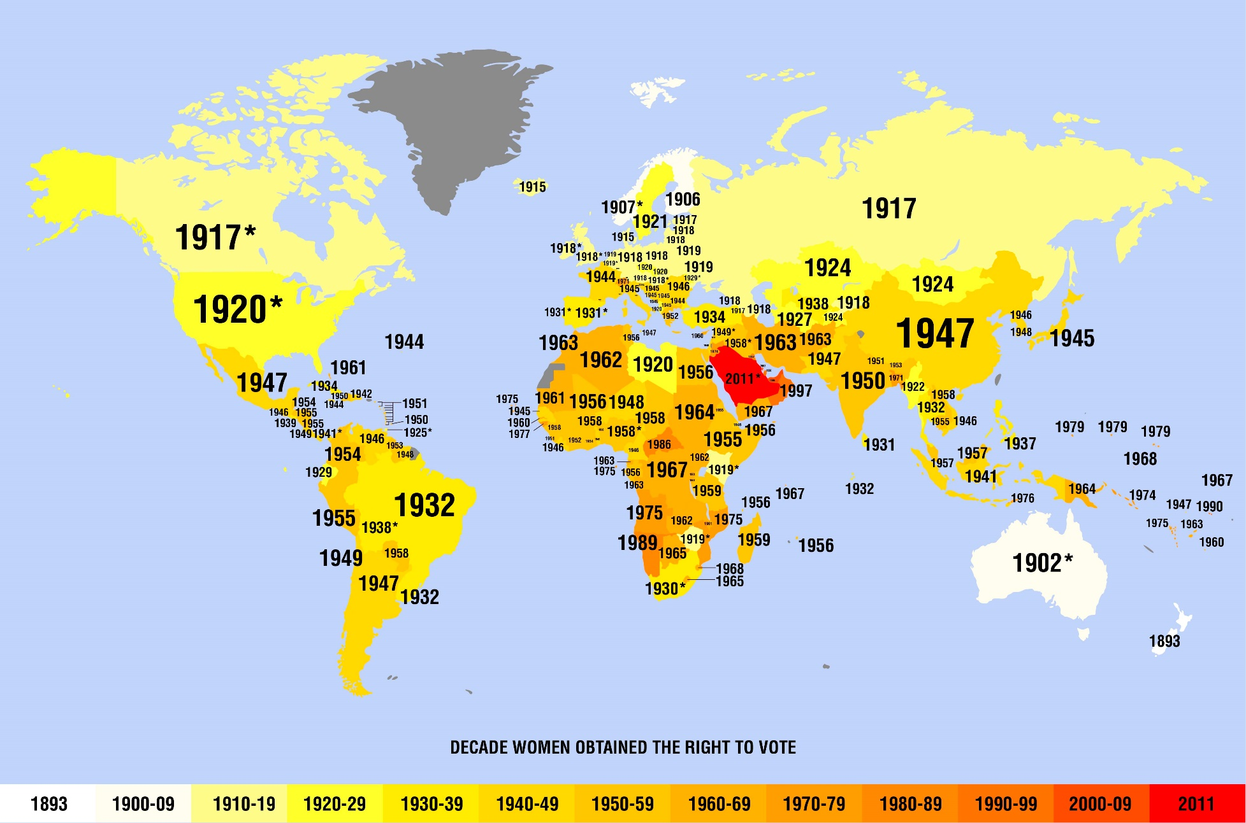
Claiming vote
‹#›

Slide 28
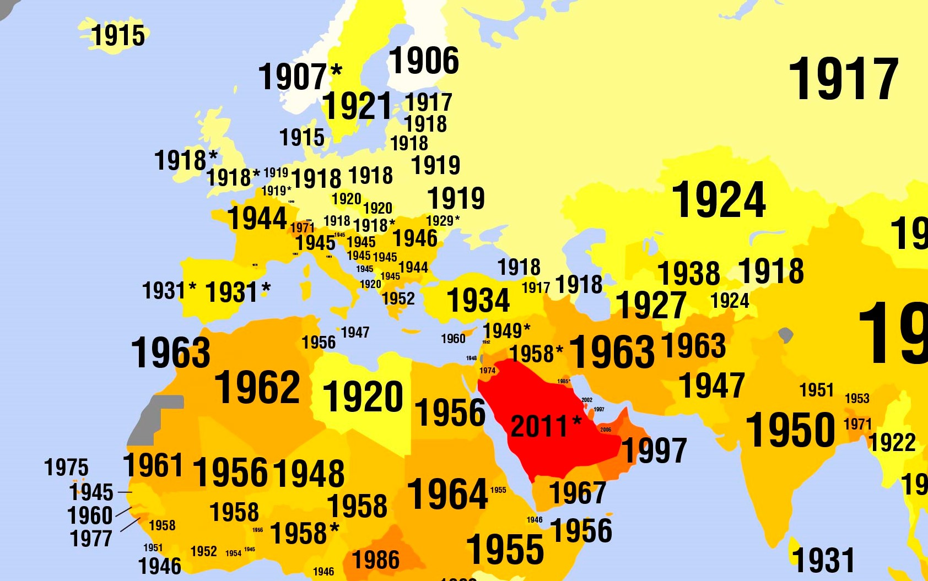
Claiming vote in our countries
‹#›

Slide 29
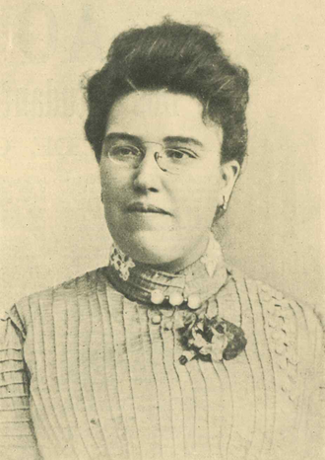
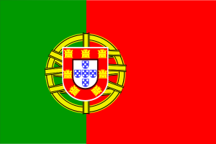
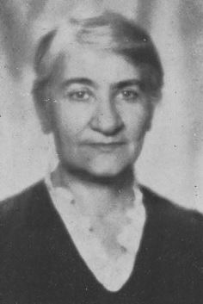
Forerunners
Ana de Castro Osorio (1872-1935)
Feminist, political activist
Anna Apostolaki (1880-1958)
Archaeologist, museums director
‹#›

Slide 30
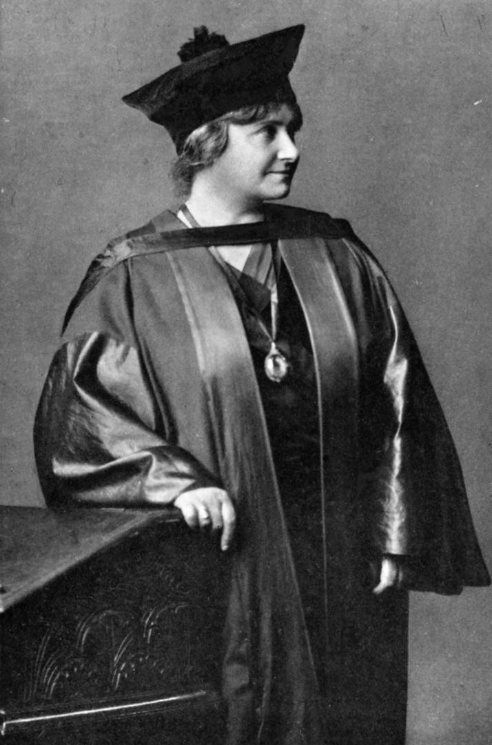
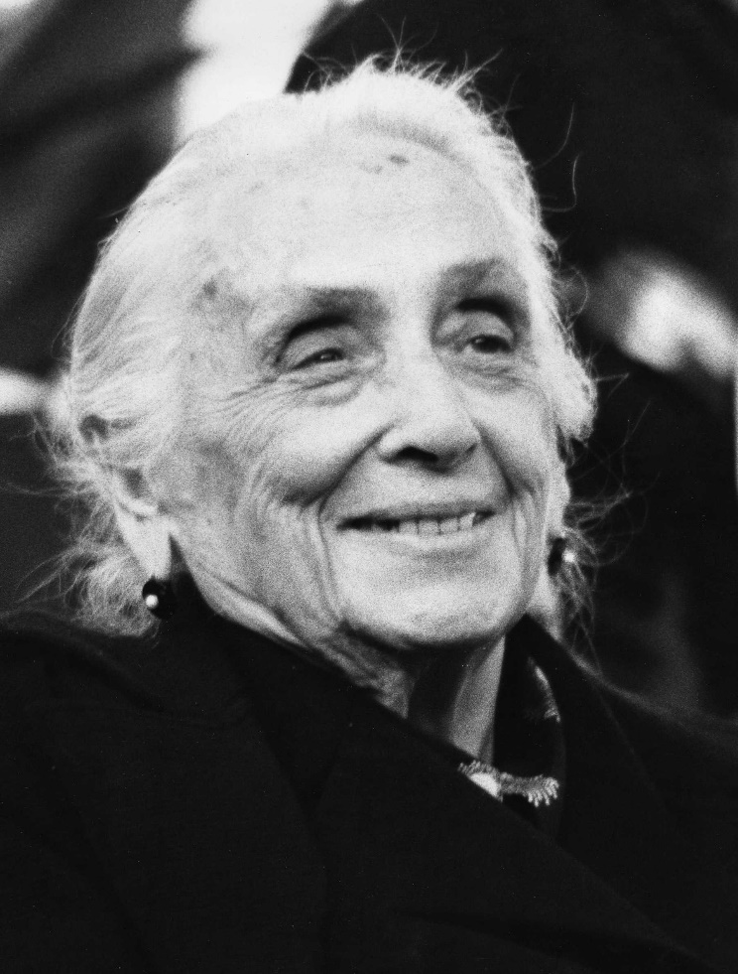
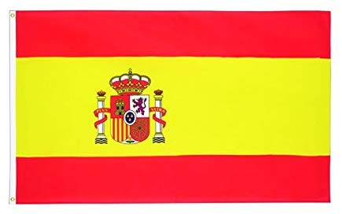
Forerunners
Dolores Ibarruri (1895-1989)
The Passionflower»
Heroin of the Spanish civil war
Maria Montessori (1870-1952)
Physician, educator, pedagogist
‹#›

Slide 31
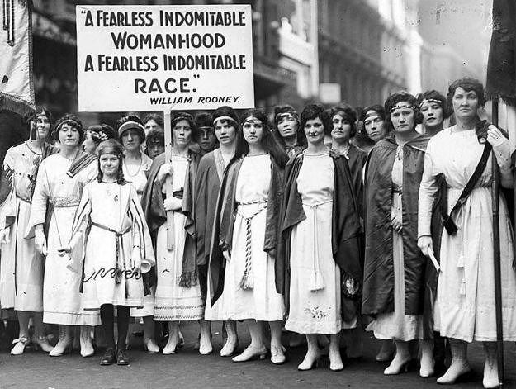
8th March from 1909 on: Woman’s Day
‹#›

Slide 32
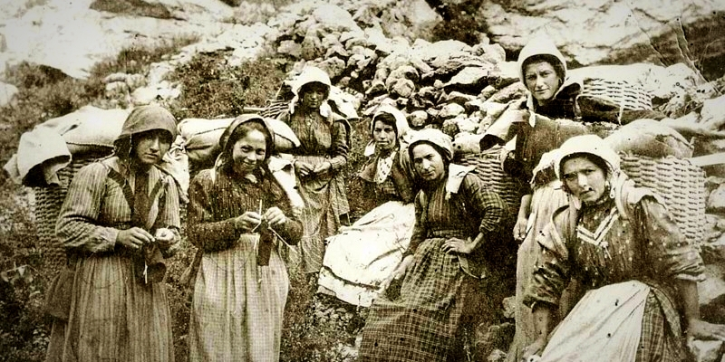
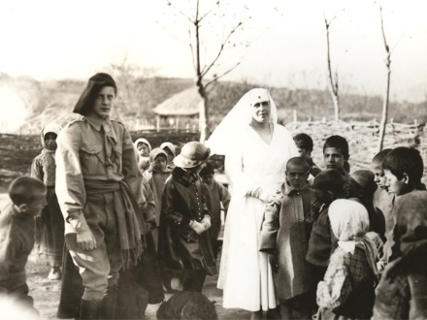
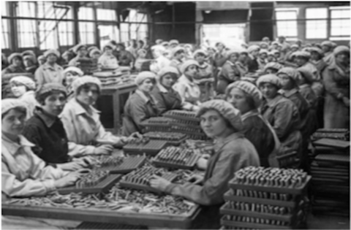
1st World War
Nurses, carriers, workers in factories in place of men sent to the war front
‹#›

Slide 33
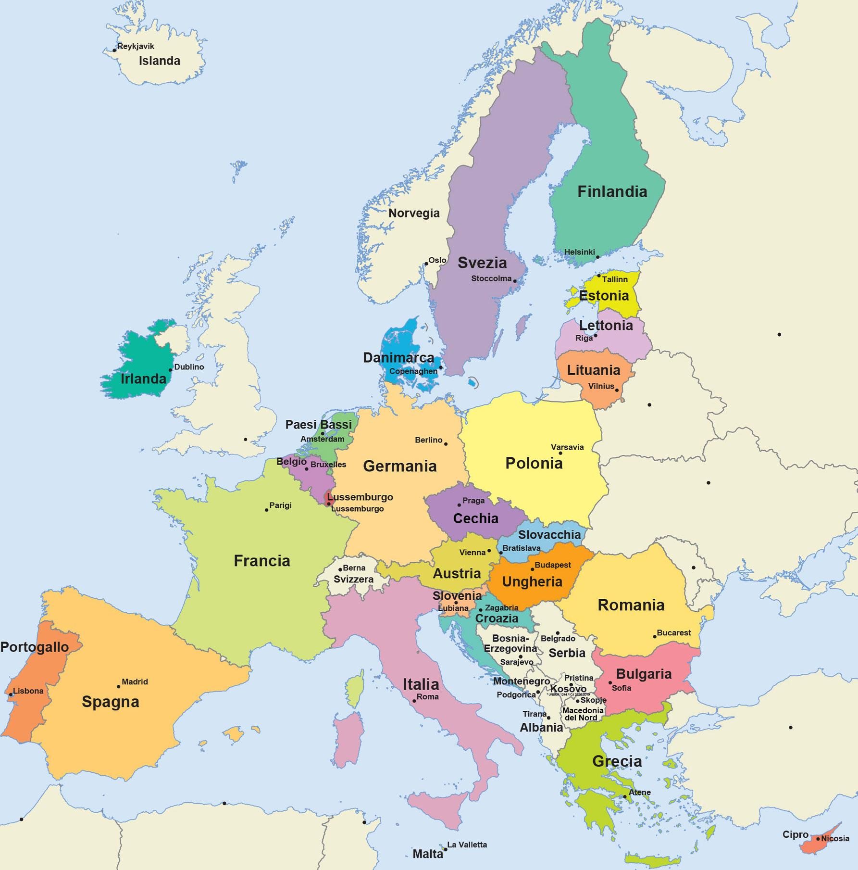
Our
common
present
European Union
‹#›

Slide 34
After 2nd World War after the end of illiberal regimens after the economic development
‹#›

Slide 35
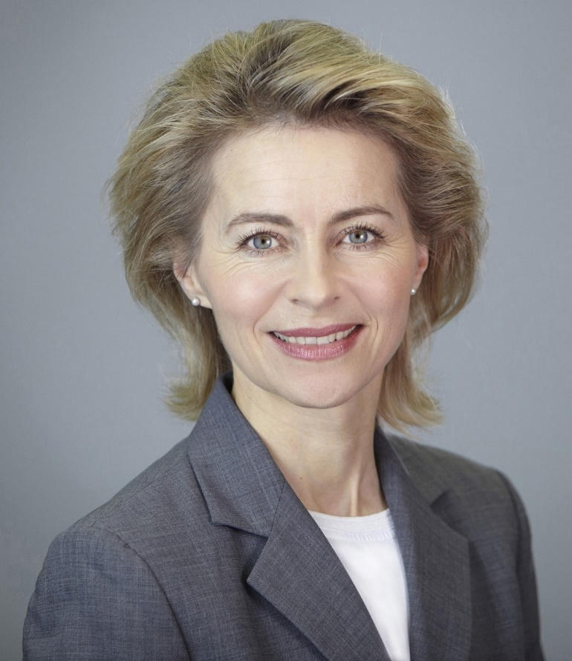
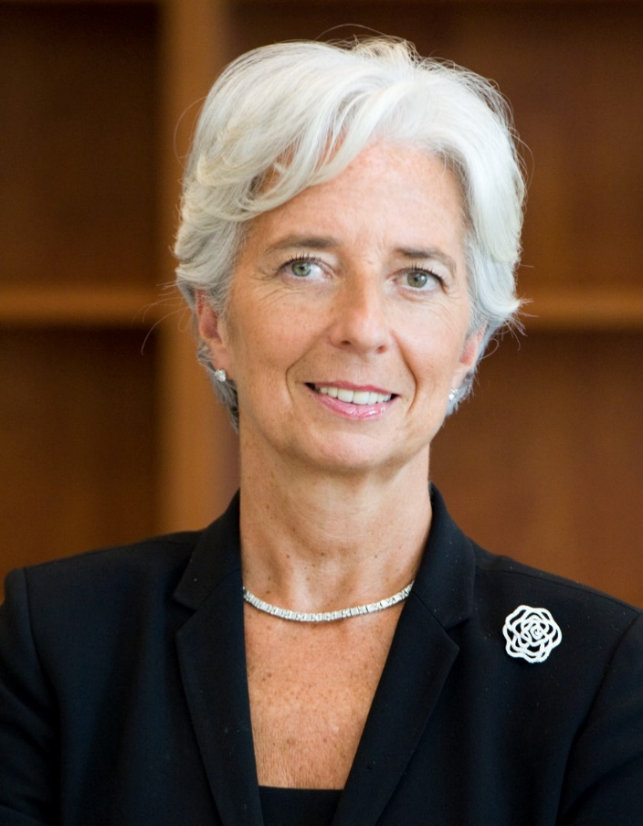
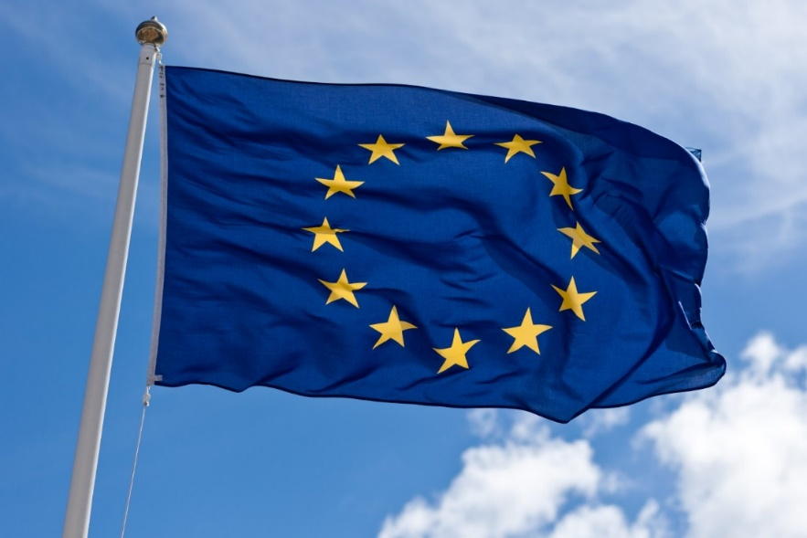
Nowadays
Ursula von Der Leyen
President
of the European Commission
Christine Lagarde
President
Of the European Central Bank
‹#›

Slide 36
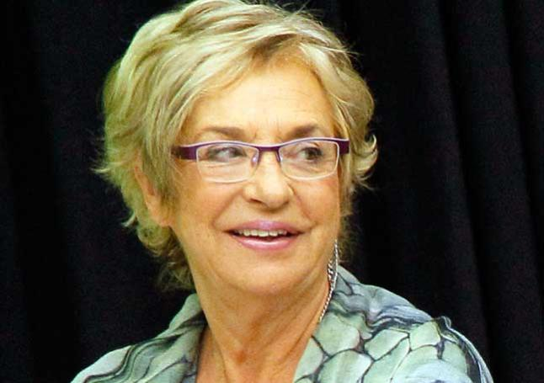
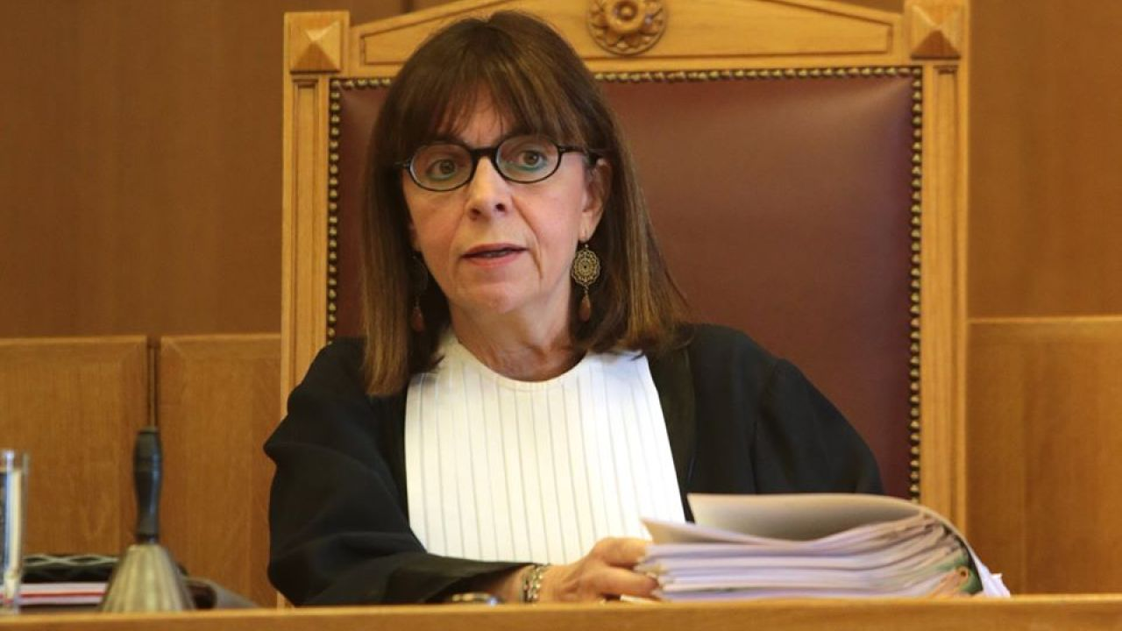
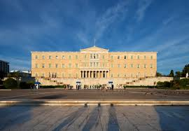
Nowadays
Ekaterini Sakellaropoulou
Greek Republic President
Rosalìa Mera Goyenechea
Spanish entrepreneur
‹#›

Slide 37
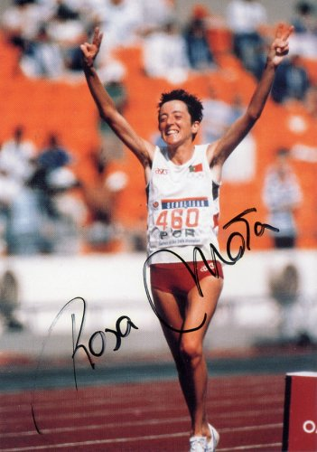
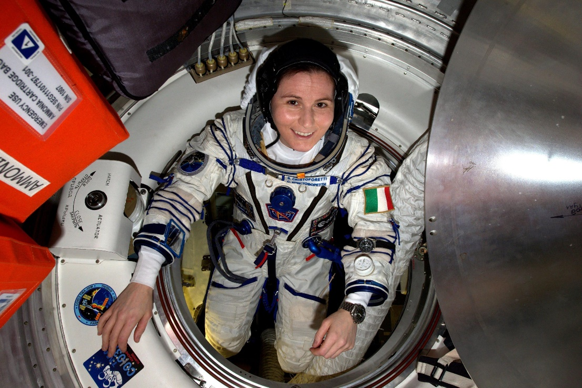
Nowadays
Samantha Cristoforetti
Pilot, engineer, European Space Agency astronaut
Rosa Mota
First female Olympic gold
Olympics-World-European Marathon Champion
‹#›

Slide 38
to conclude
‹#›

Slide 39
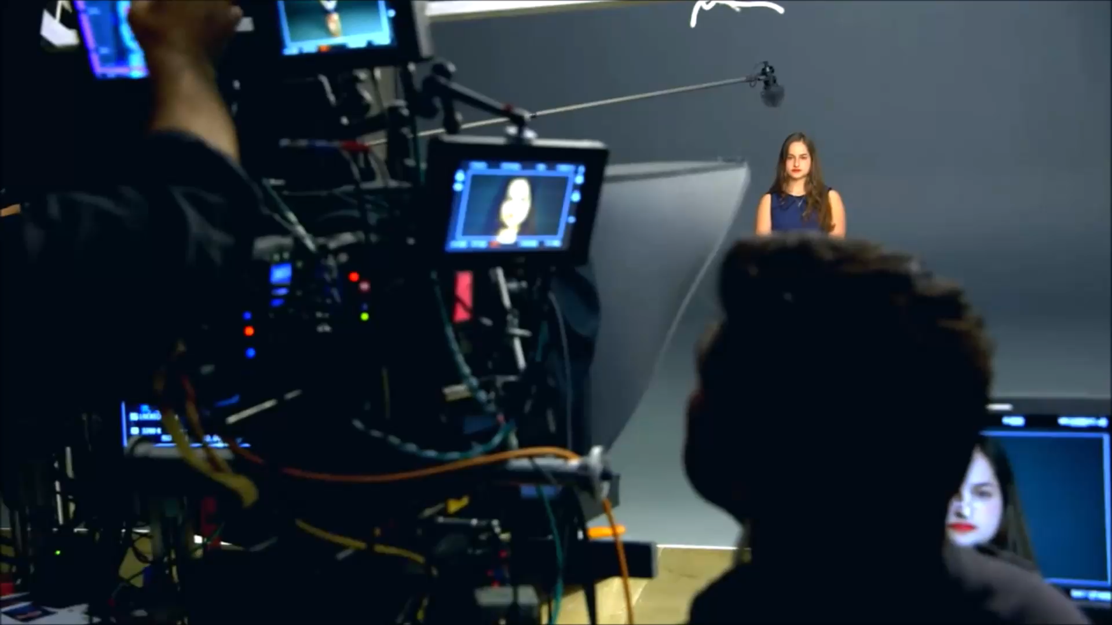
‹#›

Slide 40
Thank you
2nd meeting
Women who made a difference
Istituto Comprensivo Perugia 3, Perugia, Italy
24-28 February 2020
‹#›

