Slide 2
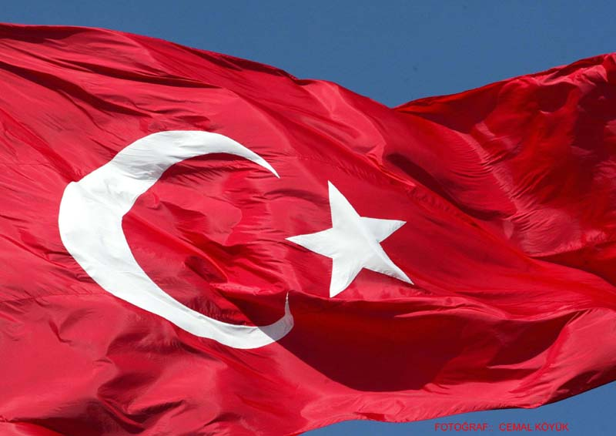
TURKISH FLAG

Slide 3
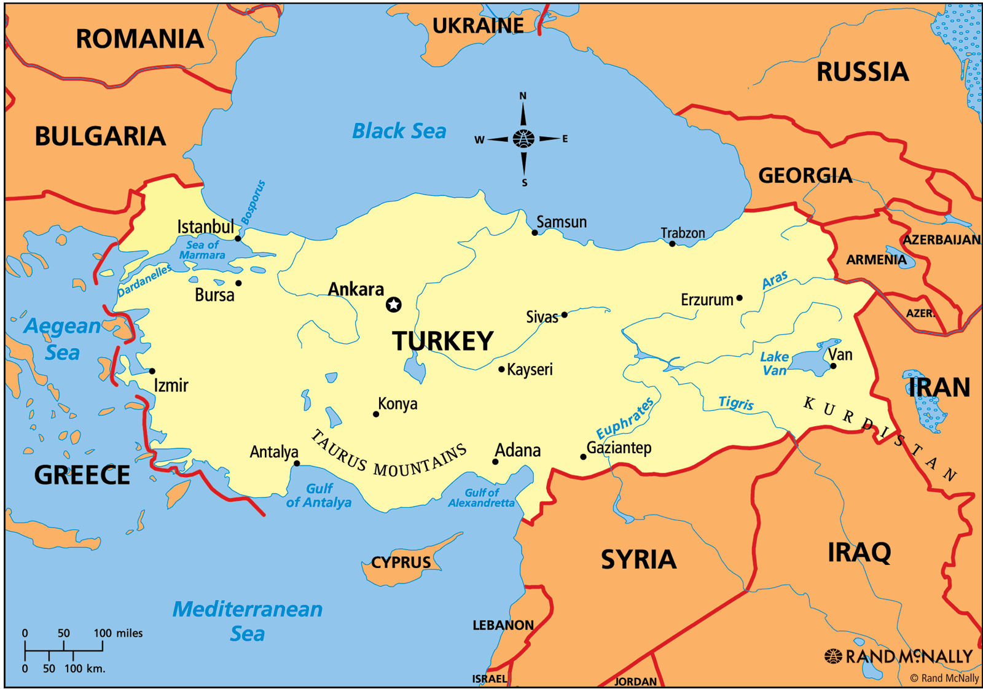
75 million people live in Turkey.

Slide 4
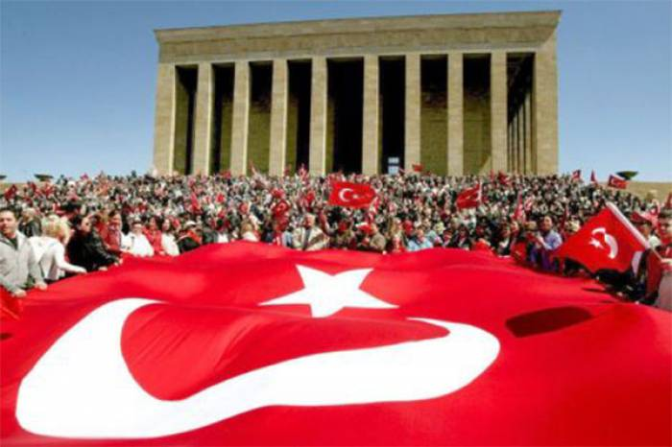
Ankara is the capital of Turkey

Slide 5
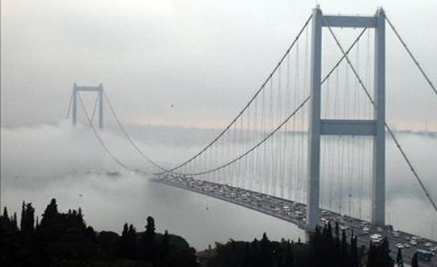
This Bosphorus Bridge connects Asia and Europe.It is in Istanbul.

Slide 6
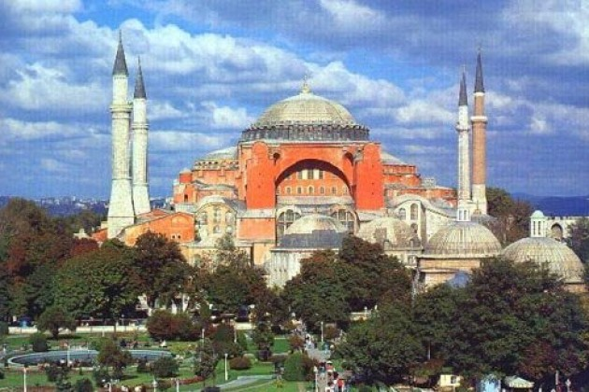
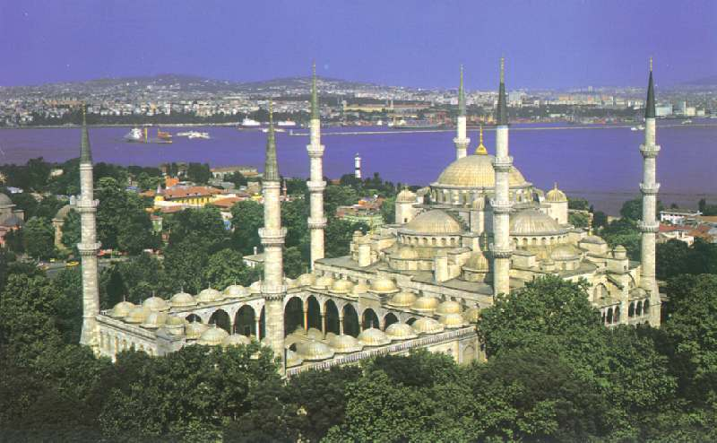
Our religion is Islam. There are many mosques in Turkey.

Slide 7
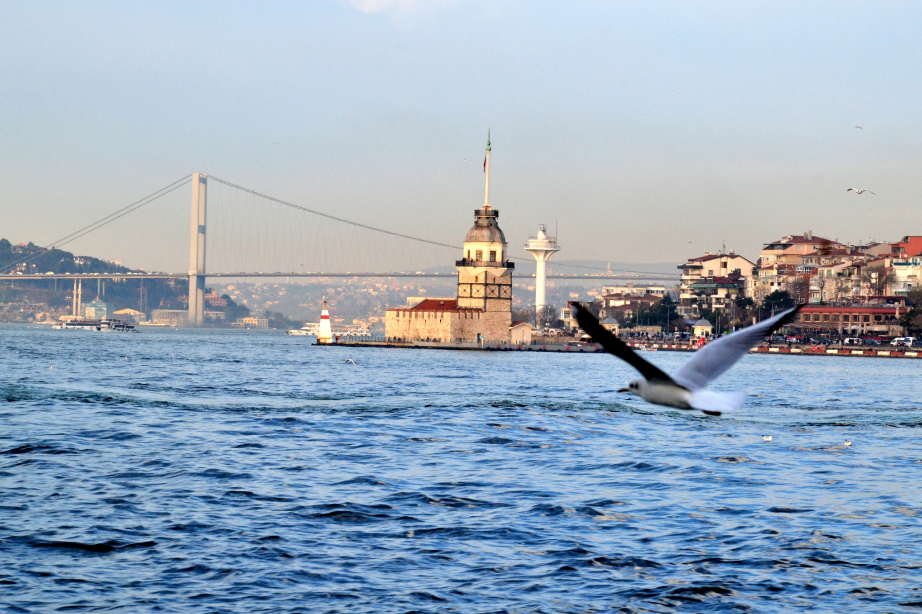
Istanbul is the most famous,the most beautiful and the most crowded city of Turkey.

Slide 8
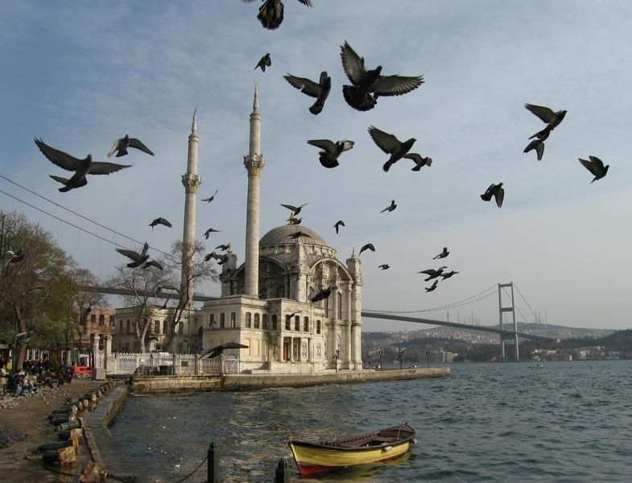
15 million people live in Istanbul and it is more crowded than many European
Coıntries.

Slide 9
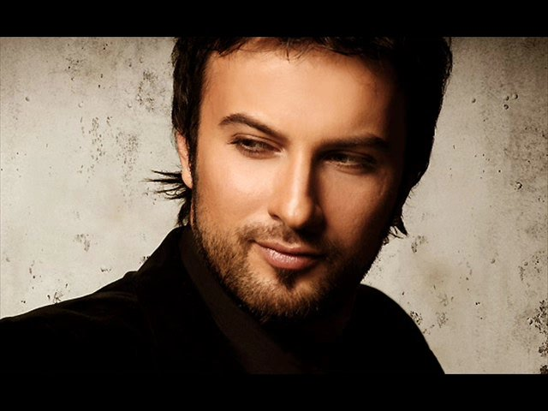
Tarkan (on the left) and Hadise (on the right) are famous Turkish singers.

Slide 10
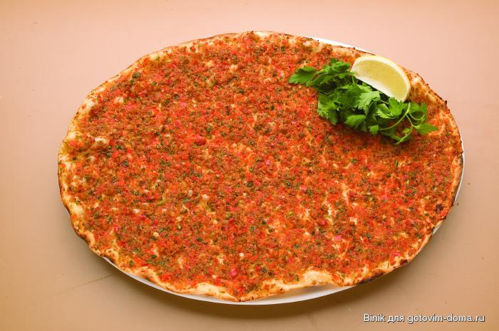
Lahmacun (above) and kebab (on
The left) are Turkish traditional
foods.

Slide 11
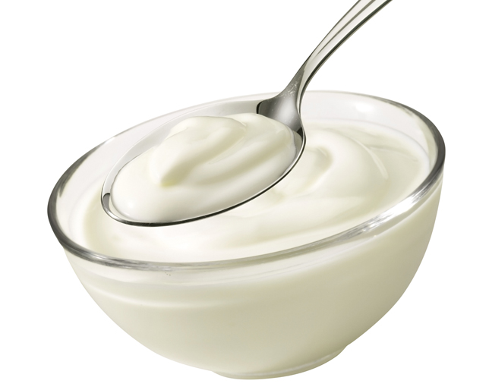
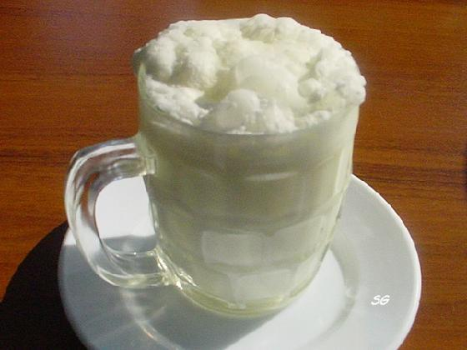
Yogurt is originated from Turkey and we eat it nearly with every meal.
We make Ayran from yogurt putting a bit water and salt in yogurt.

Slide 12
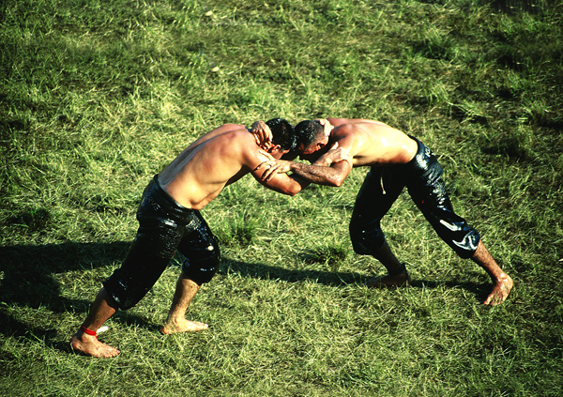
Wrestling is our traditional sport.

Slide 13
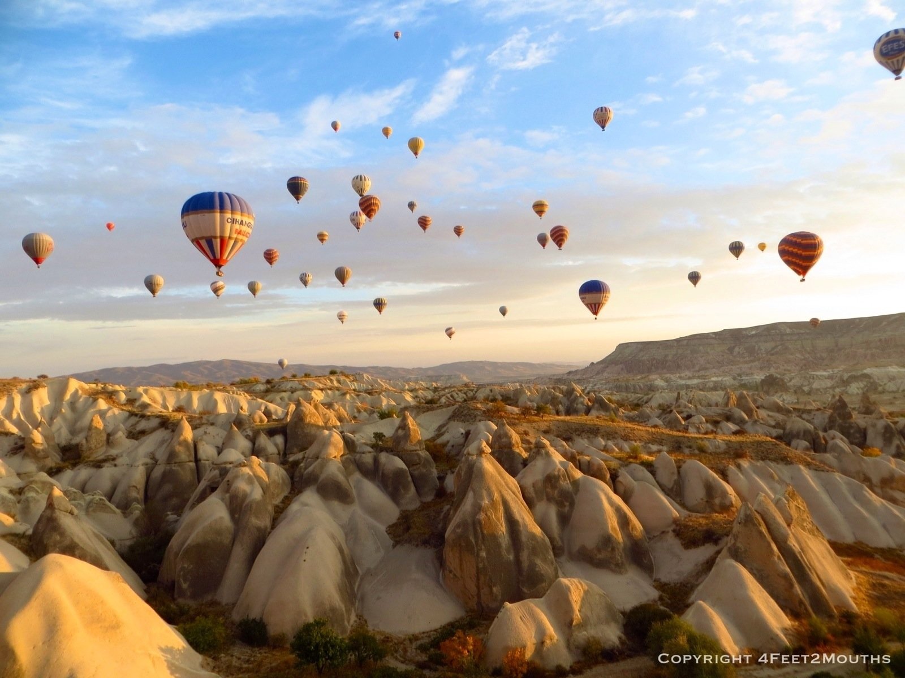
Air Balloons at Cappadocia

Slide 14
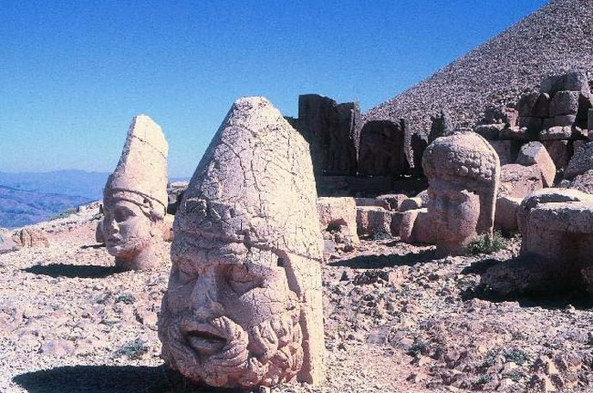
The Gods on Mount Nemrut
Dates back to 50 BC

Slide 15
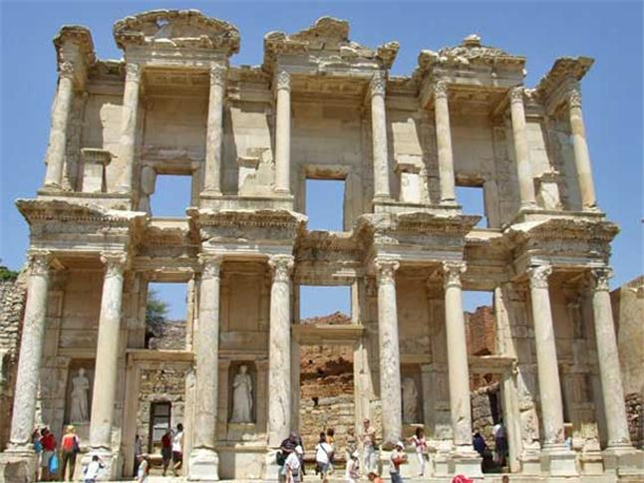
Ephesus the ancient city

Slide 16
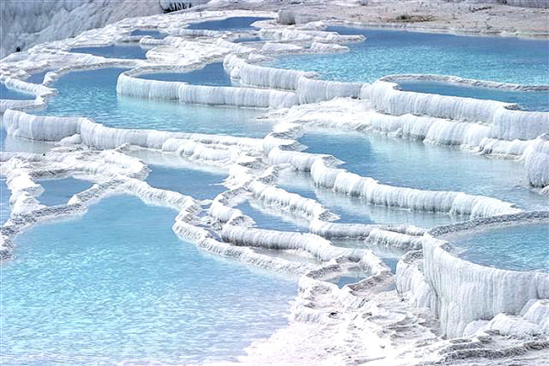
Pamukkale (Cottoncastle)

Slide 17
