Slide 1
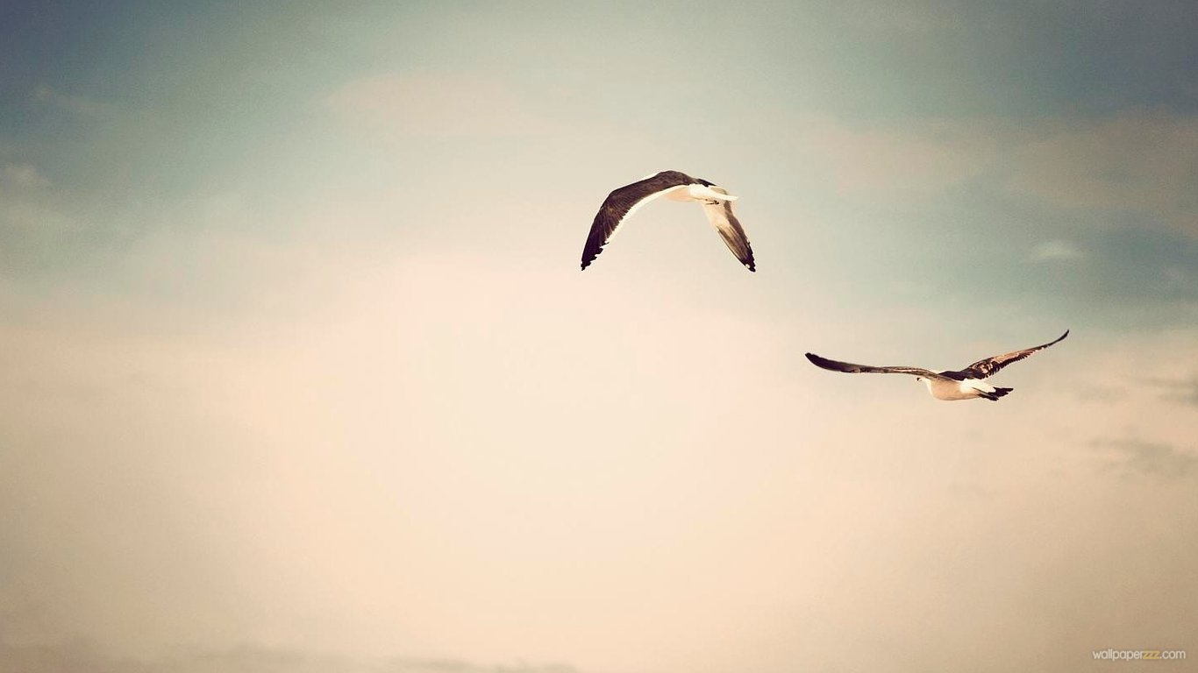
Freedom

Slide 2
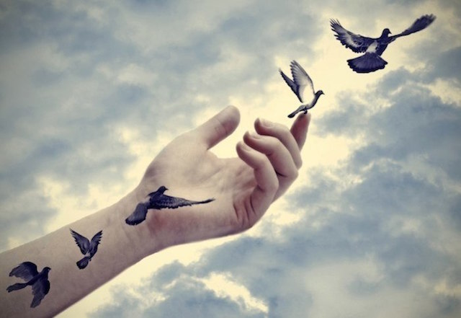
Freedom is...
one of the core societal values
- choose a religion
- say our own opinions
- Political freedom - the ability of man to realize their goals and reach goals within the company.

Slide 3
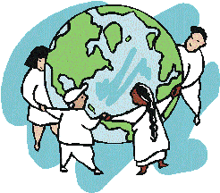
Freedom in countries

Slide 4
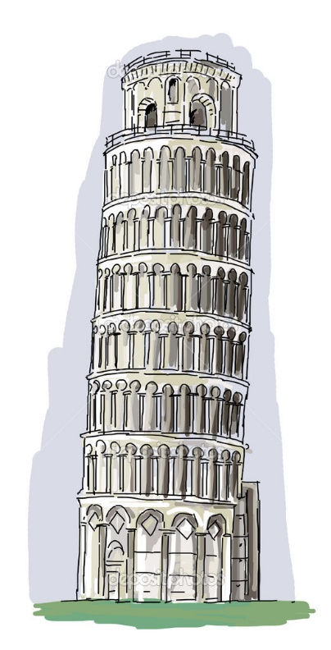
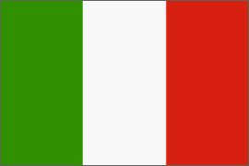
Italy
-Kids in Italy can't go outside whenever they want. Until 14 years old. But in Slovakia we have to just ask our parents to go out and we can ,already as small children .
London
-In London kids can't go from the school to home alone. Until 15 years old.

Slide 5
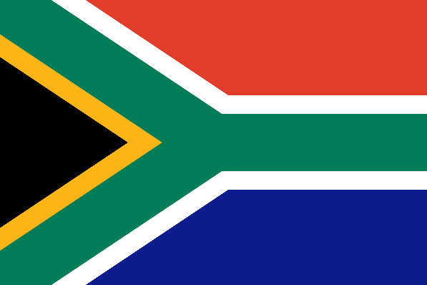
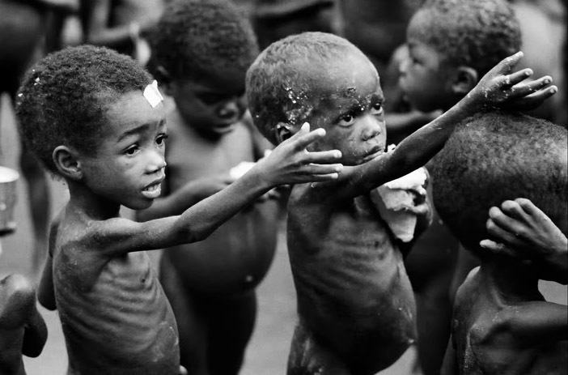
Africa
-Kids from Africa haven't got freedom, hungry person isn't free because he would do everything for food.

Slide 6
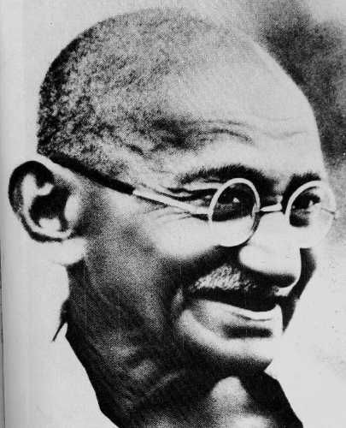
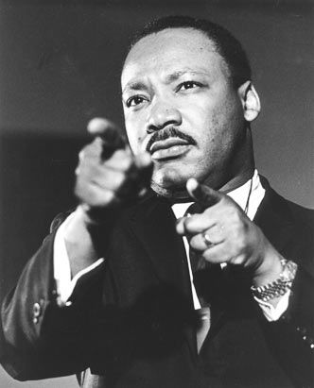
People who fought for freedom .
Nelson Mandela
Gándhí
Martin Luther King Jr.

Slide 7
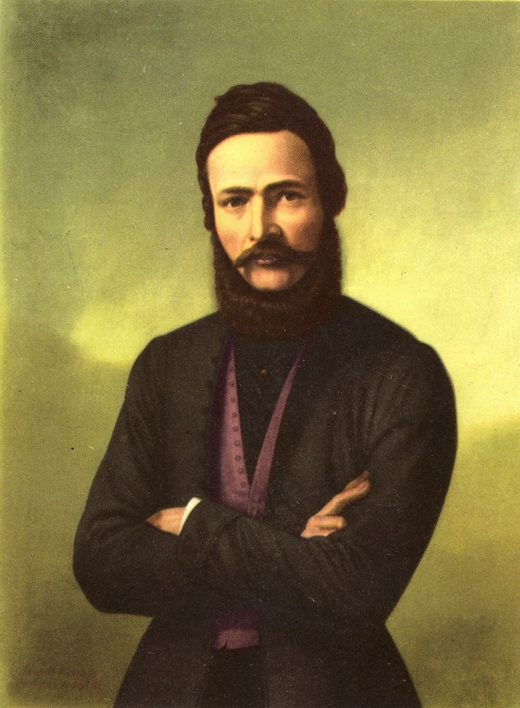
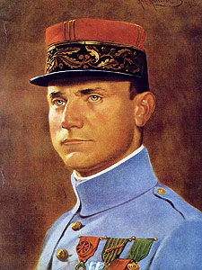
People who fought for freedom –Slovak people

Slide 8
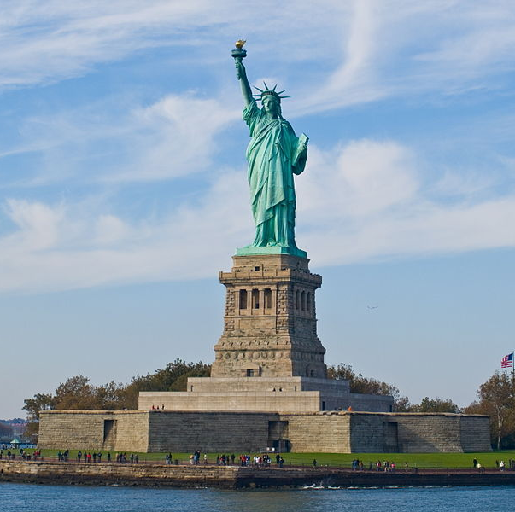
Statue of Liberty
People built this statue in NYC 4.7.1776 - the day the Declaration of Independence
Statue of Liberty reminds friendship and helps granted by France to American settlers.
- In left hand a statue holds torch and her crown has got seven rays and this is symbol of freedom.

Slide 9
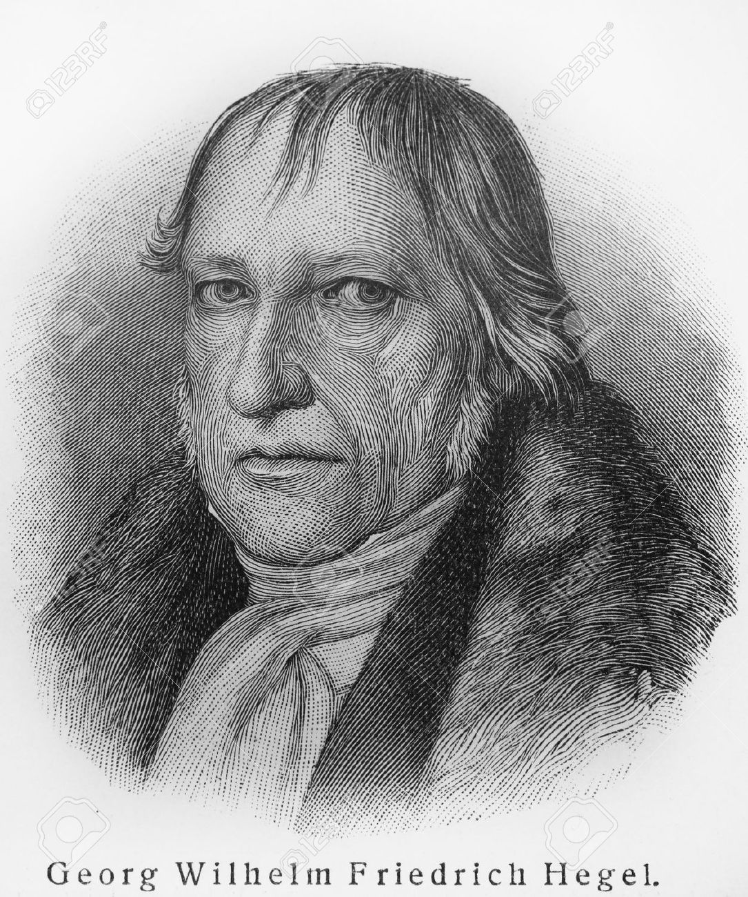
''The essence of human is freedom „
Freedom is simple word, for the most people is freedom the opportunity to do what they want and decide how they want. But what does freedom in the real life mean? The problem of the most people is mind. Do you feel free?

Slide 10
What does freedom mean?
-J<- I think that freedom is feeling. Everybody should feel this feeling. Everybody should be free. Be free means that I can say whatever I want (of course just with decent way).
-F<- Every person in the world should be free. Freedom has got a lot of kinds.Feel of freedom is something unwritable. For me are Symbols of freedom simply Slovakia‘s nature .
-D<- Freedom means do whatever you want to do and nobody can say me what I have to do.
-I<-For me is freedom like jump from the reef. While you are jumping you feel just adrenaline and free. Freedom is option do things which you want to do.

Slide 11
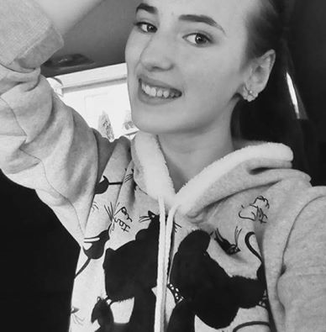
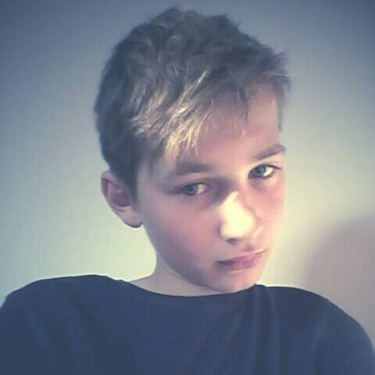
What does freedom mean for our closer friends.
My name is Sabina, I‘m 14 years old and I think that freedom for teenegers means be outside how much we want to be, say our views but sometimes we don't care about the way we say some things.
My name is Jakub , I‘m 12 years old and be free means do whatever we want to do.

Slide 12
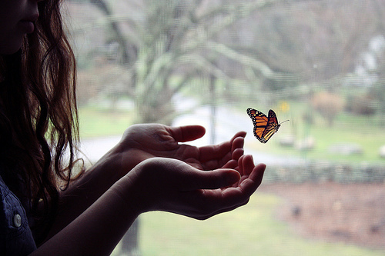
Thanks for watching !

