Slide 1
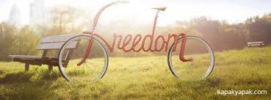
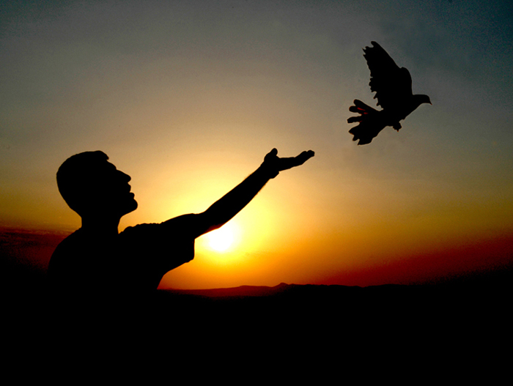
FREEDOM

Slide 2
Freedom=to be independent
Freedom =do not live under the oppression
Freedom=use your own will

Slide 3
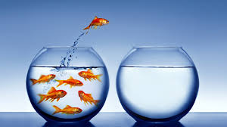
Freedom is the most important and indispensable notion in our life. Nobody wants to be governed by the other. Nobody accepts to be forced.

Slide 4
If all affecting situations of people are examined , freedom is the most important. Because what means non free person is that he/she doesn’t have connection to life . People who is under oppression by someone else actually can not live. Because they do other’s requests,but not theirs.

Slide 5
All of the people have rights which are innate. These rights keep freedom and equality. People are equal irrespective of language,religion, race and people are freedom. People say their ideas, take decisions and realize their decisions owing to freedom. Nobody does not have a right to block other people’s freedom .

Slide 6
Besides them all, we should remember when someone’s freedom starts, the other’s finish. Freedom is everyone’s happiness.

Slide 7
FREEDOM
We live as a free nation or die.
Abraham Lincoln
Freedom ,history’s indelible sole value.
Albert Camus
Freedom is sweeter than bread, more beautiful than sun.
Mihayloviç Dostoyevski
I give my life for love but I sacrifice my love even for freedom.
Victor Hugo
Freedom is not other than justice.
Voltaire
The only thing we can not have is freedom without giving the other.
William Allen White

Slide 8
Prepared by

