Slide 1
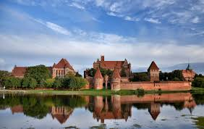
Malbork
Nel Kućmańska
Agata Burnos
Karolina Biernacka
Magda Biernacka

Slide 2
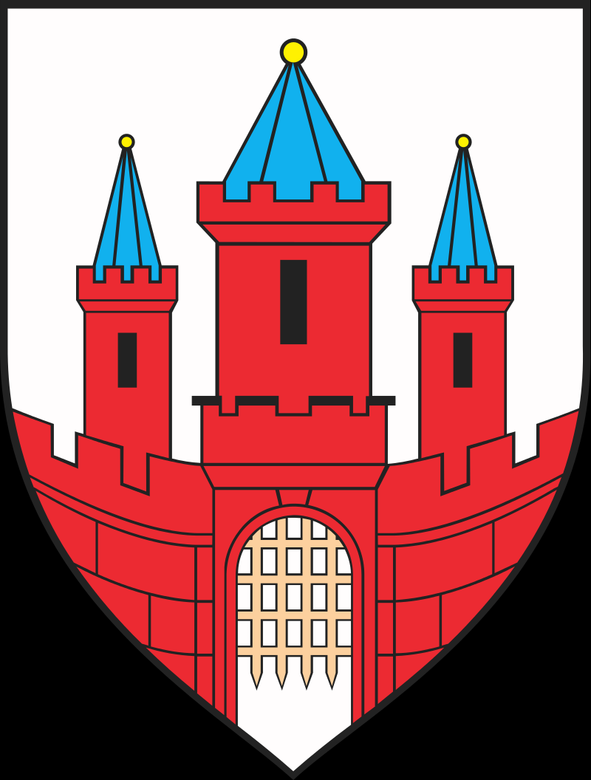
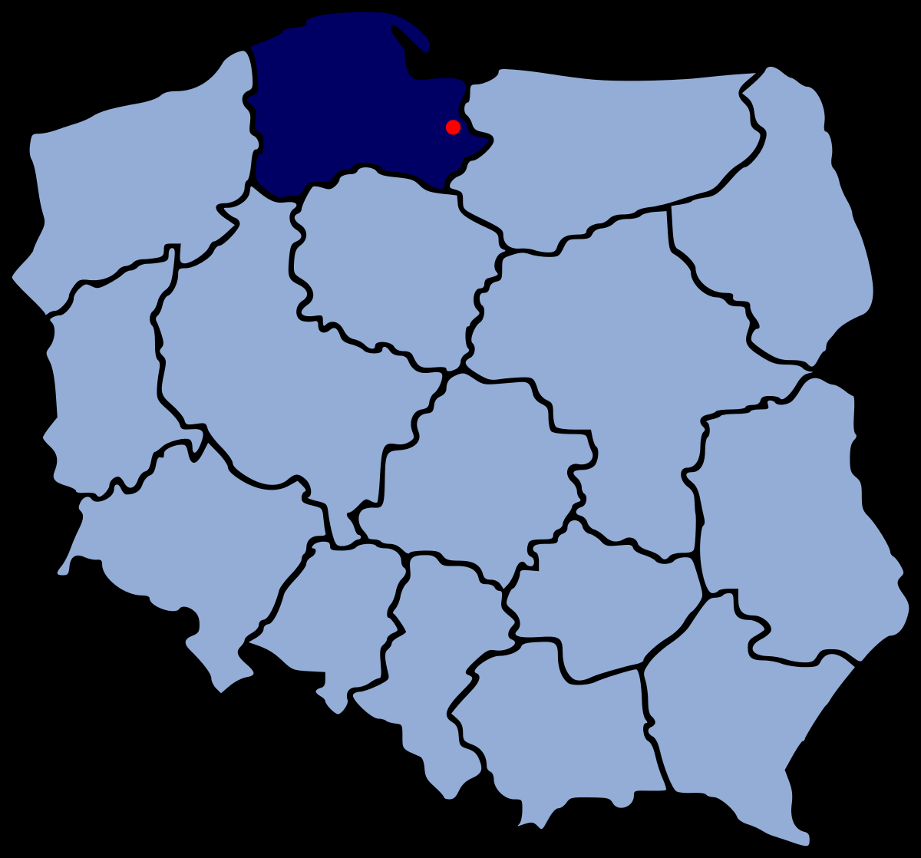
Informations
Malbork is an average size city in the northern Poland, located in the Pomeranian Voivodeship.
In this city 38 723 people live.
Surface is 17,2 km
Symbol Flag Map

Slide 3
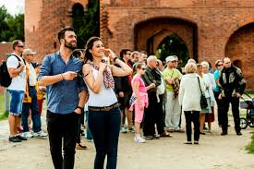
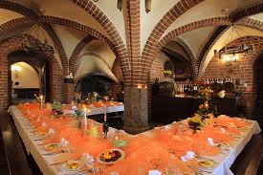
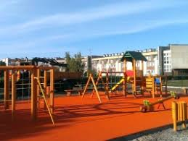
Informations
Every year this city is visited by tourists from all over Poland and Europe.
Malbork is located about 30 km from Elblag.
There are hotels, restaurants, playgrounds throughout the city.
We can also visit great museums for example the Castle Museum.

Slide 4
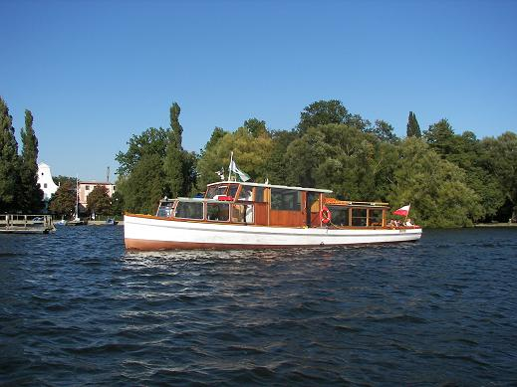
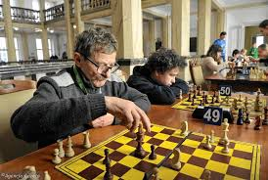
Culture
There is a Malbork Culture and Education Centre and tactical aviation base in the city.
In June, the days of Malbork are celebrated, and in July, the siege of Malbork. You can see knights' tournaments, shows, take part in competitions, and there are stalls around the castle.
Local chess tournaments and music concerts are held here throughout the year.
Malbork, lying on a waterway, offers cruises by boat and water tram. In the summer season, you can bathe in the increasingly clean waters of Nogat and admire the city panorama from a kayak or gondola.

Slide 5
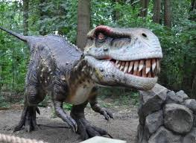
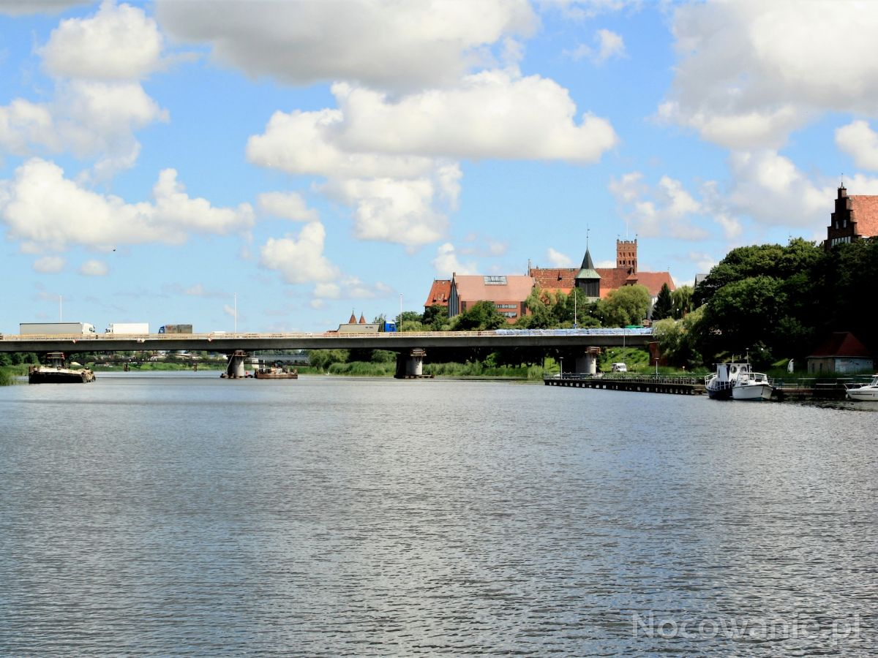
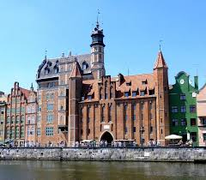
Attractions
Dino Park- entertainment place for the whole family. Park of moving dinosaurs and dragons, 5D Cinema, Mini ZOO, rope park.
Nogat- river, is 62 km. Surrounds the castle in Malbork.
„ Brama Mariacka”-St. Mary's Gate, historic city gate. Built in the XIV century in the Gothic style.

Slide 6
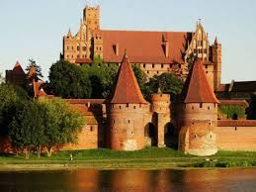
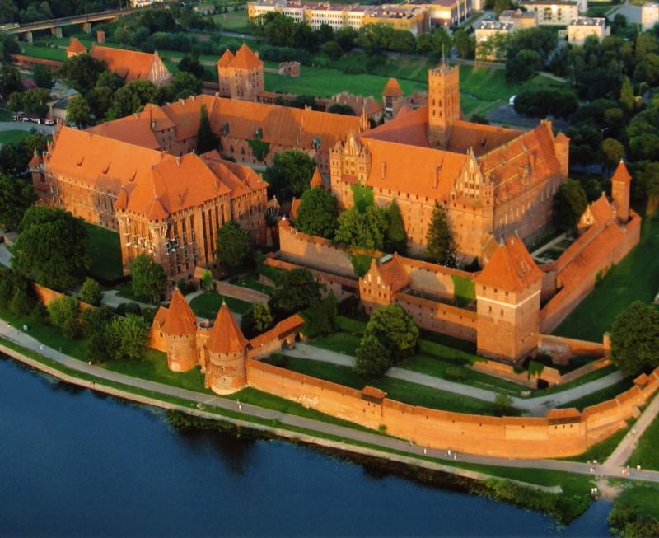
Castle in Malbork
It is the world known castle. It was the castle of the Teutonic Order. It is the largest castle in the world, as far as the area is concerned. It is made of red brick. It has a long and interesting history. It belongs to Poland's official national Historical Monuments. Now there is a huge museum with a lot of fantastic exchibitions of Polish history, royal jewellery, great weapon and military machines.

