Slide 1
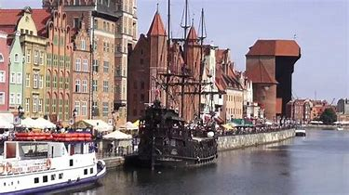
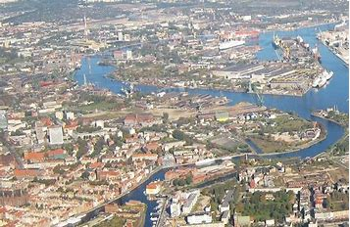
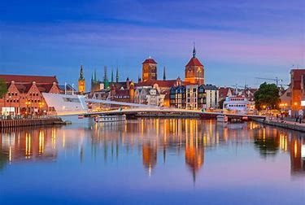
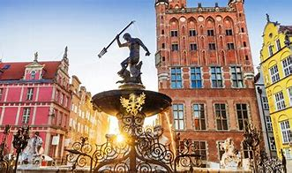
Places in Gdansk worth visiting

Slide 2
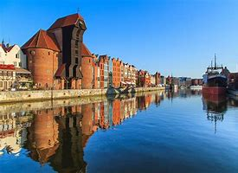
Old Town
The most important historical part of Gdańsk is considered one of the most beautiful complexes of this type in Poland. It consists of two historical districts - the Old and the Main Town, called the Old Town. Here you can see extremely valuable monuments from different periods of architectural styles, created for centuries by artists from around the world.

Slide 3
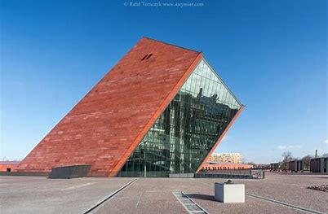
Museum of the Second World War
The museum aims to disseminate knowledge about World War II and to cultivate the memory of its victims and heroes, to be a modern facility in the form and with the exhibition and educational and research activities. The museum is to promote Poland as a country of values and civic attitudes, implementing a program of bringing people closer together.

Slide 4
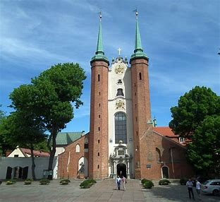
Oliwa Archcathedral
Inside the cathedral there are 23 altars of high historical value, mostly Baroque and Rococo, made partly of marble or its imitation. Their iconographic content reflects the program of the Post-Tridentine church.
The former main altar made in the style of the Dutch Renaissance from 1605 and the present main, most complete baroque work in Pomerania (1688).

Slide 5
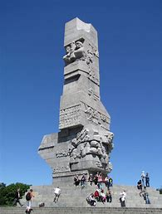
Westerplatte
Westerplatte - a peninsula (formerly an island) formed in 1845–47 in Gdańsk, at the mouth of the Martwa Wisła to the Gulf of Gdańsk. In the years 1926–1939 the Republic of Poland inside the territory of the Free City of Gdańsk, a symbol of the outbreak of World War II.

Slide 6
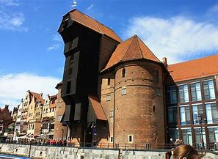
Żuraw
Crane Gate, Crane (German: Krantor) - a historical harbour and one of the water gates of Gdańsk, which is located on the Motława River. It is one of the branches of the National Maritime Museum in Gdańsk and the largest and oldest of the preserved cranes of medieval Europe.

Slide 7
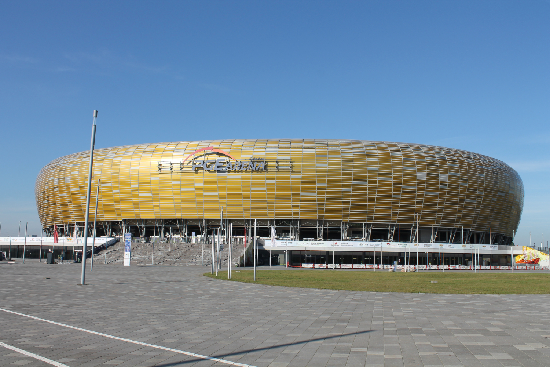
Stadion Energa Gdansk
PGE ARENA Gdańsk - a football stadium in Gdańsk, located in the Letnica district. It is the property of the city of Gdańsk and its main user is the Lechia Gdańsk football club. The stadium was commissioned on July 19, 2011, and the first official match was a meeting between Lechia and Cracovia played on August 14.

Slide 8
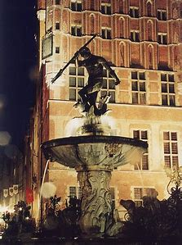
Neptune's fountain
The Neptune Fountain (Kaszb. Krësztof) - a historic fountain in Gdańsk, which was founded on the initiative of the mayor Bartłomiej Schachmann and the city council. It stands in the most representative part of Gdańsk called Długi Targ, in front of the entrance to the Artus Court.

Slide 9
Thanks for watching
By Nela Habyk

