Slide 1
ERASMUS+ PROJECT KA229 2018-20
I AM MY LIFE HERO
SPAIN
CYPRUS
POLAND
ITALY
The Italian breakfast

Slide 2
Come
and
have breakfast
with us!
You are welcome!

Slide 3
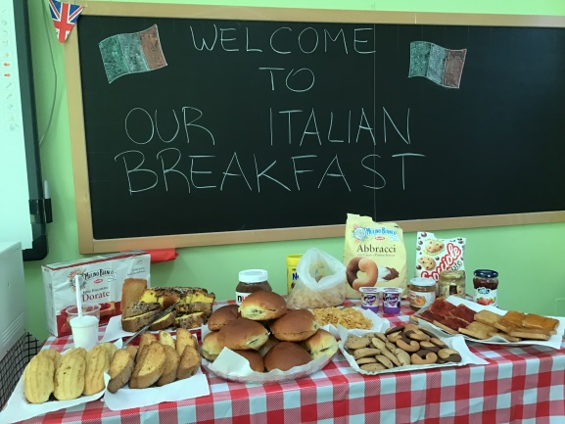
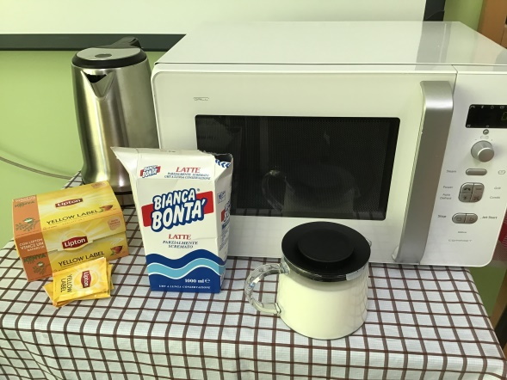
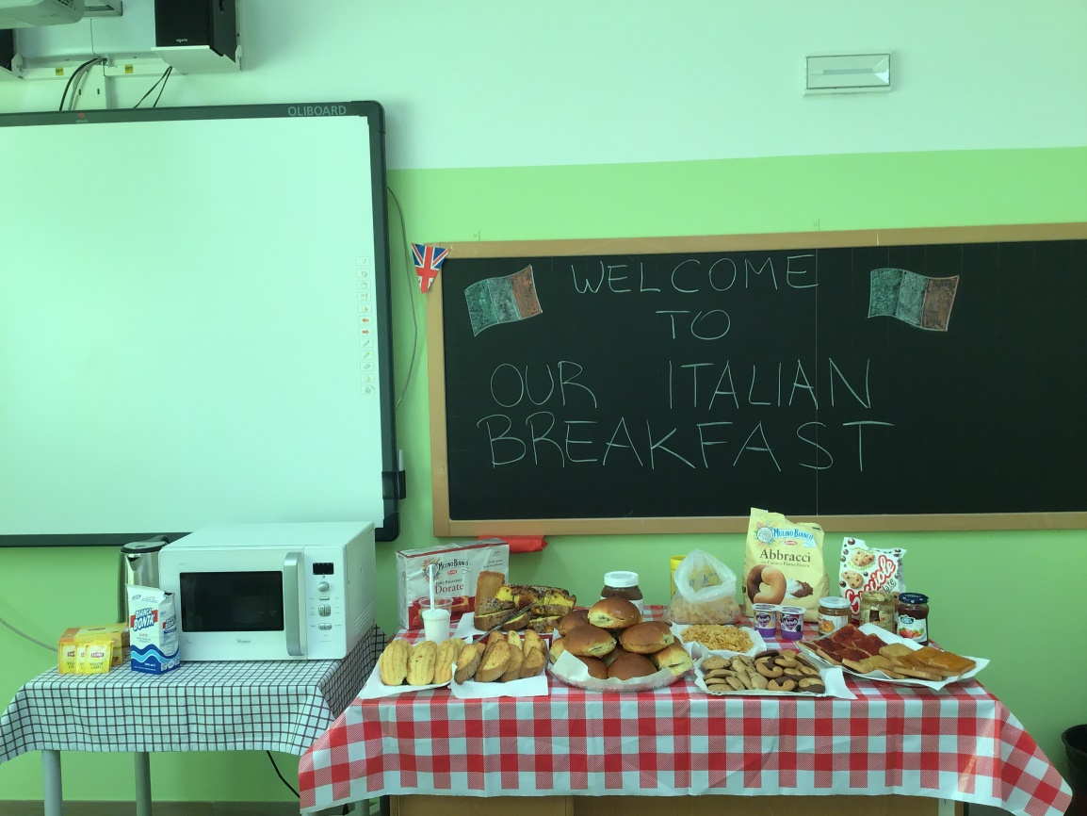
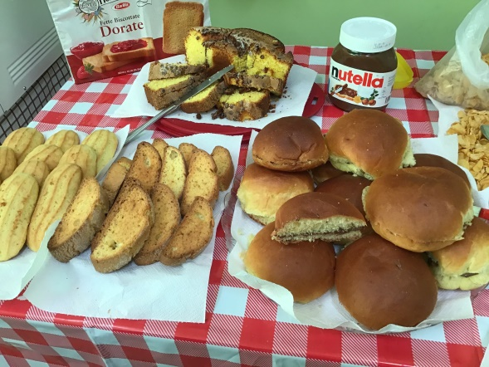
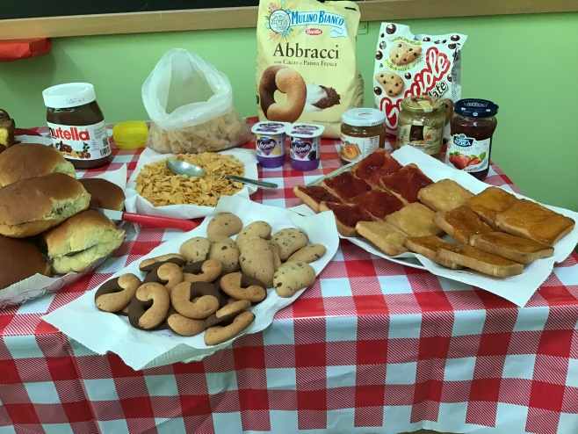
Good morning!
Breakfast is served!

Slide 4
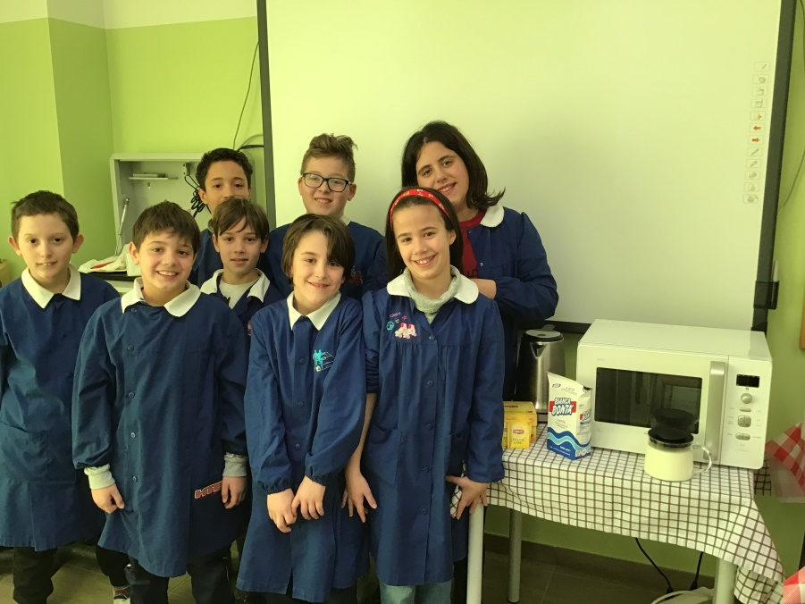
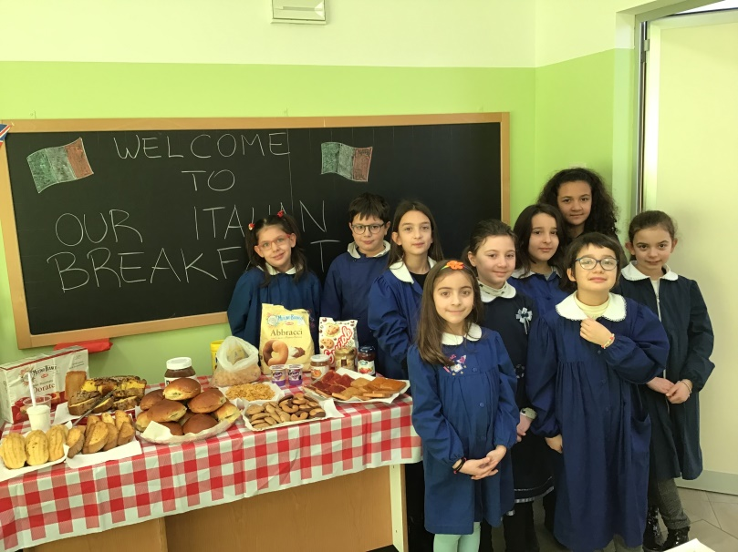
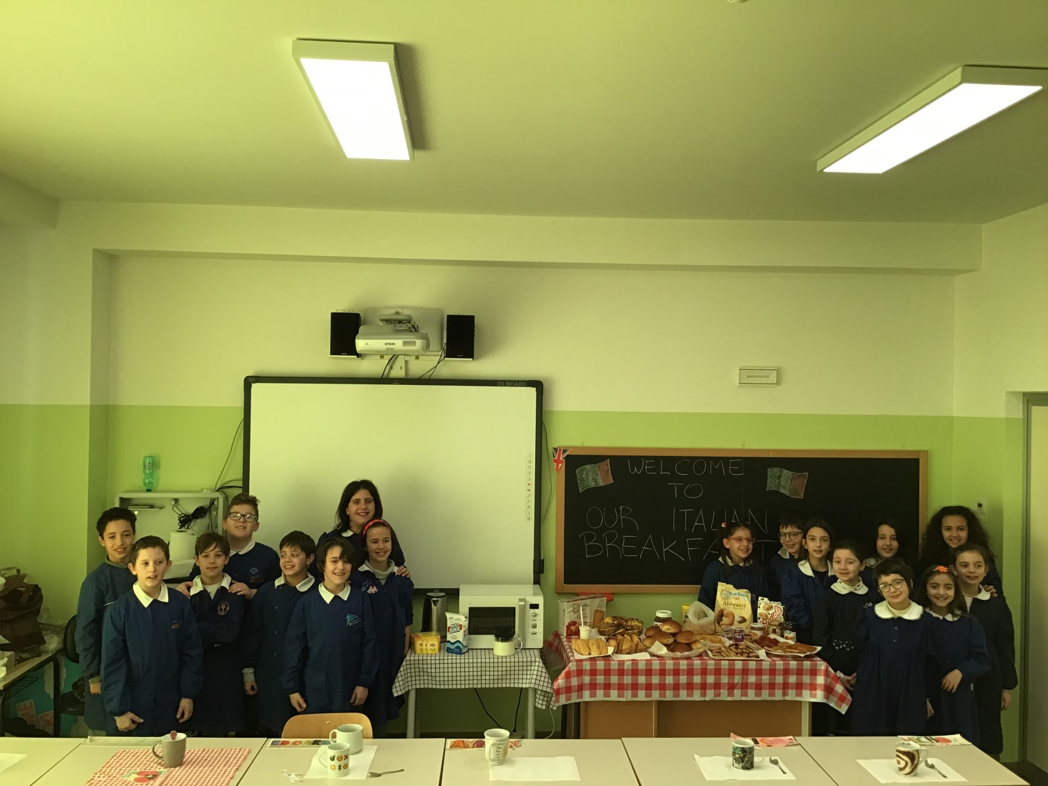
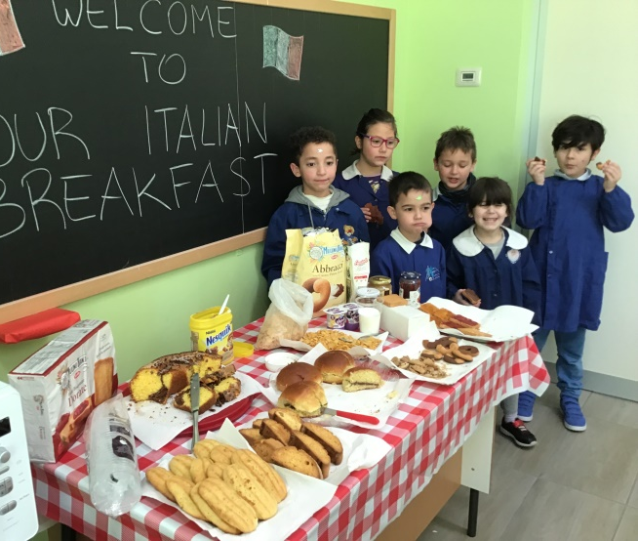
Join us!

Slide 5
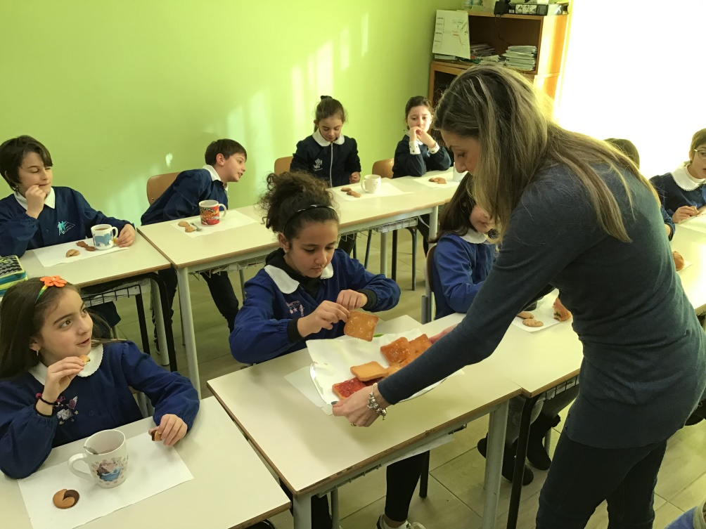
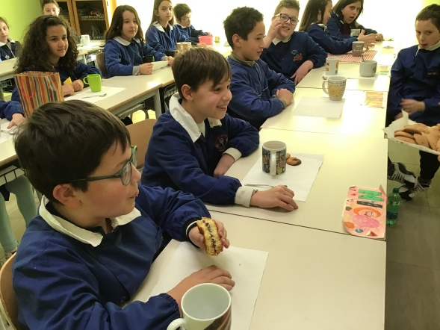
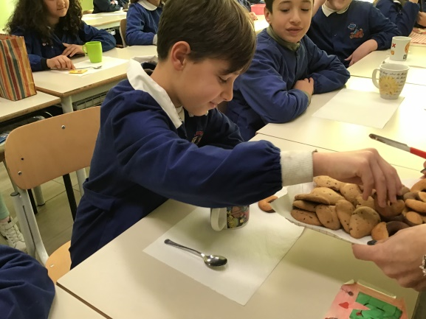
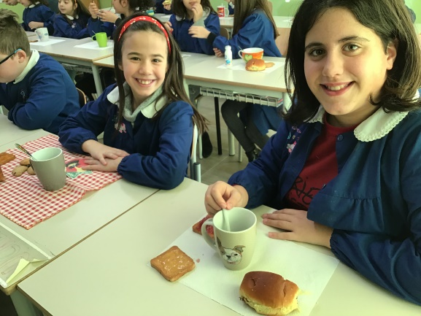
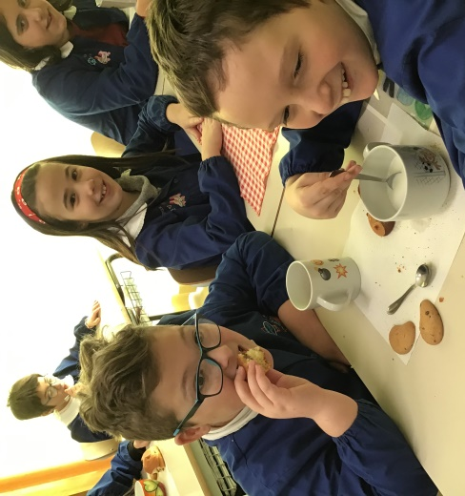
Would you like FETTE BISCOTTATE with jam?
Would you like some tea?
Would you like some milk?

Slide 6
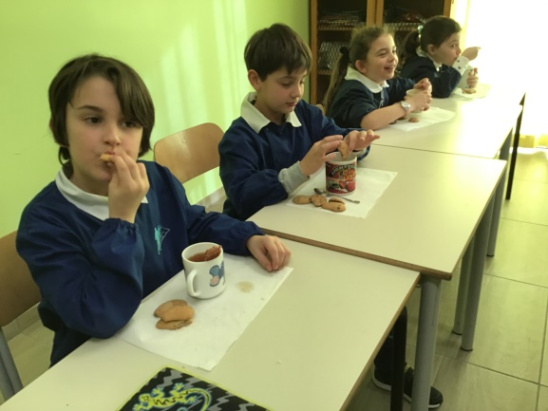
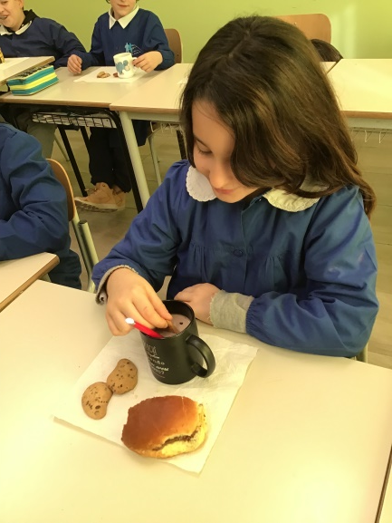
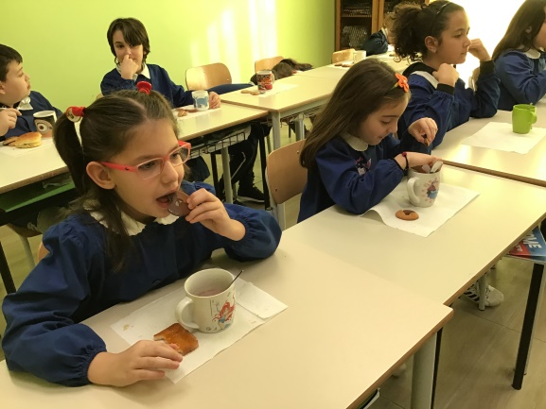
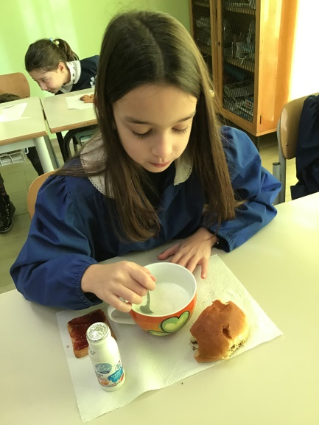
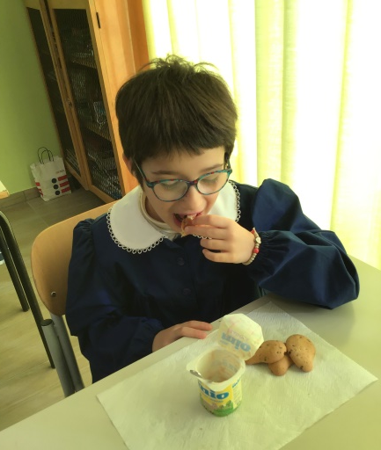
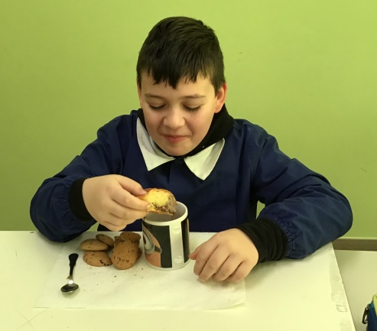
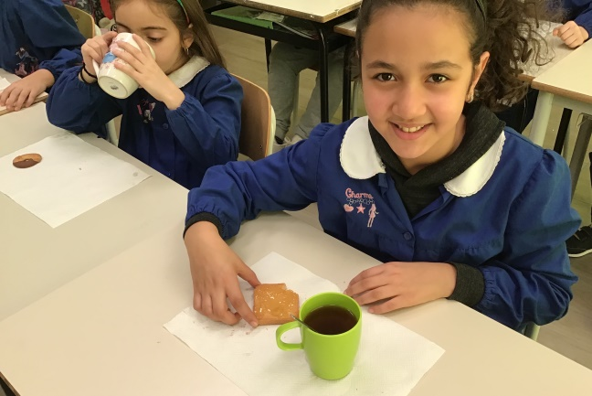
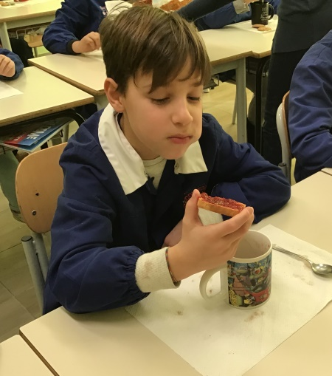
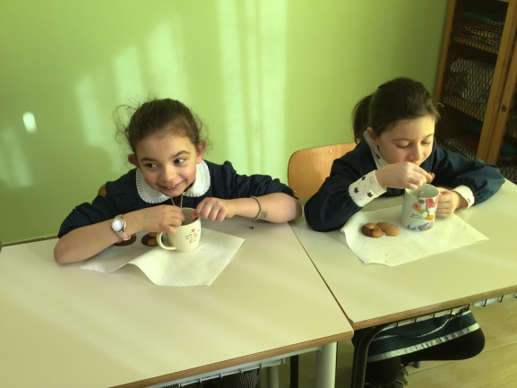
YUMMY!

Slide 7
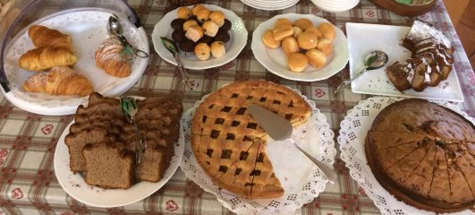
There are no particular recipes for breakfast in Italy.
The only basic rule is that
it ought to be
sweet and carbohydrate-based.

Slide 8
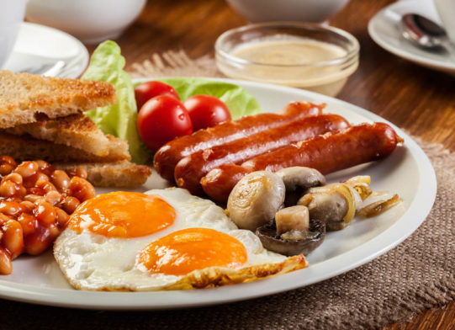
Most Italians do not like eating salty foods in the morning, particularly meat or fish.
No bacon or sausages for example,
but even eggs are usually never seen.

Slide 9
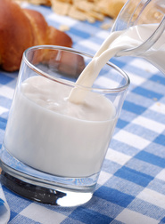
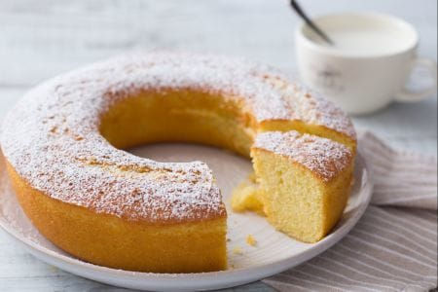
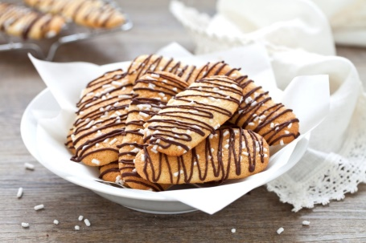
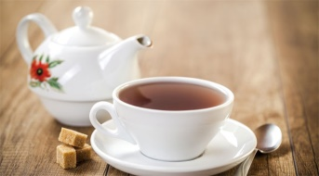
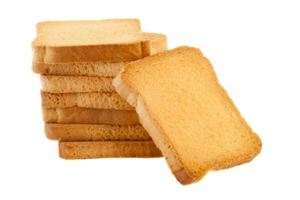
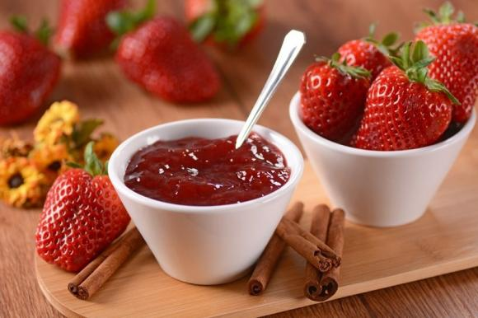
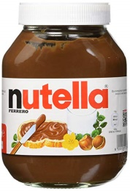
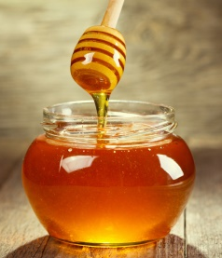
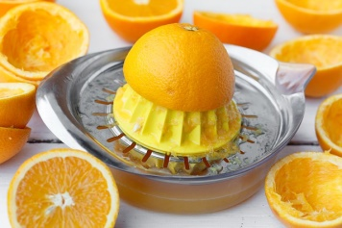
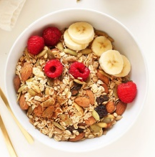
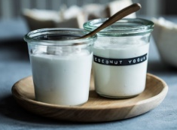
Italians don't like cooking so early in the day, so the only thing we prepare is usually coffee, milk, tea or orange juice and the rest comes from the fridge or the cupboard - or the bakery.
A lot of people, particularly younger ones, like to have corn flakes or muesli with milk or yogurt.

Slide 10
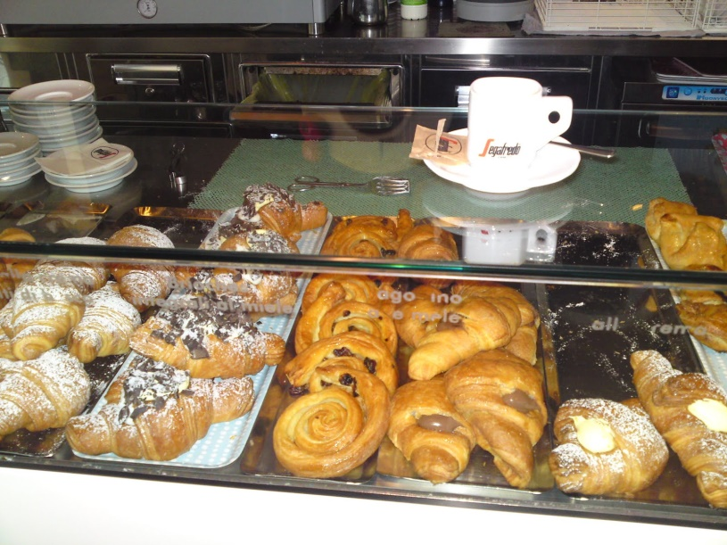
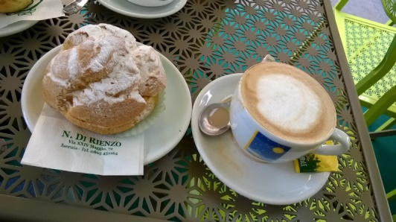
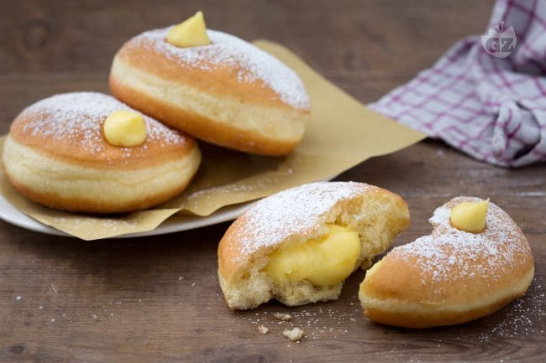
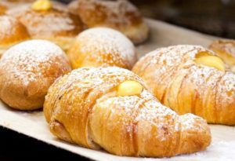
A very common and beloved breakfast solution for working people is going to an Italian bar on the way to their working place and have some coffee-based beverage - espresso, macchiato, cappuccino, and variants - with some kind of pastry,
the 'cornetto' (croissant) or 'bombolone' (a fried pastry filled with cream or fruit jam).

Slide 11
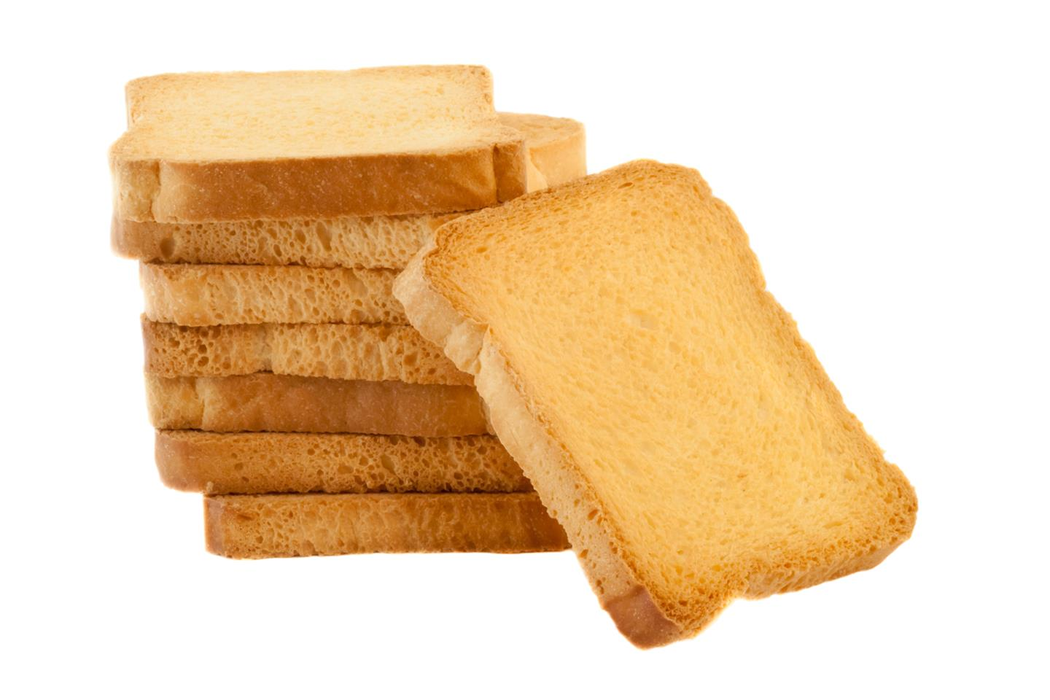
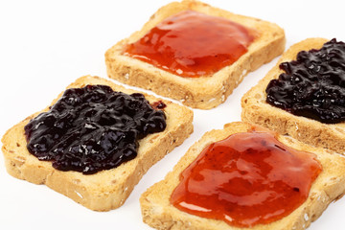
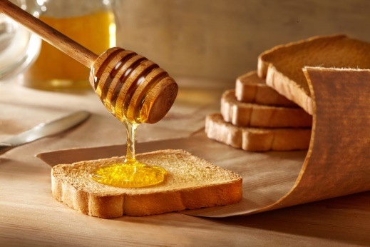
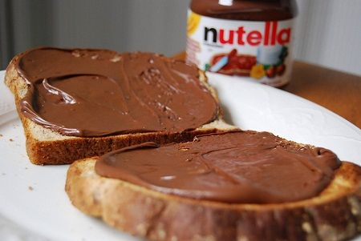
During the “HEALTHY WEEK” in Cyprus
we want to prepare you
FETTE BISCOTTATE
with JAM, HONEY or NUTELLA
FETTE BISCOTTATE are dry twice-baked biscuits. We usually spread on them home-made jam, honey or the famous Italian hazelnut cream called NUTELLA.

