Slide 1
ERASMUS+ PROJECT KA229 2018-20
I AM MY LIFE HERO
SPAIN
ITALY
CYPRUS
POLAND
NATIONAL HERO WEEK

Slide 2
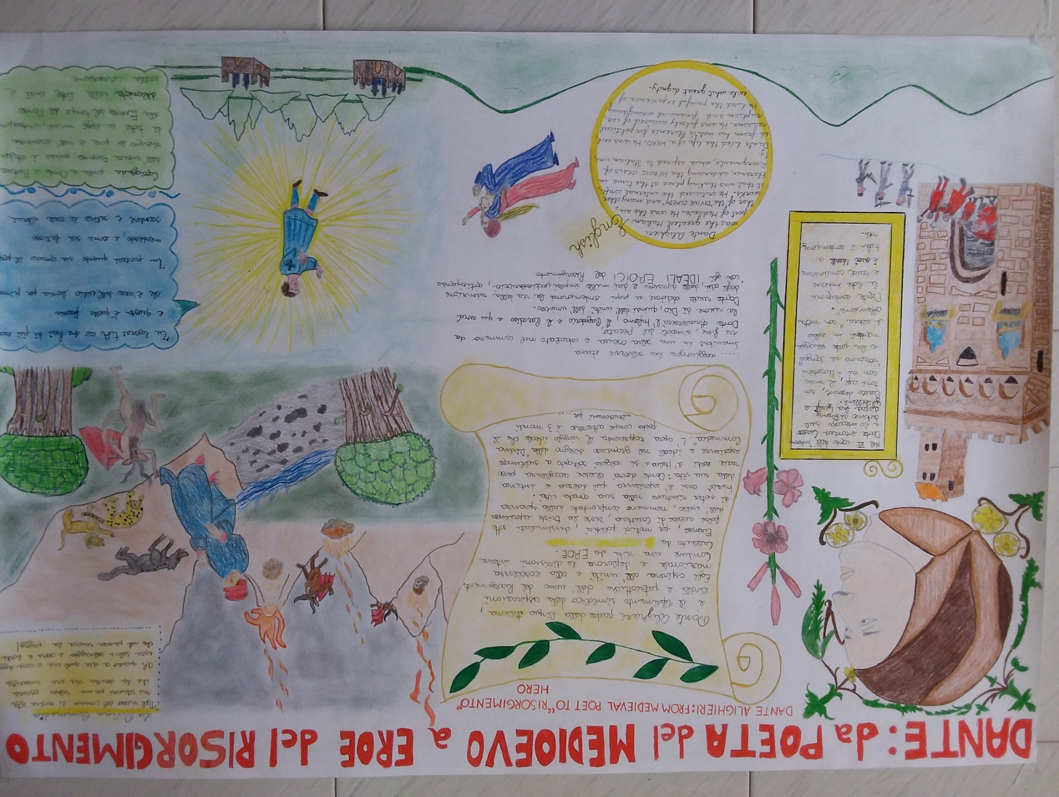
TORRICELLA Secondary school Students HERO
DANTE ALIGHIERI: FROM MEDIEVAL POET TO «RISORGIMENTO» HERO

Slide 3
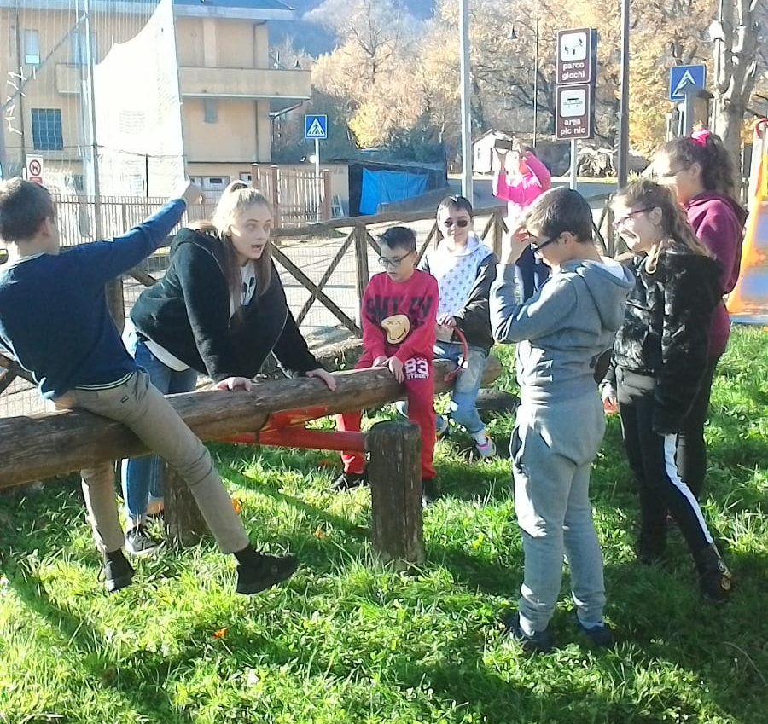
VALLE CASTELLANA Secondary school Students HERO
THE UNICORN-SHEEP
When 2017 earthquake hit our area, it not only crushed our homes but our hopes too.
But this was only at first.
Later, we suddenly found ourselves more connected to each other.
It was us, the younger kids, who knew that the monster had betrayed his own maker: Nature.

Slide 4
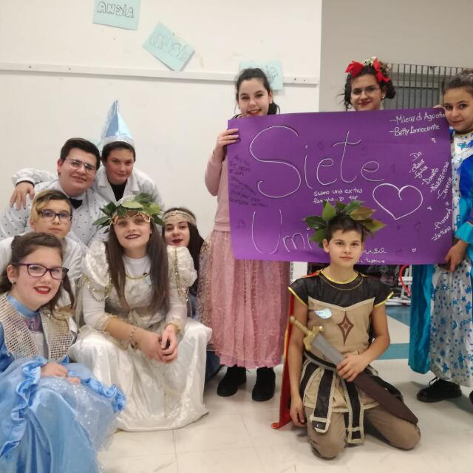
Then we found shelter at school, we found courage being together in our classroom. Your dreams become everybody dreams if you stay together.
Right now the monster is watching us. He can see us, we can’t see him.
His strength is our fear of him striking back again.
Yet we have figured out a spell which is working well: we are ignoring him, right now we are living unafraid, we are learning how to be stronger, how to fight him back and overcome him.

Slide 5
When we are at school, we read and we make and it’s here that we have conceived a mythical beast who is going to fight the monster for us, if he ever comes back.
We have called this beast:
THE UNICORN-SHEEP.
Half unicorn, half sheep, he is mild looking but unbeatable. The unicorn-sheep doesn’t give up, he watches over us, he whispers us fairy tales about faraway places and he gives us courage.

Slide 6
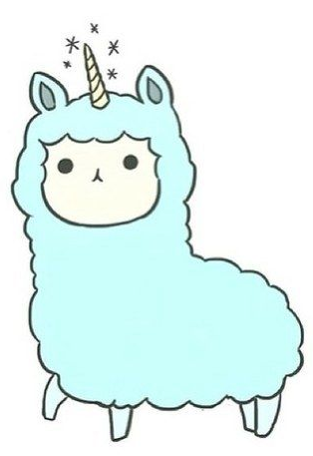
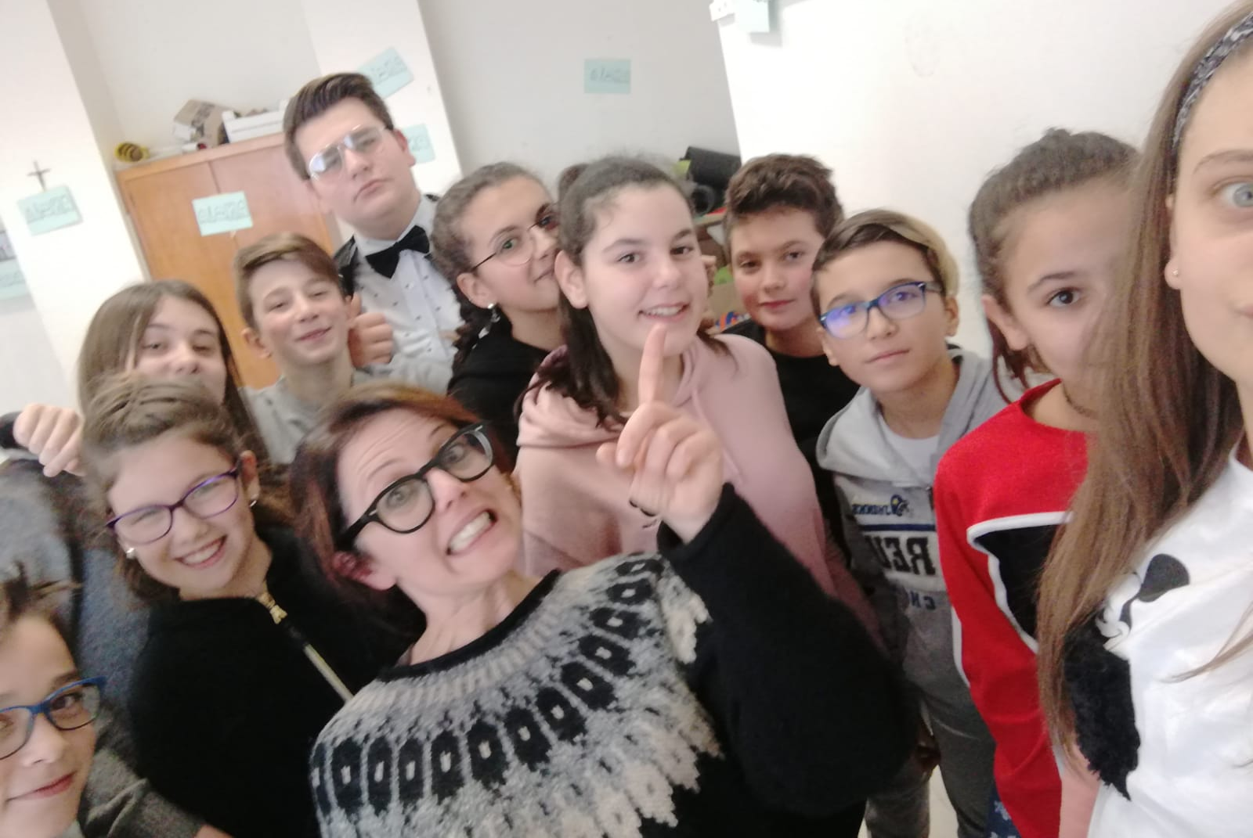
He is our soft hero. By now he represents our future the way we want to imagine it: resilient and welcoming.
THE UNICORN-SHEEP

Slide 7
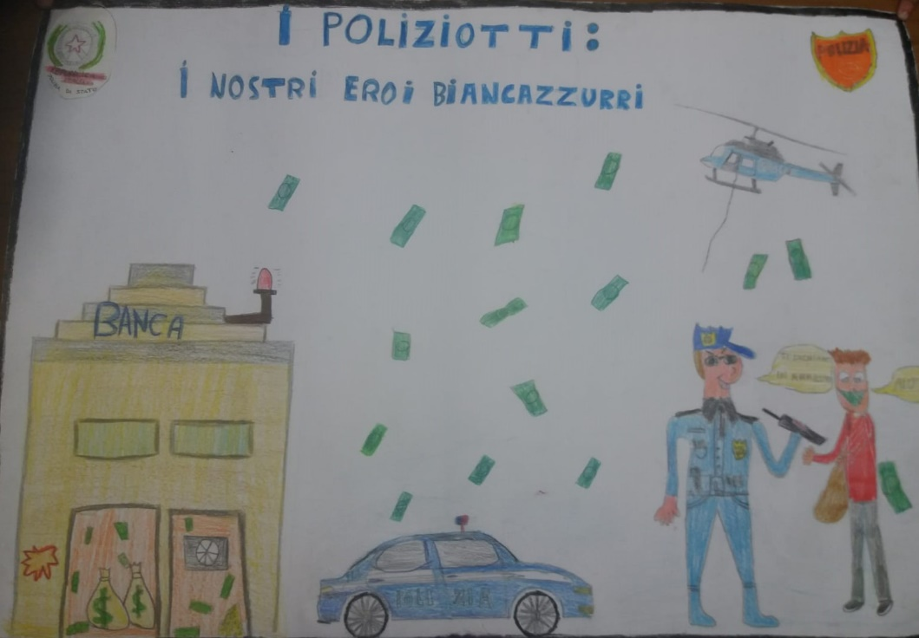
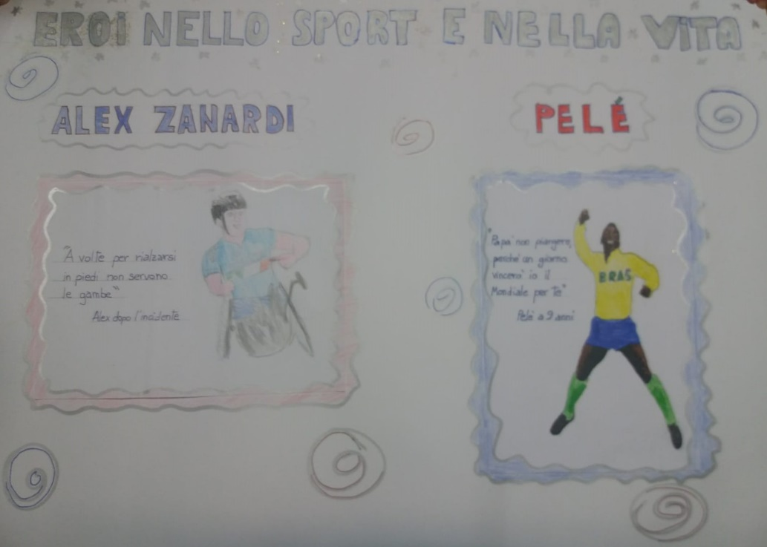
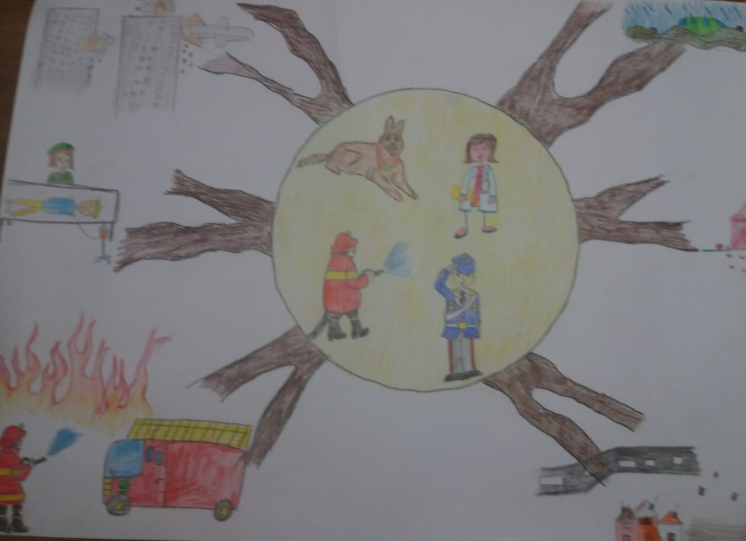
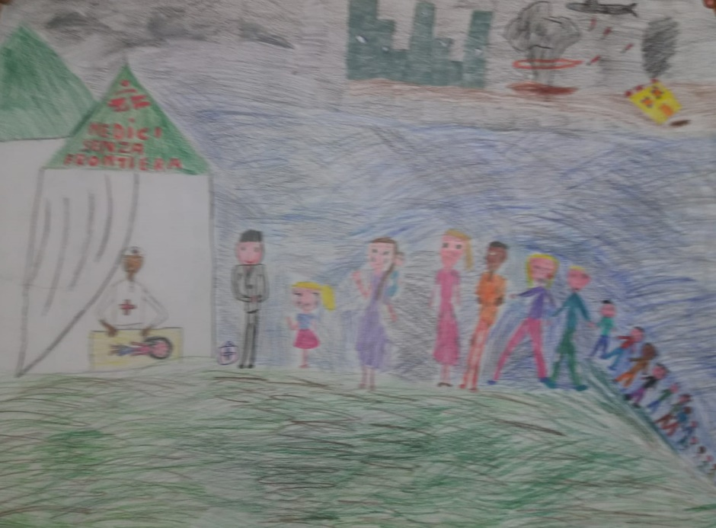
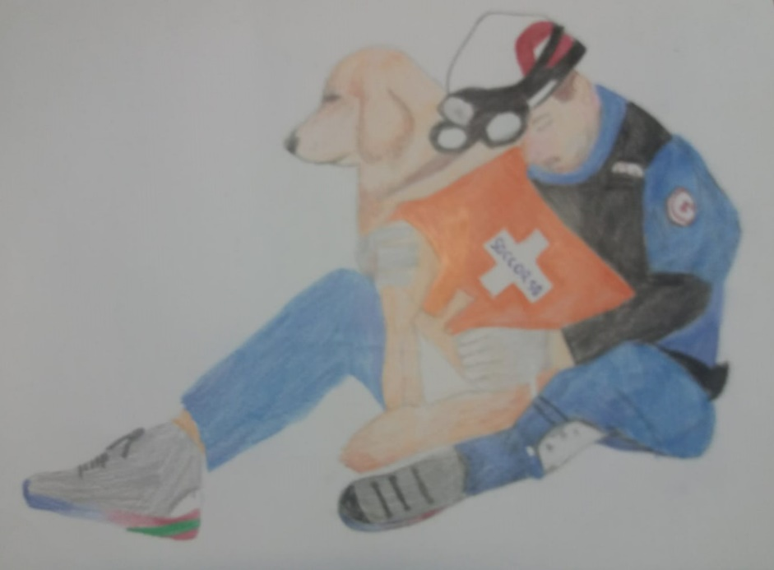
TORRICELLA primary school Students HEROES
SPECIAL
PEOPLE

Slide 8
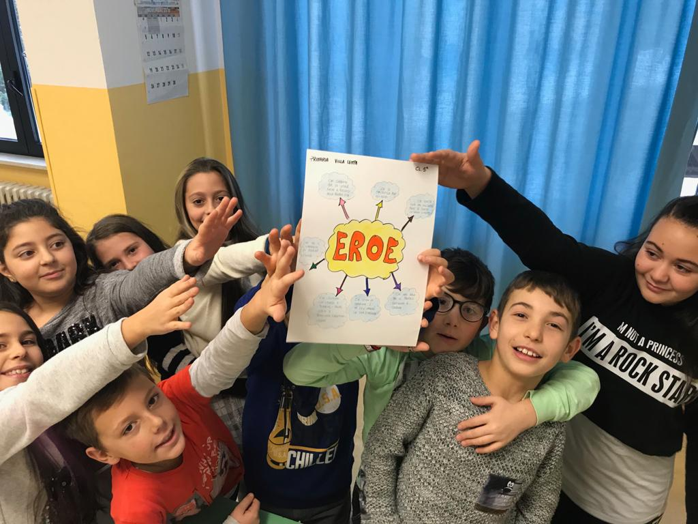
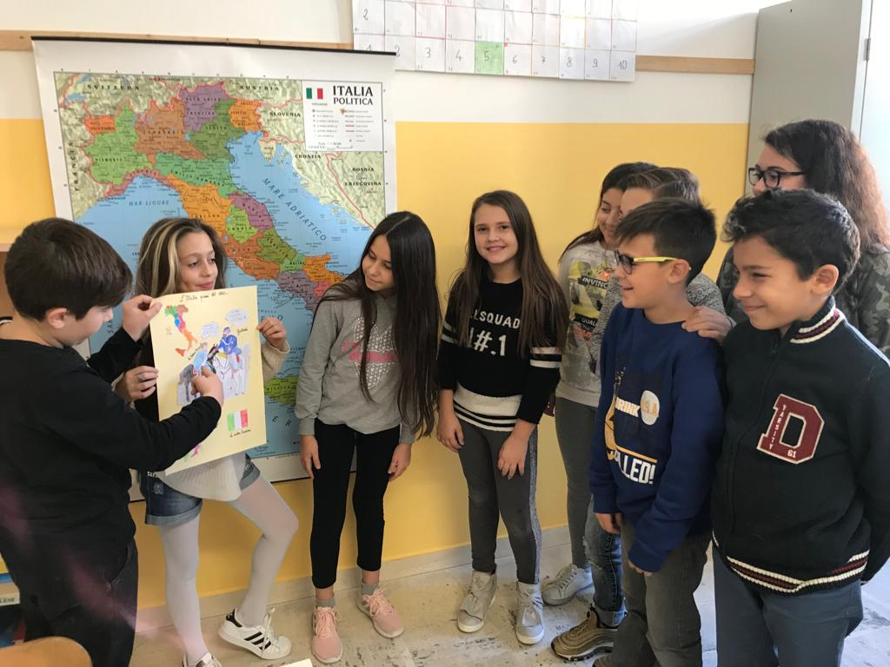
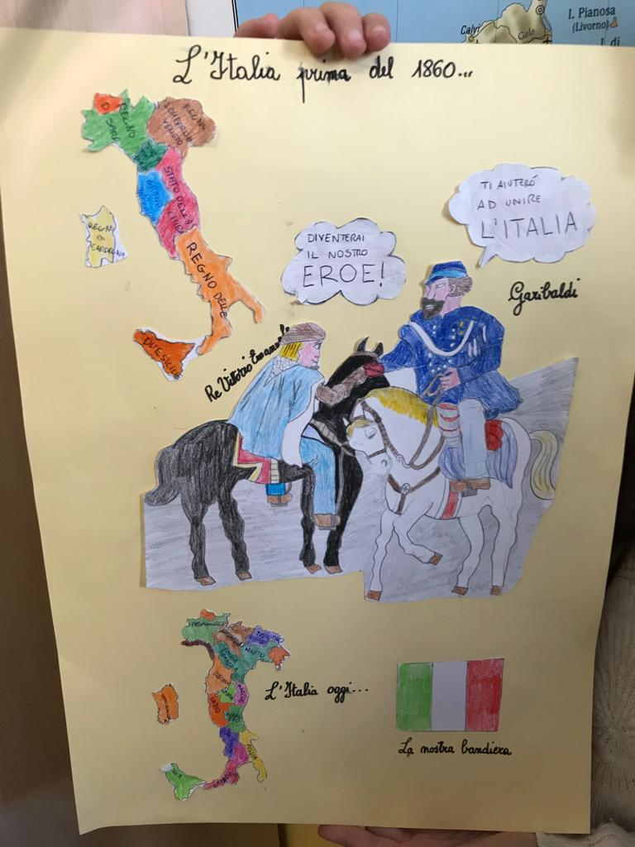
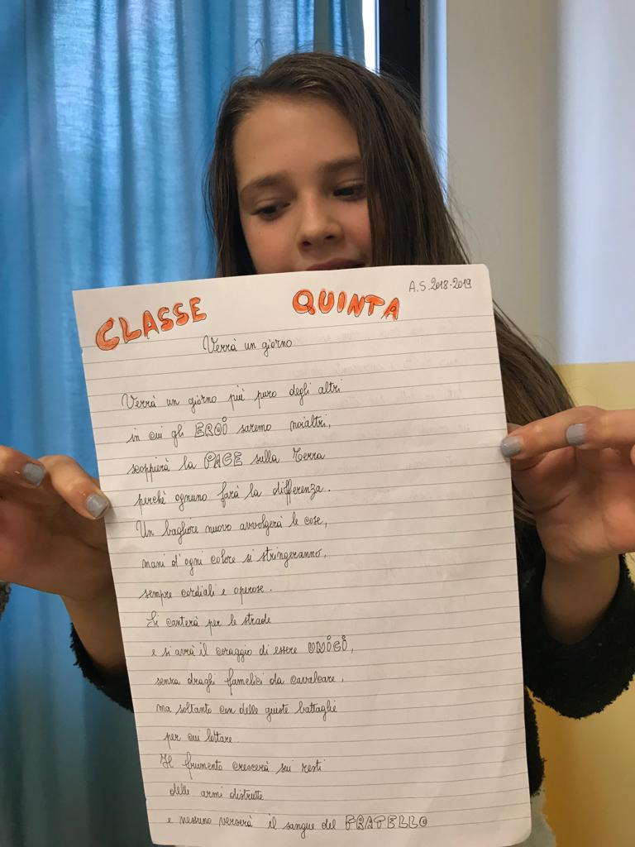
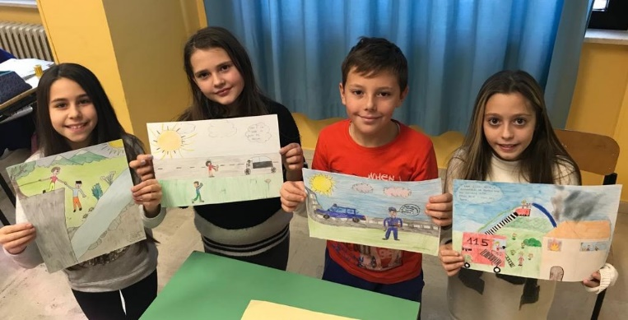
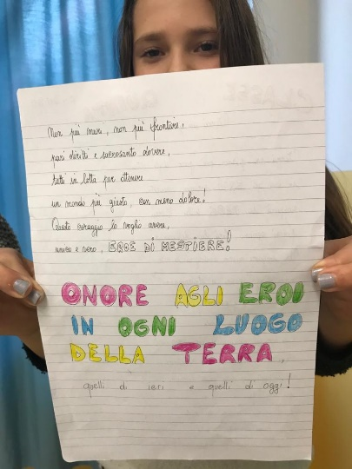
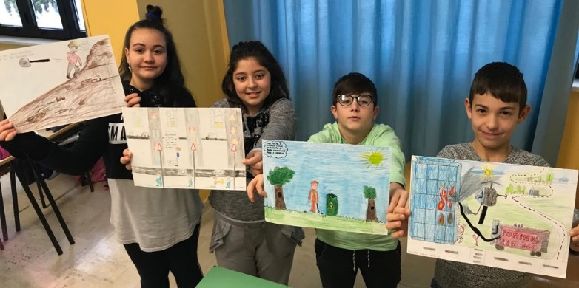
VILLA LEMPA primary school Students HEROES
YESTERDAY AND TODAY’S HEROES

Slide 9
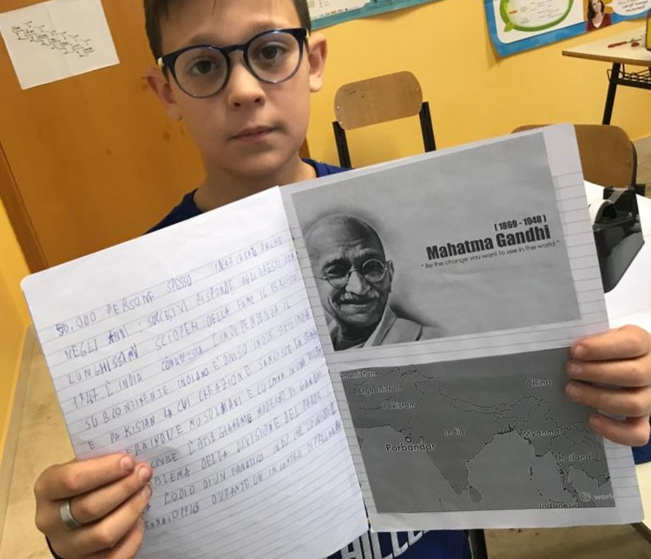
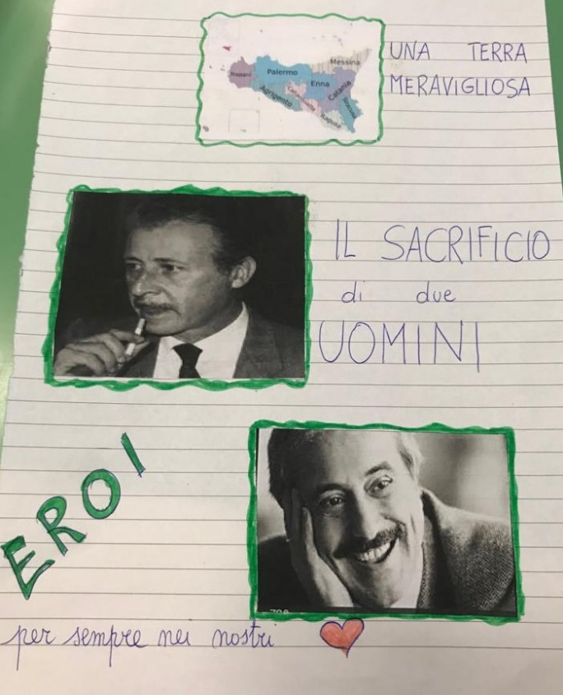
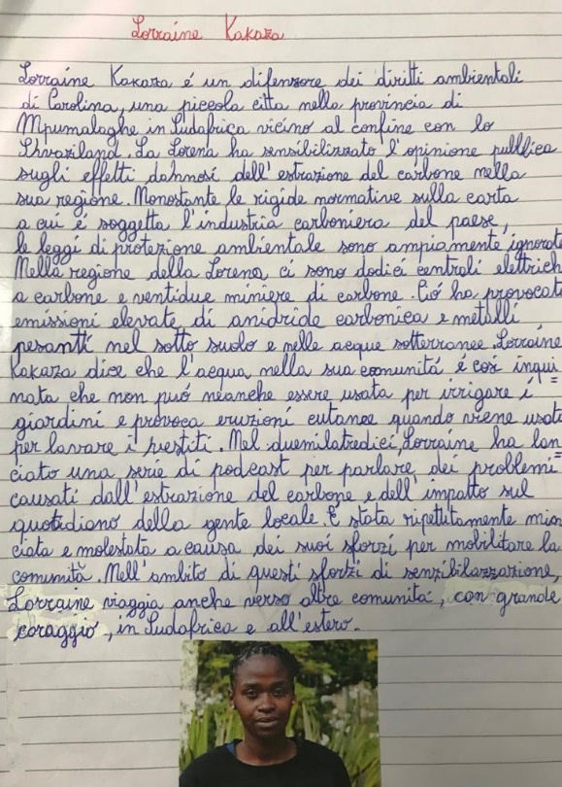
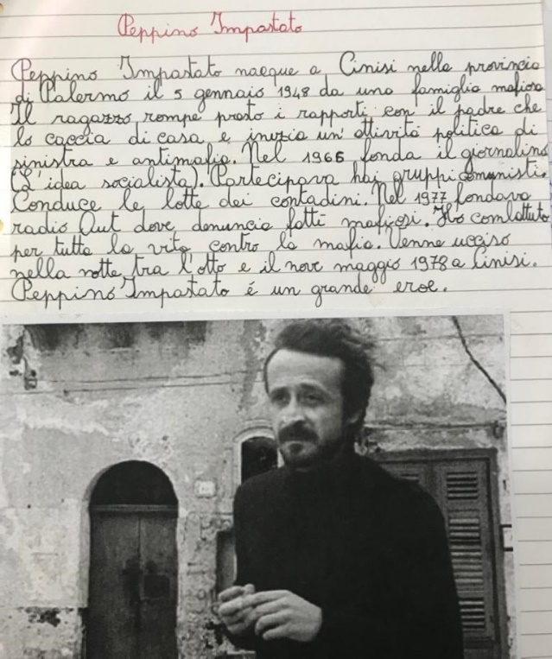
OUR RESEARCHES

Slide 10
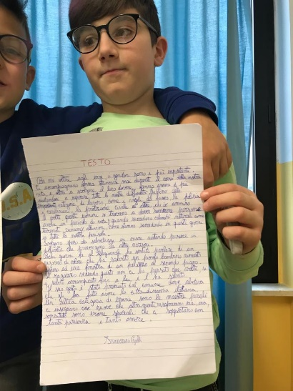
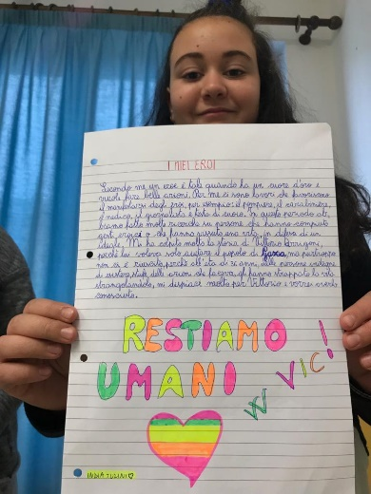
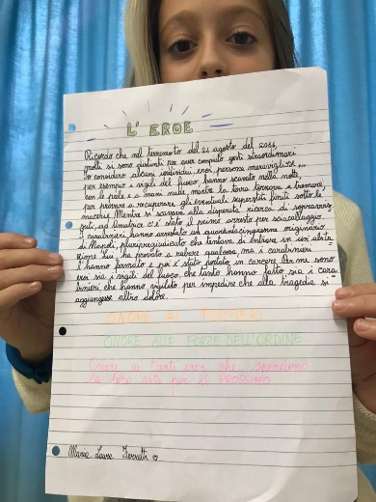
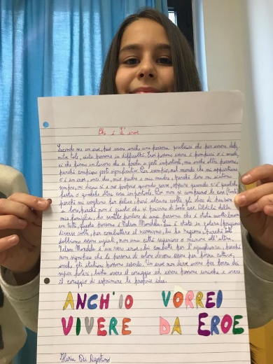
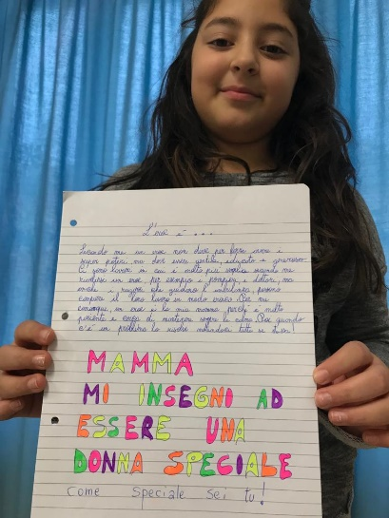
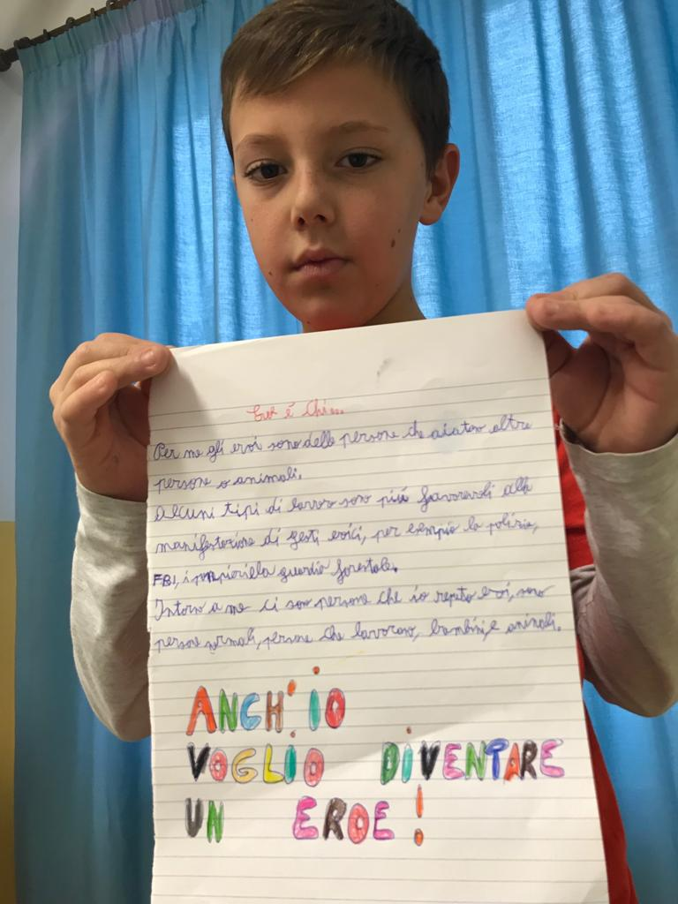
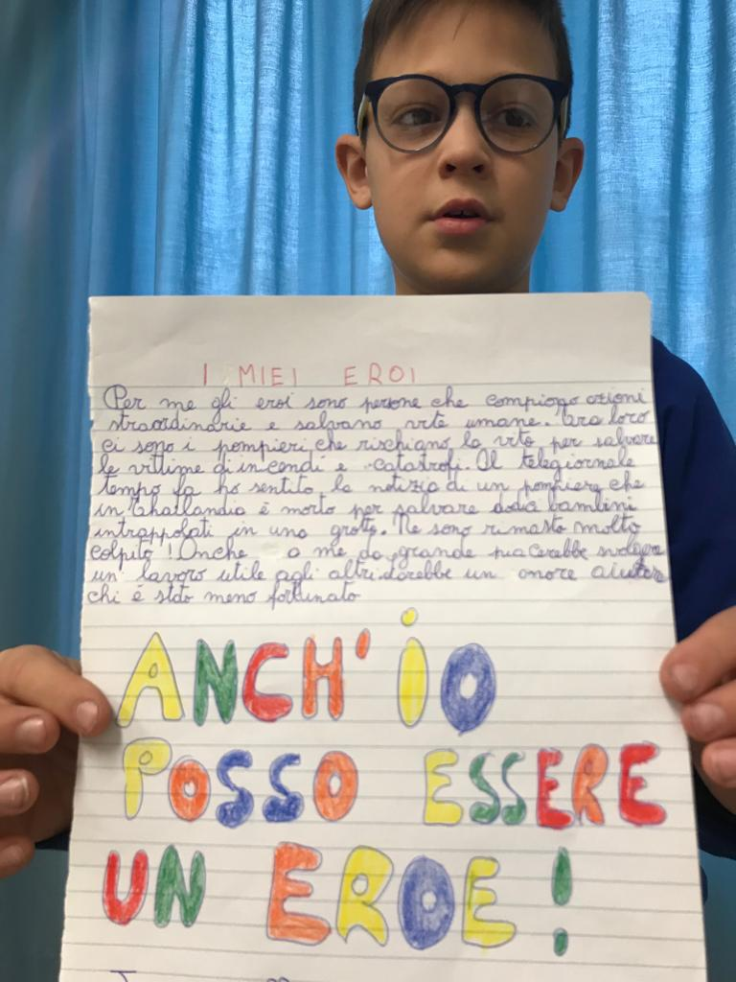
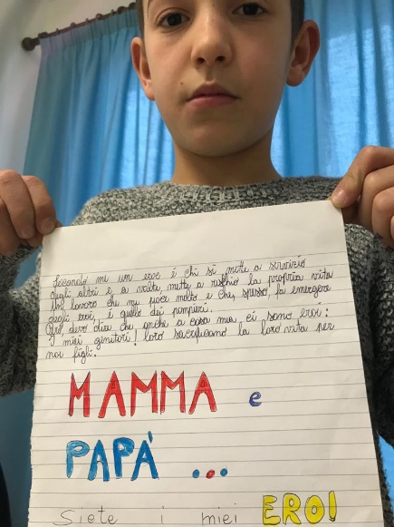
OUR REFLECTIONS

Slide 11
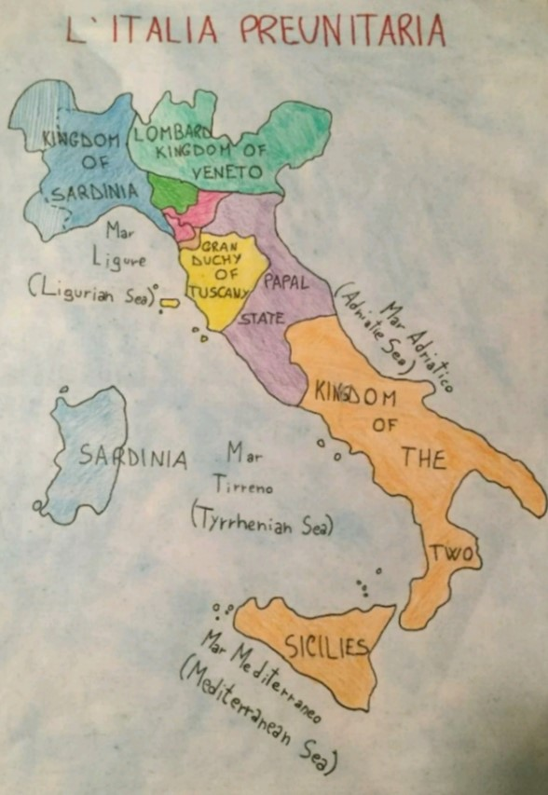
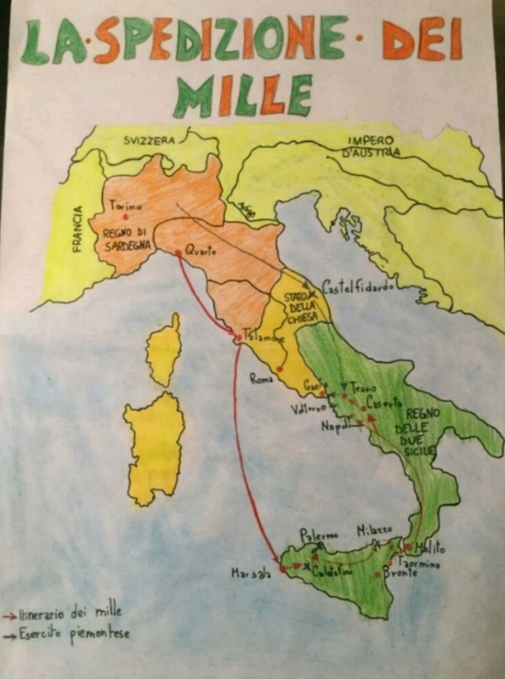
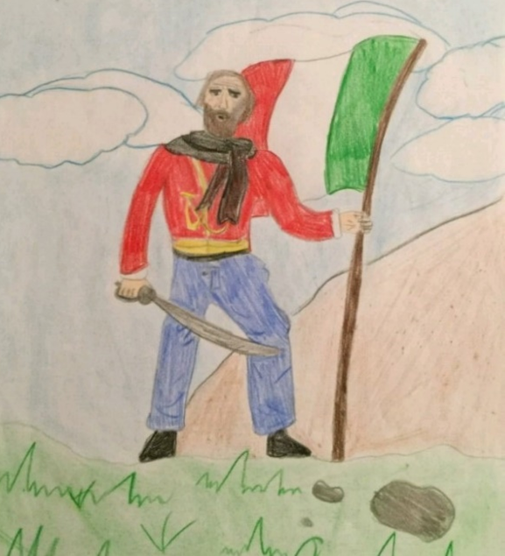
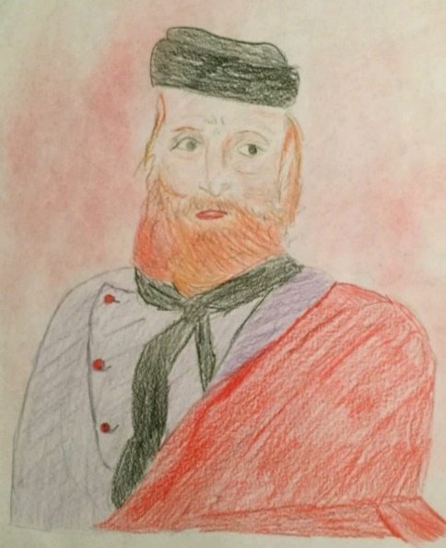
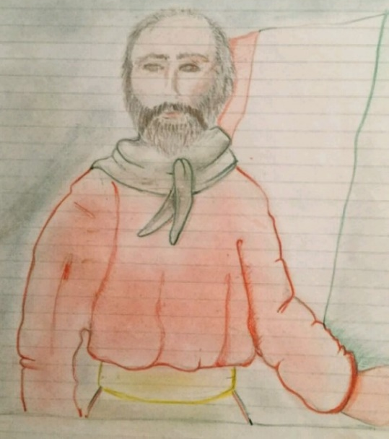
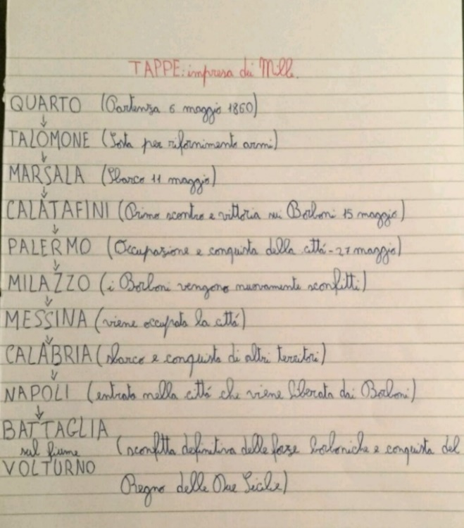
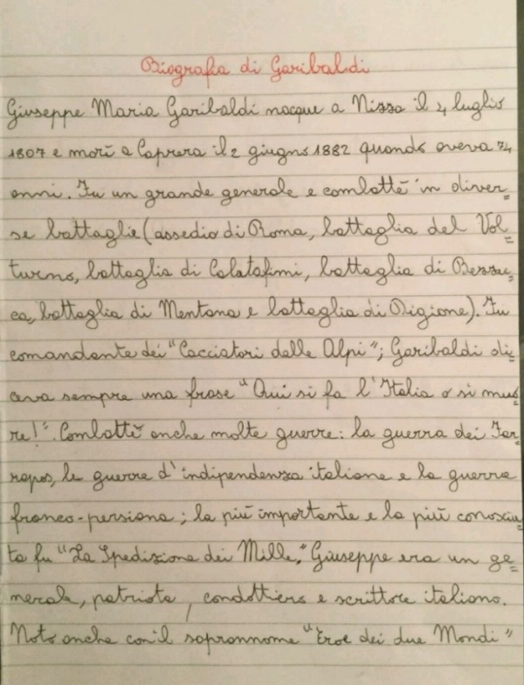
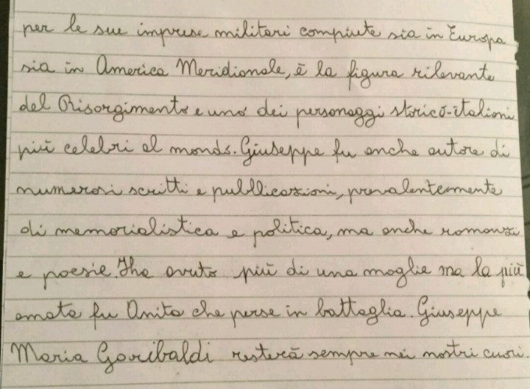
FAVALE primary school Students HEROES
Giuseppe Garibaldi
and his history

Slide 12
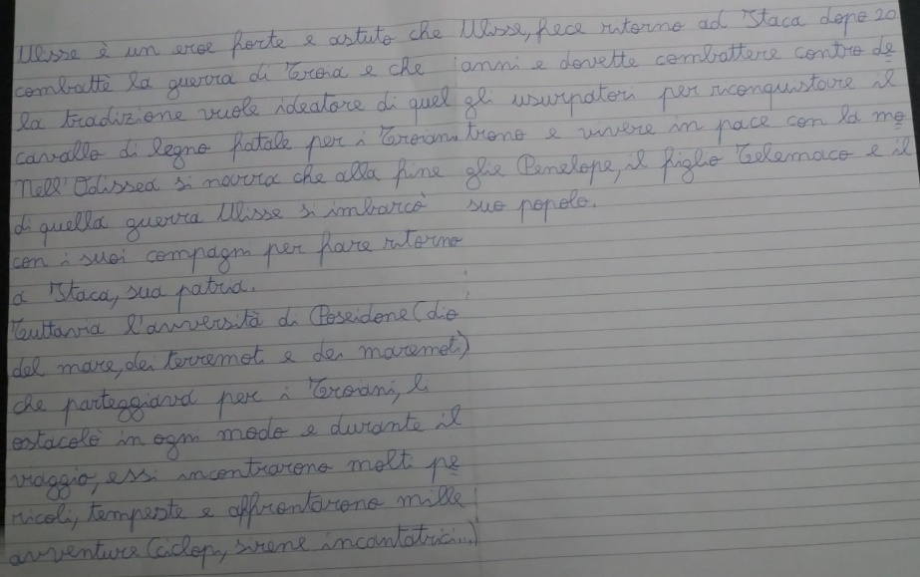
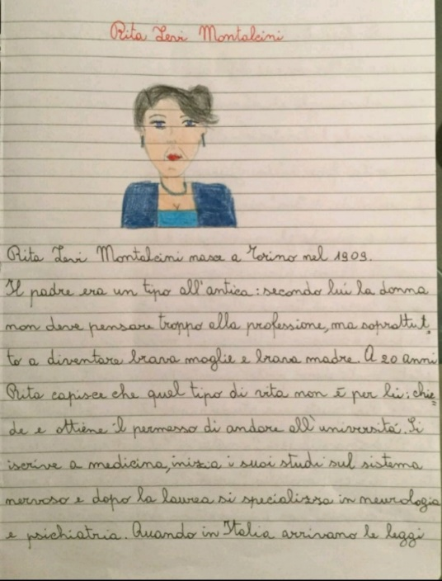
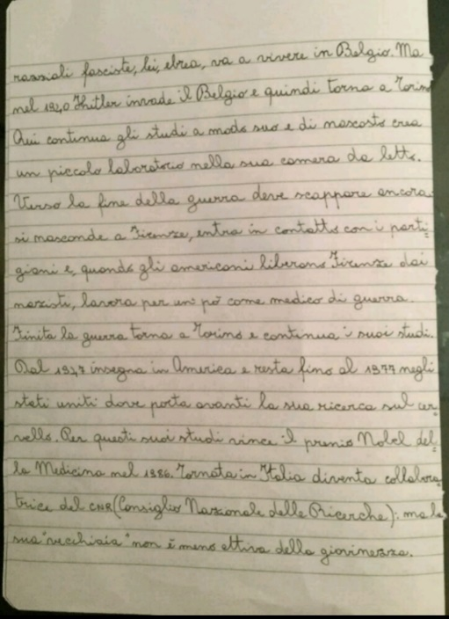
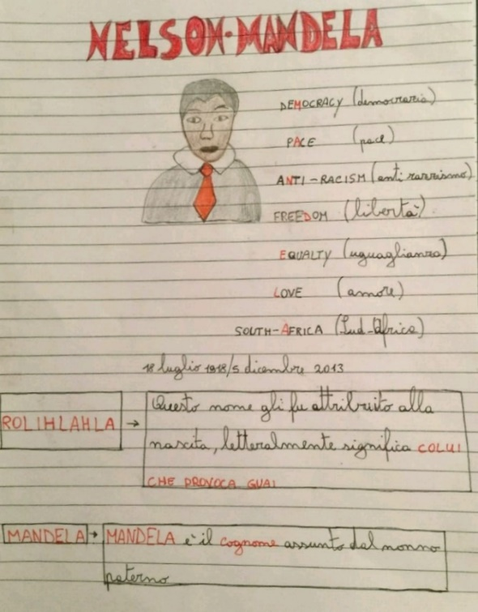
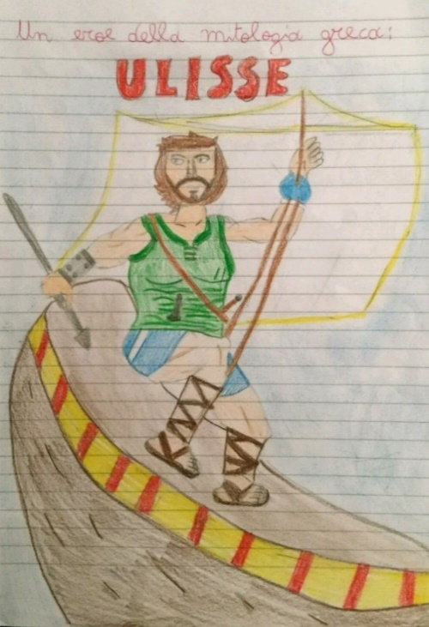
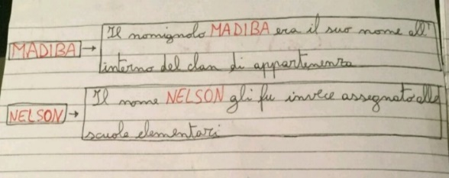
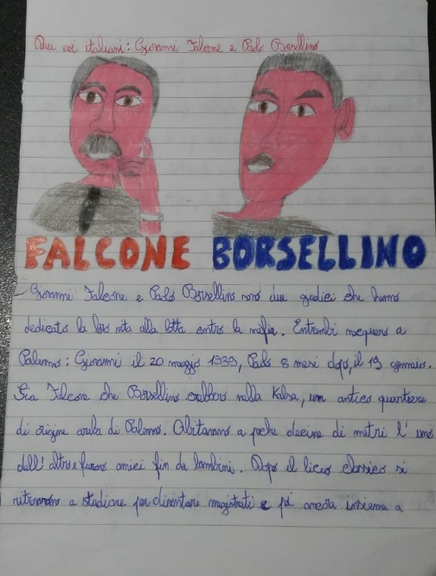
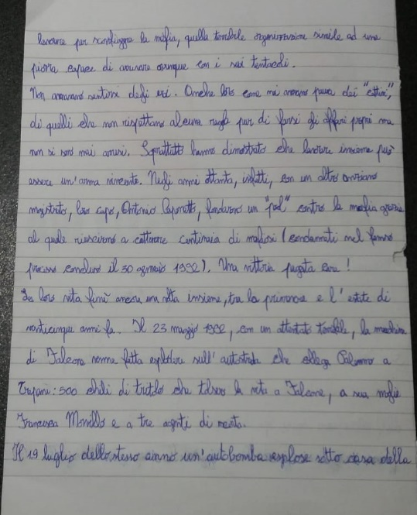
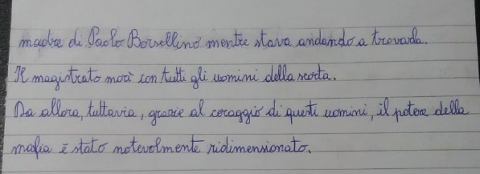
Great women and men

Slide 13
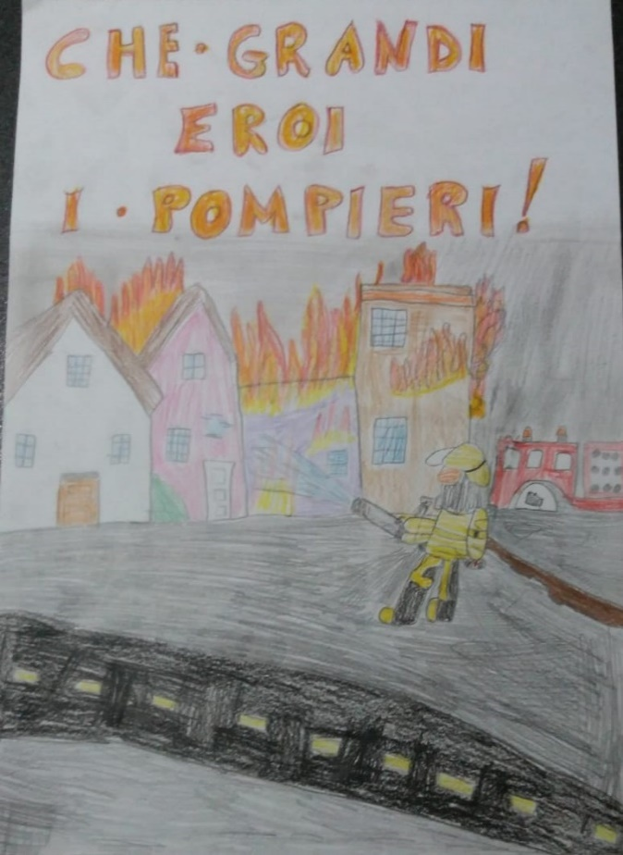
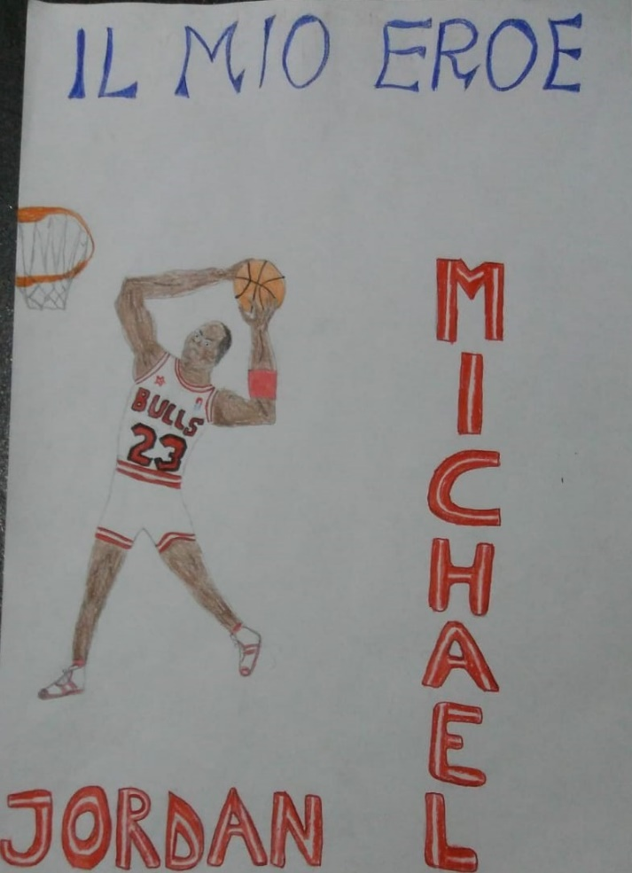
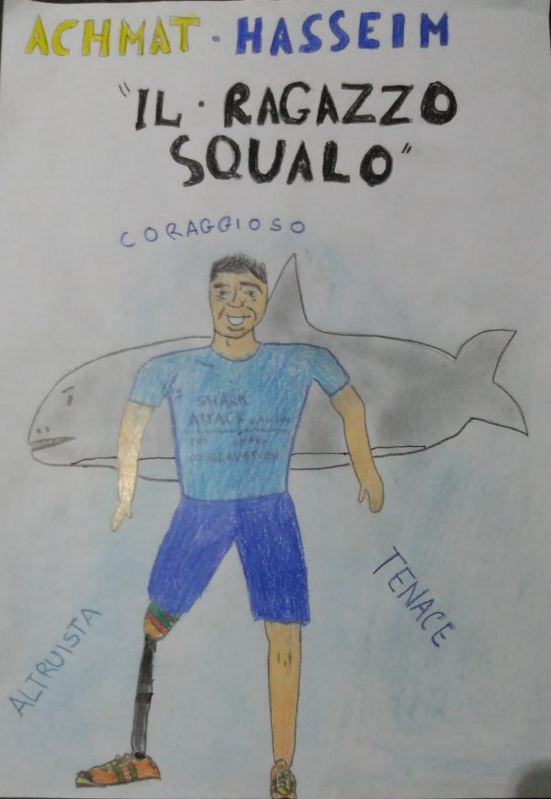
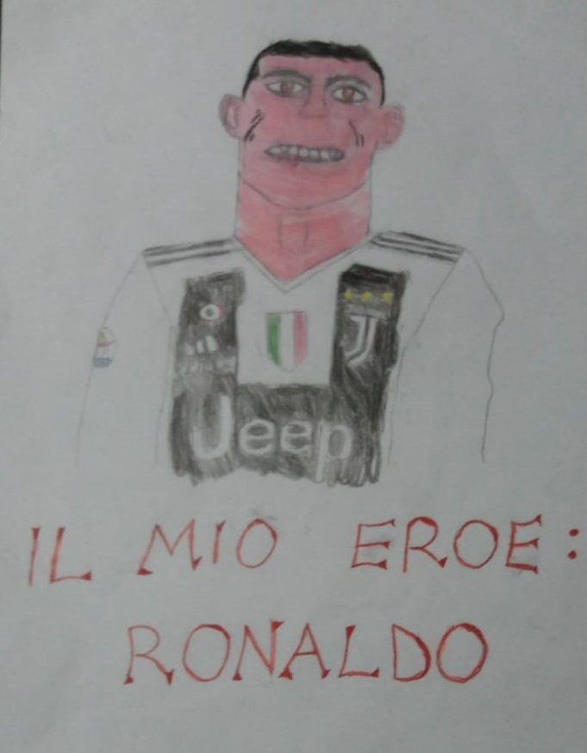
Special people

Slide 14
CIVITELLA DEL TRONTO primary school Students HEROES
FIREMEN
OUR MODERN HEROES

Slide 16
The greatest Italian hero in history
GIUSEPPE GARIBALDI
The HERO OF TWO WORLDS

Slide 17
Garibaldi’s life
timeline
Evolution of the Italian flag

