Slide 1
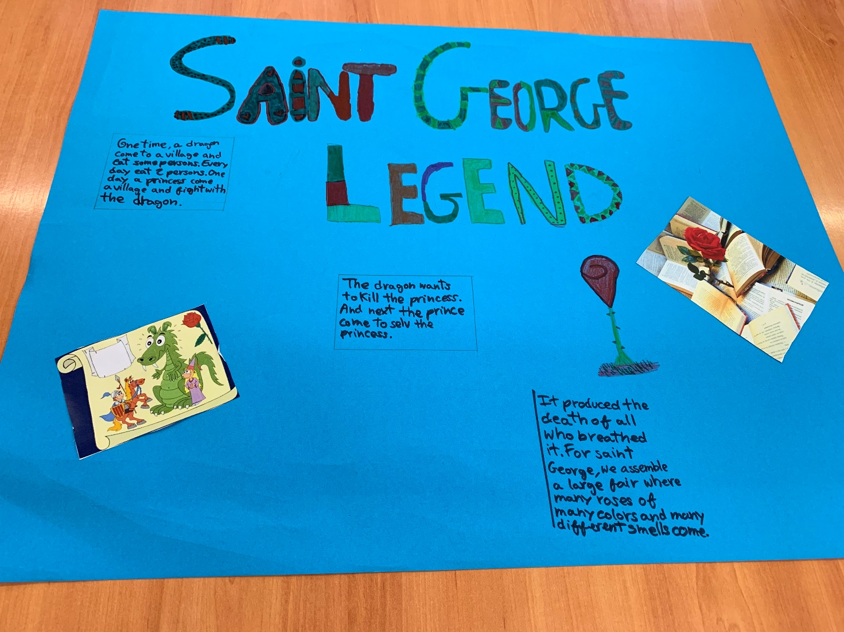
Our Hero is Saint George, he was a very nice Legend...

Slide 2
Once upon a time, there was a bad dragon that wanted to eat all the people of a town...

Slide 3
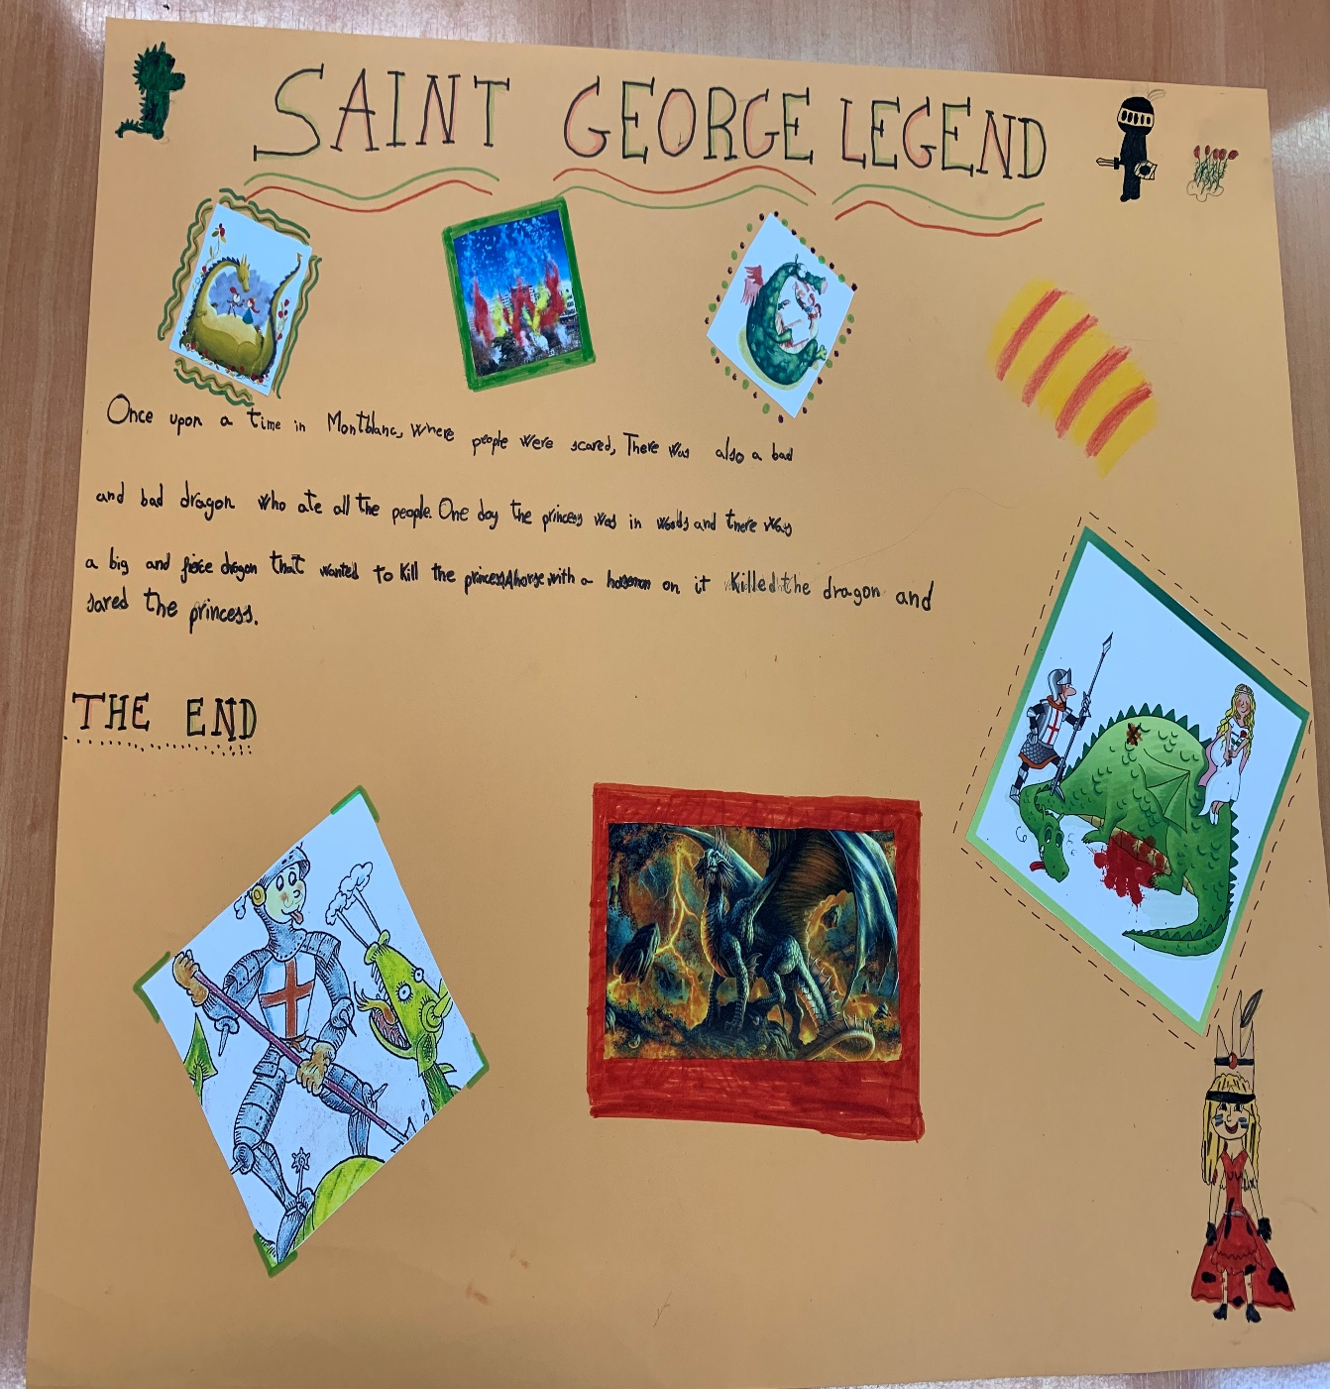
One day, when the Dragon wanted to eat the Princess of the town, a horseman called Saint George appeared and killed the Dragon...

Slide 4
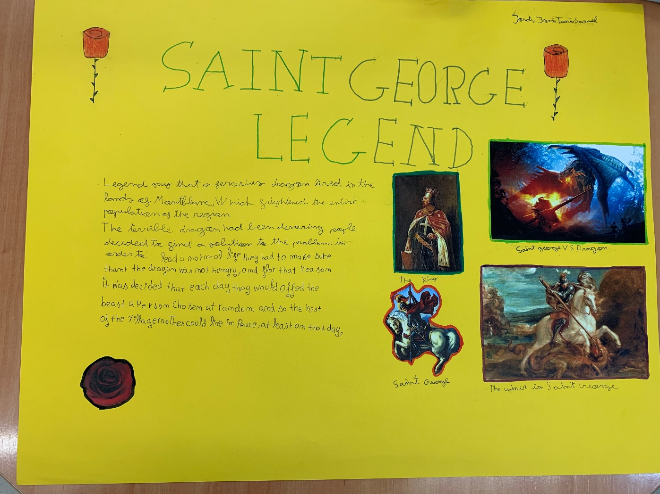
The blood of the Dragon became in a rose that Saint George give to the Princess.

Slide 5
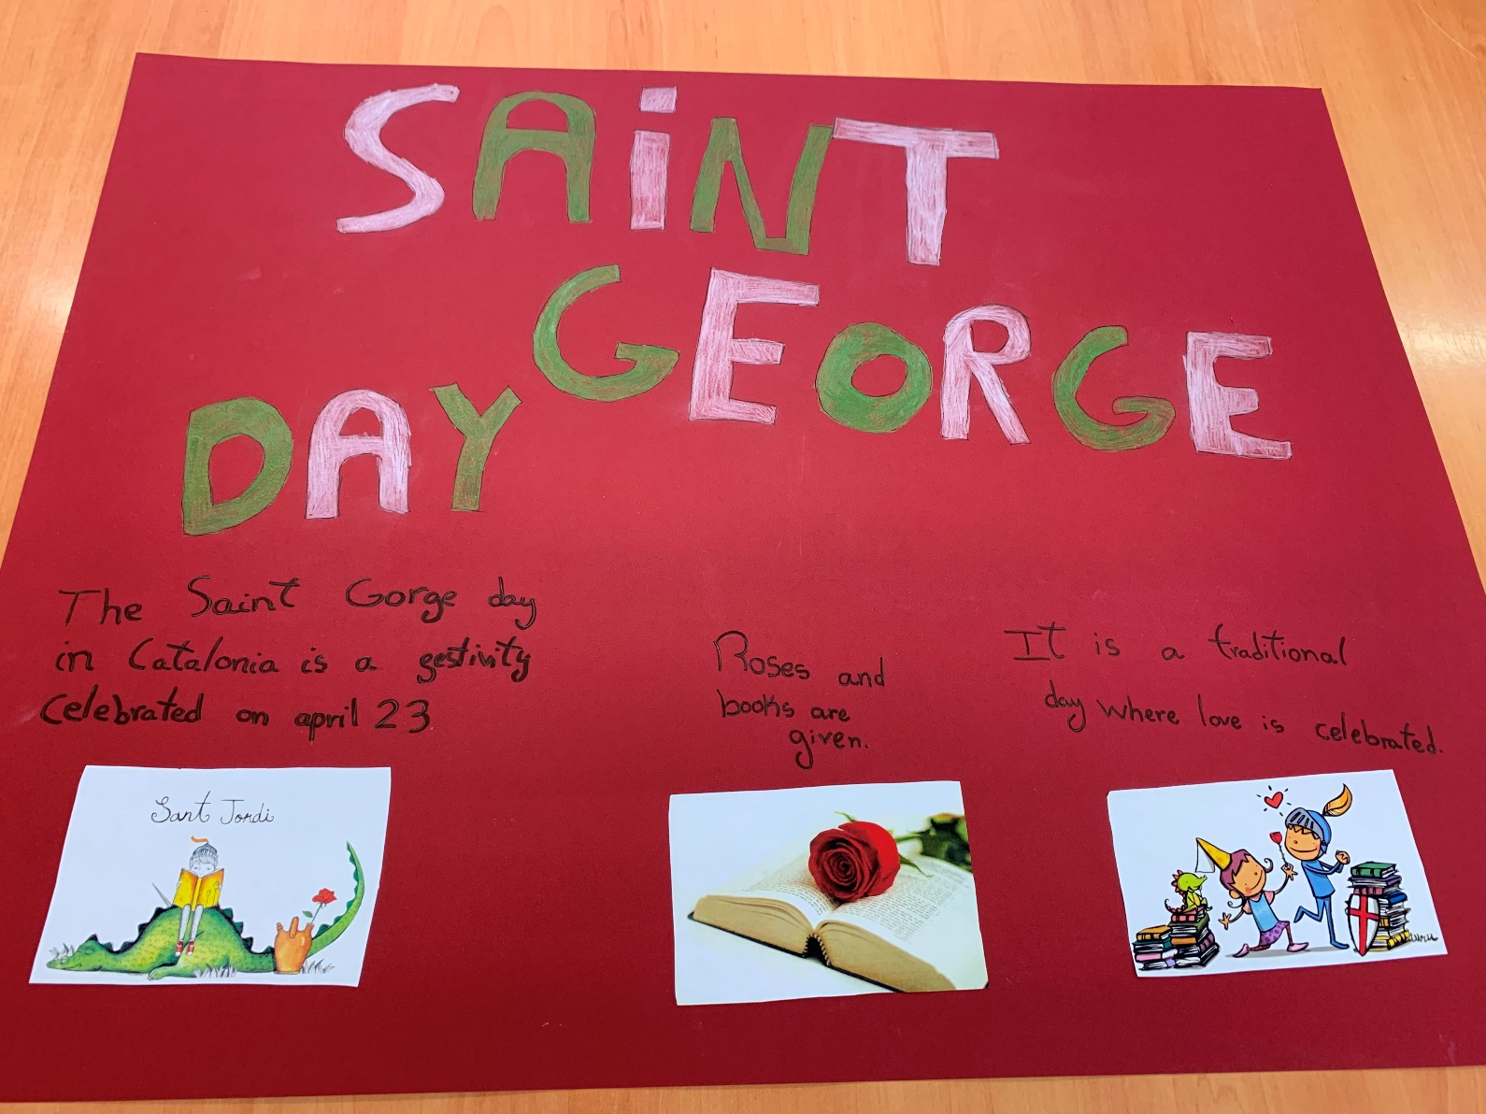
Nowadays, every 23rd of April we celebrate Saint George...

Slide 6
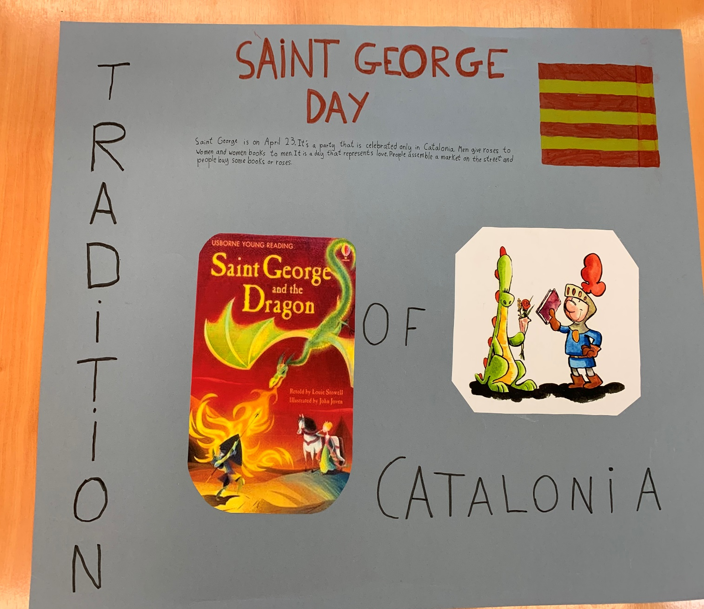
The boys give a rose to the girls...

Slide 7
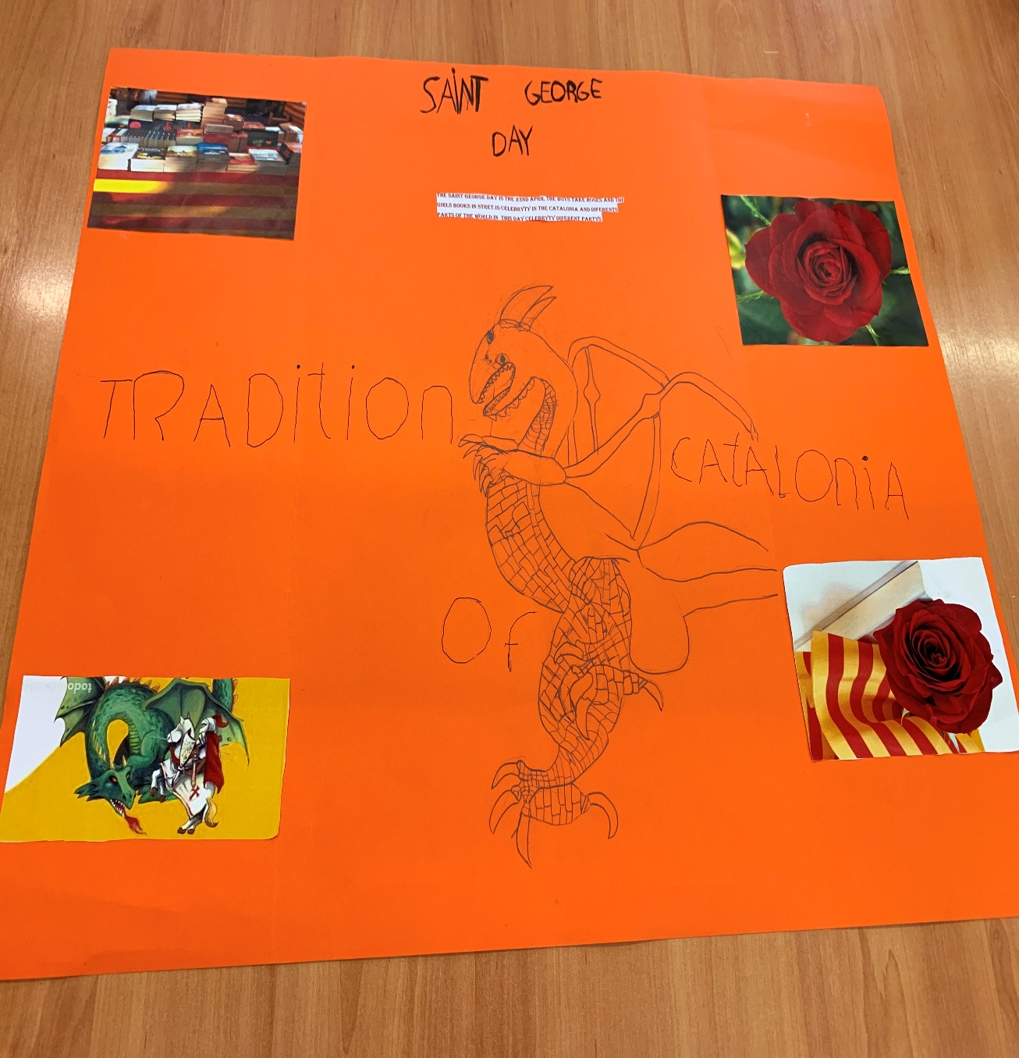
And the girls give a book to the boys!

Slide 8
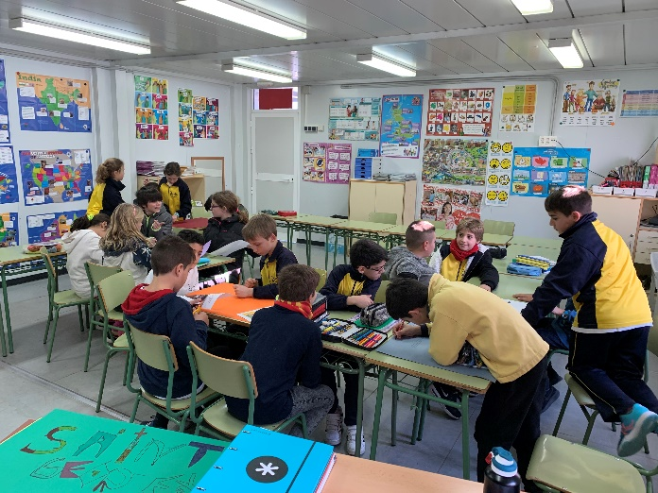
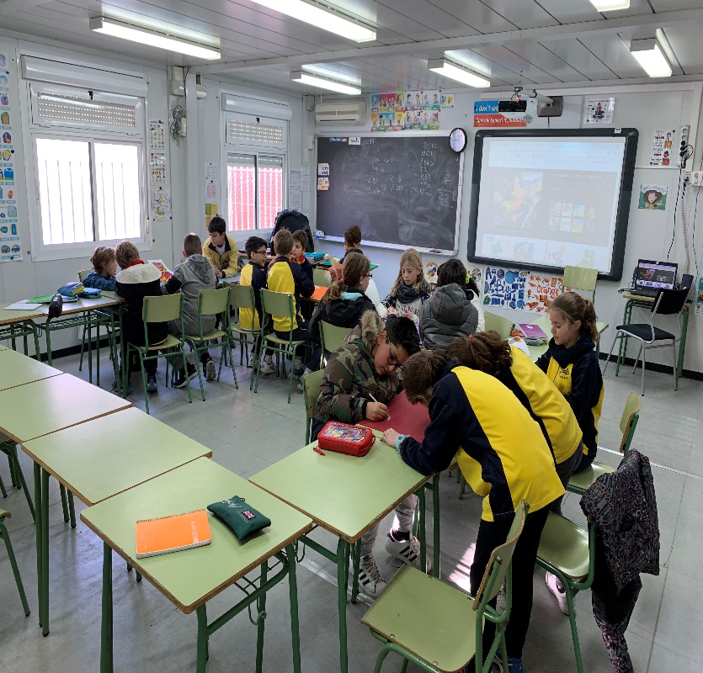
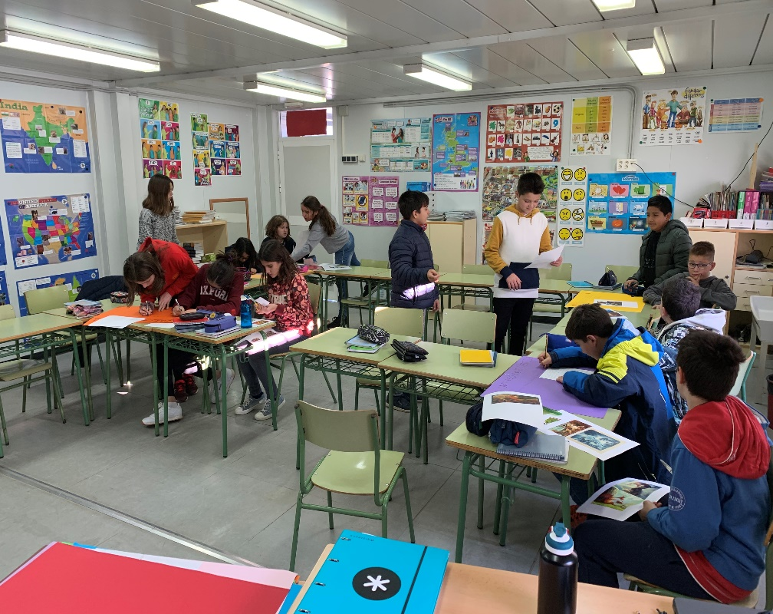
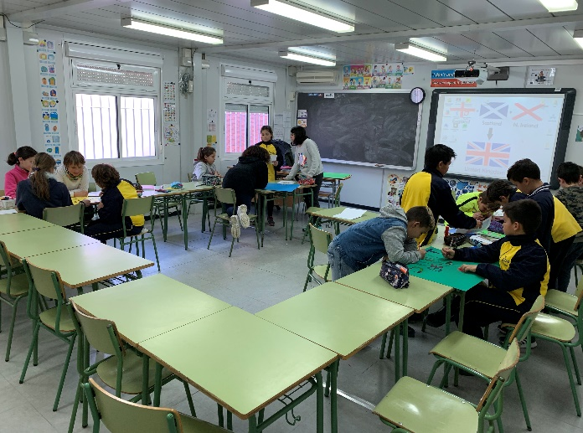
Saint George Legend and Saint George day

