Slide 1
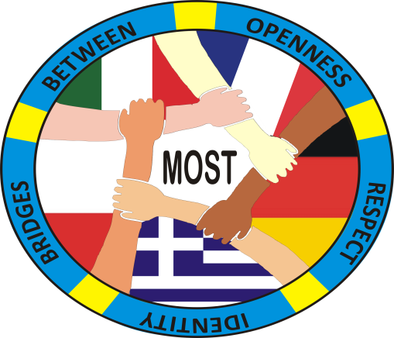
GREECE
Festival of Cultures
C2 Potenza, ITALY (13-17 April 2018)

Slide 2
Greece, officially the Hellenic Republic, historically also known as Hellas, is a country in Southern Europe, with a population of approximately 11 million as of 2016. Athens is the nation's capital and largest city, followed by Thessaloniki.

Slide 3
THRACE, GREECE

Slide 4
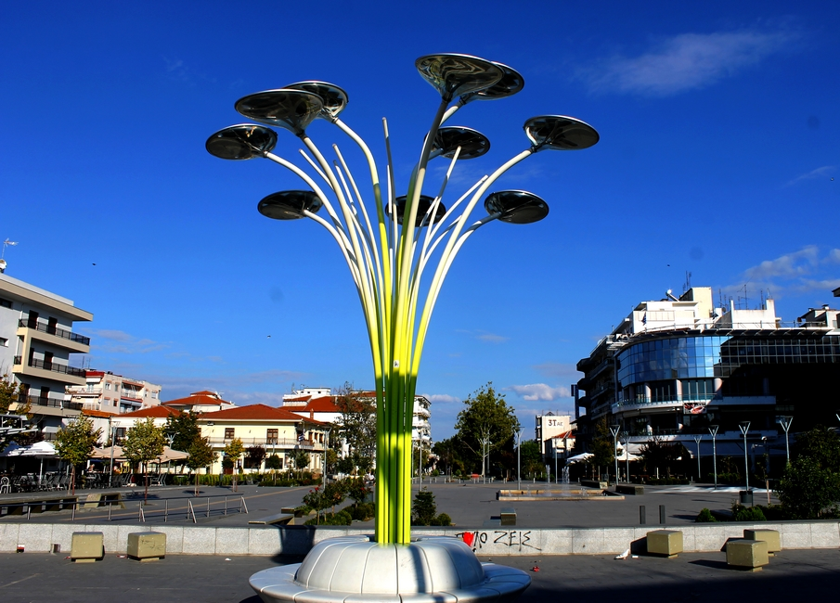
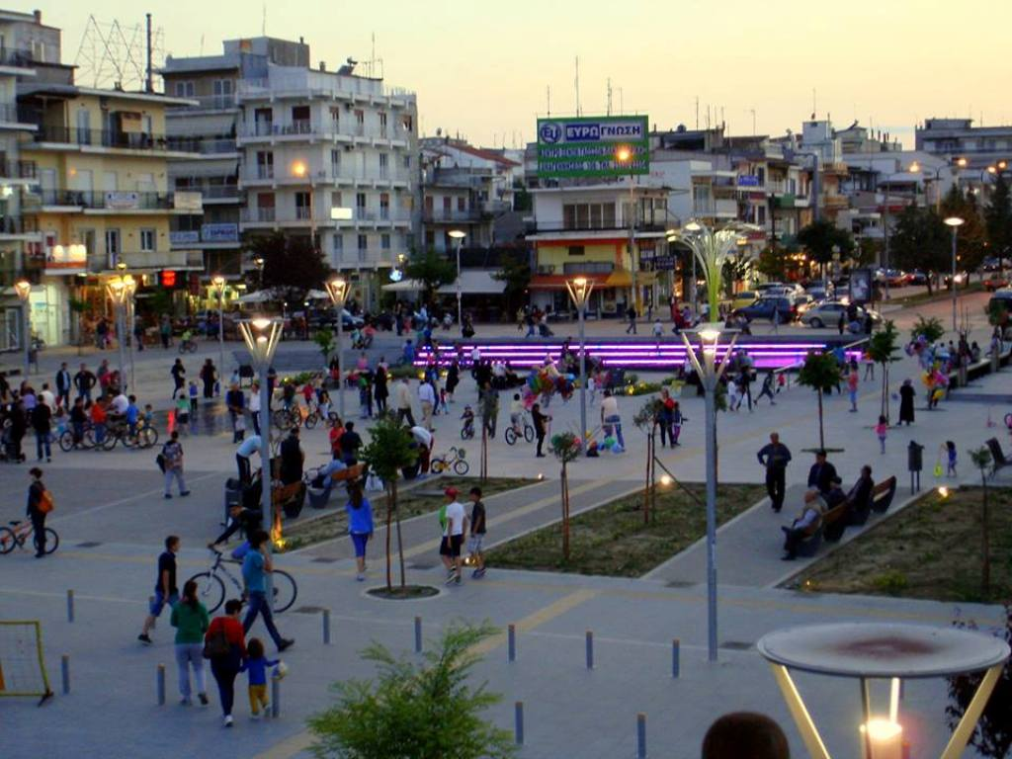
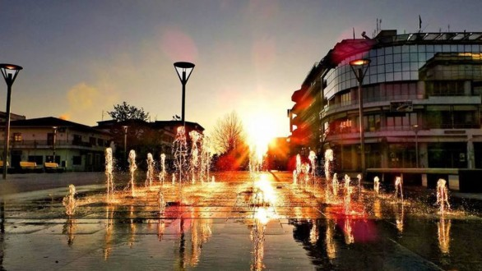
ORESTIADA EVROS GREECE

Slide 5
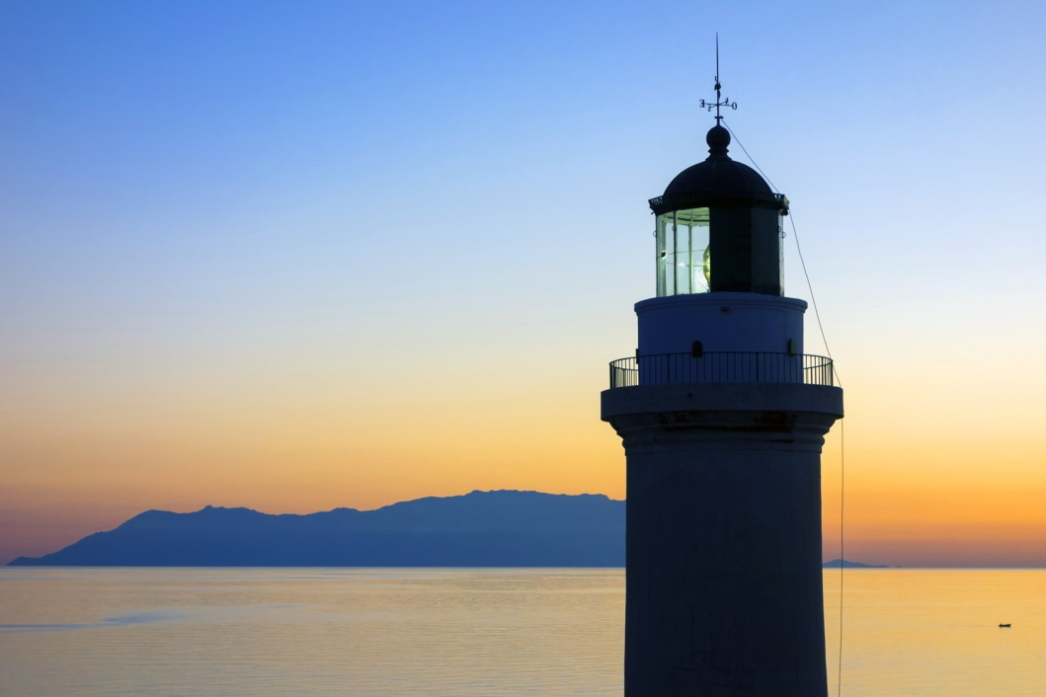
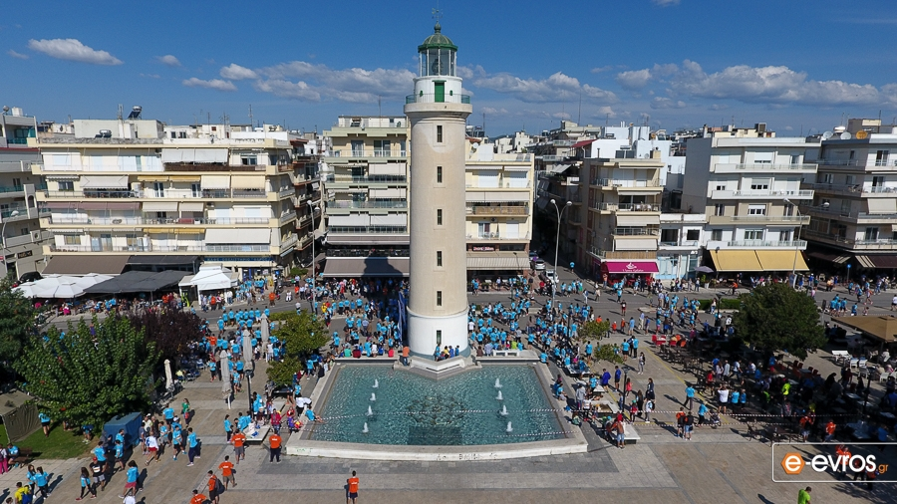
ALEXANDROUPOLIS EVROS GREECE

Slide 6
DANCE
In a country where folk dances are as alive today as they were in ancient times, Greece counts over 4,000 traditional dances spread across all regions of the country. Some dances are also known outside the Greek borders and were brought to many corners of the world thanks to the vast Greek diaspora. With the social function of bringing the community together, traditional dances are usually performed at weddings, baptisms, births or name days, or festivals and holidays such as Easter. Here are seven traditional Greek dances you should know.

Slide 7
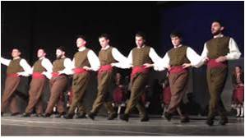
THRACIAN DANCE

Slide 9
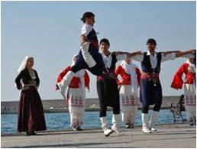
CRETAN DANCE

Slide 11
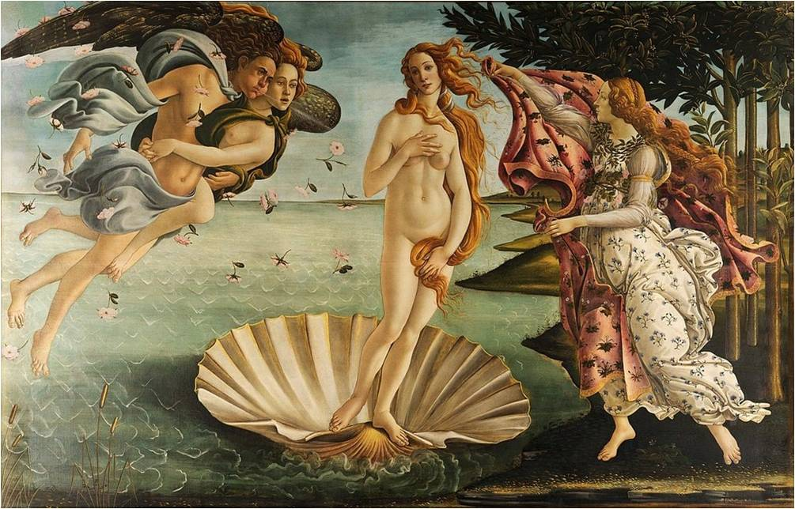
ART
One of the many fields in which ancient Greece has had a deep influence is art. The first to develop the concept of aesthetic beauty, ancient Greeks created spectacular sculptures that have inspired artists from the Renaissance until today. Furthermore, Greek mythology was a major source of inspiration for many European painters, which depicts the many tales and myths in their works.

Slide 12
WINGED VICTORY OF SAMOTHRACE
“NIKI TIS SAMOTHRAKIS”

Slide 13
STATUE OF KOUROS

Slide 14
STATUE DISCOBOLUS OF MYRON

Slide 15
POSEIDON,
GOD OF THE SEA

Slide 16
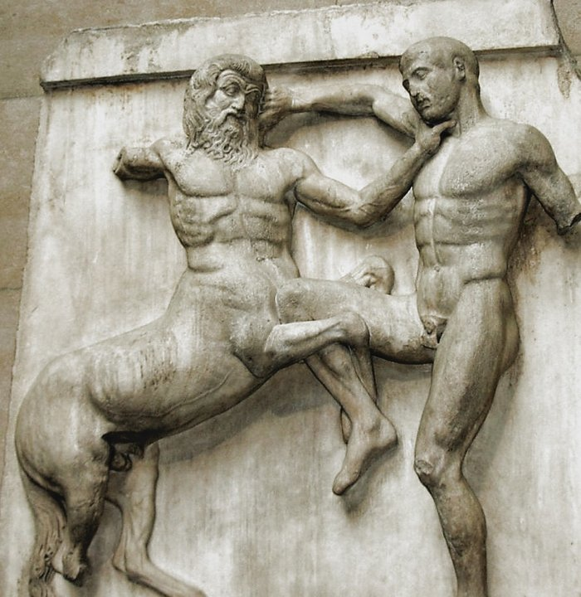
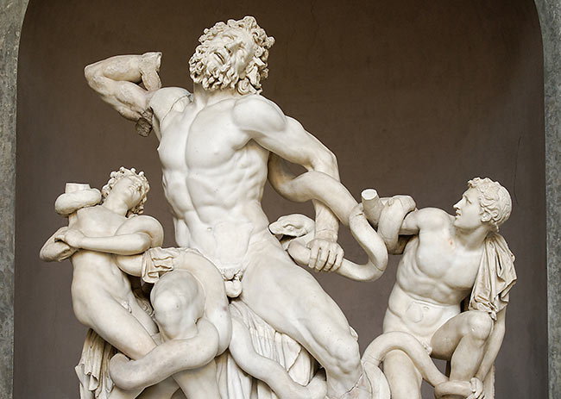

Slide 17
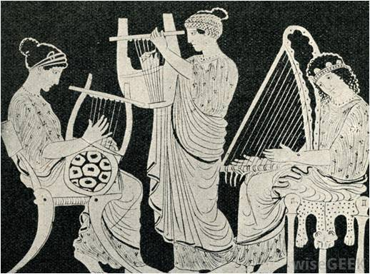
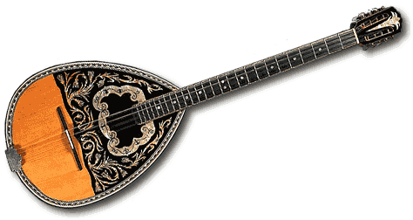
GREEK MUSICAL HISTORY
Greek musical history extends far back into ancient Greece, since music was a major part of ancient Greek theater. Later influences from the Roman Empire, Eastern Europe and the Byzantine Empire changed the form and style of Greek music. In the 19th century, opera composers, like Nikolaos Mantzaros (1795–1872), Spyridon Xyndas (1812–1896) and Spyridon Samaras (1861–1917) and symphonists, like Dimitris Lialios and Dionysios Rodotheatos revitalized Greek art music.

Slide 19
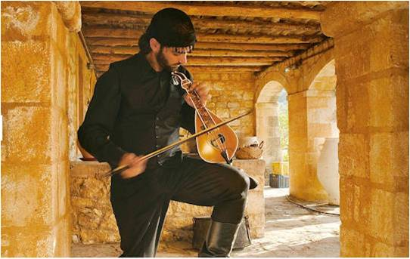
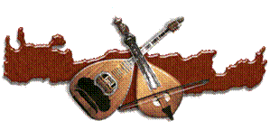
CRETAN MUSIC
The Cretan lyra is the dominant folk instrument on the island; it is a three-stringed bowed instrument similar to the Byzantine Lyra. It is often accompanied with laouto (laoúto), which is similar to both an oud and a lute. Nikos Xylouris, Psarantonis (Antonis Xylouris), Thanassis Skordalos, Kostas Moundakis, Ross Daly, Nikos Zoidakis and Vasilis Skoulas are among the most renowned players of the lýra. The violin is used also in Cretan music. The most renowned player of the violin is the Antonis Martsakis which is also a dancer. Mandolin is also used in Cretan music. Loudovikos ton Anogeion is a well-known mandolin player from Crete. The bass in that music coming from the laouto. Giannis Haroulis and Michalis Tzouganakis are notable artists of the instrument.

Slide 20
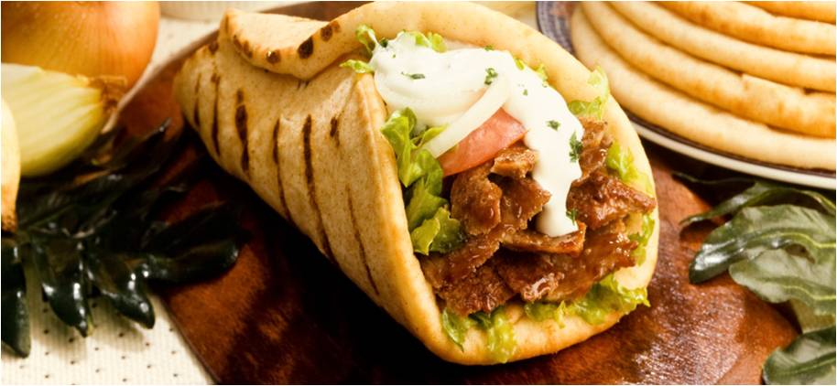
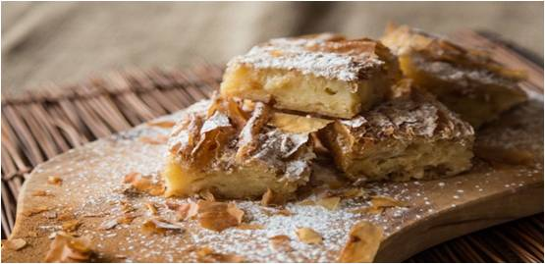
GREEK COOKING
Greek cooking offers an incredibly rich and diverse array of foods and beverages that are the culmination of literally thousands of years of living, cooking, and eating. While each Greek meal is fresh and inviting, it is also a trip back through Greece's history. Ingredients The names of foods, cooking methods, and basic ingredients have changed little over time. Bread, olives (and olive oil), and wine constituted the triptych of the Greek diet for many centuries, just as they do today. Greece is a nation of small farmers who produce an incredible array of mainly organically produced cheeses, oils, fruits, nuts, grains, legumes, and vegetables, supplemented by an array of greens and herbs that grow in the wild. These are the foods that form the base of the traditional Greek regimen, to which they add both variety and nutrition.

Slide 21
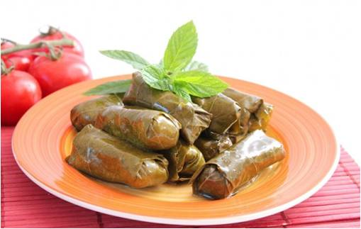
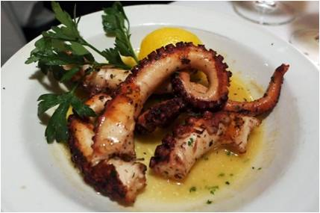
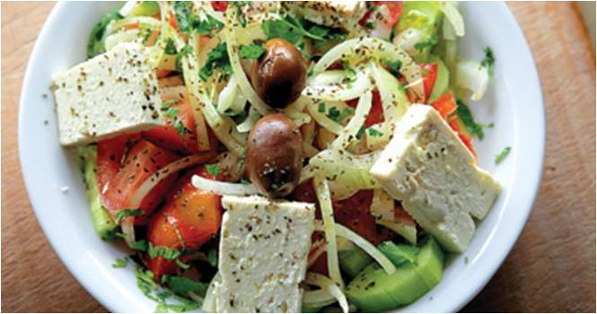
GREEK INGREDIENTS
Greece's climate is perfect growing for olive and lemon trees, producing two of the most important elements of Greek cooking. Spices, garlic and other herbs such as oregano, basil, mint, and thyme are widely used, as are vegetables such as eggplant and zucchini, and legumes of all types. With 20 percent of Greece made up of islands - and no part of the Greek mainland more than 90 miles from the sea - fish and seafood are a popular and common part of the Greek diet. Lamb and goat (kid) are the traditional meats of holidays and festivals, and poultry, beef, and pork are also in plentiful supply. Vineyards cover much of Greece's hilly terrain and the country has become known for its array of fine wines and spirits, most notably ouzo, an anise-flavored liqueur that is the national spirit.

Slide 22
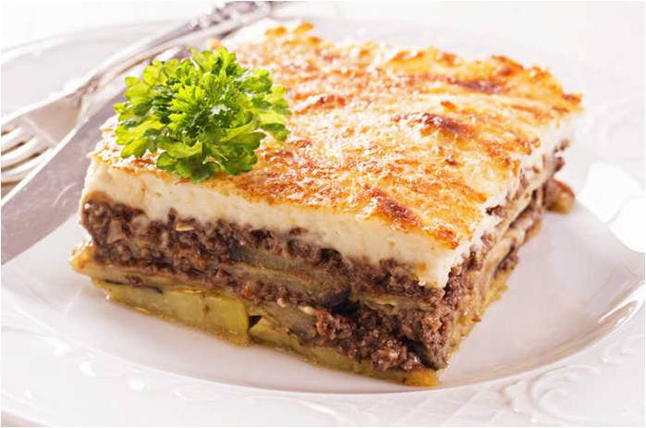
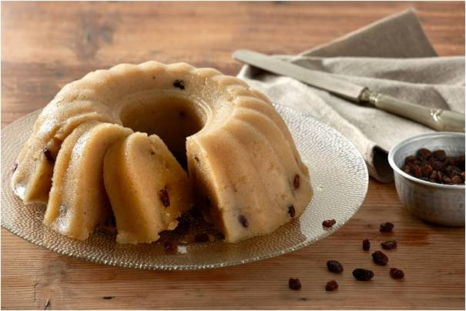
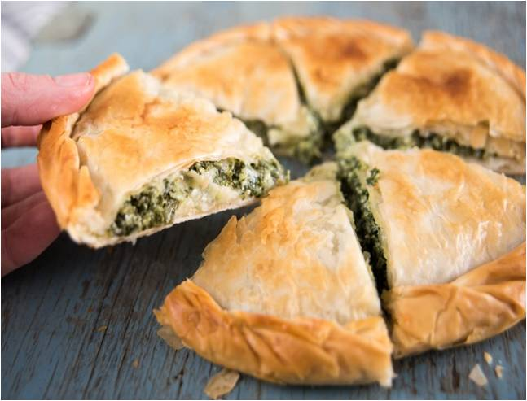
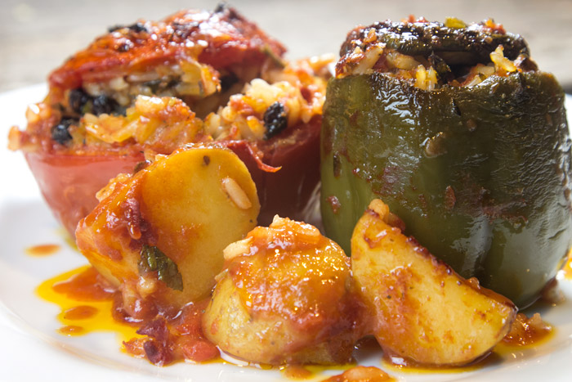
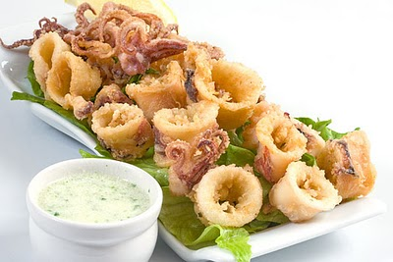

Slide 23
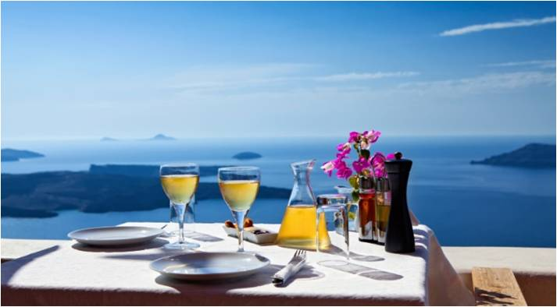
GREEK BEVERAGES STRAIGHT FROM NATURE
Greek wine has created a buzz in the last few years, and its diversity lets you take a drinkable souvenir with you from a number of fantastic locations. Depending on where your travels brought you, bring home the classic white Assyrtiko or sweet Vinsanto from Santorini, or local wines from the islands of Lesvos, Kefalonia, Limnos or Rhodes. Plus, it’s hard to go wrong with a refreshing white Moschofilero or one of the richest Greek reds, Xinomavro. If you’ve spent time exploring Crete, take home a fiery raki/tsipouro or the sweet rakomelo, or try one of a huge variety of local ouzos you can find all over Greece. Finally, one of the most unique tastes in Greece is the mastiha liqueur, a local speciality of the island of Chios.

Slide 24
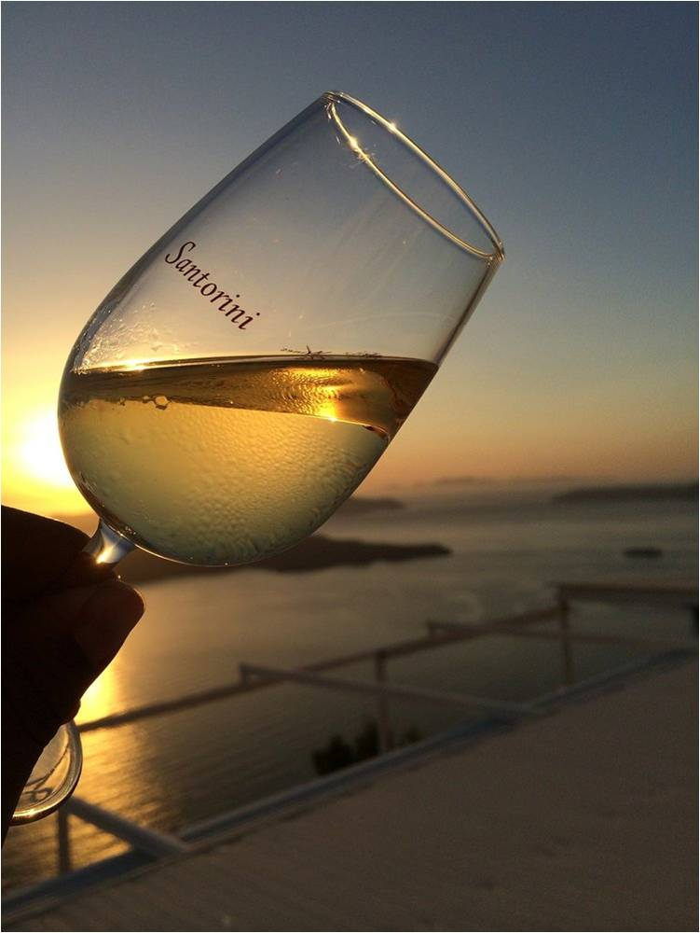
WHITE WINE

Slide 25
RED WINE

Slide 26
LIQUEUR

Slide 27
OUZO

Slide 28
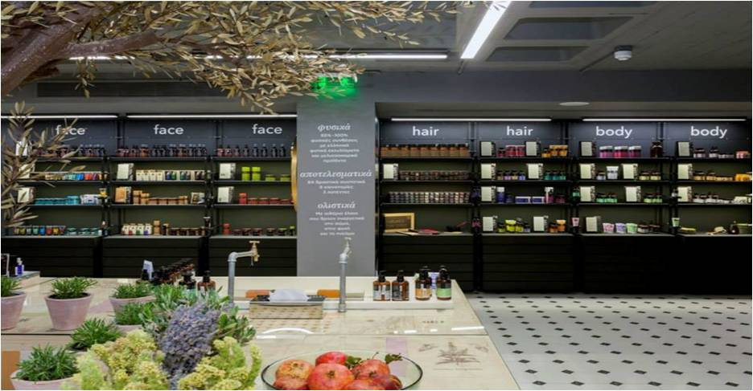
GREEK COSMETICS STRAIGHT FROM NATURE
Though the Greek climate may seem a little dry, this is actually a misperception, and the country has rich ecosystems with incredible biodiversity. Several clever companies have worked to harness the bounty of Greek nature and have bottled it up into high-quality cosmetics. The internationally-famous Korres has its own research lab where biologists work to identify the healing properties of various Greek plants, and they offer a huge variety of natural products, from sunscreen to body wash to makeup, made with the best Greece has to offer. A similar company is Apivita, which is also inspired by the richness of Greece’s natural landscape and traditional philosophies of well-being and holistic medicine.

Slide 29
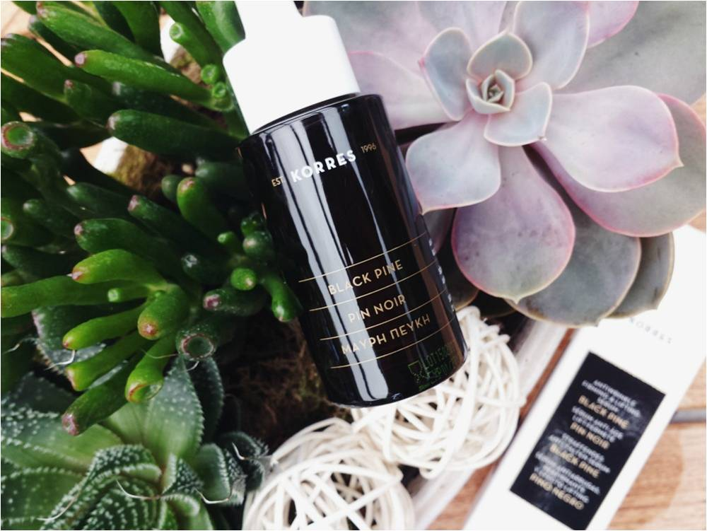

Slide 30
