Slide 1
Working experience in a hospital
Alina Seyfert; Carolin Tudziers

Slide 2
Structure
Company
Facts
Economical Situation
Exercises
Alina
Carolin

Slide 3
Company
1982 opening of the hospital
1995 renovation of all sections
2005 opening of radiology office
2013 cooperation with Heidelberg

Slide 4
Facts
7 departments
280 beds
700 employees
12.500 inpatients
20.000 outpatients
44,7€ billion income
Good infrastructure

Slide 5
Economical Situation
problems with financing
Supplies for patients get more expensive
general costs increase
2011/2012 losses of 2 Million €
→2014 improvement of economical situation
→more patients
→support of Heidelberg

Slide 6
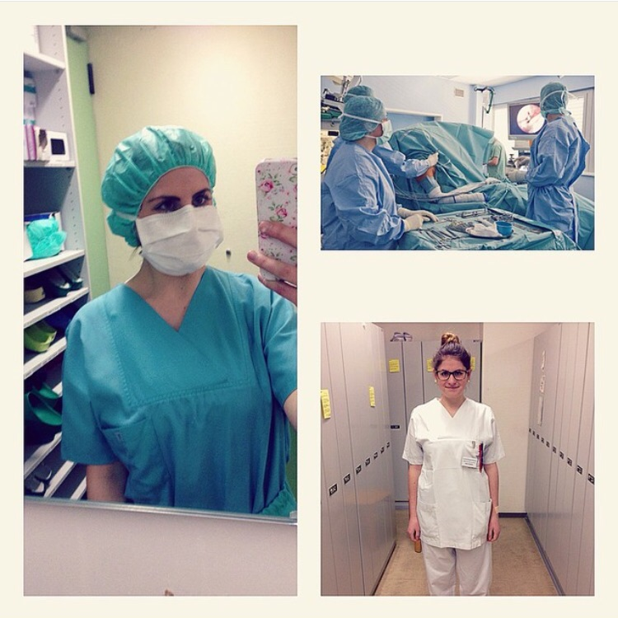
Exercises
watching and helping the nurses
admisson of new patients
took the blood pressure & the temperature of the patients
help the nurses with giving the meals to the patients
bring the patients to their medical checks

Slide 7
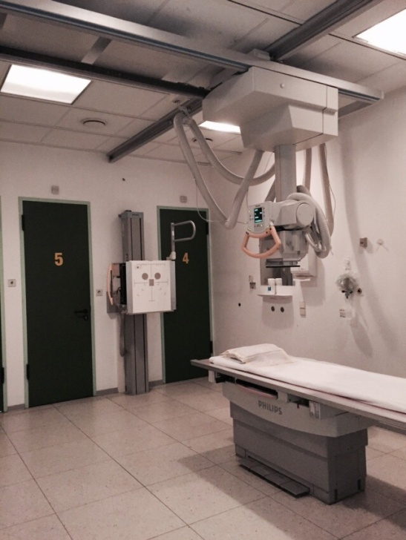
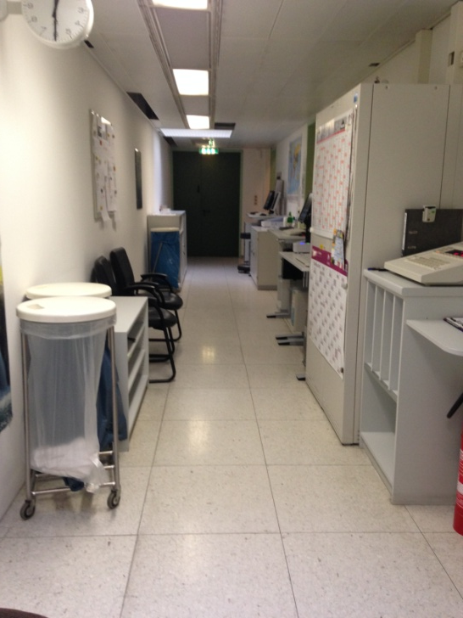
Exercises
Introducthe patients to the x-ray examination
Help them to stay in their position
Announce the patients for their x-ray
Bringing documents to the archives

Slide 8
Thank you for your attention.

