Slide 2
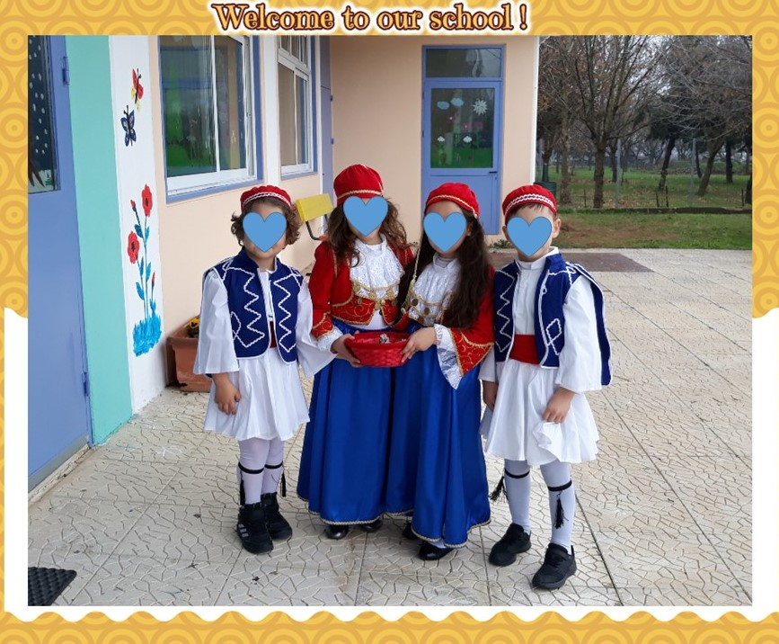

Slide 3
Rizario Kindergarten is a preschool education school that offers quality in the educational process and is constantly evolving, incorporating all kinds of innovation in its program.
We have as goal to create a school that will be innovative and provide access to a high level of education for all .It is one of etwinning schools that has been awarded this title for the year 2018 among of thousands of schools in Europe.

Slide 4
Part of our philosophy and our priority is to improve our work by adopting new teaching methods and constantly training our staff for the benefit of the whole school unit.
Our goal is children’s all sides development and their smooth socialization, in order that they be ready to face the “information and knowledge society "where they are going to live.

Slide 5
Its pioneer participation in various innovating programs(environment education, health education, Olympic education, traffic education, STEM, robotics ,teaching of English, European projects Comenius, Erasmus and e twinning )has made it known throughout the local society and wider community and it can exhibit a quite rich action in the last 20 years, with a lot of National and European discriminations.

Slide 7
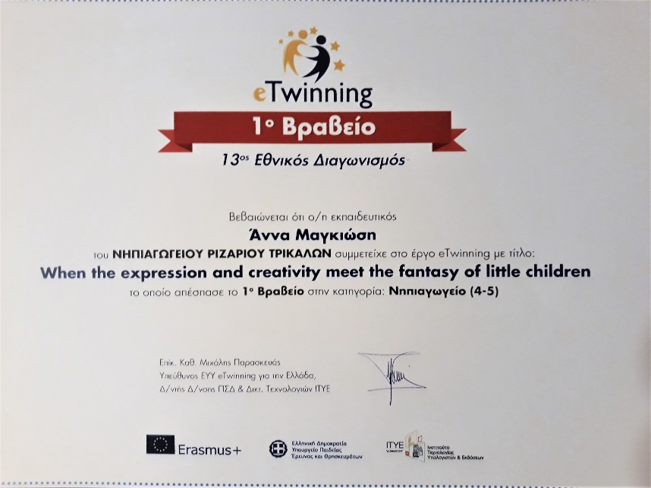
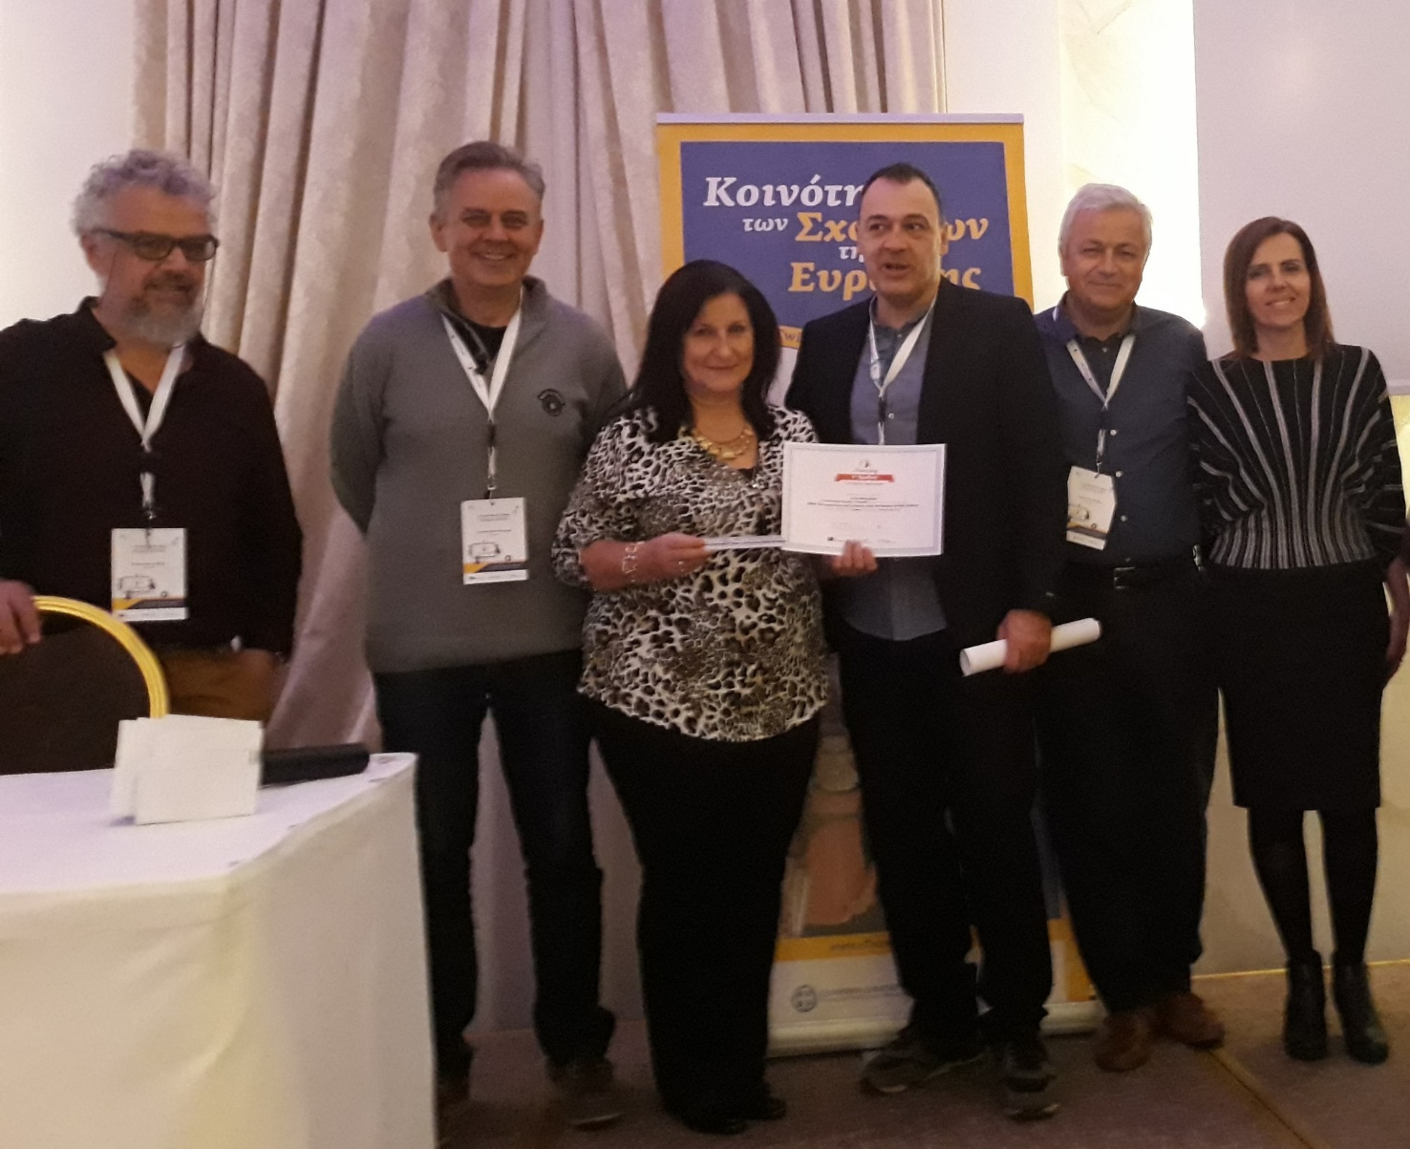

Slide 8
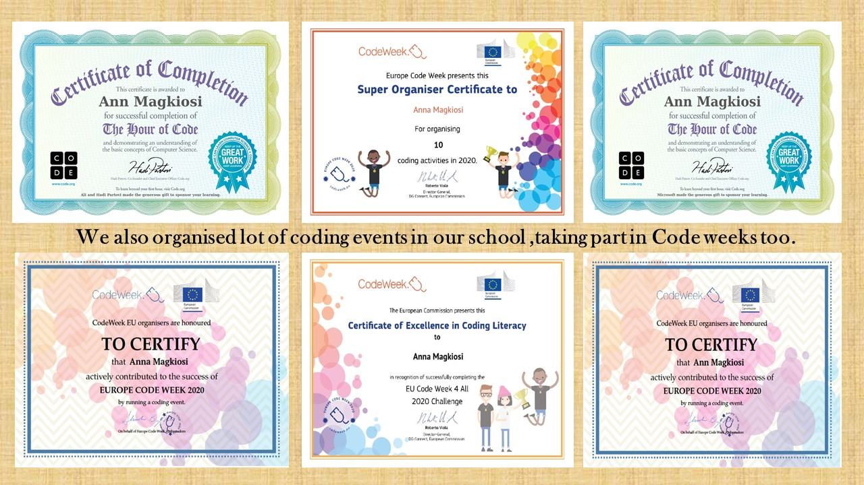

Slide 9
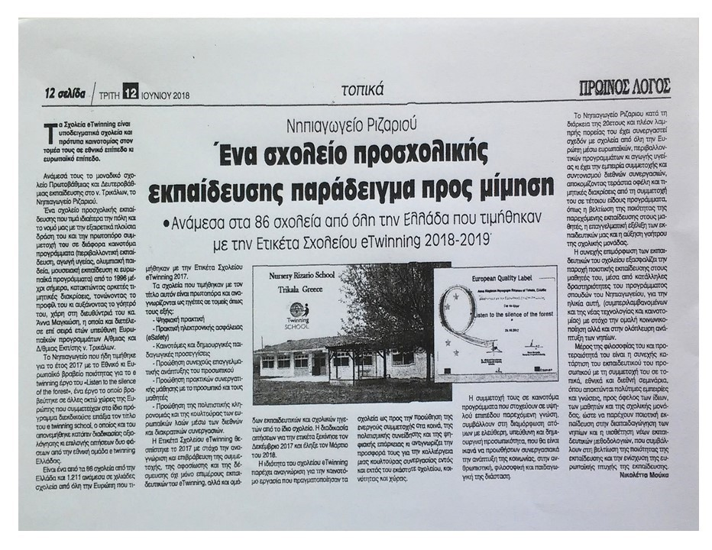

Slide 10
By participating in international partnerships and giving our teachers the opportunity to visit other countries, to experiment with new ways of teaching, to know the way that other people think and to understand the idea of European education, we believe that we are helping to strengthen the European dimension in education, while at the same time strengthening the European aspect of common education.

Slide 13
Our aim is the creating of a digital kindergarten that will be open to society ,will be innovative and provide access to high-quality education for all children, a school that will be a model in the educational and local, national and European community.
Rizario Kindergarten, is a preschool education center with well-trained staff offering its students, regardless of gender or ethnicity, equal opportunities for all-round development, smooth socialization and quality education so they are ready to face the society of information and knowledge where they will live.

Slide 14
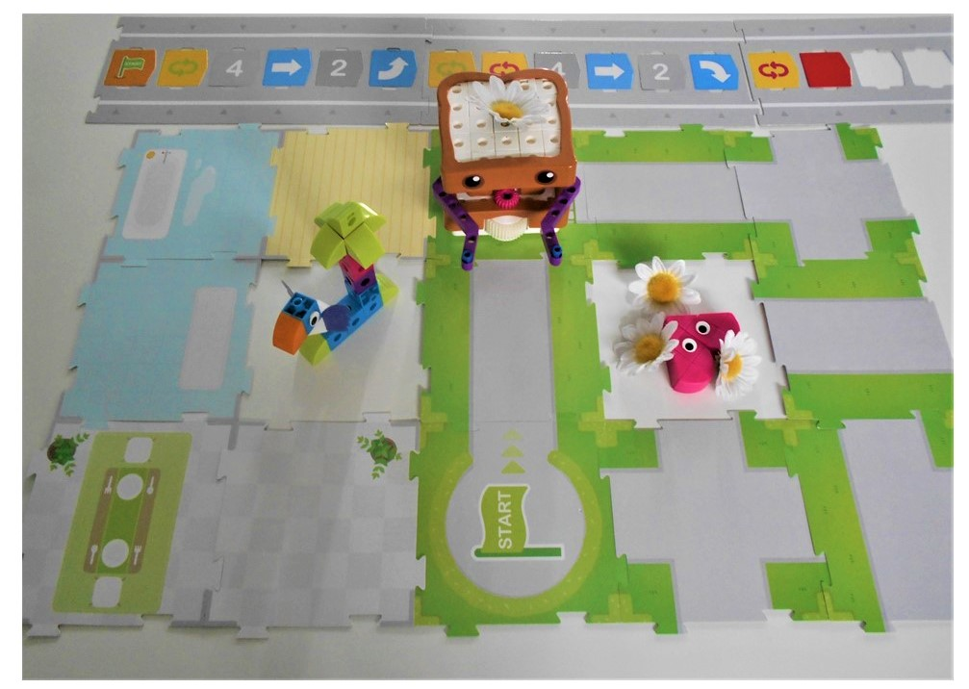

Slide 17
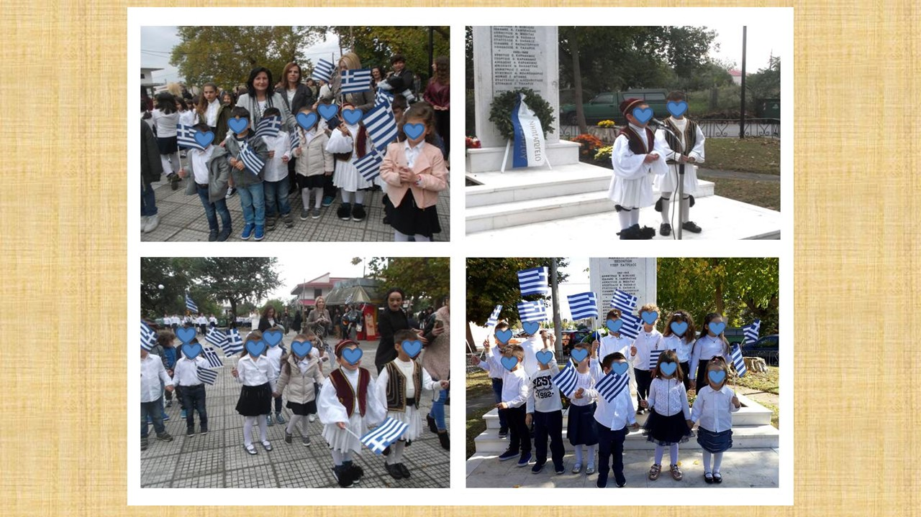

Slide 18
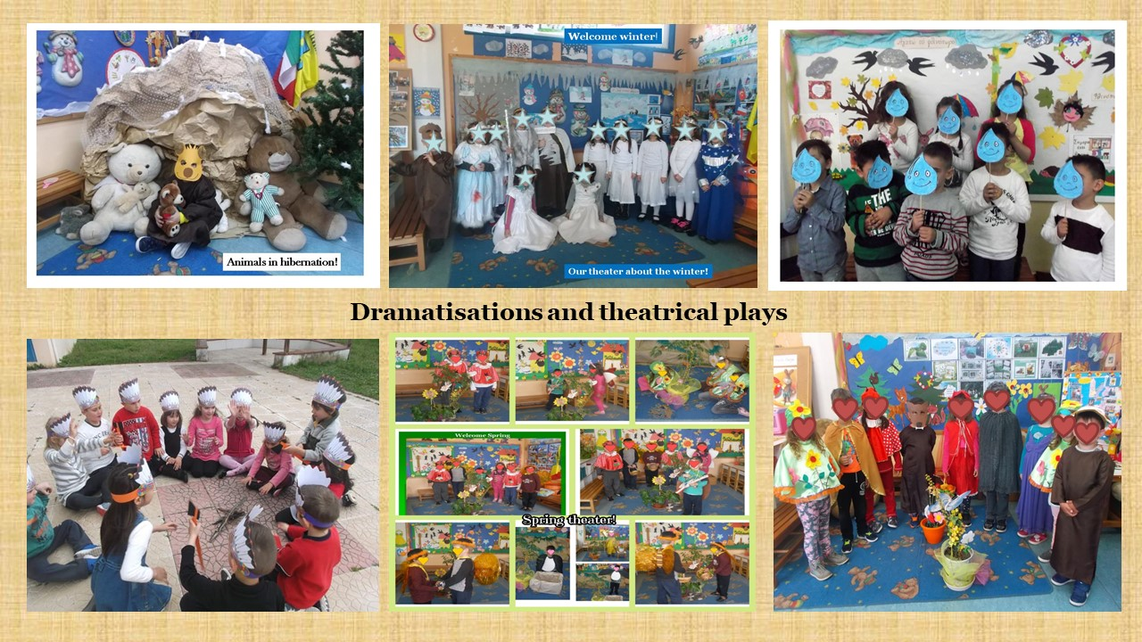

Slide 20
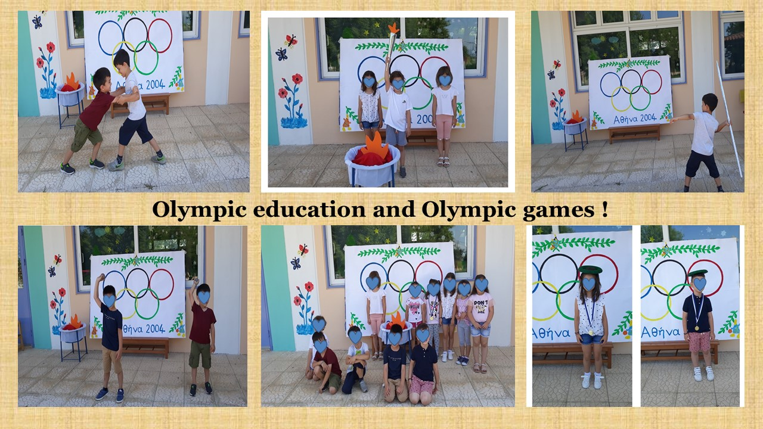

Slide 21
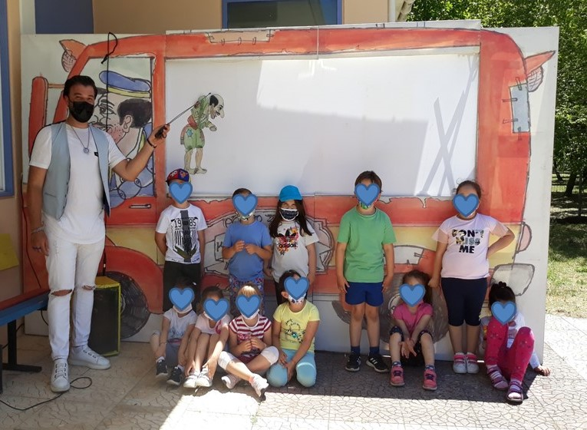
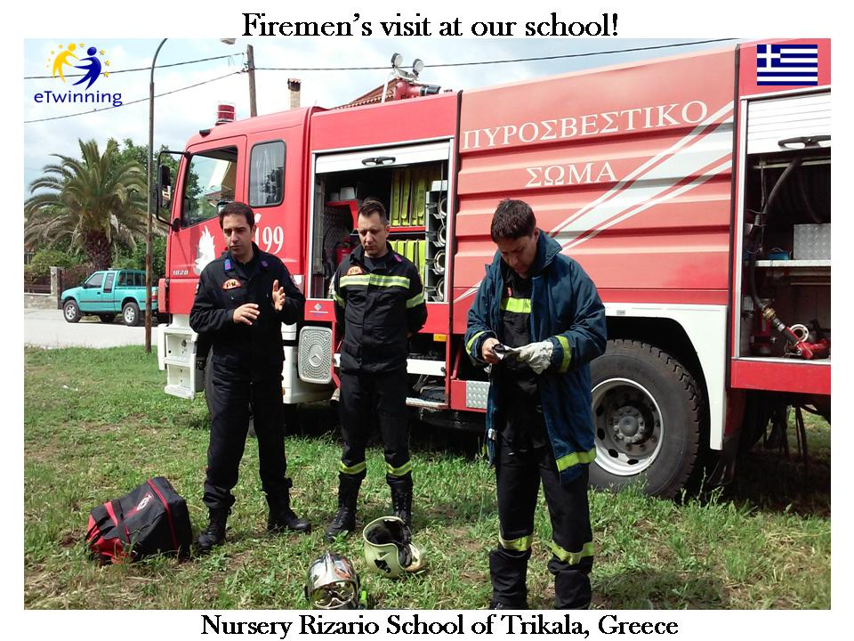
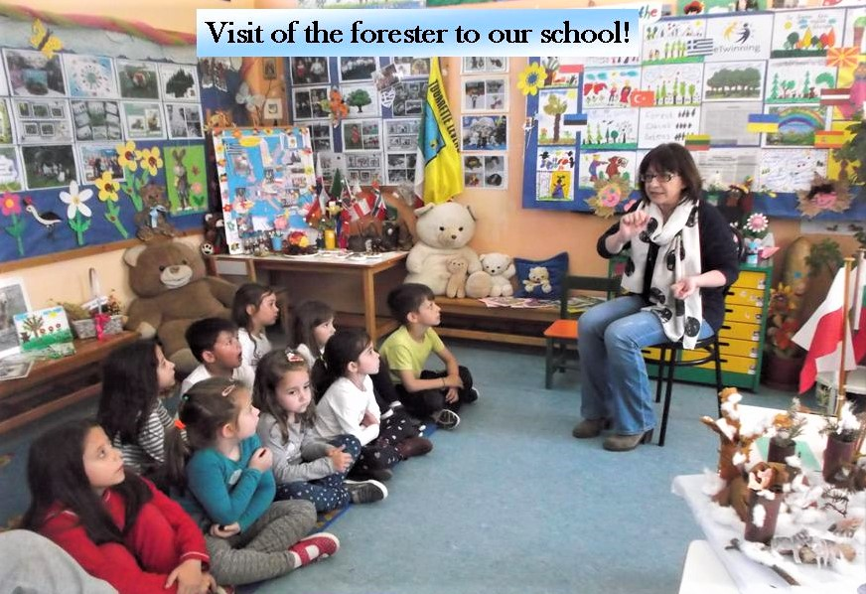
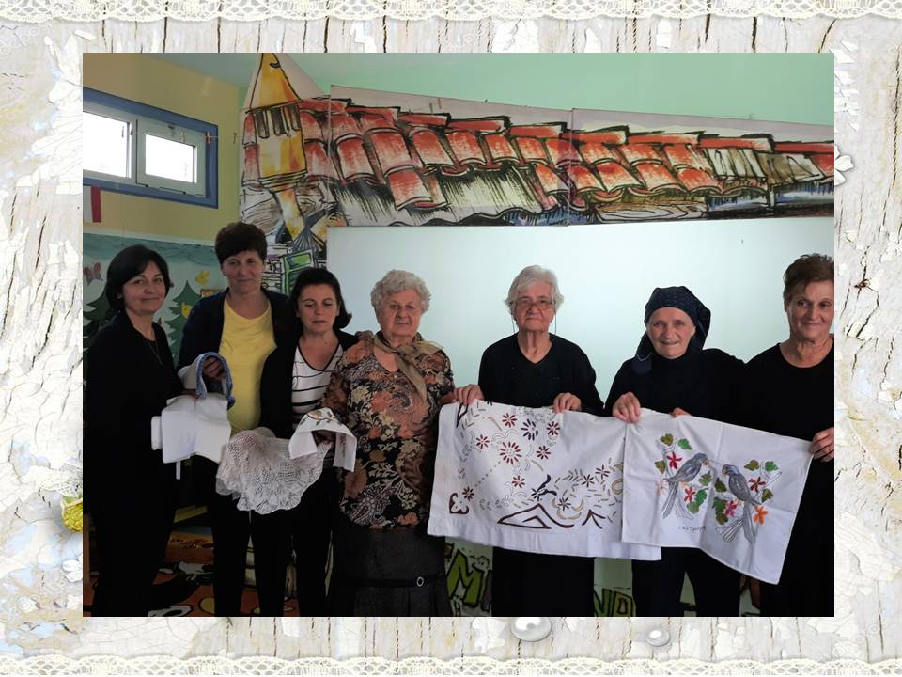
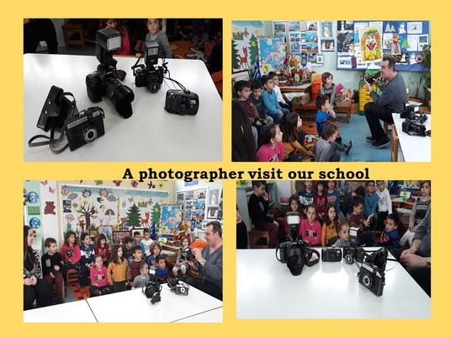

Slide 22
Pre-primary education in Greece
Children first go to kindergarten at the age of 4 years. The curriculum in kindergarten aims to prepare students for the first grade and the years to follow.
At the age of 6 years, students enter the Primary
or Elementary school until the age of 12 years.
Of course they are schools for younger children (age 2 to 4) the kindergarten stations or Vrefiki stathmi.

Slide 23
Primary Education
In the age of 6 years children start their
lessons in the primaries schools.
There are 6 (six)"classes" :
Grade 1: age 6 to 7
Grade 2: age 7 to 8
Grade 3 : age 8 to 9
Grade 4 : age 9 to 10
Grade 5 : age 10 to 11
Grade 6 : age 11 to 12

