Slide 1
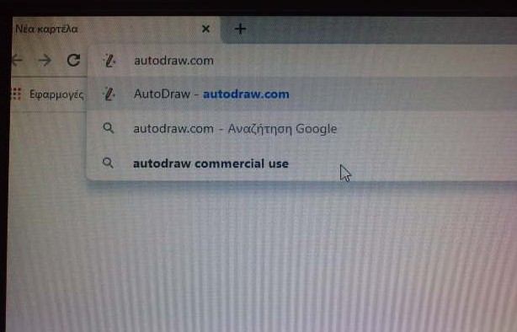
What is Auto Draw?
Auto Draw is a change game, an internet-based tool.
Auto Draw is available at autodraw.com.
Fast Drawing for Everyone!

Slide 2
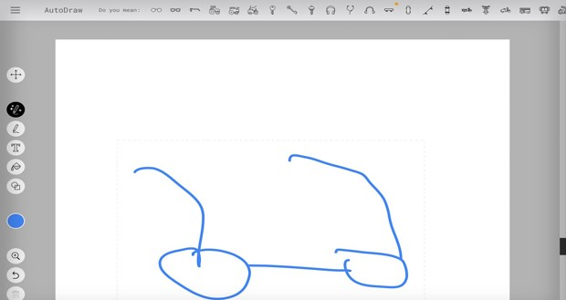
How does it work;
We make a sketch with the mouse and our system shows a set of ready-made business sketches to choose from and replace ours.

Slide 3
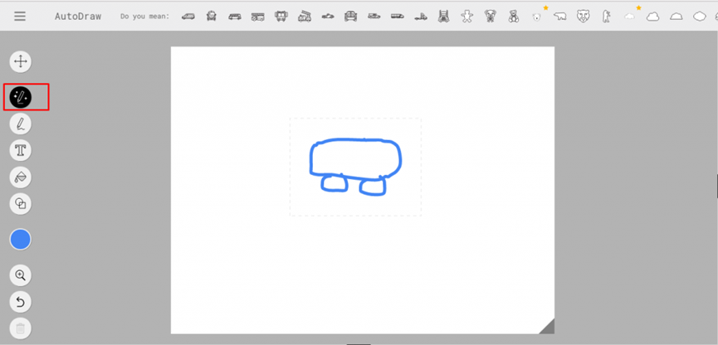
The application uses Artificial Intelligence to understand what we almost want to design through a few lines that we draw on its empty canvas.
By selecting one of the suggested sketches you will see your sketch changing and the result improved.

Slide 4
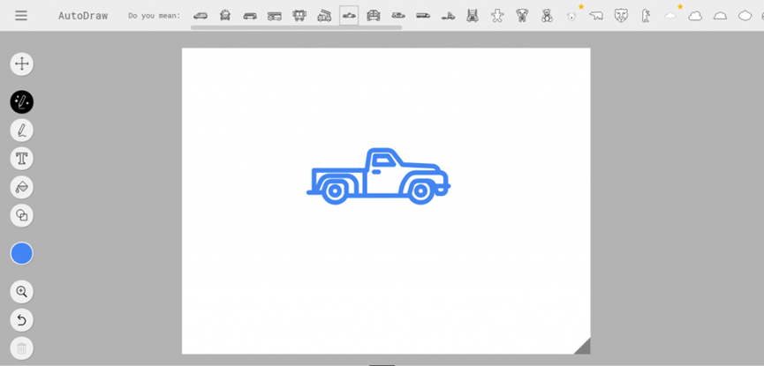
The application can prove to be particularly useful for teachers as it enables them to create sketch-sheets according to what they want to present, even if their design skills are not as well developed.

Slide 5
Auto Draw has common painting tools made up of a white canvas where you can draw freely with the drawing tool, paint, create geometric shapes, and enter text.

Slide 6
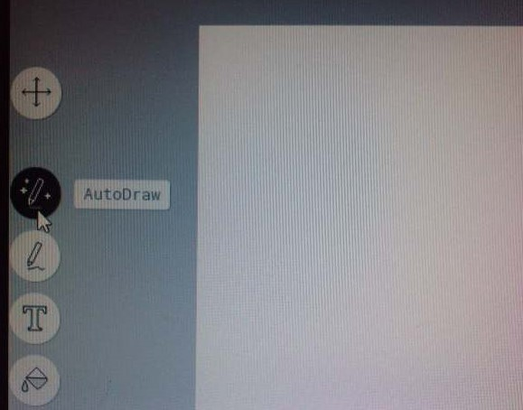
Start draw and the Auto Draw suggestion tool will start guessing.

Slide 7
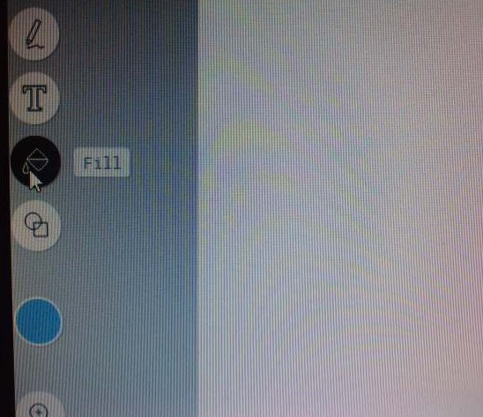
Add color with the Fill tool.

Slide 8
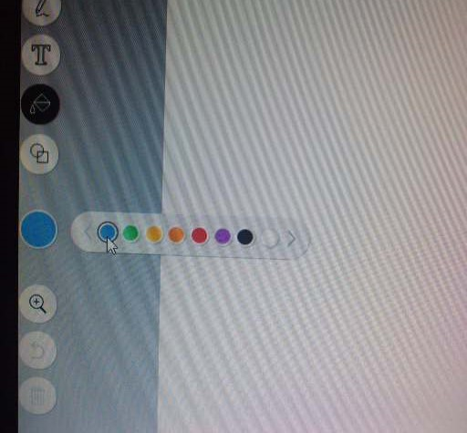
Choose colors with the color picker.

Slide 9
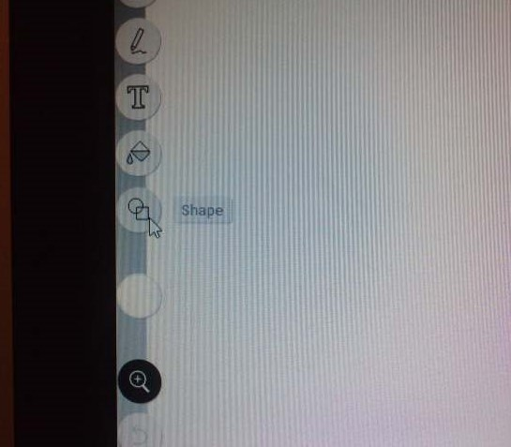
Make shape with the Shape tool.

Slide 10
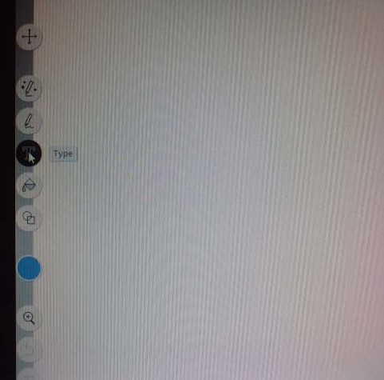
Add text with the Type tool.

Slide 11
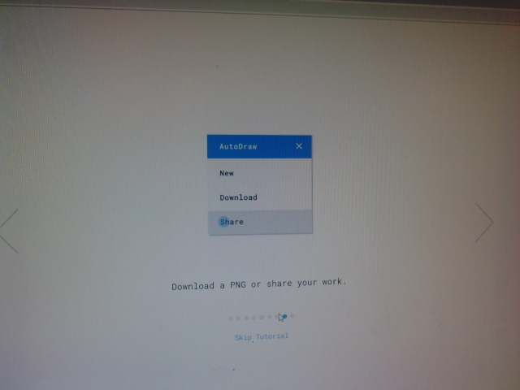
Its only downside is that we have to finish our creation, because saving is not allowed to continue later. Only saving our final creation is done.
Download or share your work

