Slide 1
Erasmus+ project 3 LTT event in France
12.11 – 15.11.2019 Torrette-Levens, France
École maternelle TORDO

Slide 2
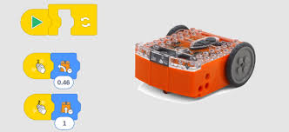
1. EDISON EDUCATIONAL ROBOT

Slide 3
Reading barcodes
to lead with sound
to led with light
Follow/avoid the line
Find all barcodes: https://meetedison.com/content/Edison-robot-barcodes.pdf
Programming in EdBlocks application
https://meetedison.com/content/EdBlocks-lesson-activities-complete-set.pdf

Slide 5
Reading the barcode

Slide 6
To lead with handclaps
1 clap – turn
2 claps – drive straight

Slide 7
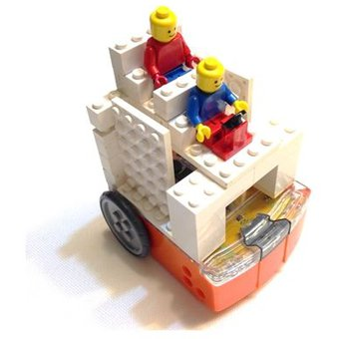
Following the line – position of robot
Black tape
Sharp angles NB!
Edison and Legos

Slide 8
Programming in EdBlocks application

Slide 9
Lets rehearse programming

Slide 12
Lets drive!
Step 1: Set up your computer
Make sure that the volume of speakers is on maximum level.
Step 2: connect Edison with your computer
Use the EdComm wire to connect Edisoni with computer.
Step 3: get Edison ready
Push the round button once.
Step 4: Download the program to Edison
Look at the right upper corner and find the button “program Edison”. Click the button.

Slide 13
New window appears.
Klick the button ‘Program Edison’.
You can hear the program being downloaded to Ediosn. After finishing downloading you can hear a beep. Don’t disconnect Edison before you can hear the beep.
To start with the programme push triangle button.

Slide 14
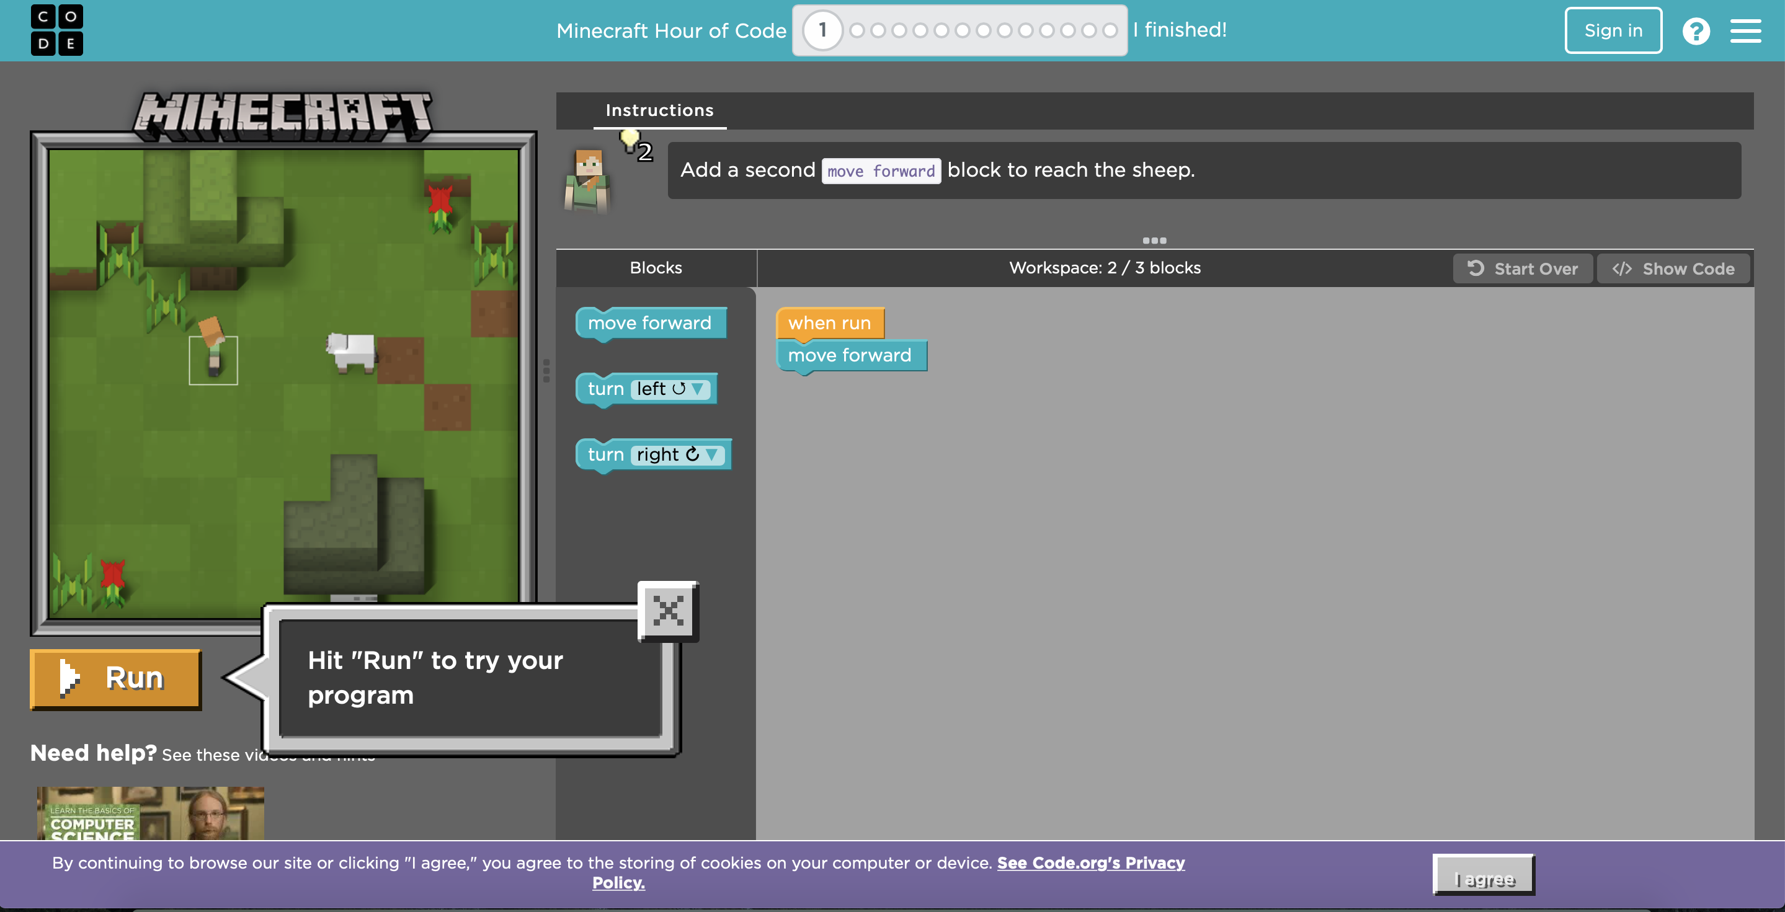
2. Programming
Minecraft education – Minecraft adventurer
https://code.org/minecraft

Slide 15
More opportunities for programming:
Younger children – games with Bee-Bots.
Scratch
Blockly
Tynker
Apps – koding games for children:
Daisy the Dinosaur
Spritebox

Slide 16
3. Animation, picture story
ANIMAKER.COM

Slide 17
Lets start:
Log in with Google account or Facebook.
Free version is limeted!
Video lenght maximum 2 minutes
Videos can not be uploaded to computer
5 shared videos per month

Slide 18
You can choose a empty project or ready templates.

Slide 21
Samples:
ANIMATION- https://www.youtube.com/watch?v=ZBEHgx4D4vU&feature=youtu.be
CHRISTMAS GREETING (READY TEMPLATE)
https://youtu.be/xcO4_DfzV1Y

Slide 22
POWTOON.COM

Slide 23
Lets start
Similar to animaker.com environment
Log in with Google or Facebooki account
Free account has limited opportunities

Slide 25
Compose videos or presentations

Slide 26
You can share your work through Facebook or Youtube

Slide 27
4. Crossword puzzles, mazes
theteacherscorner.net
https://crosswordlabs.com/
https://www.worksheetworks.com/
https://www.puzzle-maker.com/ (not fre)
https://www.education.com/ (not free)
http://puzzlemaker.discoveryeducation.com/
http://www.suchsel.de.vu/ ( not english)

Slide 28
https://crosswordlabs.com/
Crossword Labs is very easy to use. You can create crosswords and save them for playing and sharing.
You can also create account and there is more opportunities for shareing and saving. The fee is 9.95 USD.

Slide 29
https://crosswordlabs.com/
You can also use it without account, but then the created crosswords are public and can not be deleted.
You have to save the link for later use.
You can save crosswords in PDF or in Word.
When saved in Word Document you can solve the crosswords in computer.
If you share in social media or e-mail the system generates a link and then you can solve crossword in environment.

Slide 30
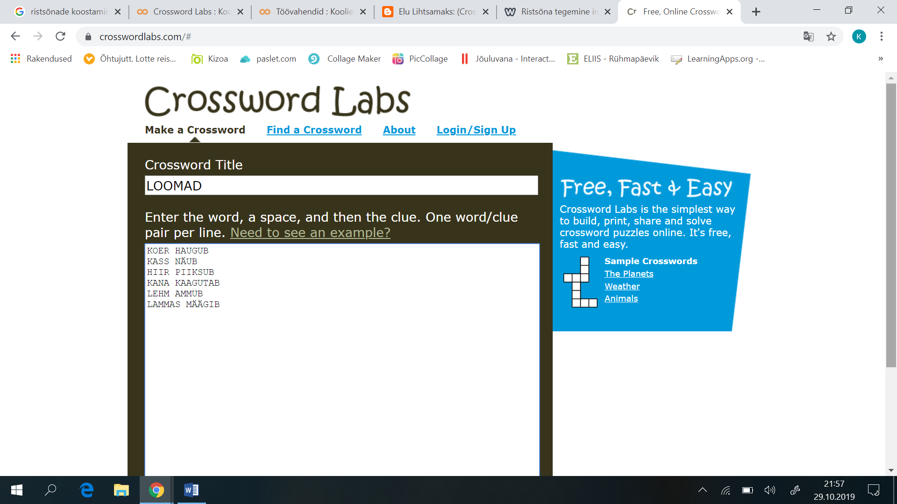
https://crosswordlabs.com/

Slide 31
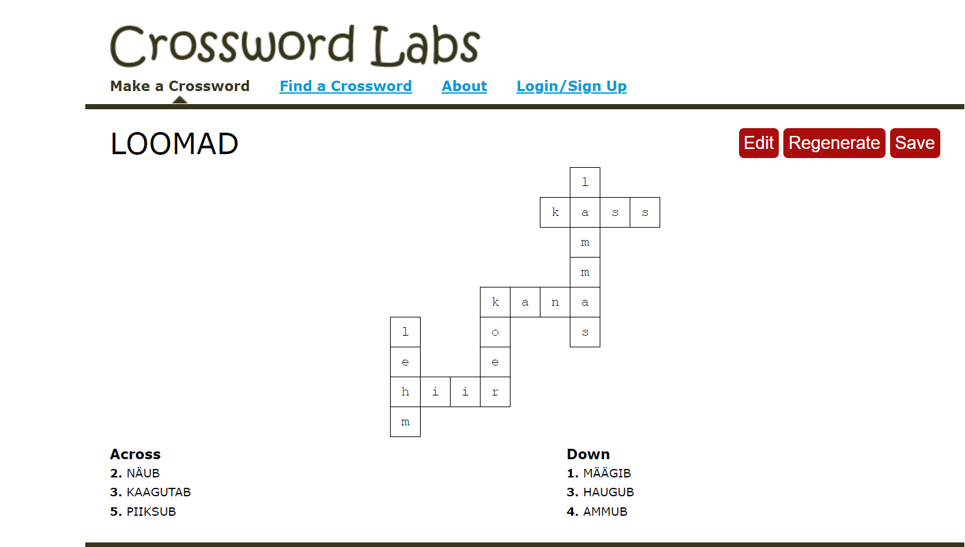
pdf

