Slide 1
Creation of e books via story jumper!
Presentation by Ann Magkiosi
Notes:
Presentation by Ann Magkiosi

Slide 2
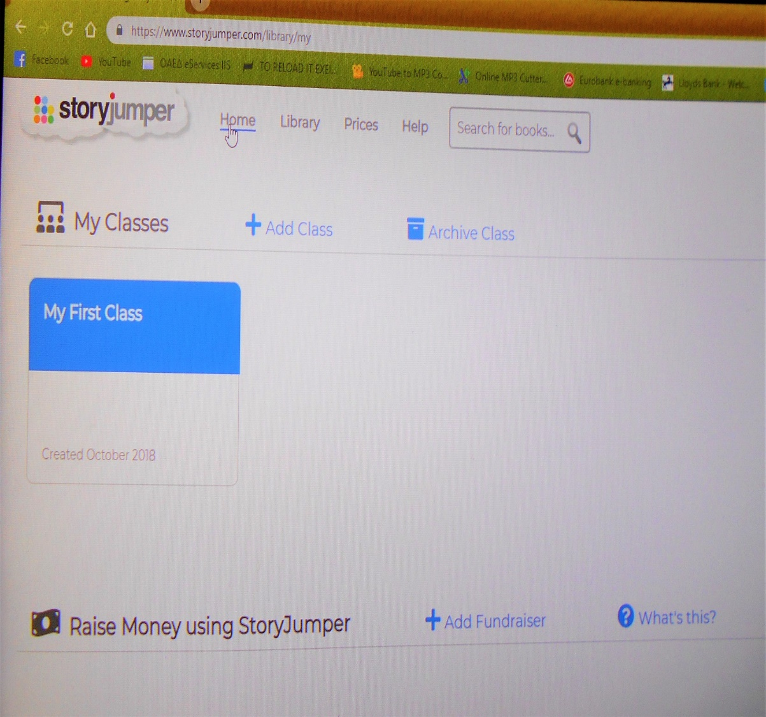
Easy web tool for all!
What is Story jumper?
Is an internet-based
tool that help us to
create easy e books!
Story Jumper is available at
https://www.storyjumper.com

Slide 3
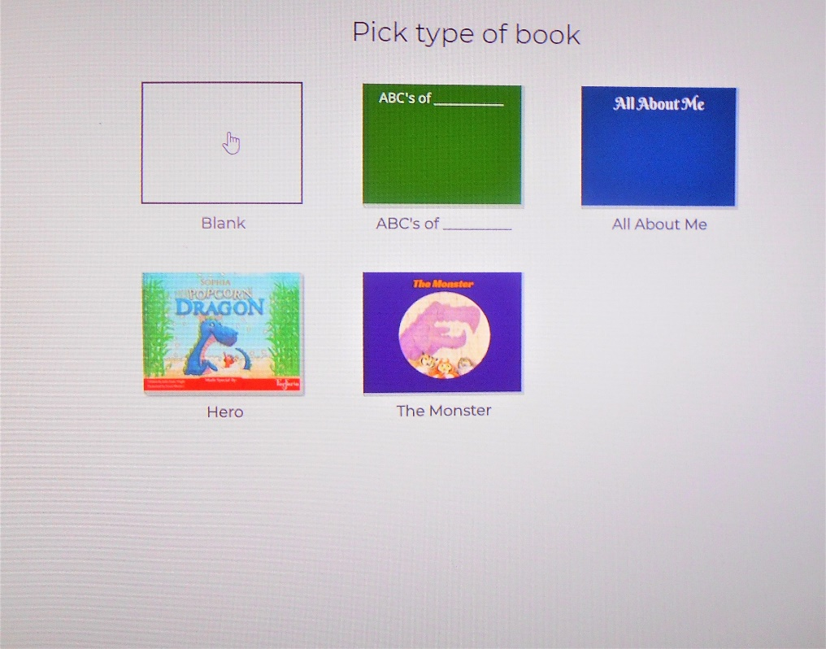
How does it work;
Make your registration first
and open the tool.
Press : Create a book
Then ender your pictures .
Chose the version of props
Choose the type of book or create your own!
In this sample we will use the blank for our e book!

Slide 4
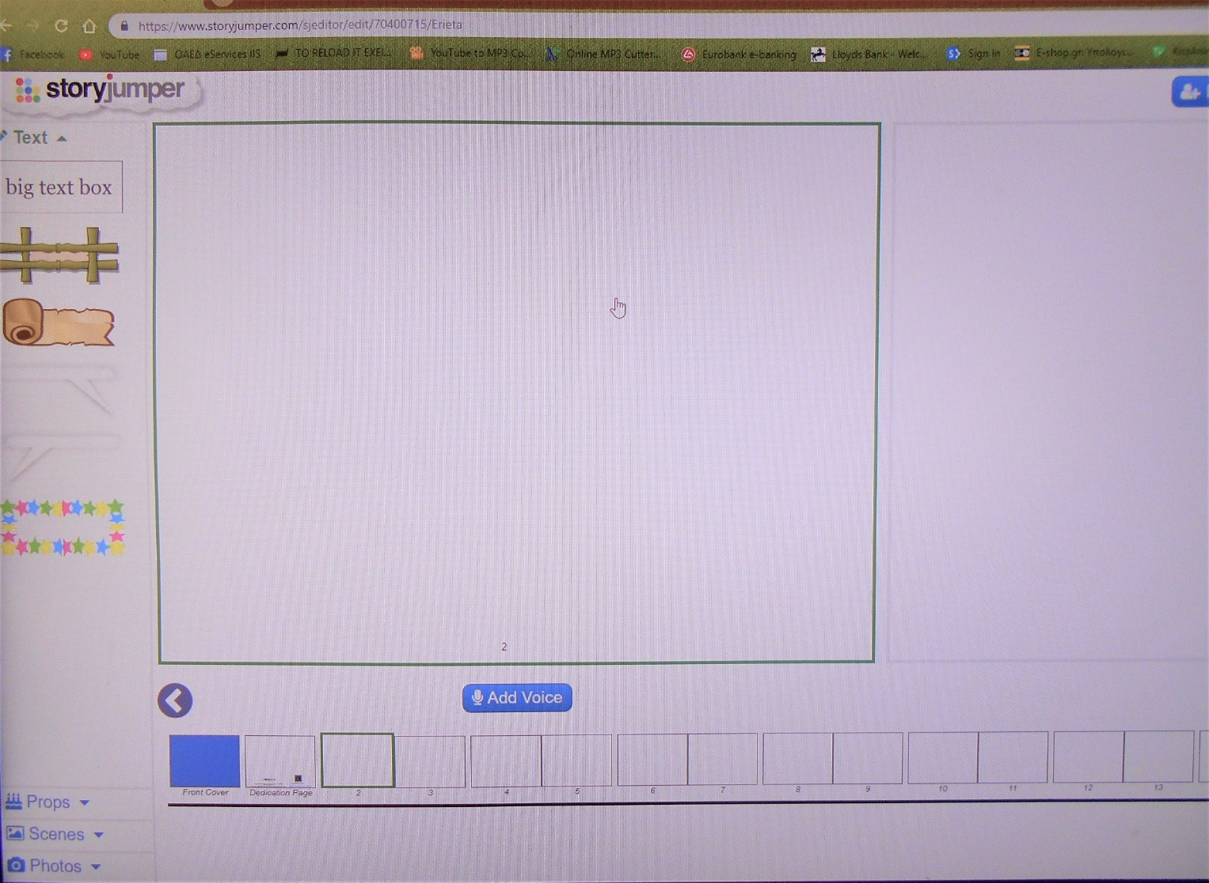
Here we are!
Press the blue box and make your first page!
Notes:
Here we are! Press the blue box and make your first page!You can ended there author’s name .the title of your book and of course you can add the picture which you want as first page!

Slide 5
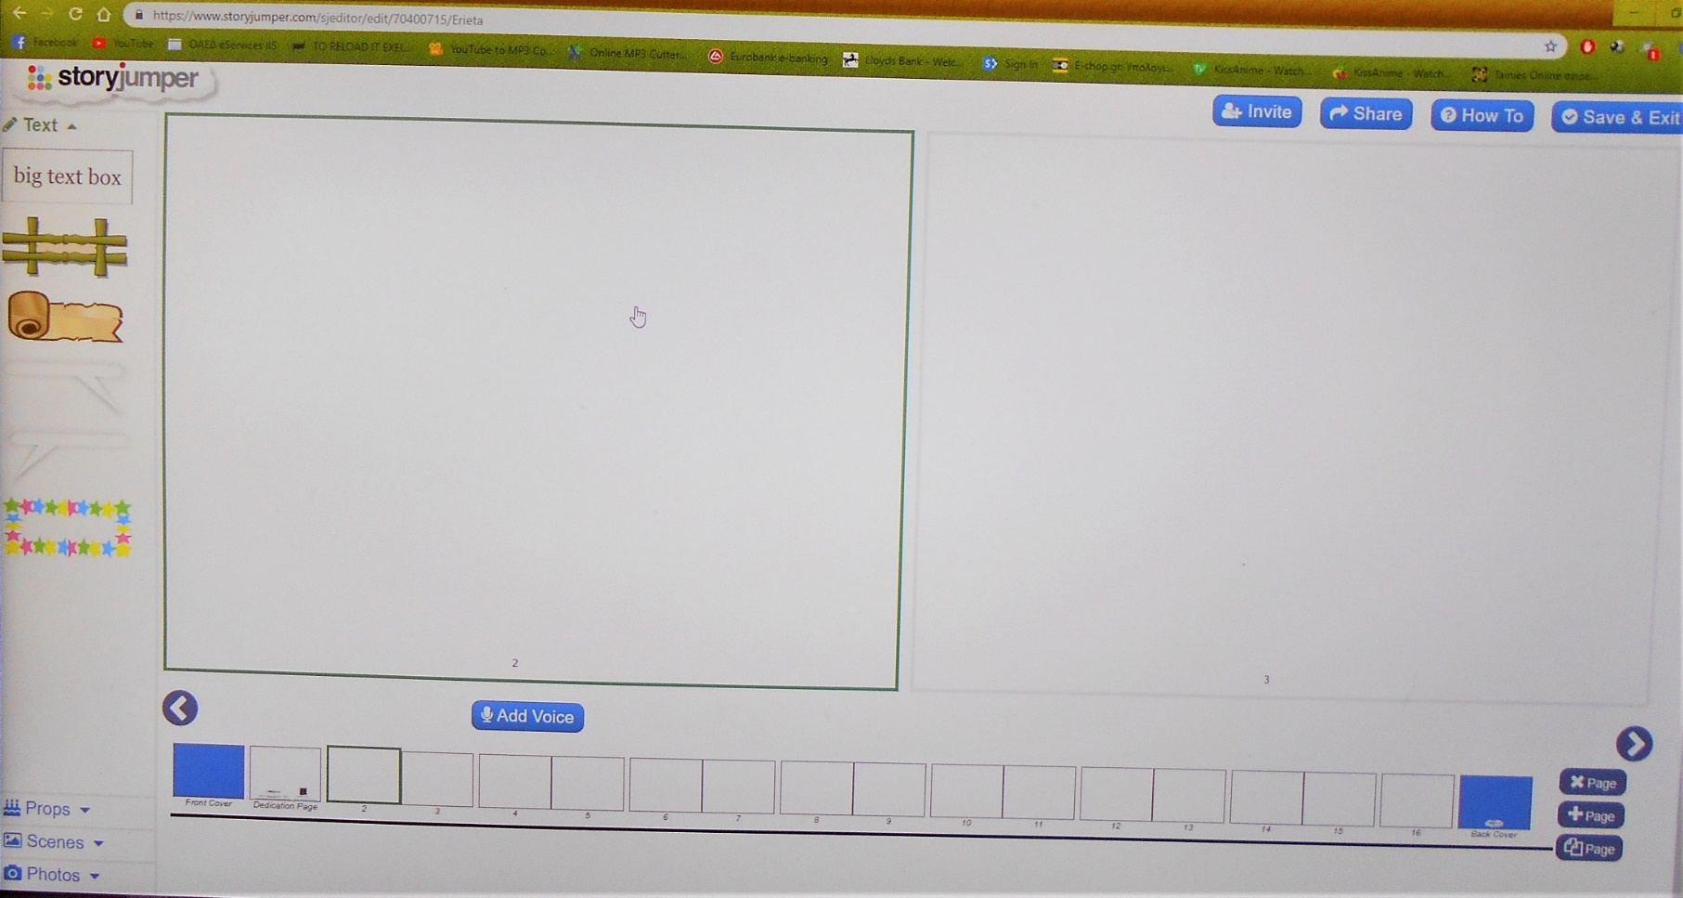
Here is the full screen !
Choosing the big text on the top you can ender your text
Of course you have some other options for text as you can see.
If you want to add more pages press +.
Also you can delete them (see the bows)
Notes:
Here is the full screen !

Slide 6
Now you can add author’s name ,the title of your book and of course you can add the picture which you want as first page.
Also you can choose the color of your book from the box of colors.

Slide 7
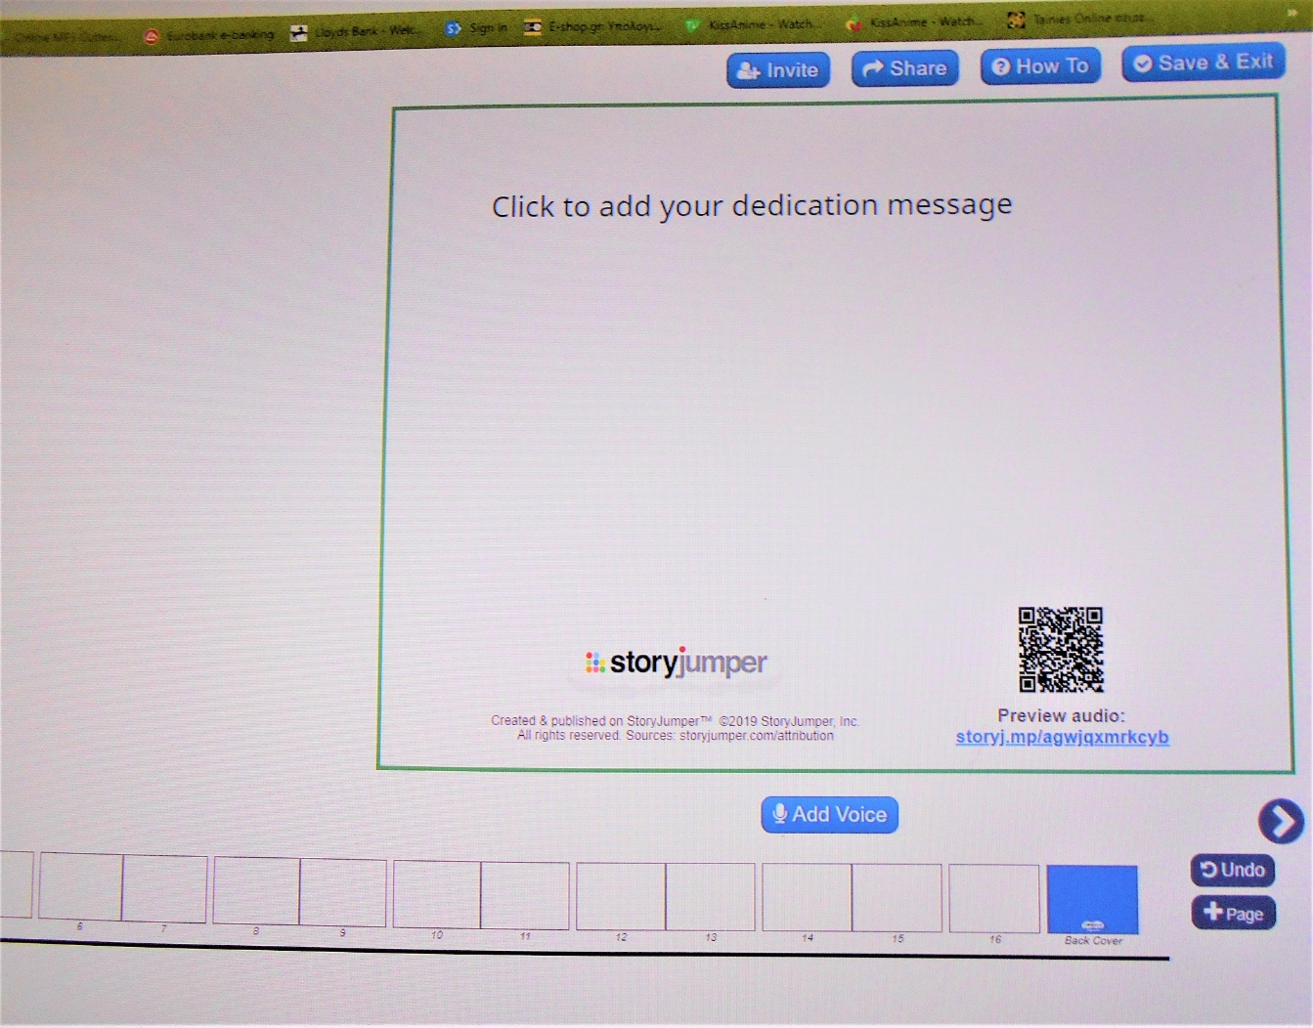
In this page (second page ) you can write your dedication message and you can take the code of your book too!

Slide 8
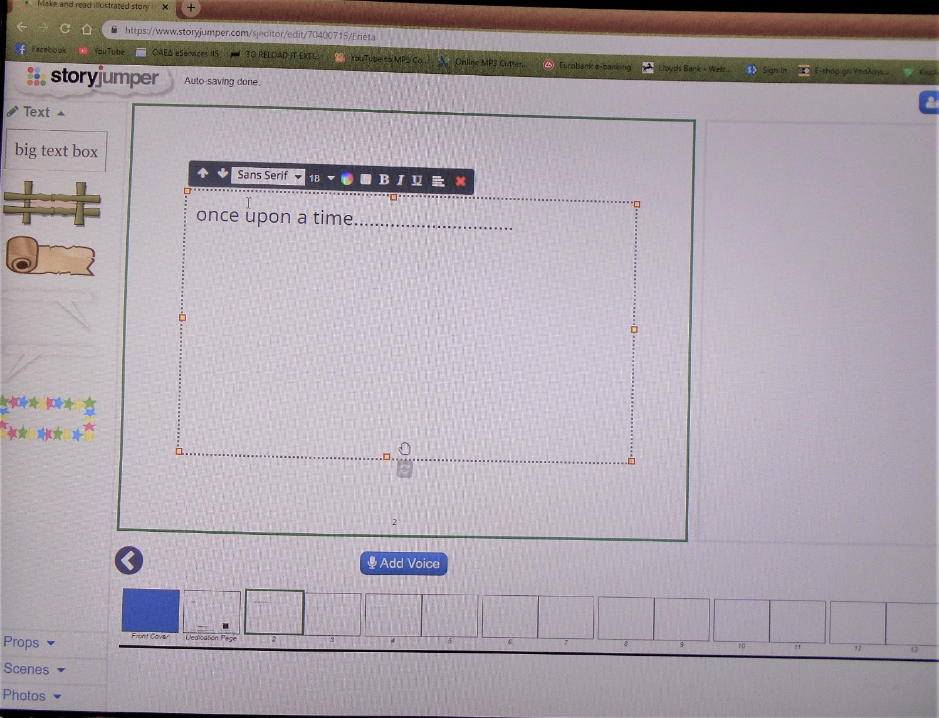
And here is a sample how you can enter text.
When you finished with this page you can press to create your next page.

Slide 9
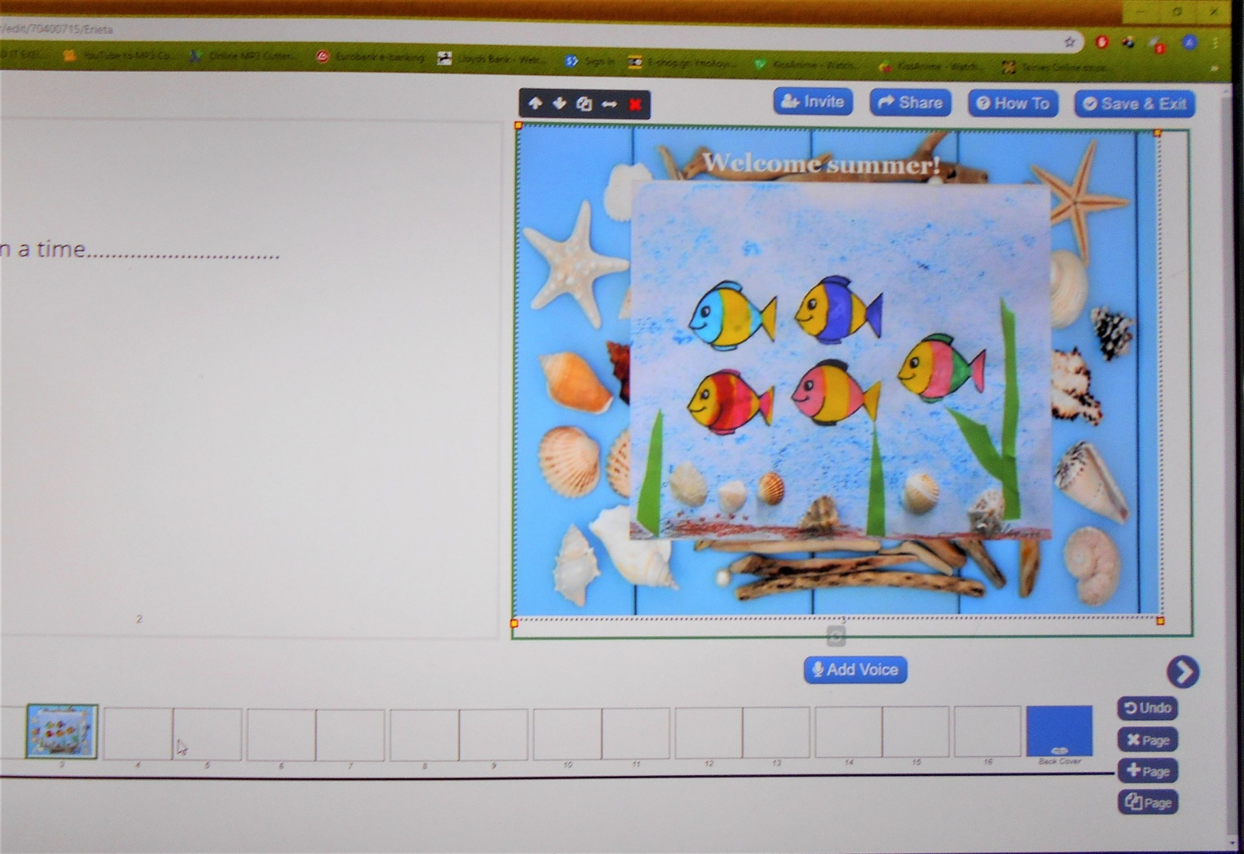
If you like you can add voice!
Save your book! Go to the next page!
Notes:
Save your book

Slide 10
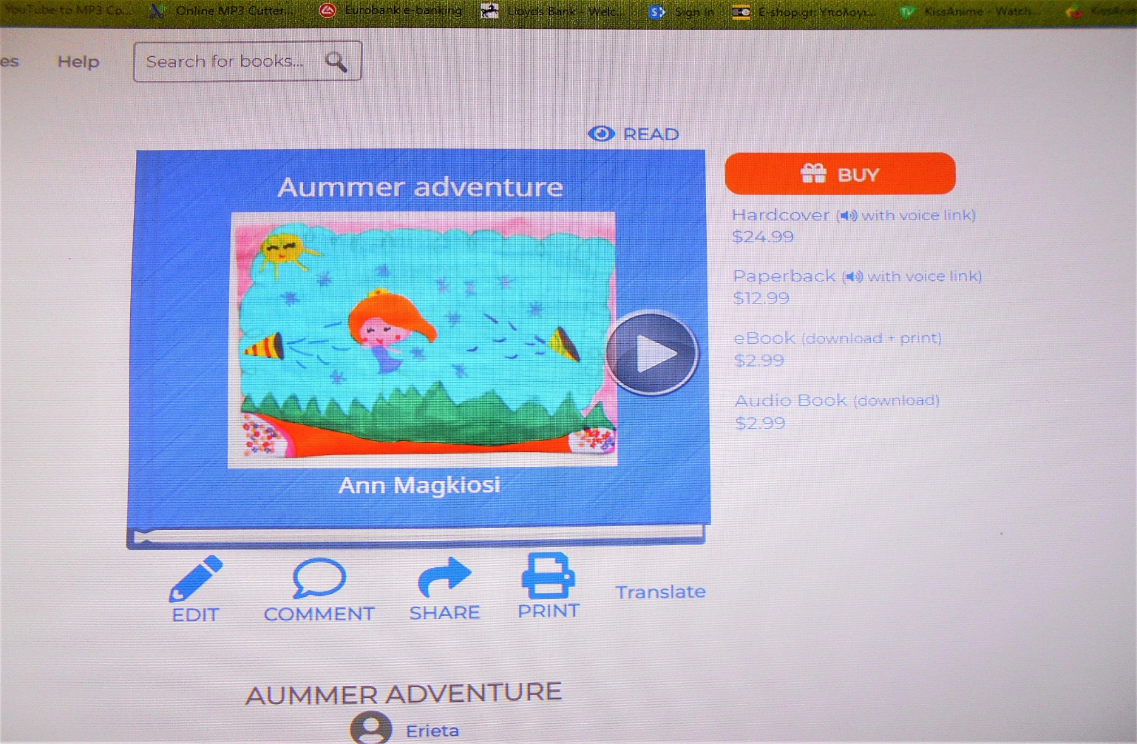
Congratulations! Your first book is ready!
Now you can share it ,but it or edit if don’t like the result
Good luck!

