Slide 1
Children evaluation test using technology
Webmeeting

Slide 2
Why?
It is mandatory to evaluate children development every year.
Opportunity to have more effective development test:
It is a game
no paper filling test
system generates summary
We can evaluate also children technical skills
Children can solve the test independenlty

Slide 3
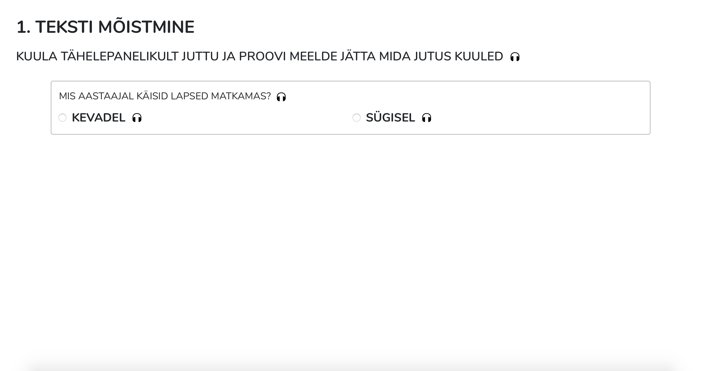
1. Listen the story and answer the questions

Slide 4
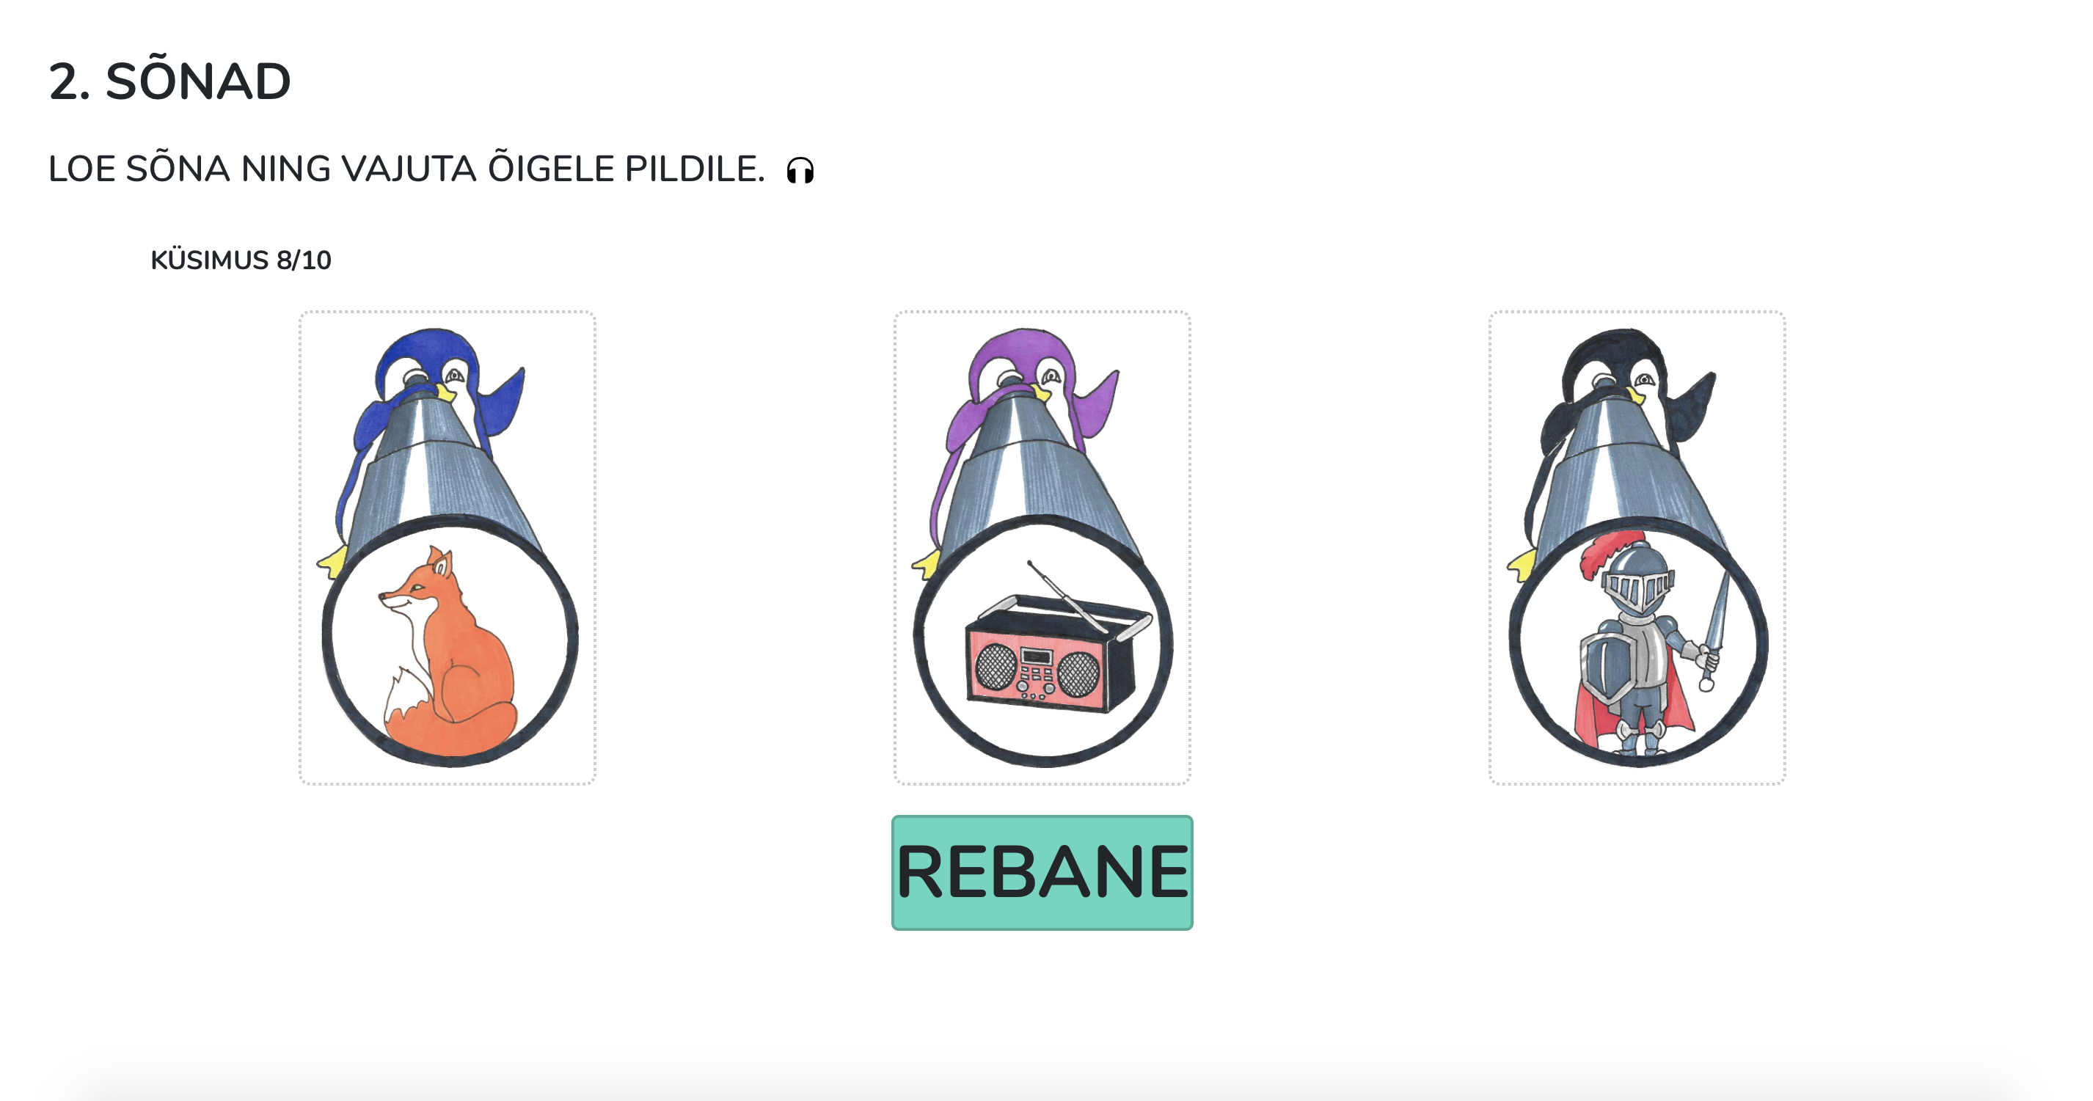
2.1 Read the words, choose the right picture

Slide 5
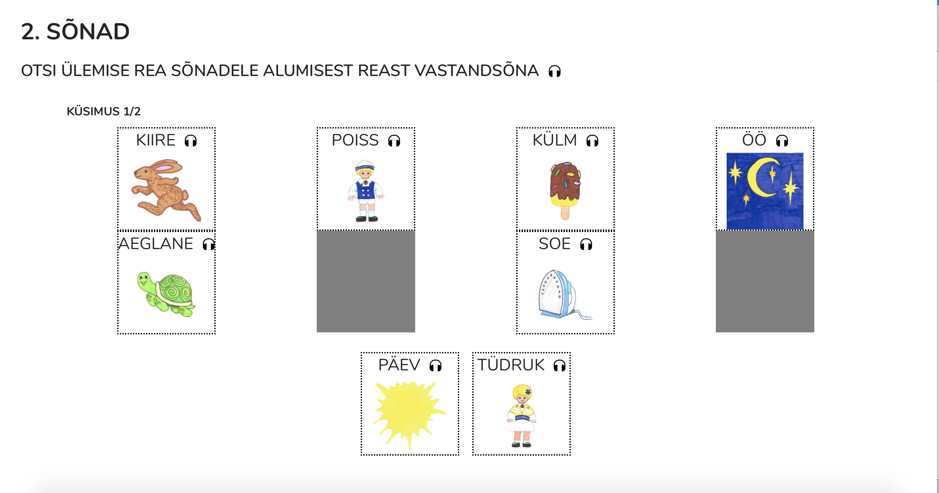
2.2 Choose the correct opposite word.

Slide 6
2.3 Read the words and choose the right word according to the picture.

Slide 7
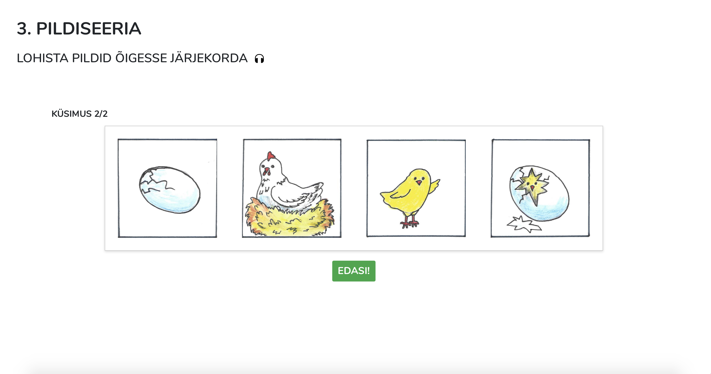
3. Put the pictures to correct order according to the events happening.

Slide 8
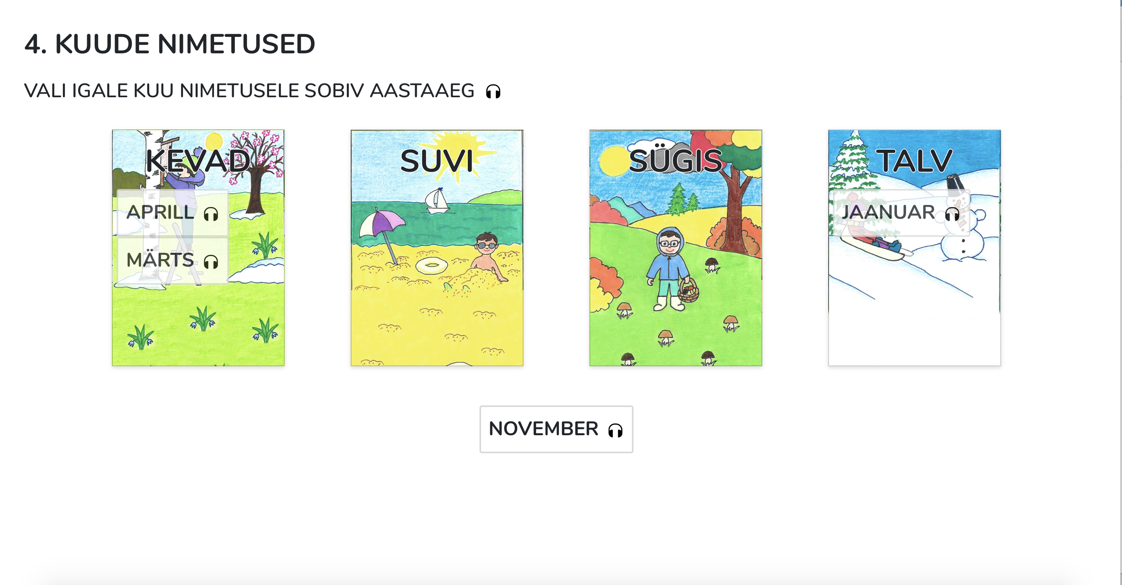
4. Choose the correct season for every month

Slide 9
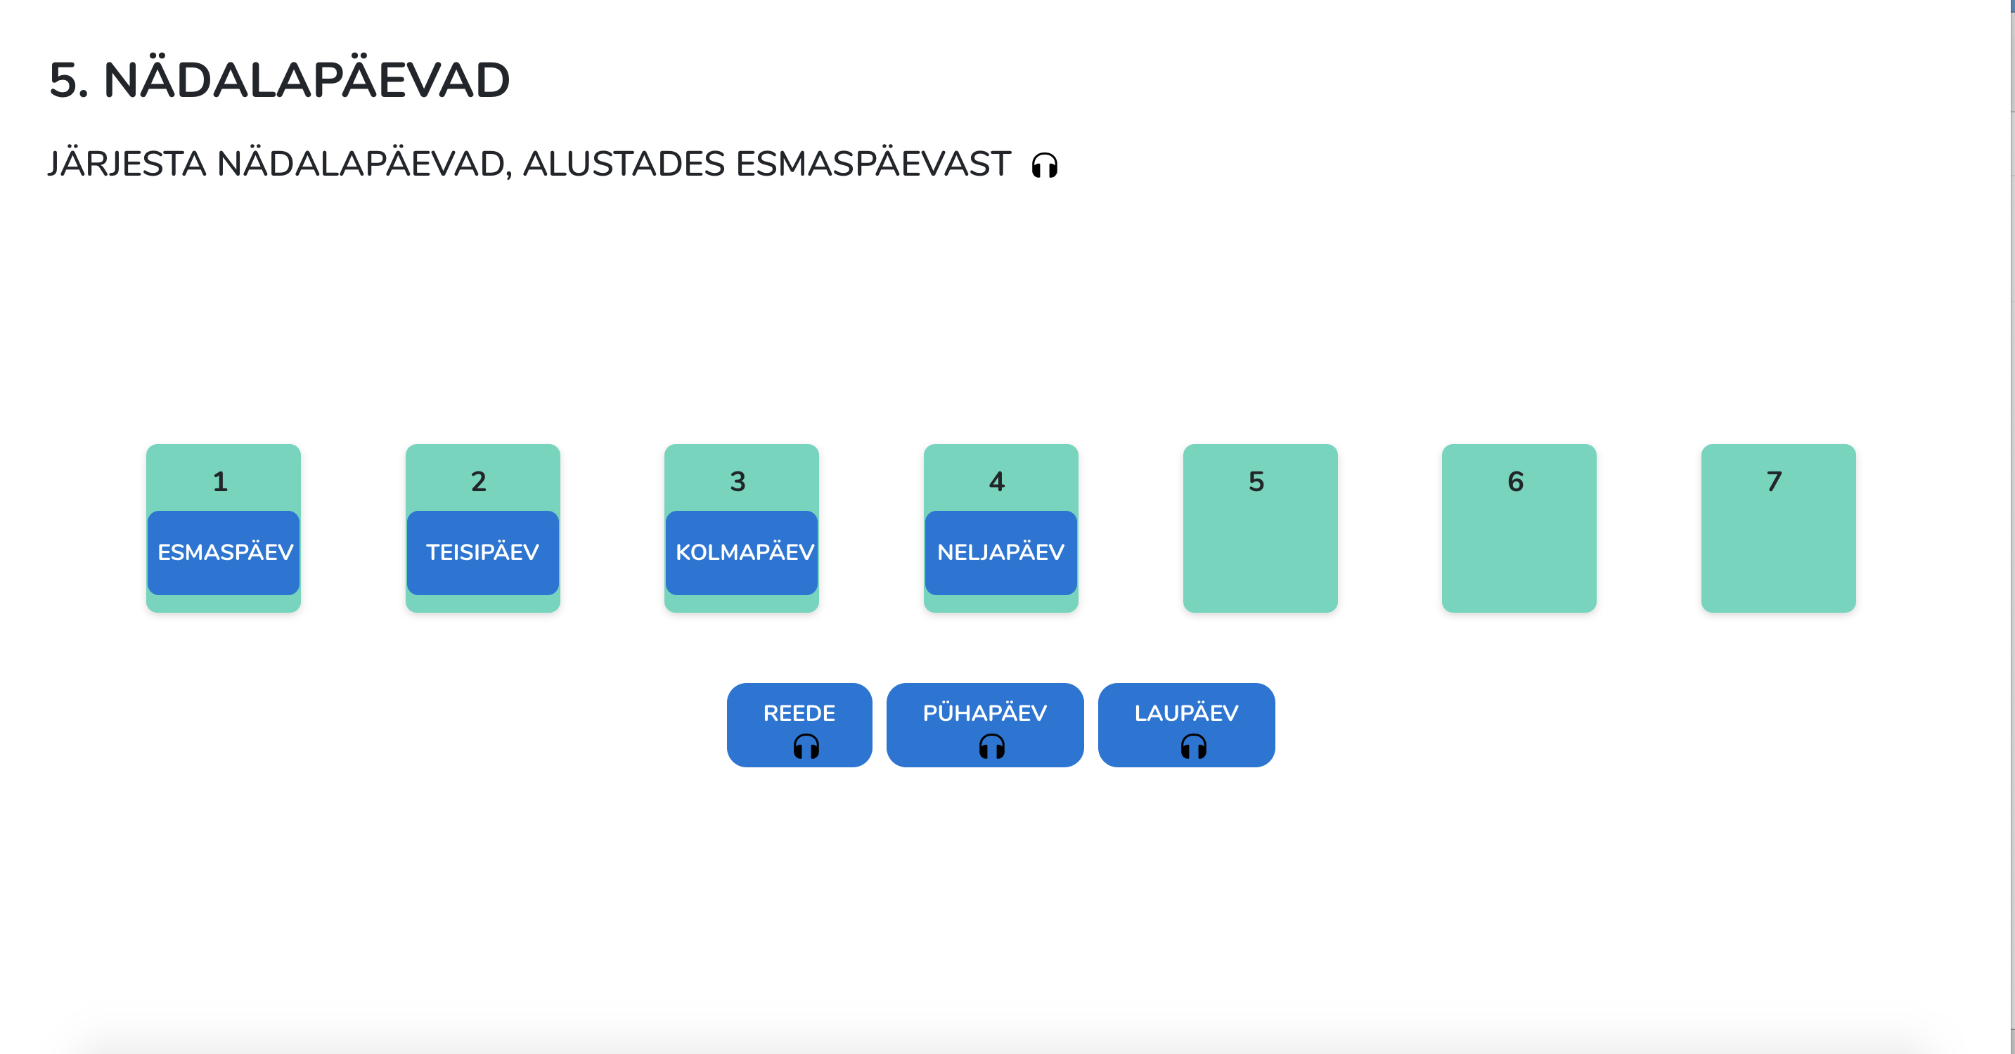
5. Put the days of the weeks to correct order

Slide 10
6. Arrange the numbers to increasing or decreasing sequence

Slide 12
7. Calculate and choose the right answer

Slide 13
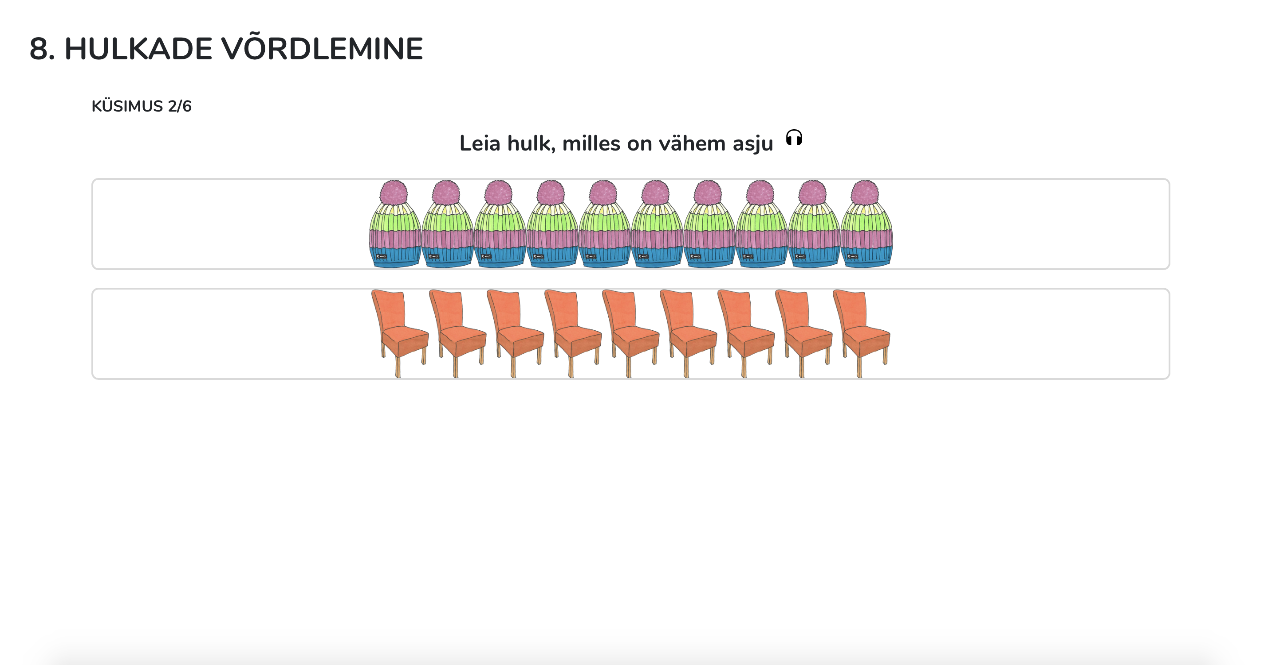
8. Compare the quantities.
Find the quantity where are more items
Find the quantity where are less items

Slide 14
Find the shortest item
Find the longest item

Slide 15
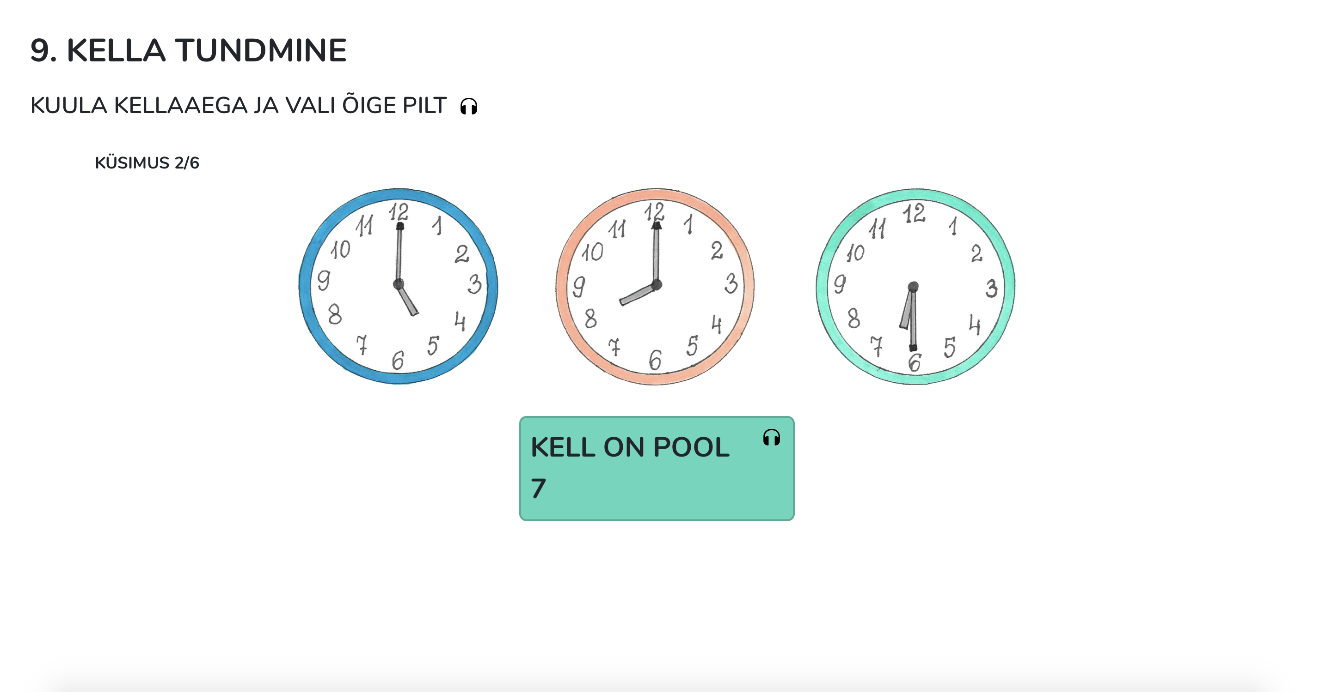
9. Choose the clock that shows the same time as written

Slide 16
10. Move with arrows according to the voice guide

