Slide 1
4. Smartweek 13.01.2020 – 17.01.2020

Slide 2
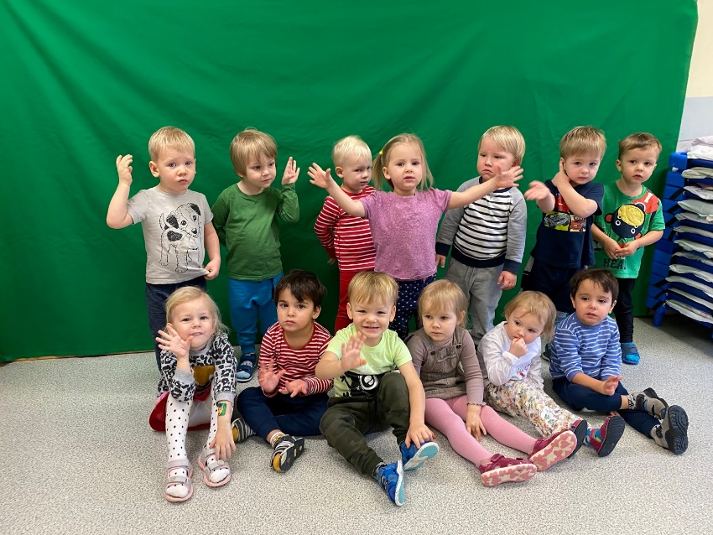
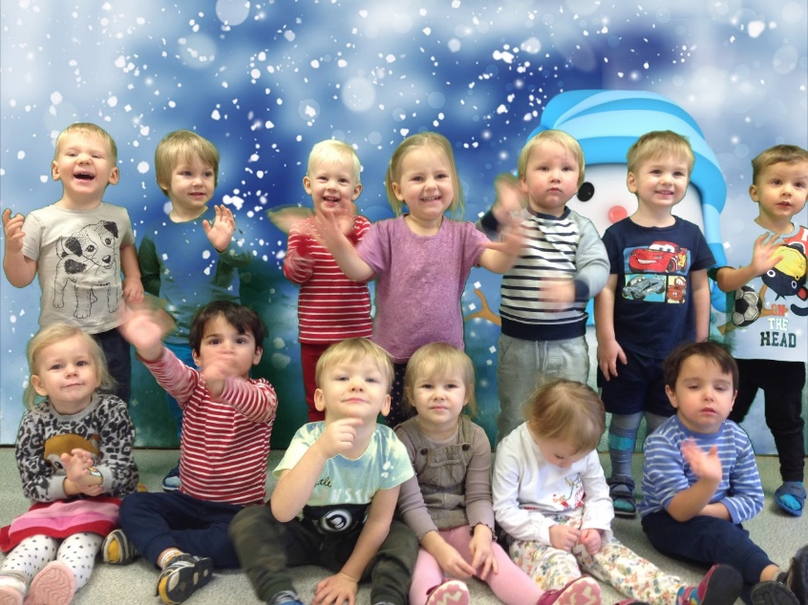
On 13.01-17.01.2020 was held in Tallinn Suitsupääsupesa kindergarten Erasmus+ project 4. smartweek with children. Different activities were carried out and children were introduced new equipment as: M-Bot and Edison robots and new environment “Green screen” for creating background for animation.

Slide 3
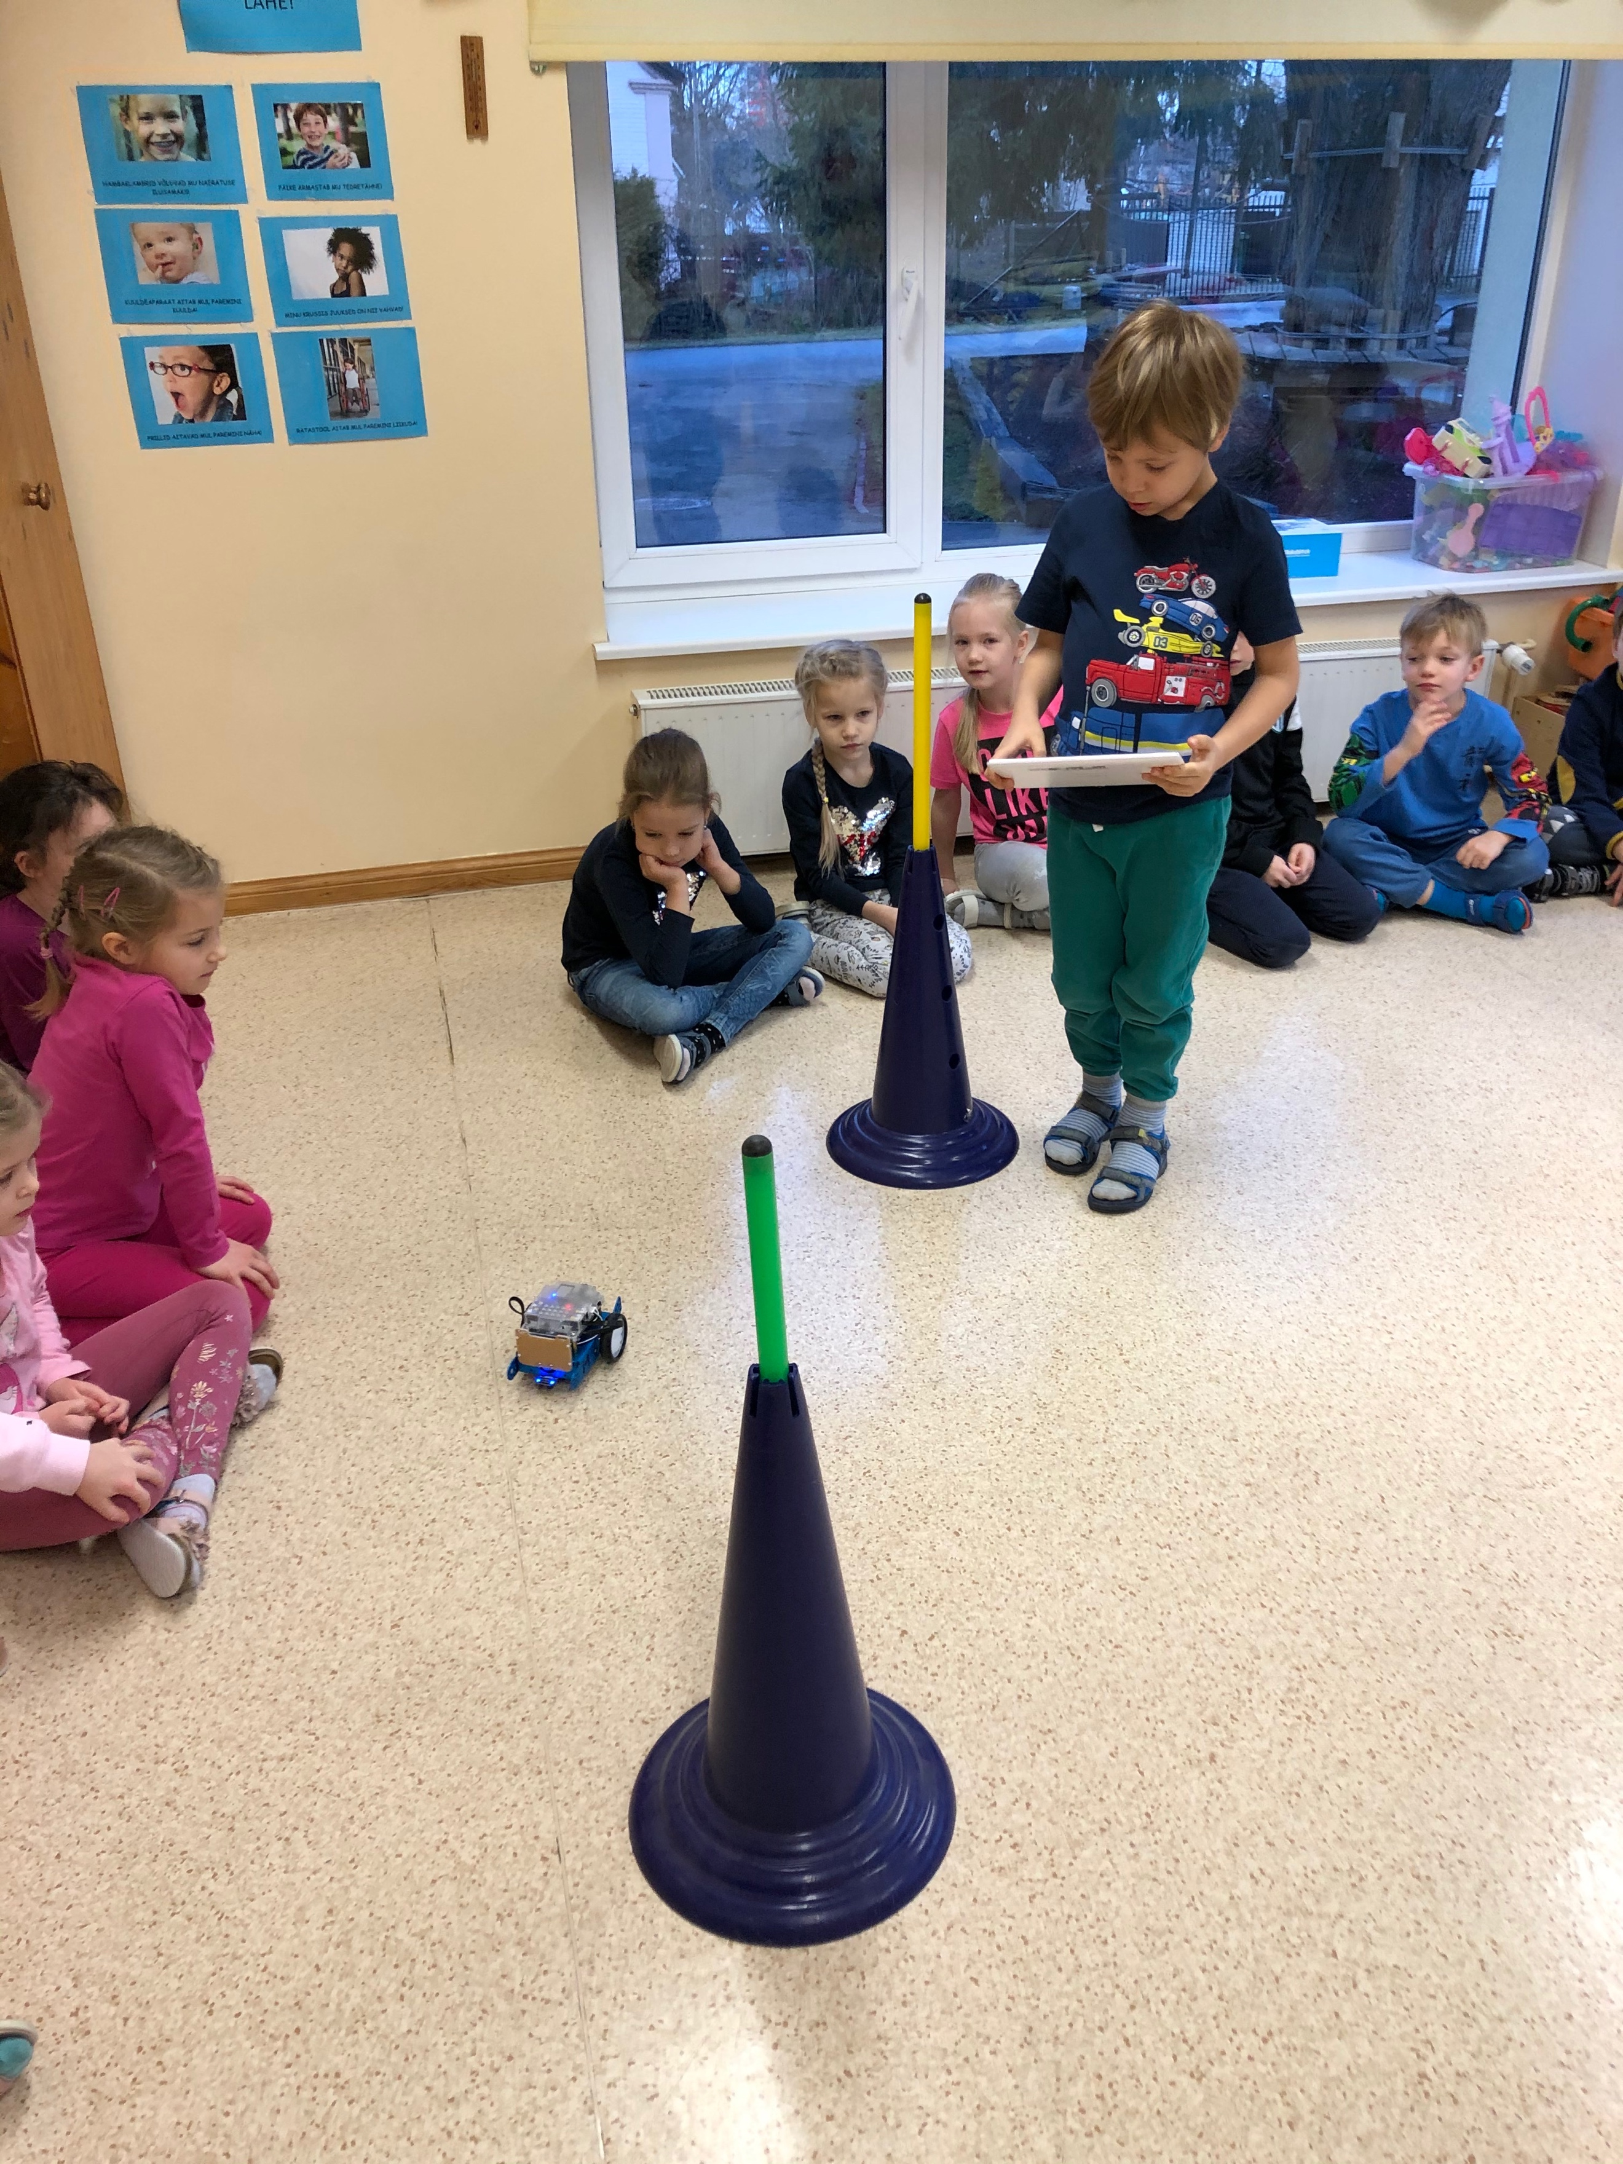
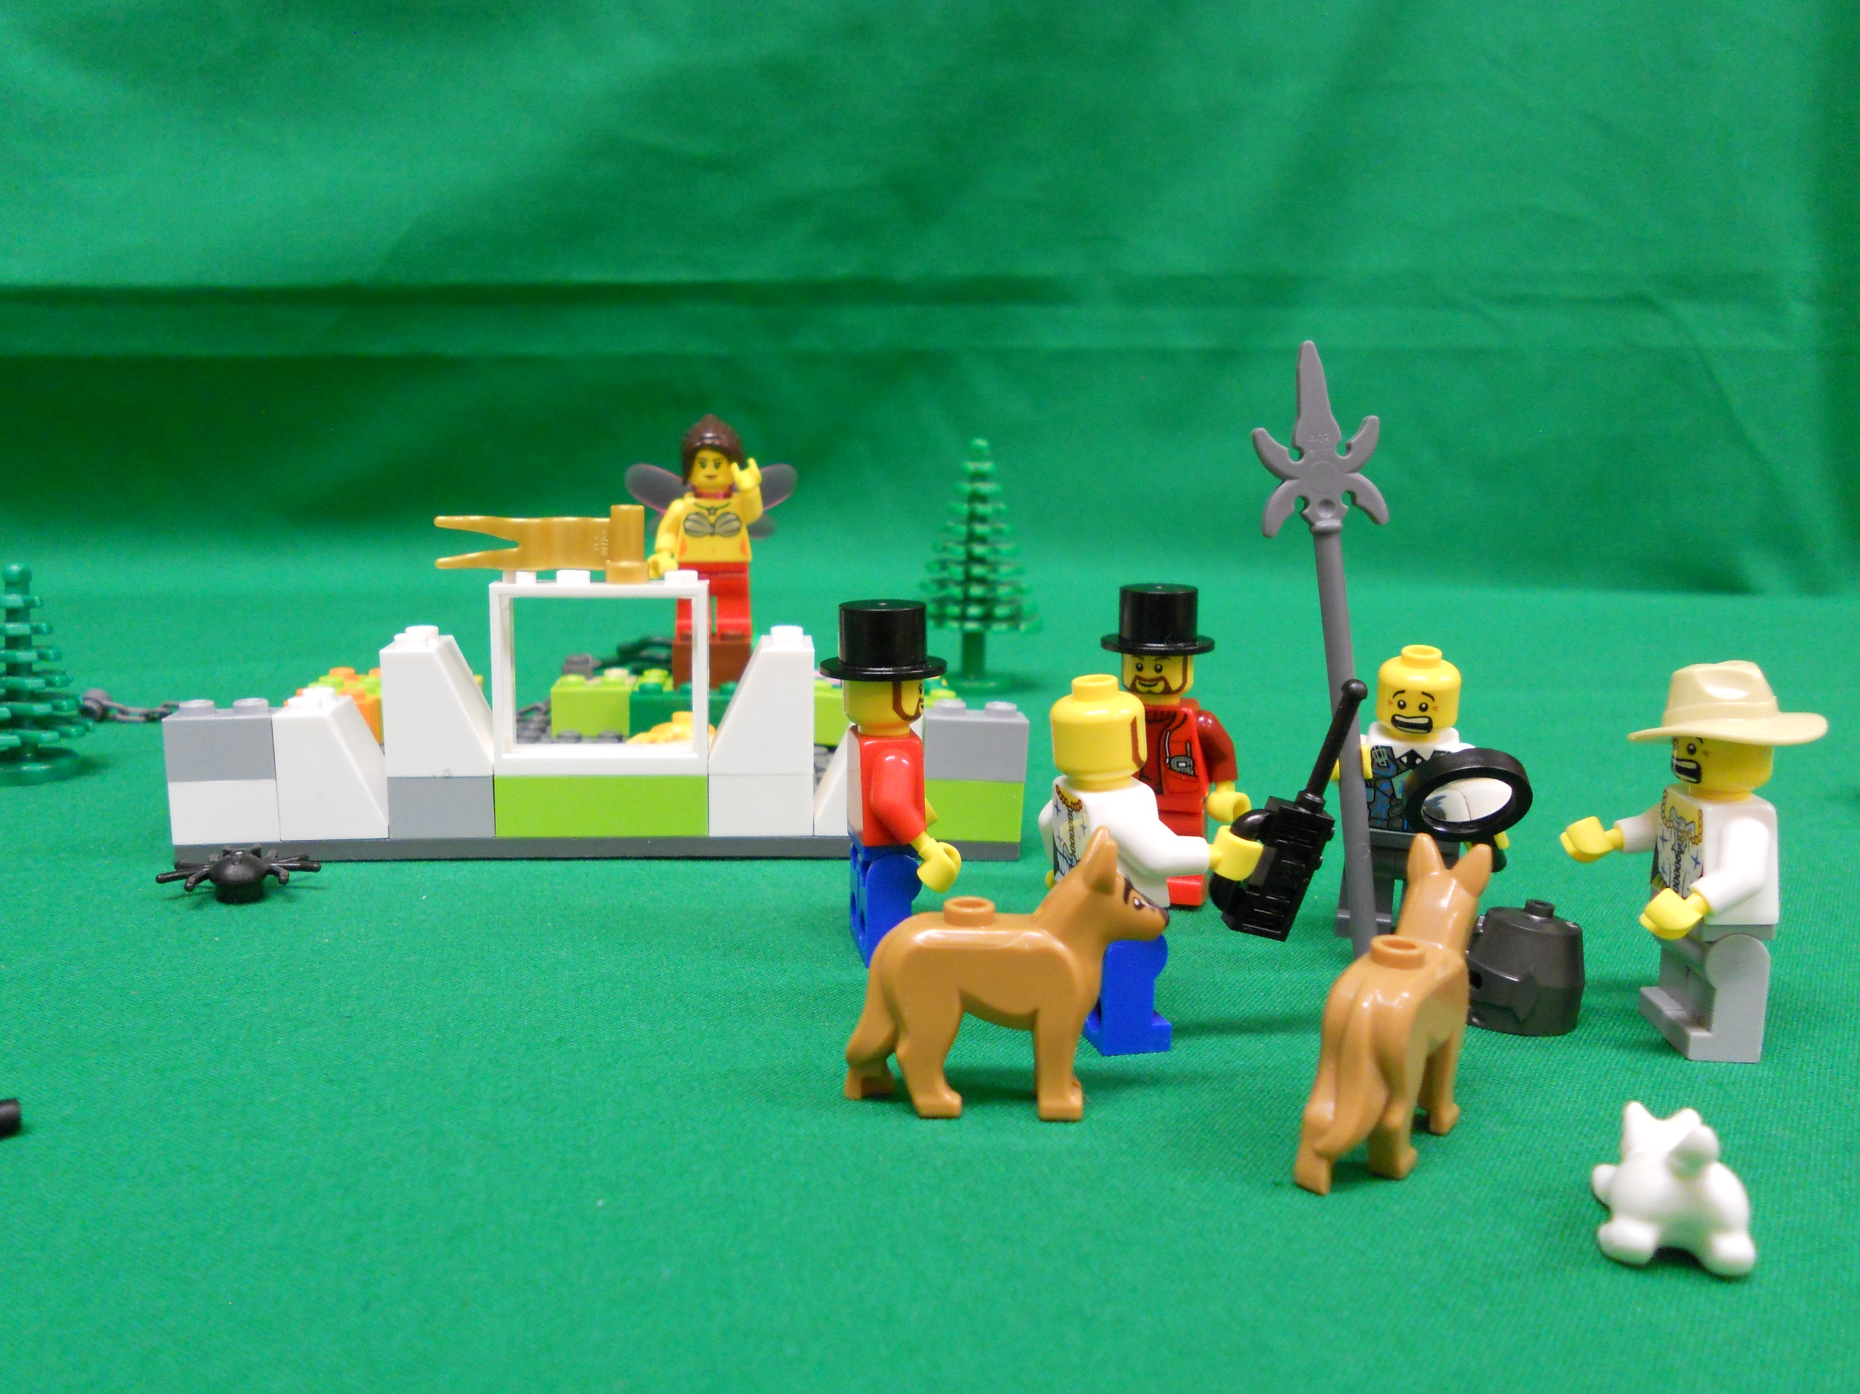
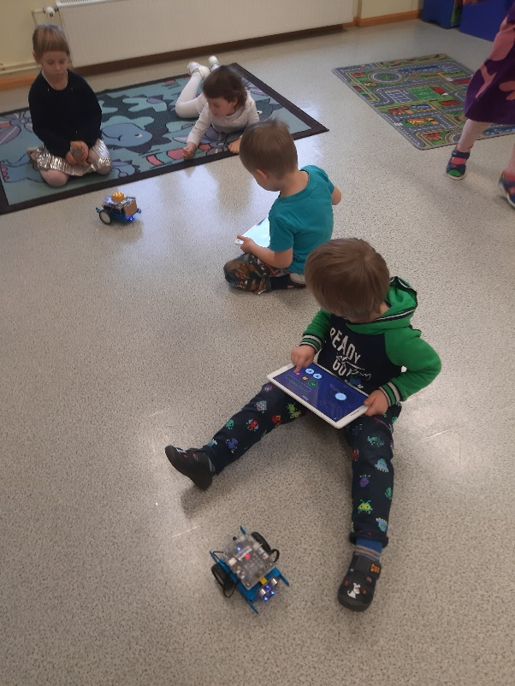
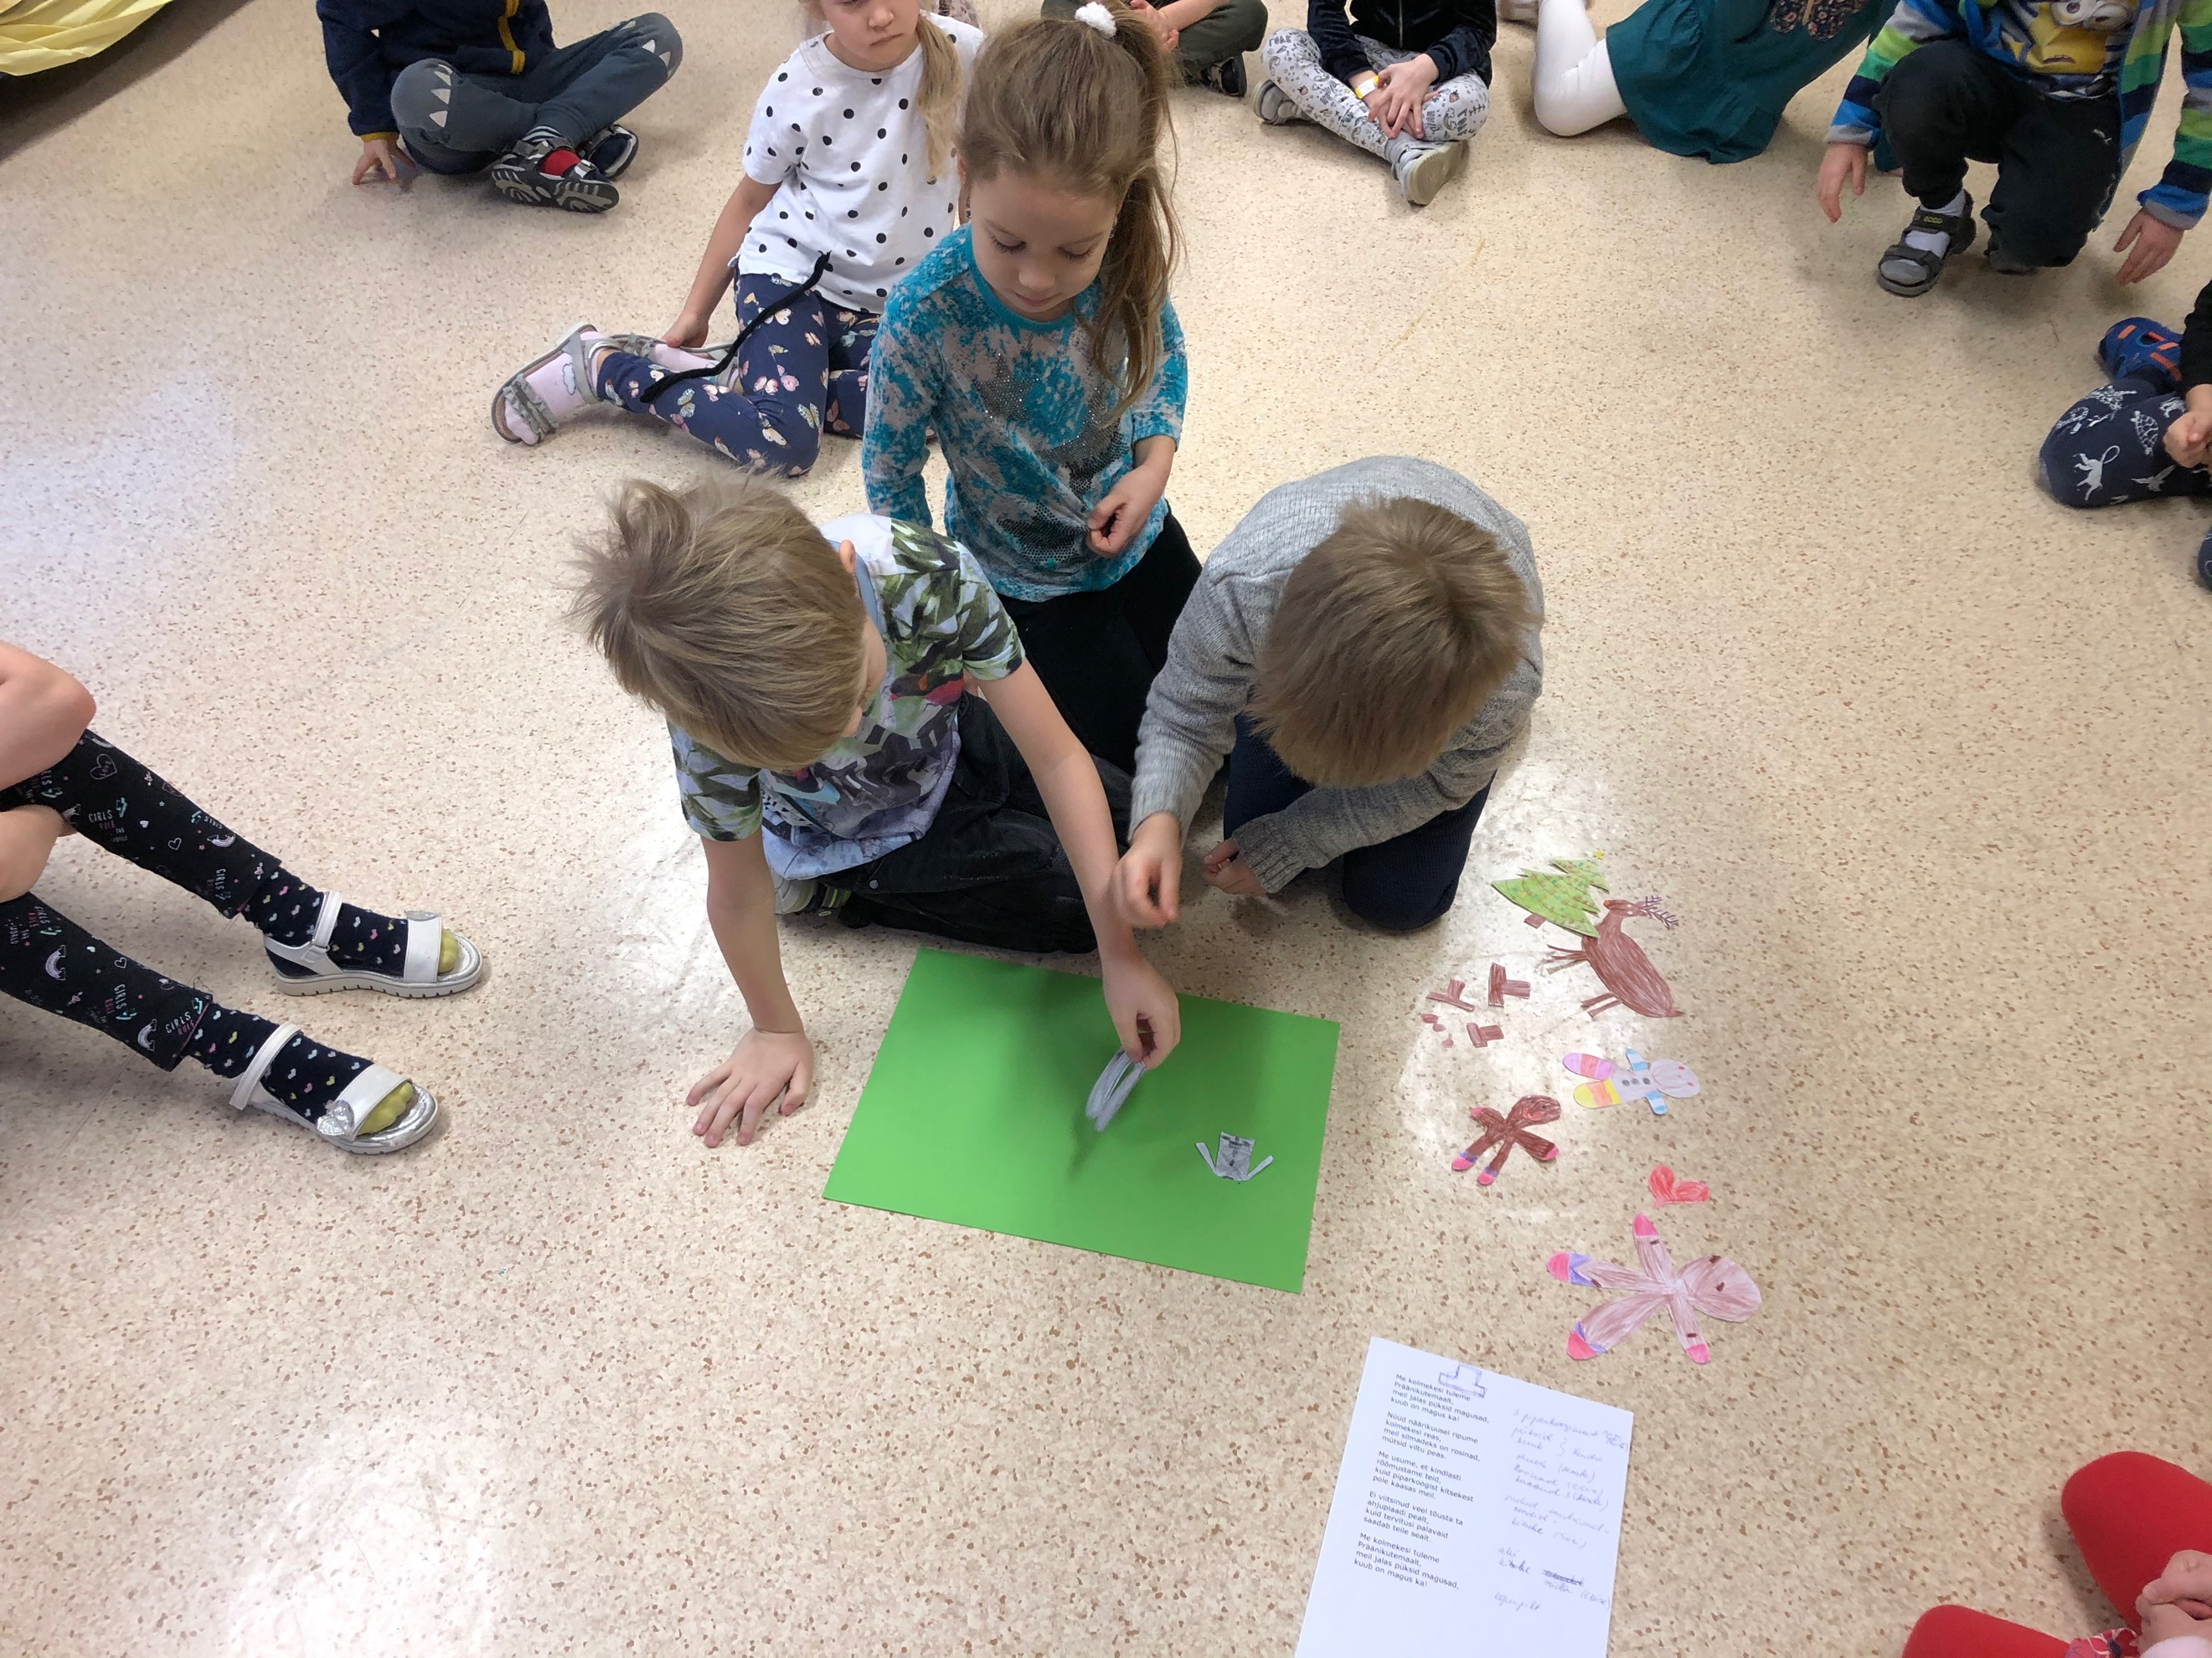

Slide 4
Common smartday when children visited different activities in all classrooms.
Children age 6-7 years
activity 1: children inserted Edison robot barcode “sumowrestling”. Robots were placed to arena and sumo competition took place.
activity 2: children worked in pairs – one child read a code from the codeticket and other child inserted the same code to Bee-Bot robot. When all codes inserted all Bee-Bots were placed behind a line and when go was pushed Bee-Bots danced in syncrone.

Slide 5
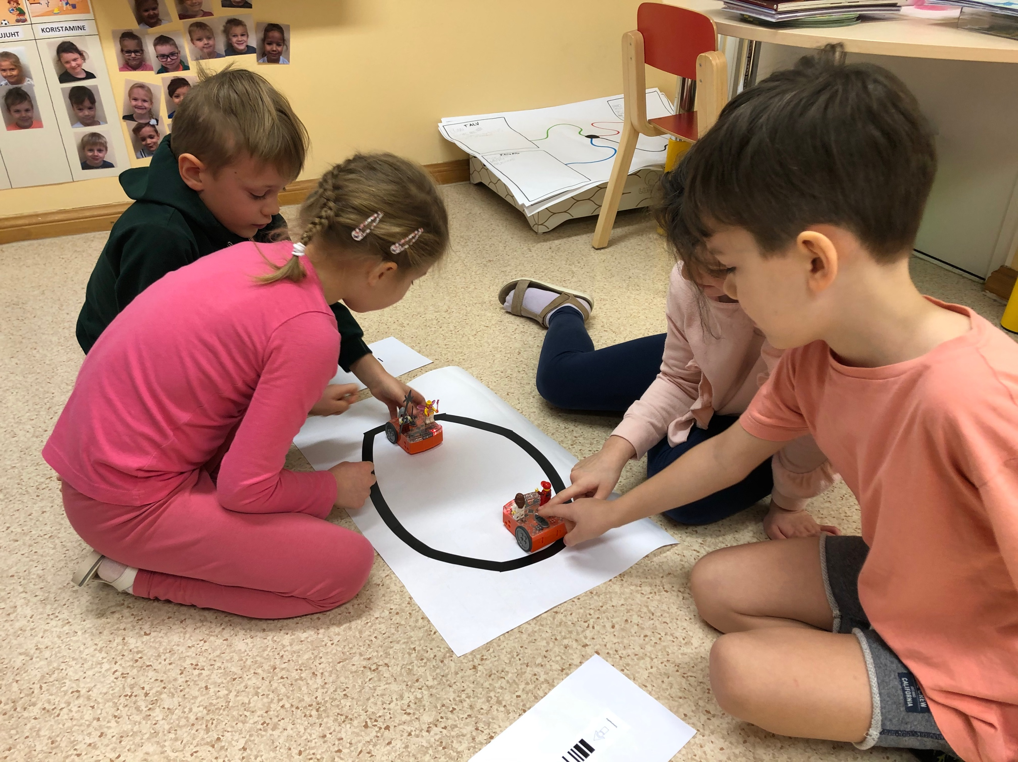
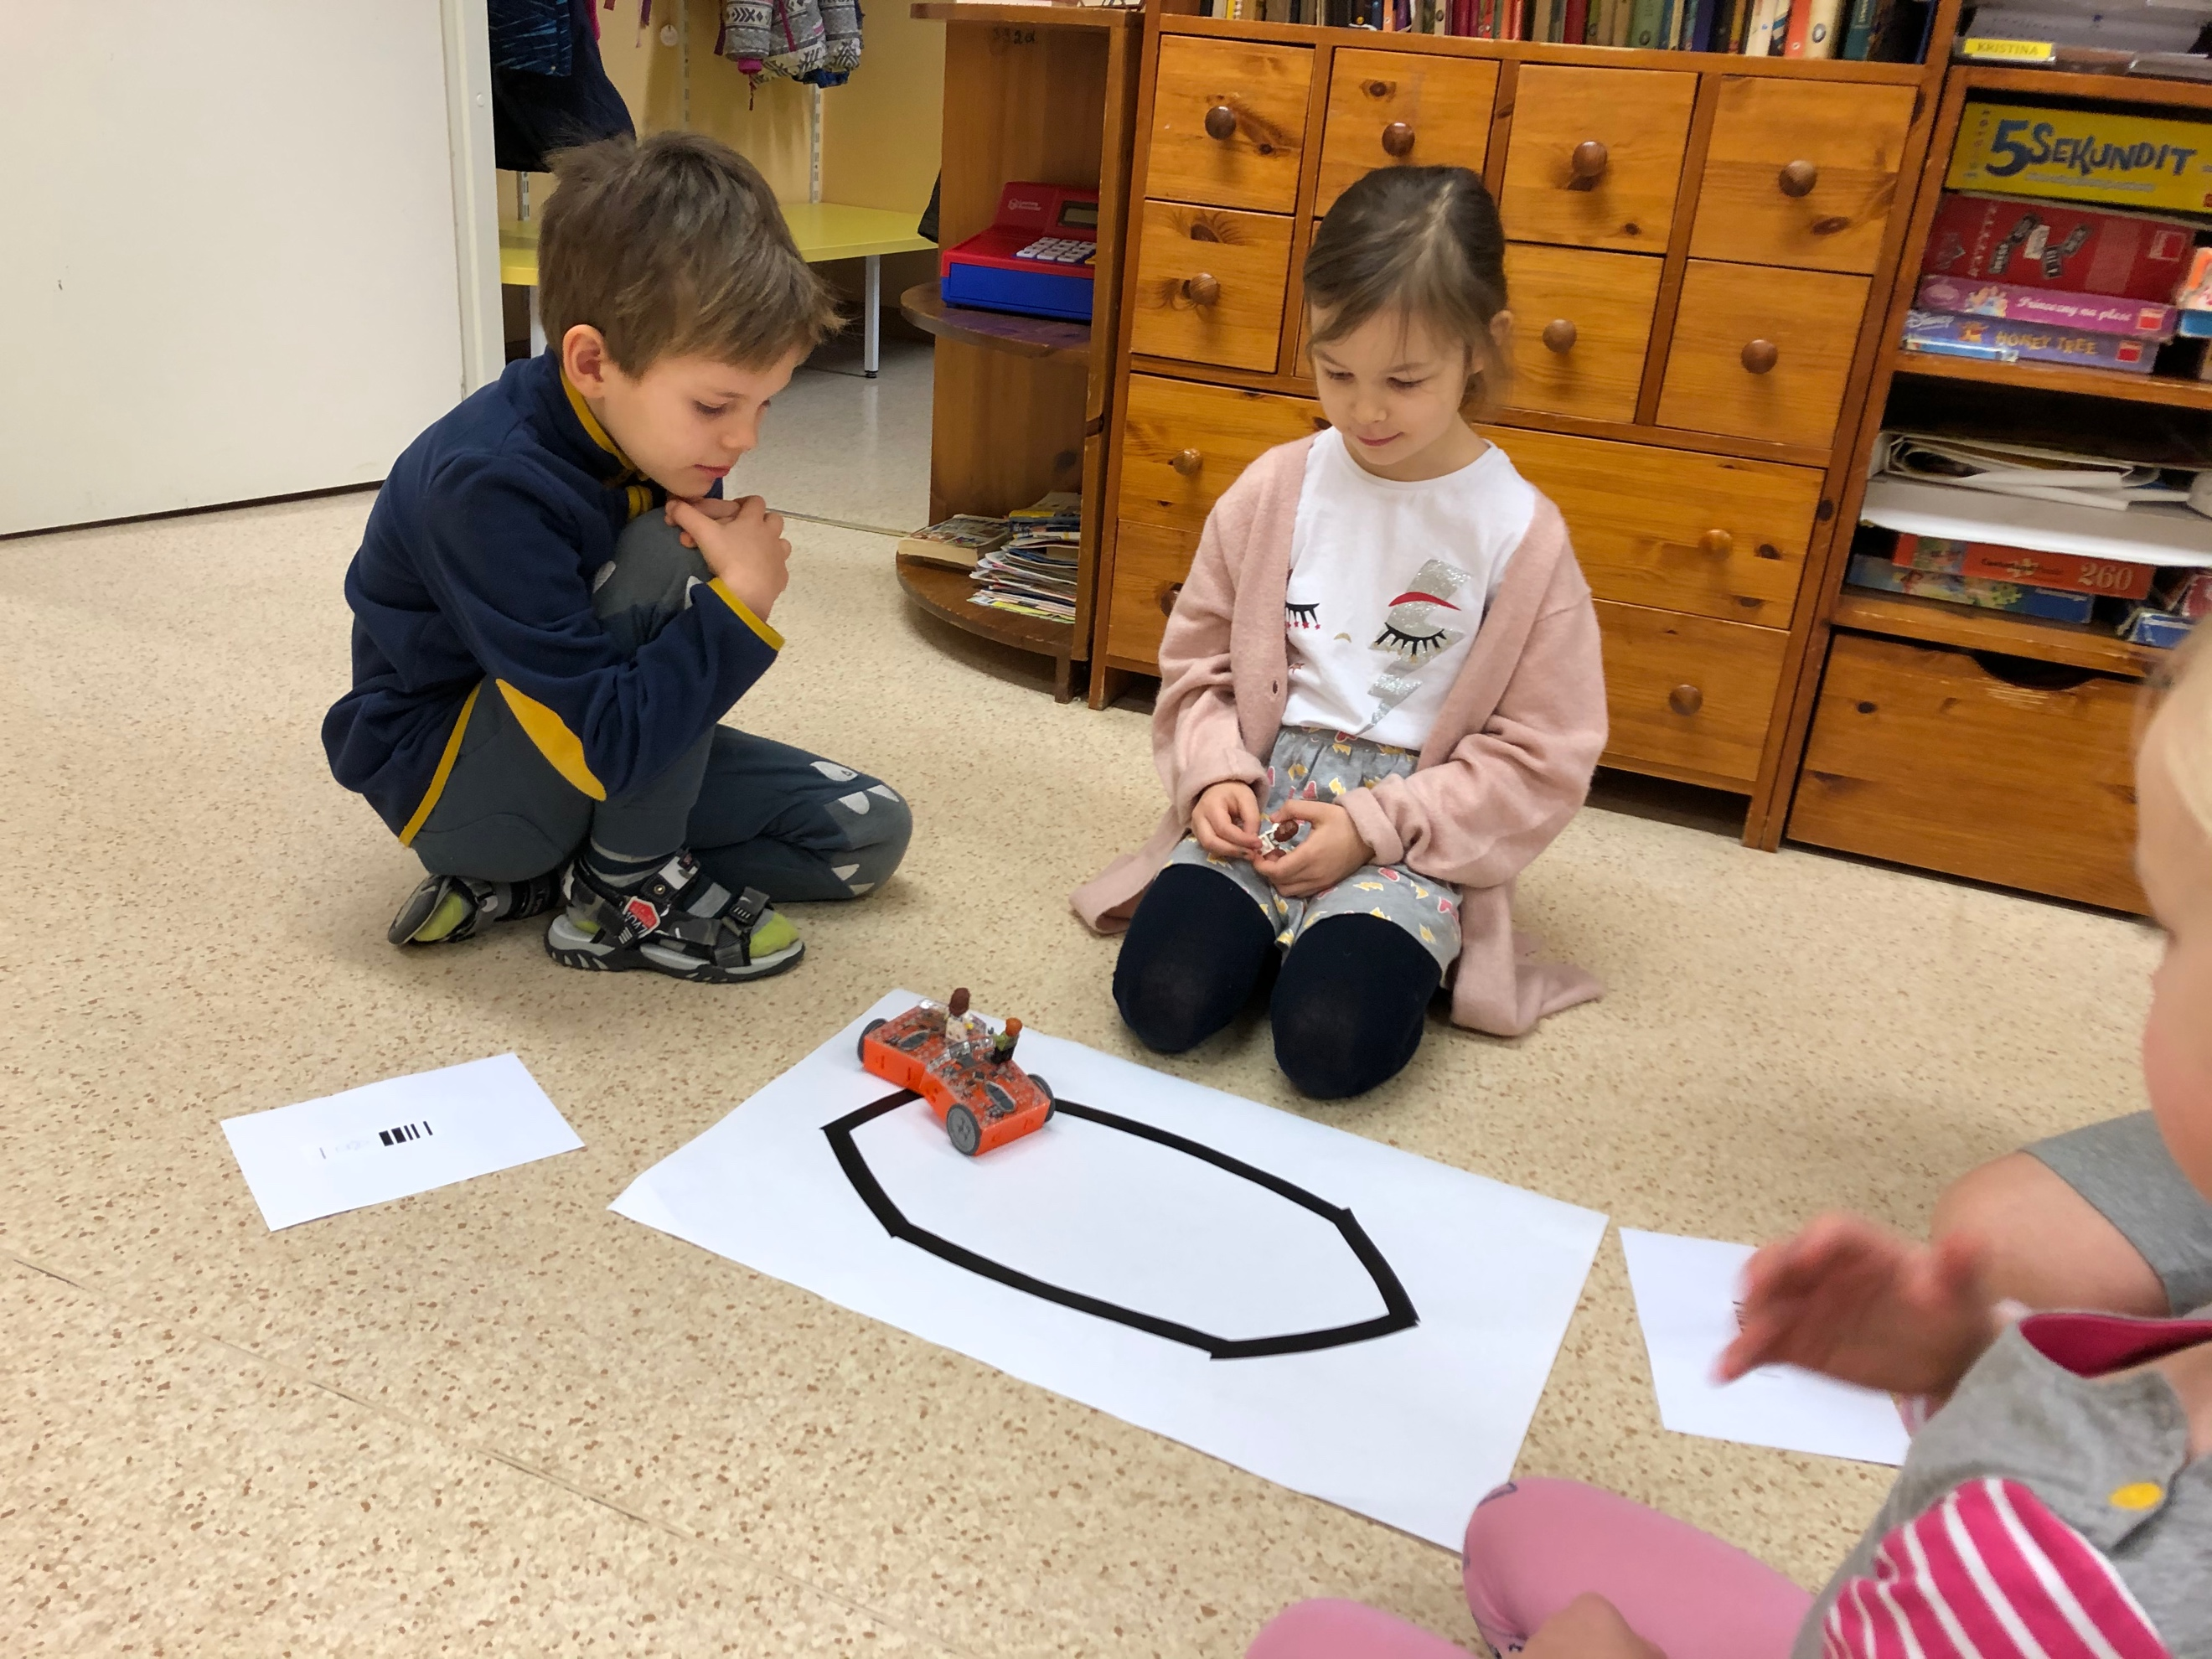
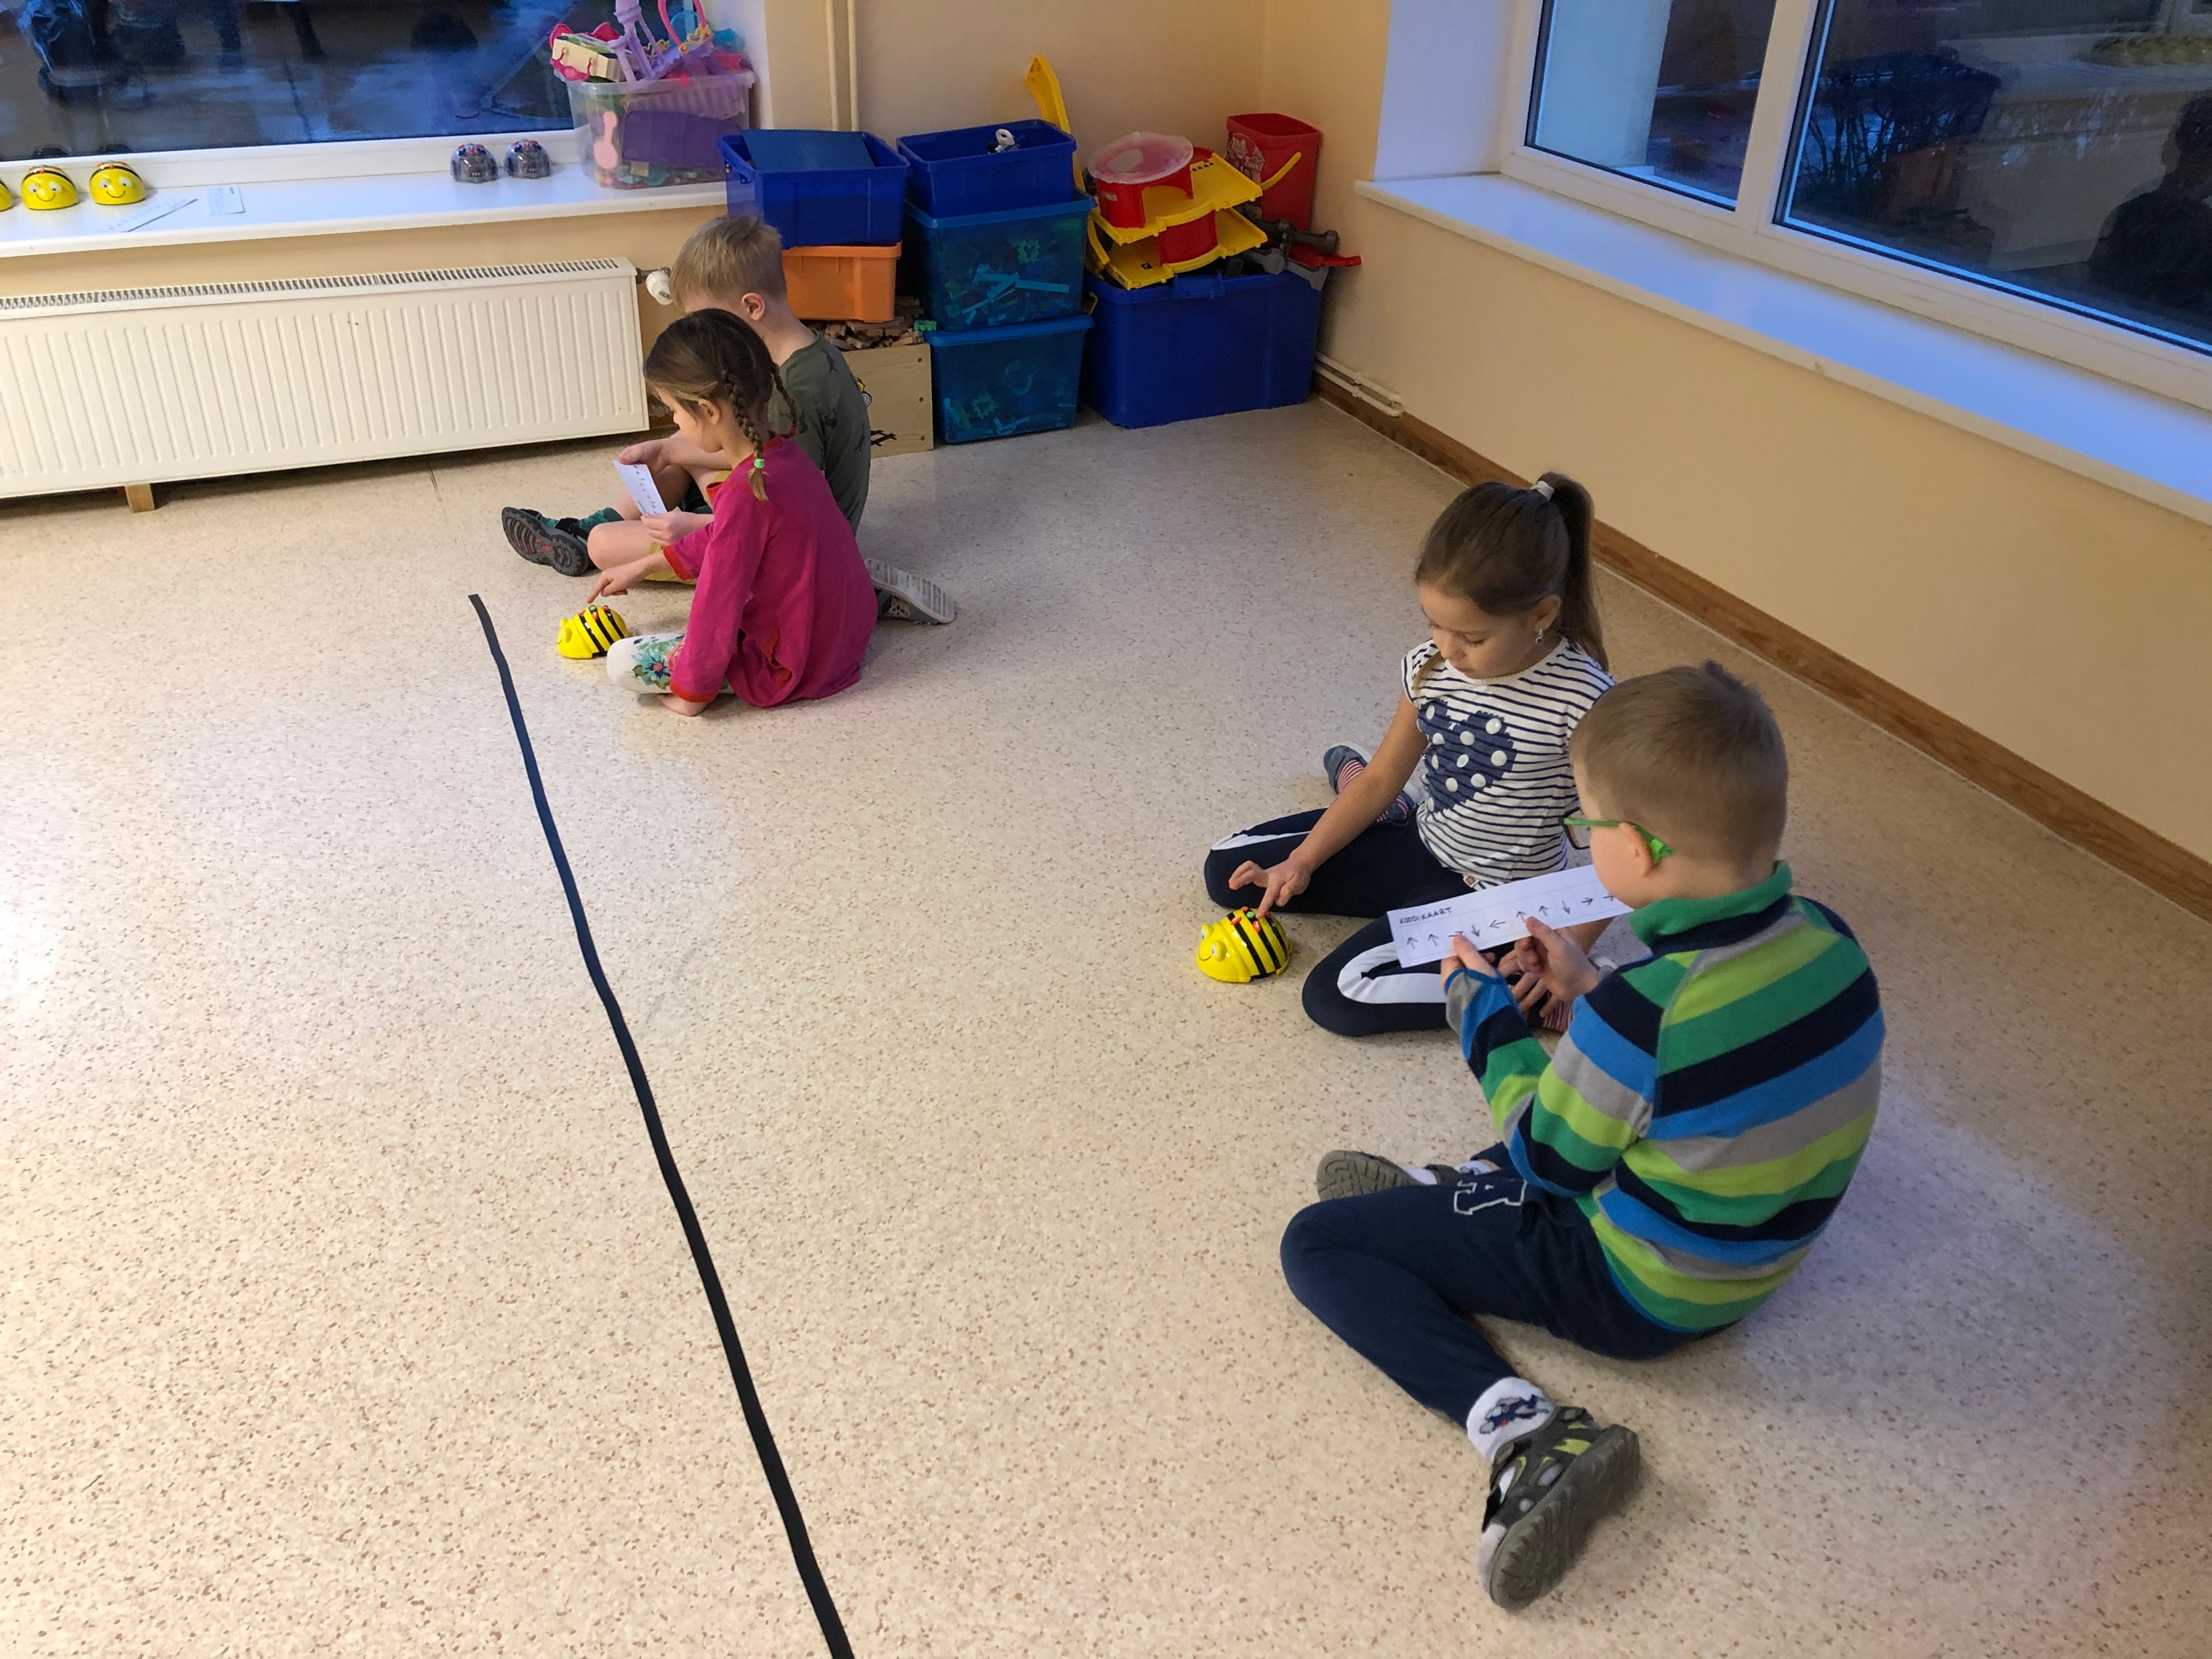
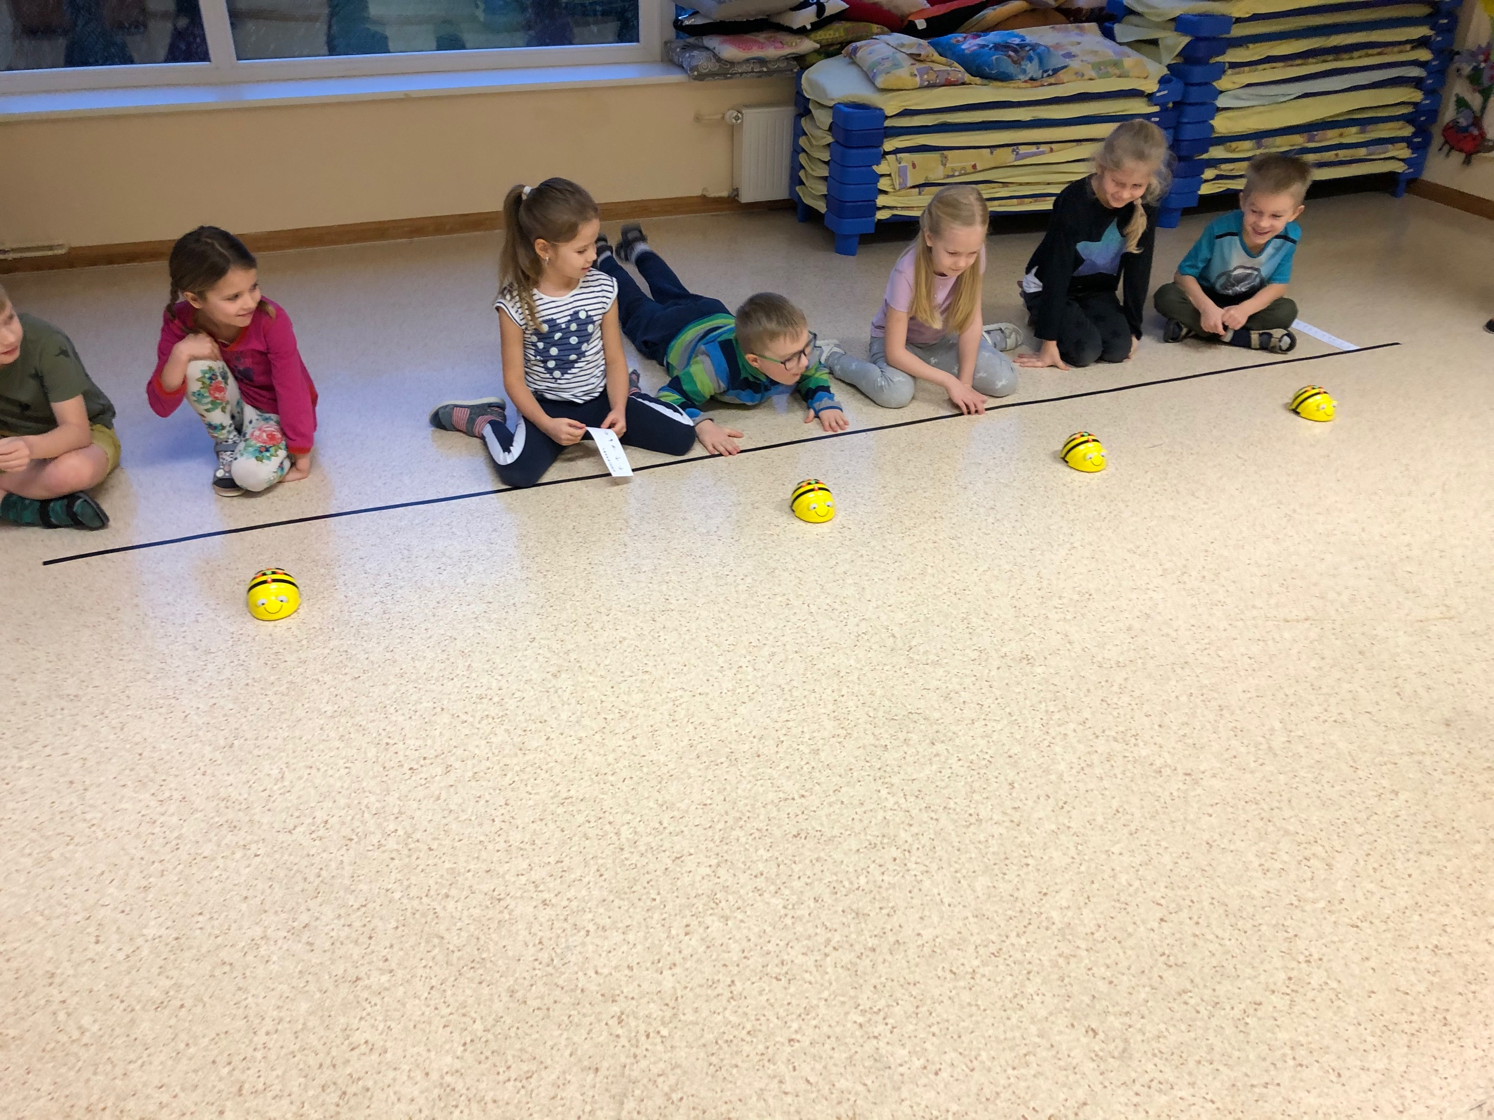

Slide 6
Children age 5-6 years old
During activity were used tablets and smartboards.
Children were devided to groups of 2-3 children. Interactive games on diggipuzzle.com page: find the right shape, code and move to right place, counting.

Slide 7
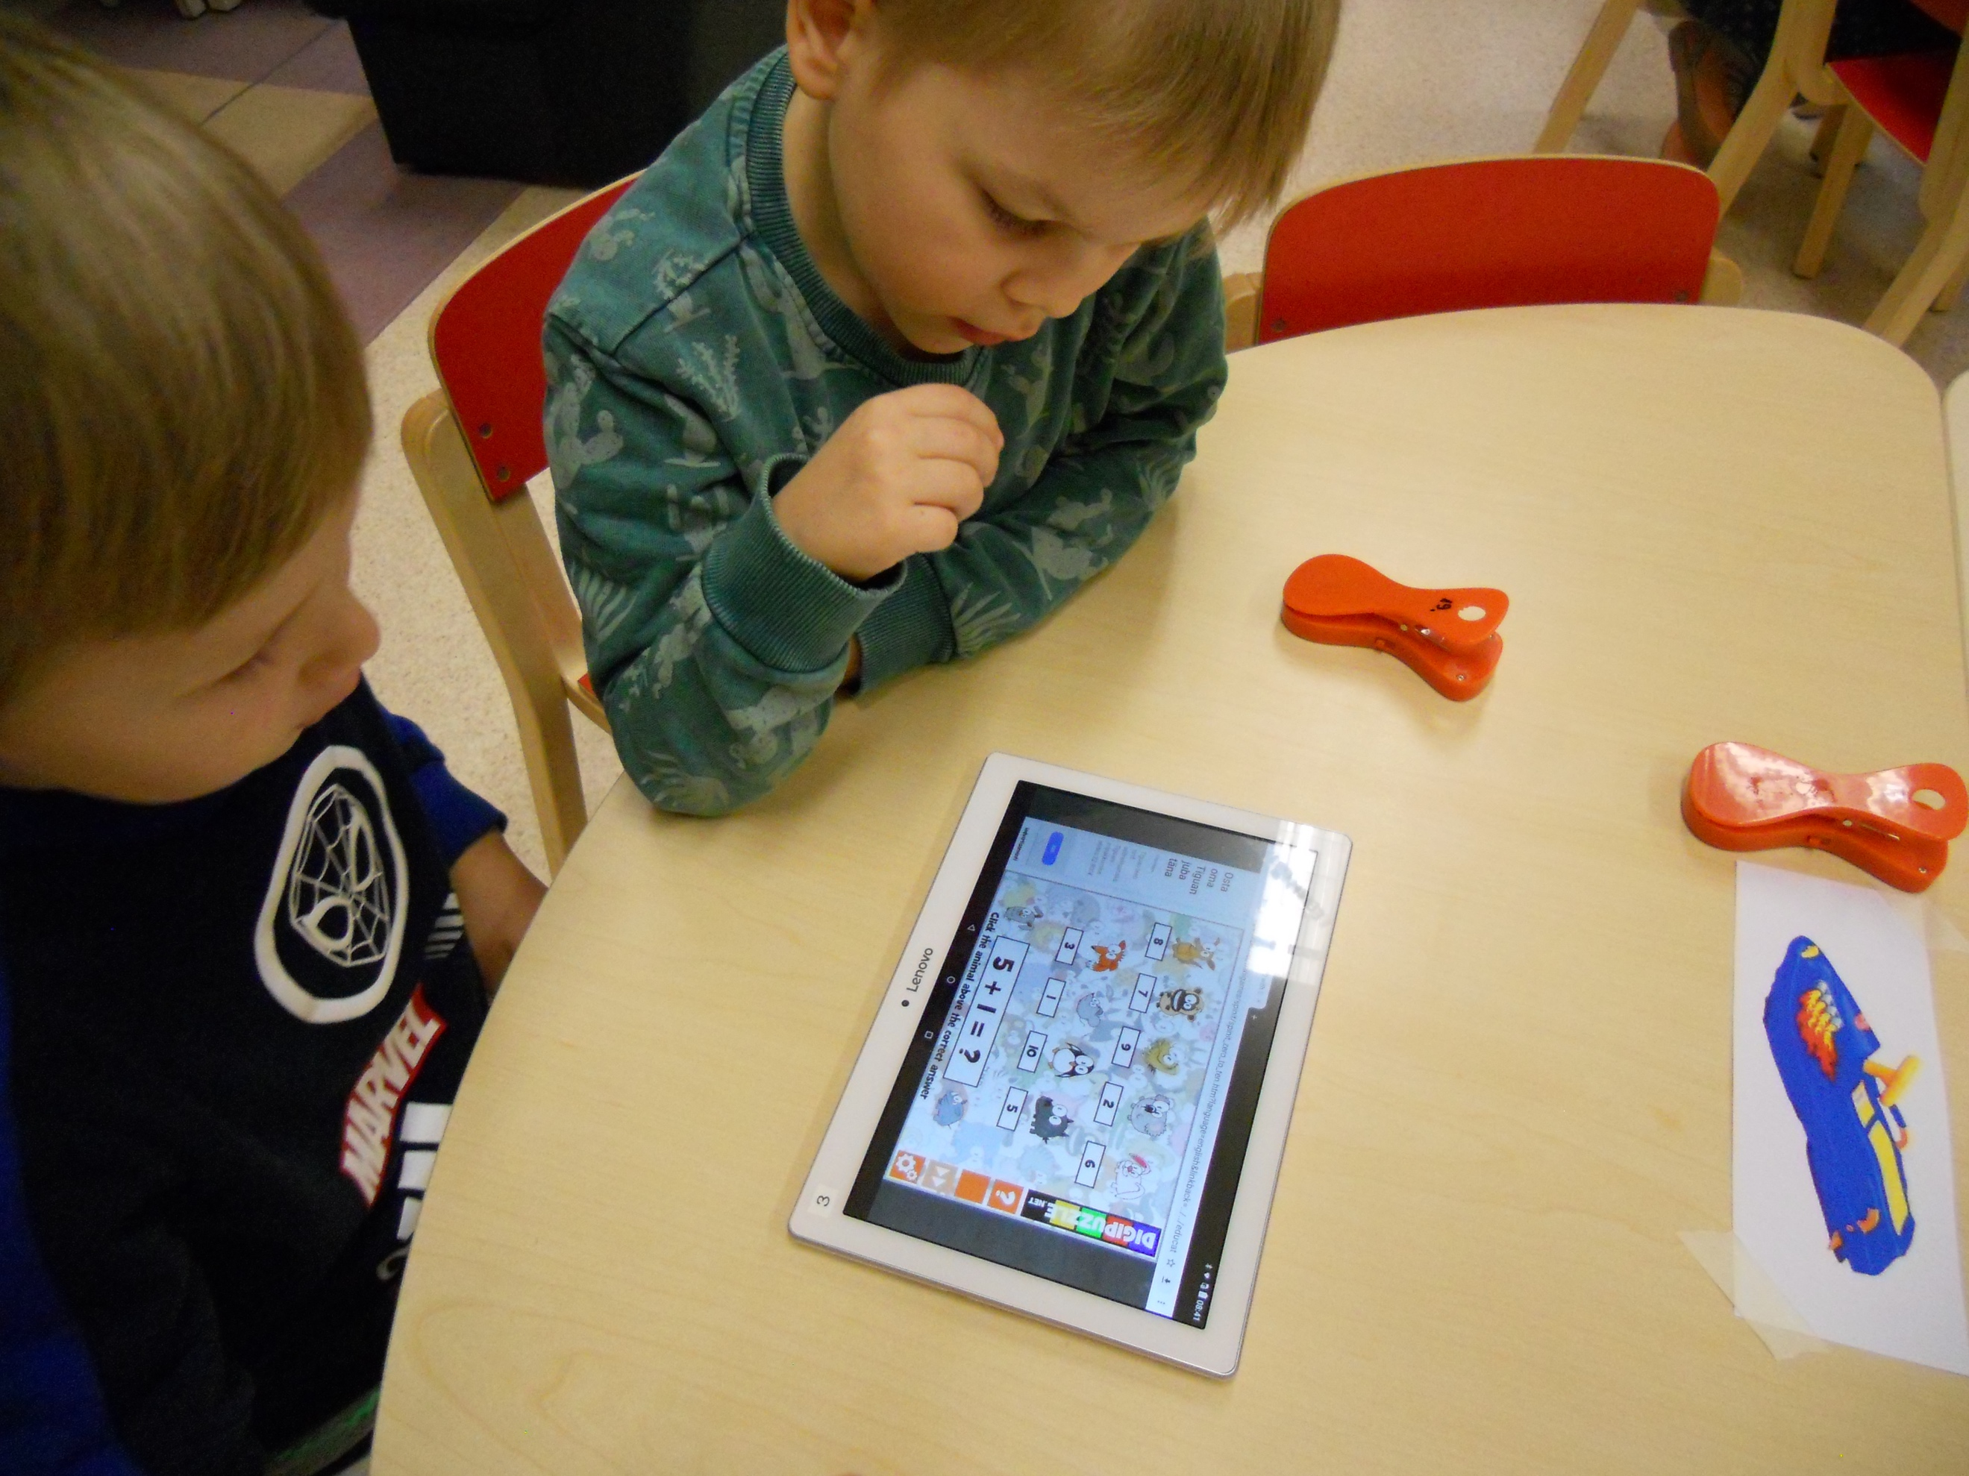
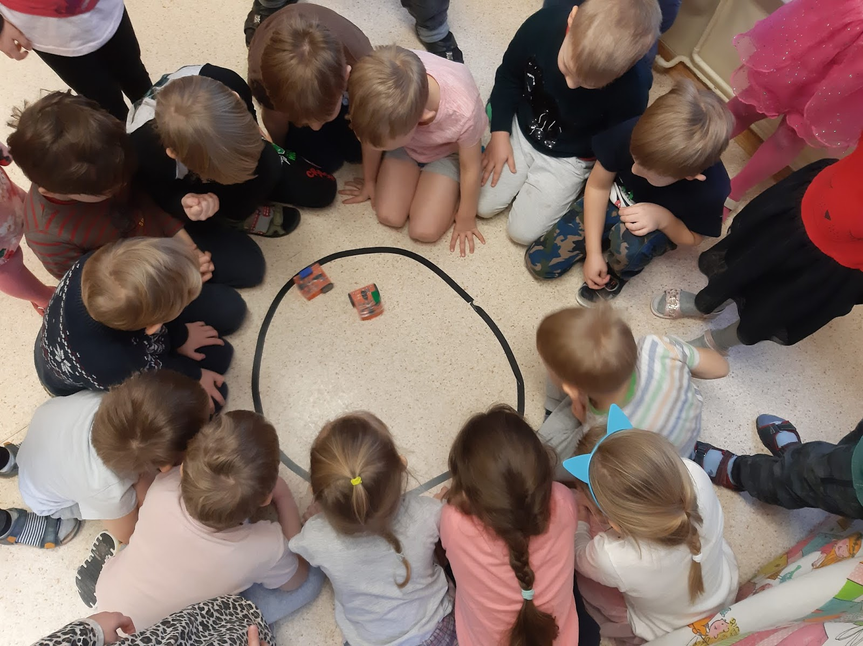

Slide 8
Children age 4-5 years
activity 1: M-bot robot. Children said their age and then choose track with the same number as their age. Children controlled the robot with remote from the beginning to the end of the track.
activity 2: Ozobot robot. Child draw a track or the number of her/his age and placed the robot to move on the track. At the end of the track was assignment: child took a ladybug, counted the dots and placed the ladybug in front of the same number, how many dots were on the ladybug.
activity 3: different interactive games on the smartboard – number connecting pictures, memo, puzzles.

Slide 9
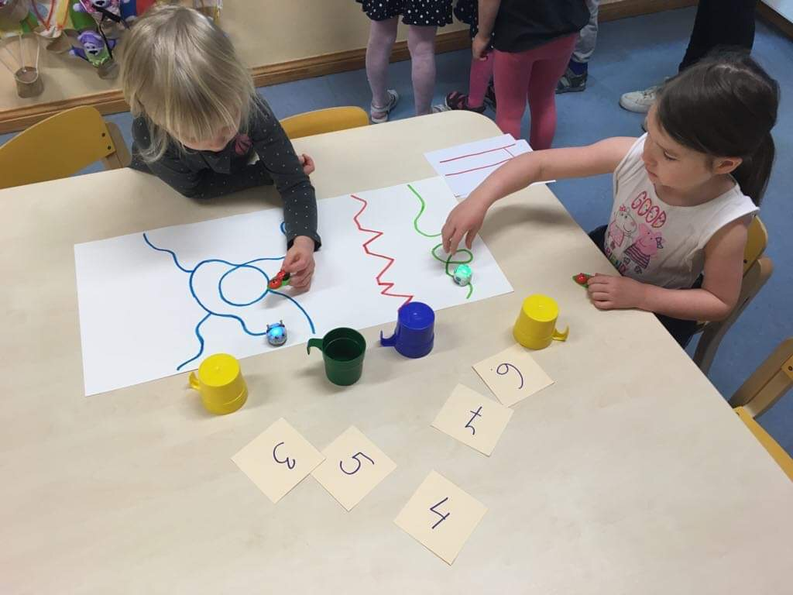
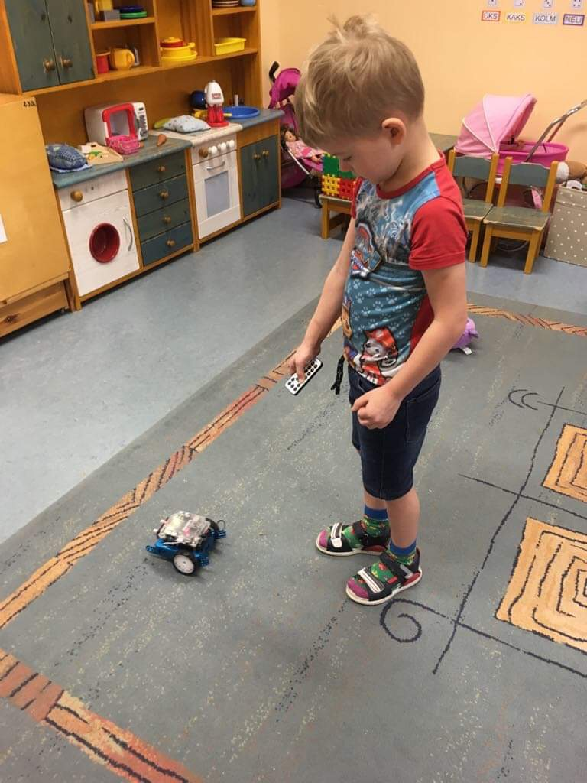

Slide 10
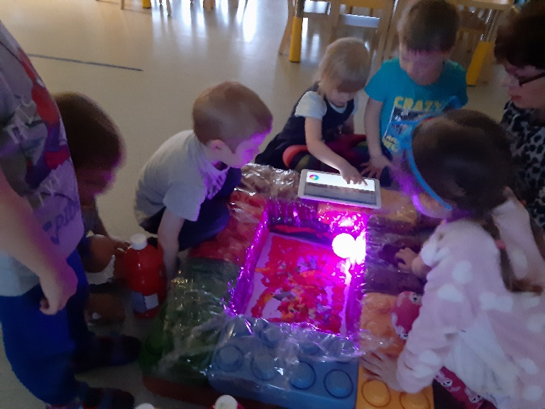
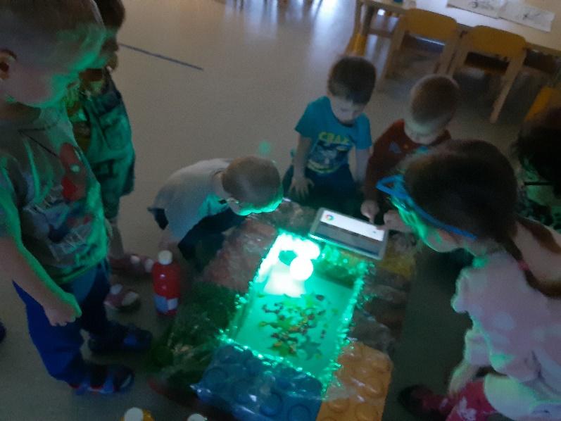
Children age 3-4 years
Painting with Sphero robot and tablet.

Slide 11
Children age 3-4 years old
Children searched with detectors animals inside folium from kinetic sand. Farm animals were then sorted to farmhouse and wild animal to forest.
Then children spelled the name of the animal and placed the animal in front of the letter the word begins with.

Slide 12
