Slide 1
Project exhibition
and dissemination activities
« Learning is interesting and fun!»
Erasmus+ Project KA2
Exchange of good practices
Presentation by Ann Magkiosi

Slide 2
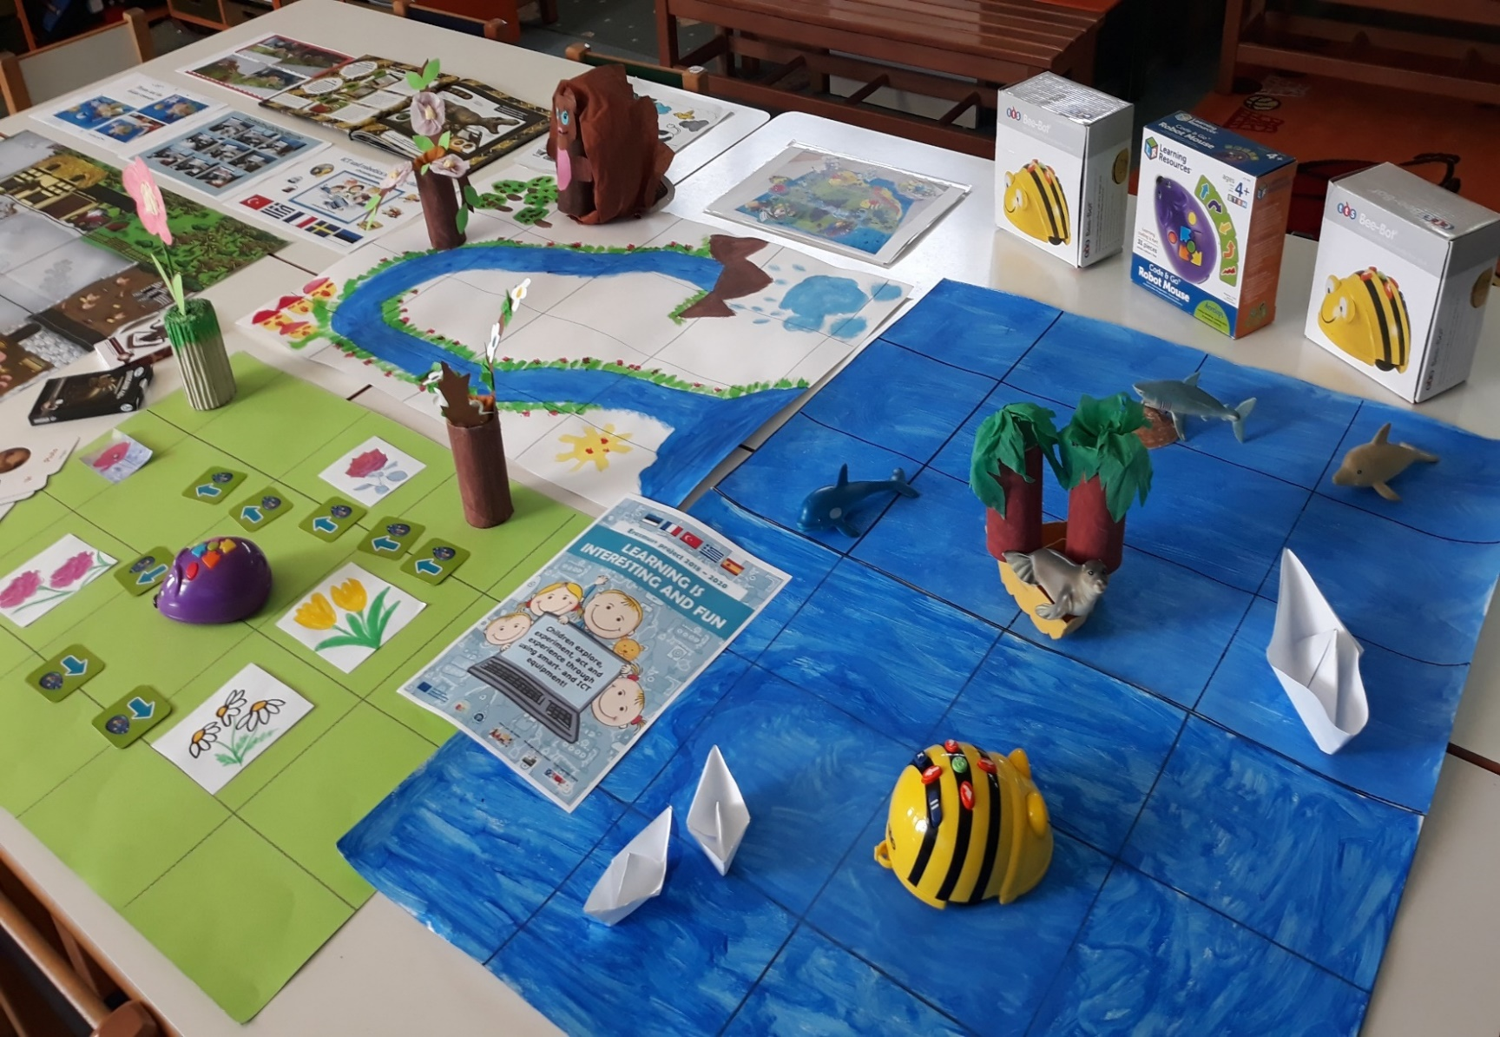
Project exhibitions

Slide 3
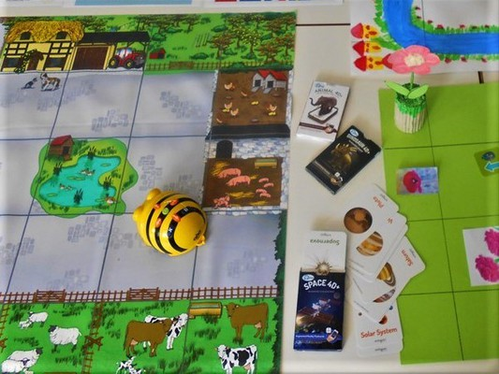

Slide 4
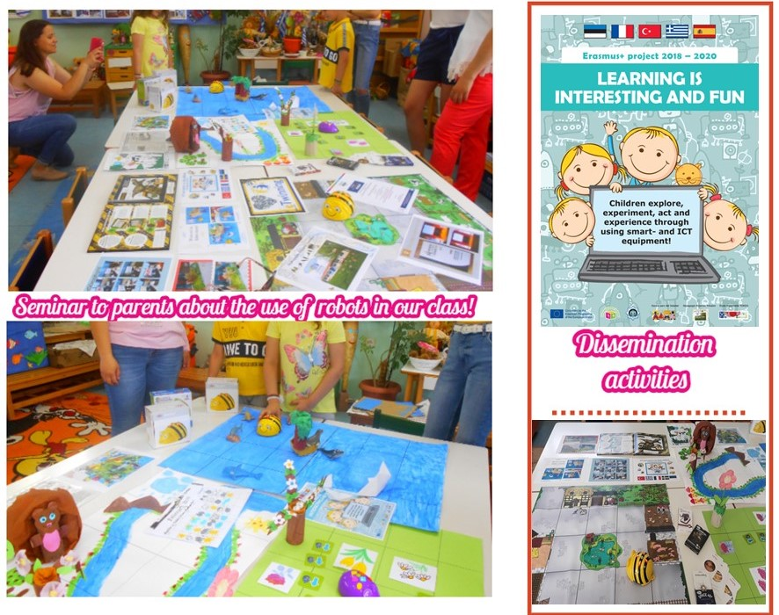

Slide 5
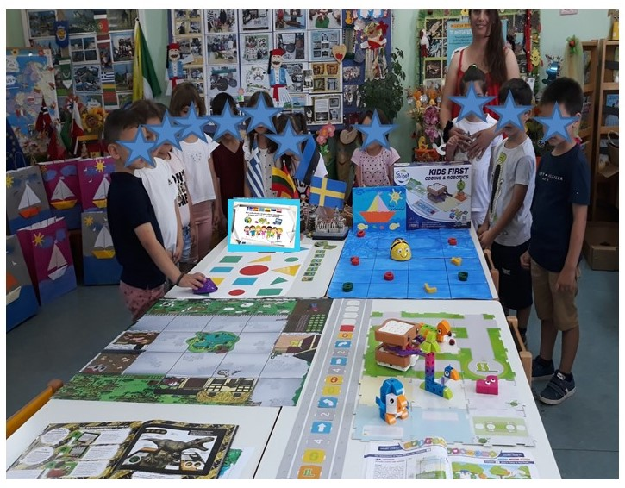

Slide 6
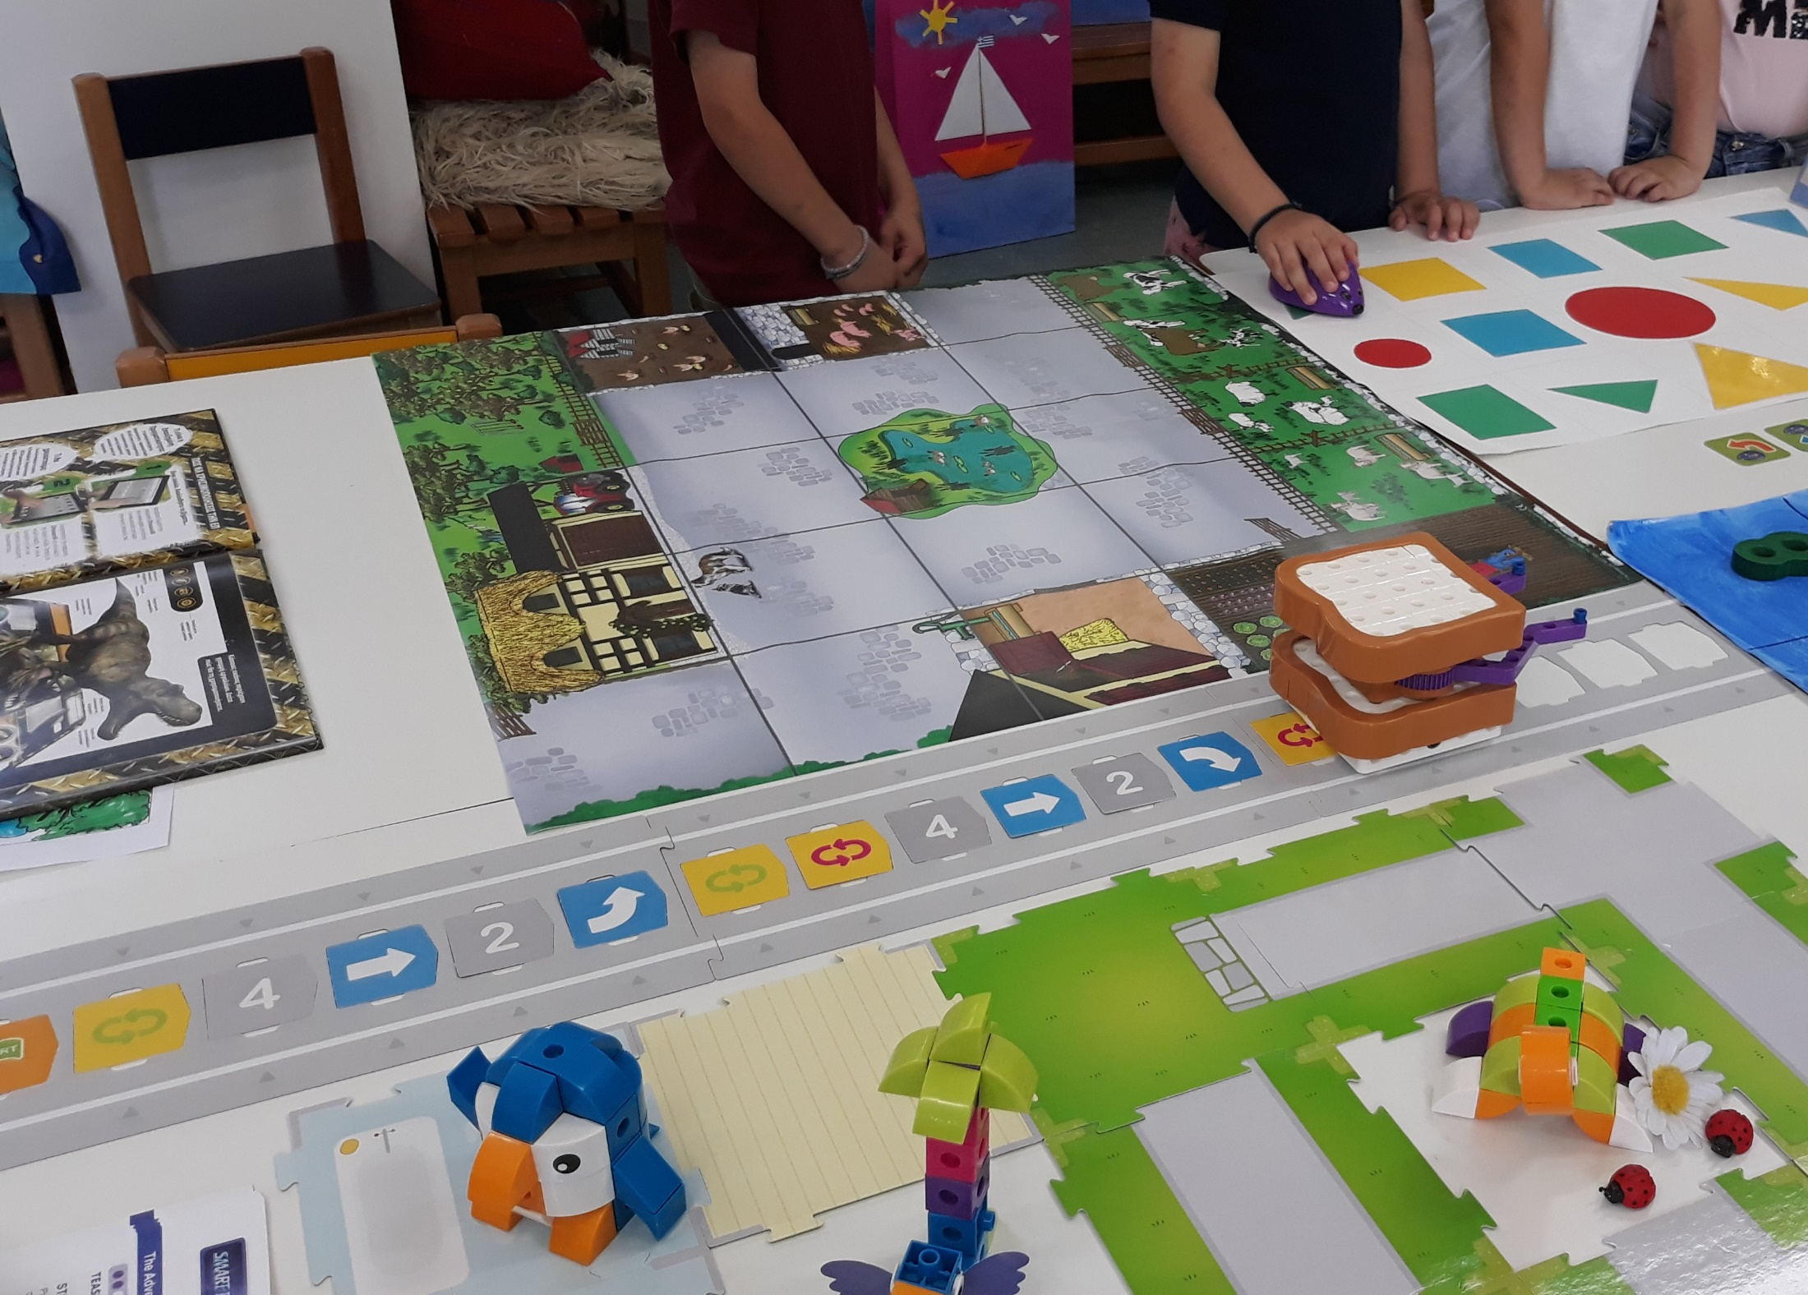

Slide 7
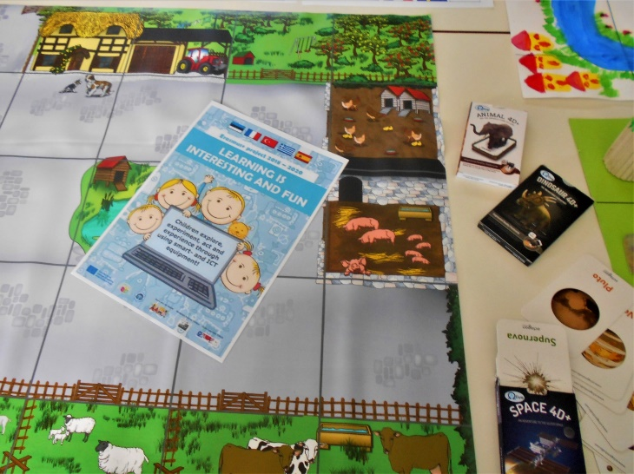
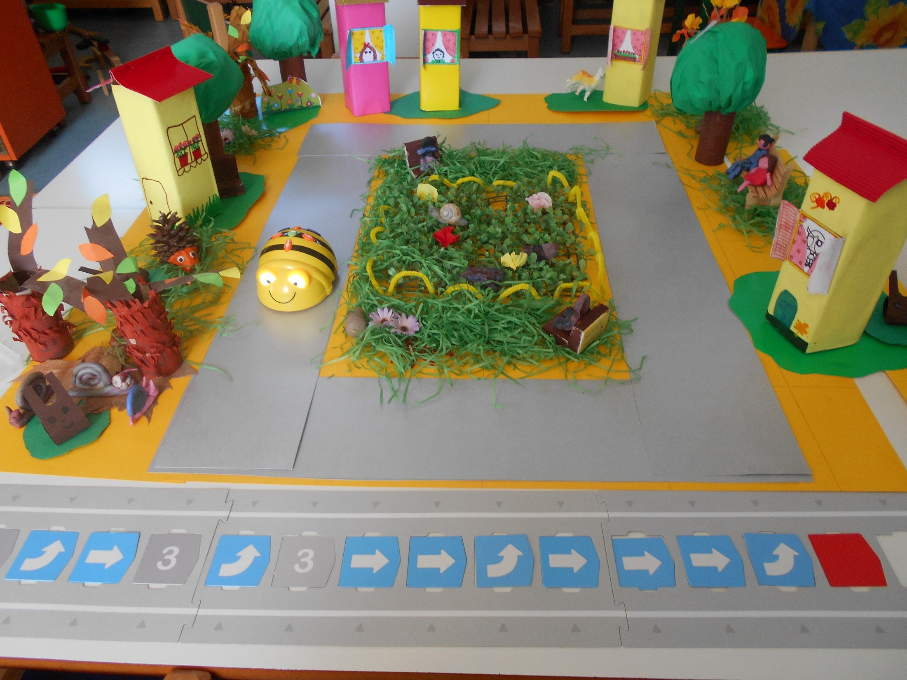
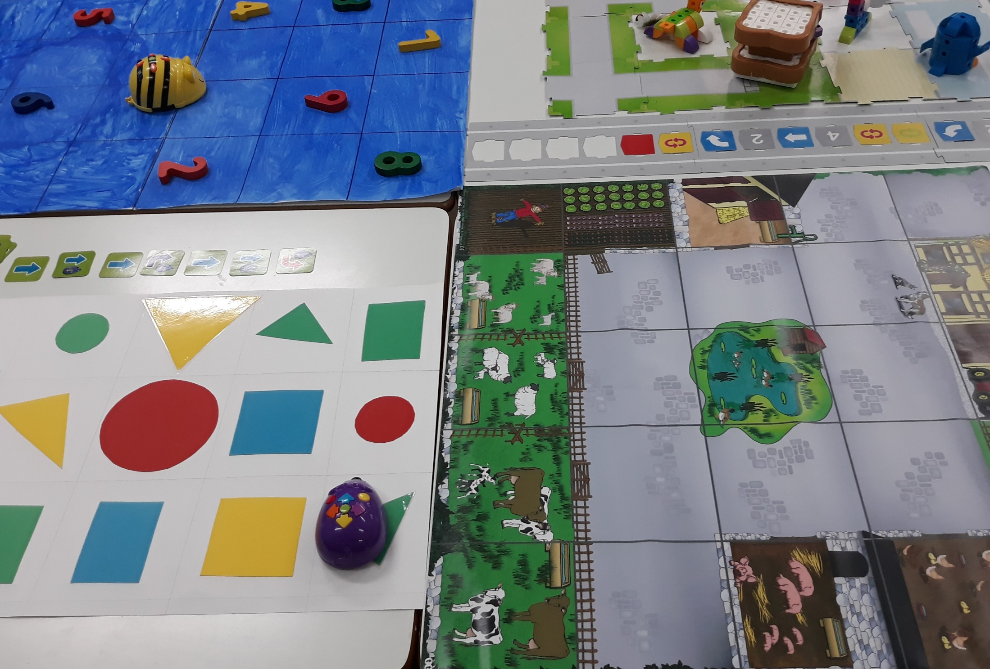
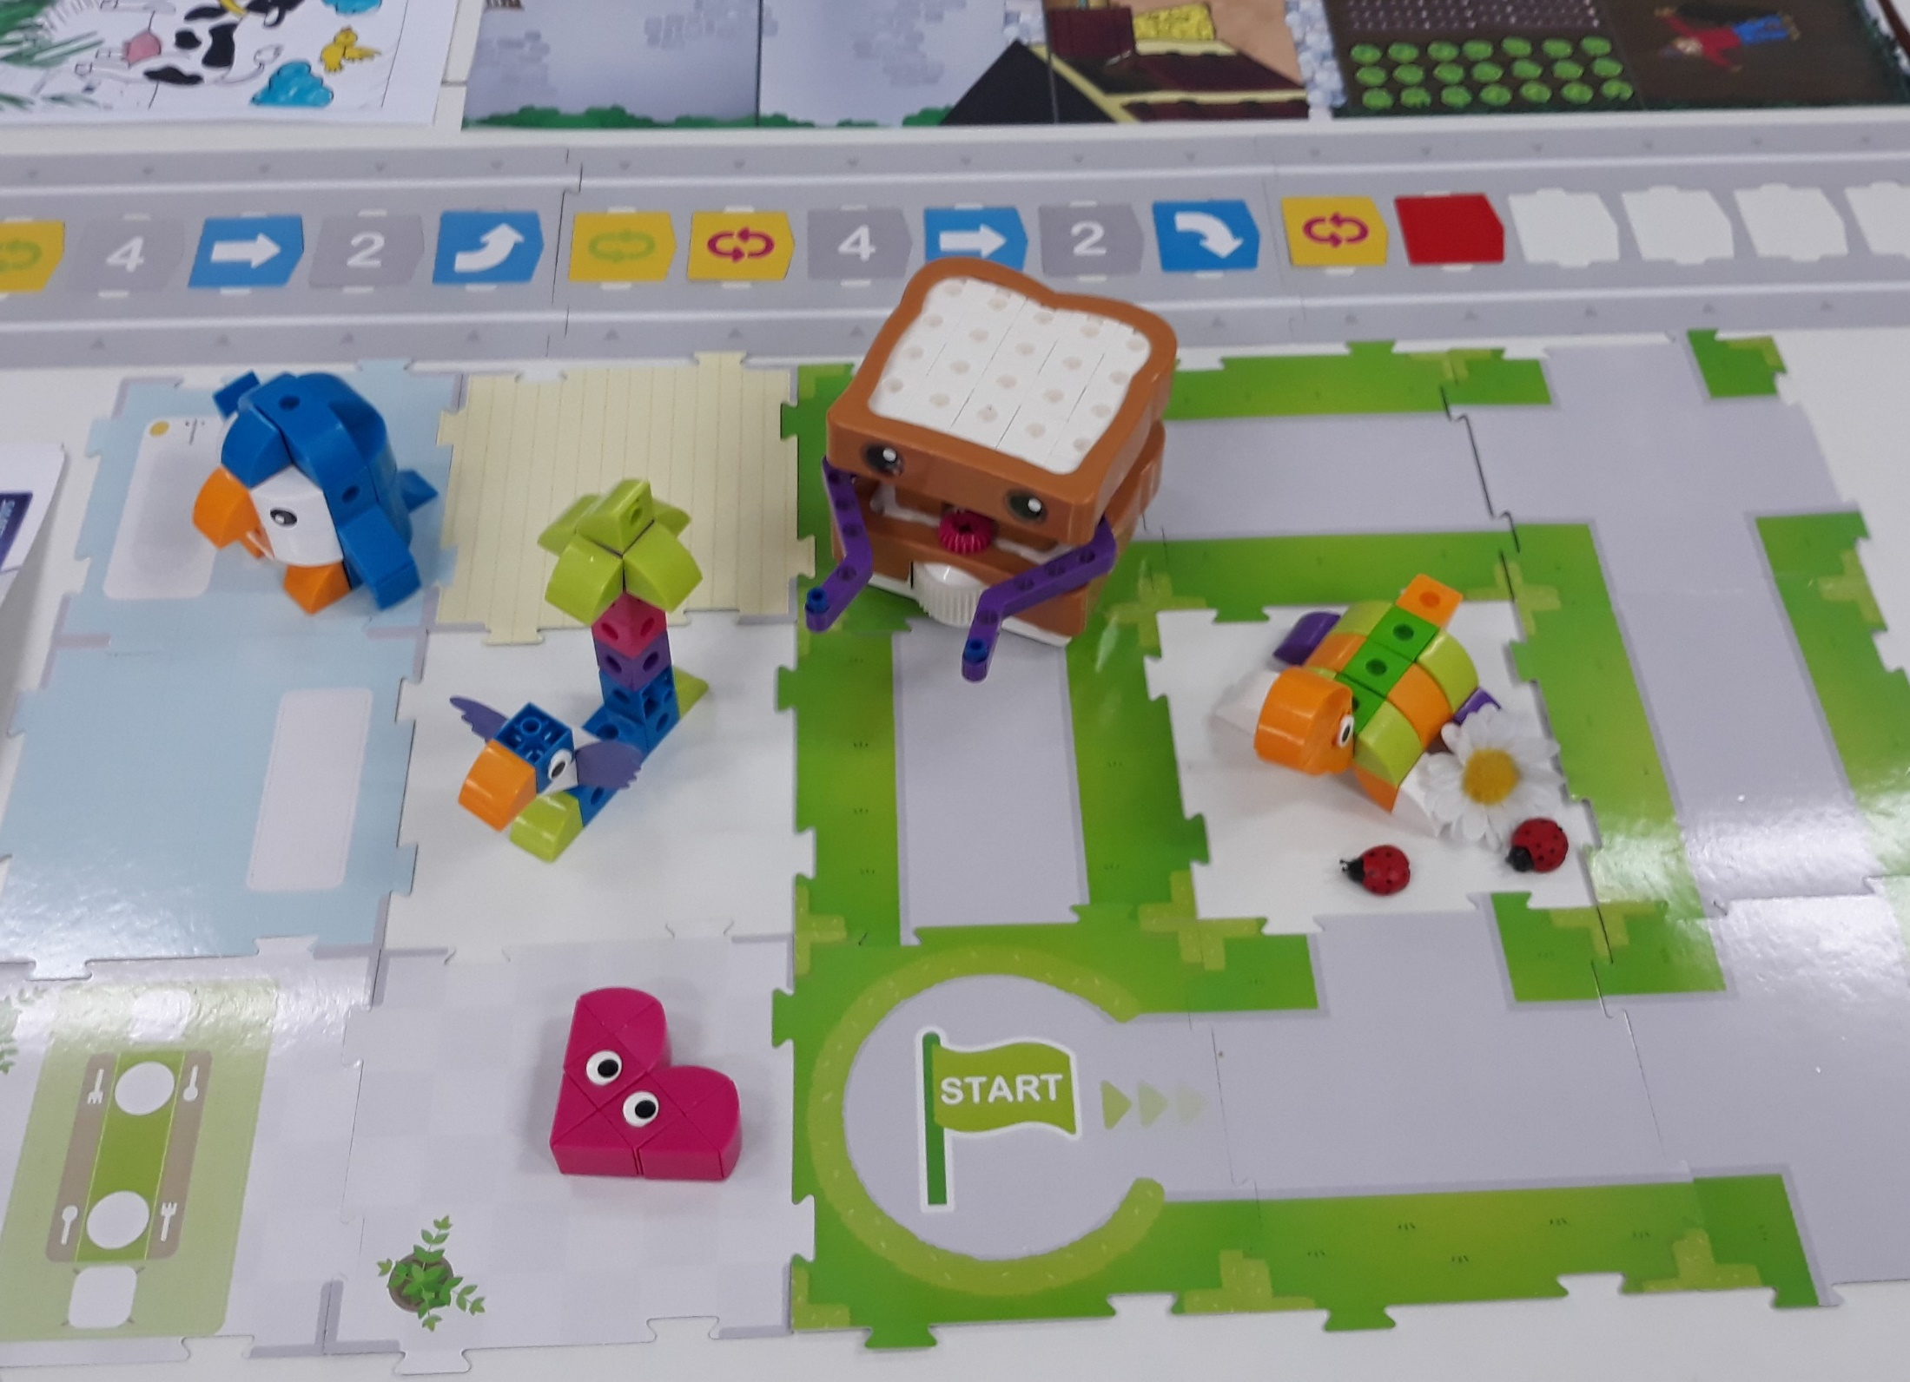

Slide 9
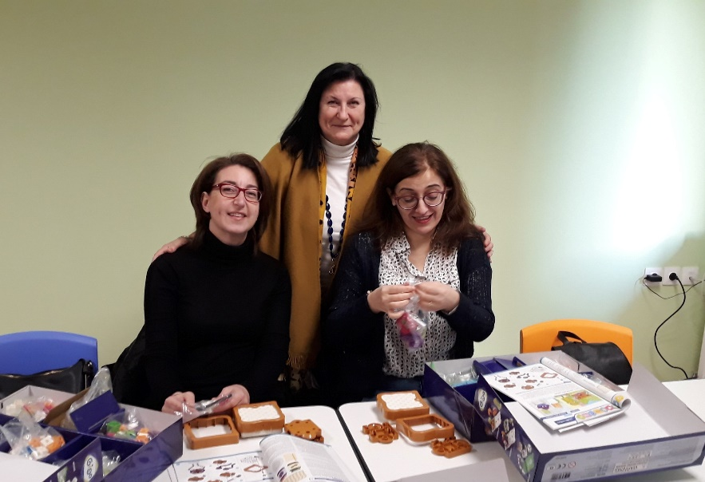
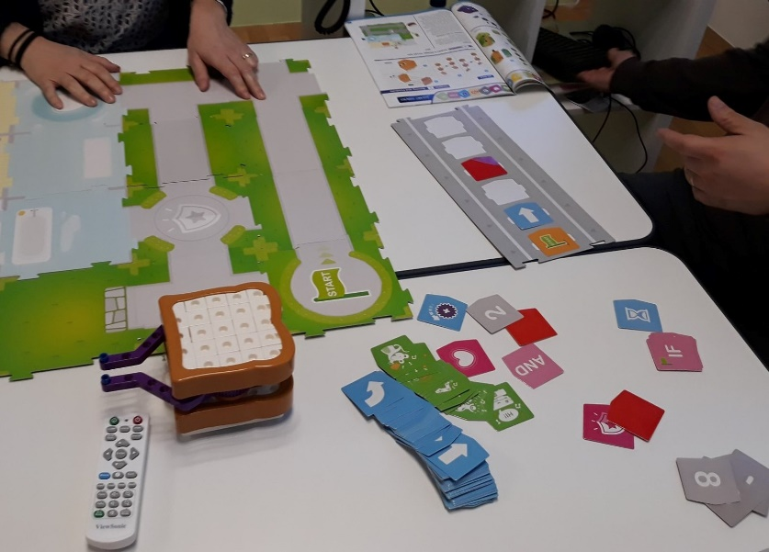
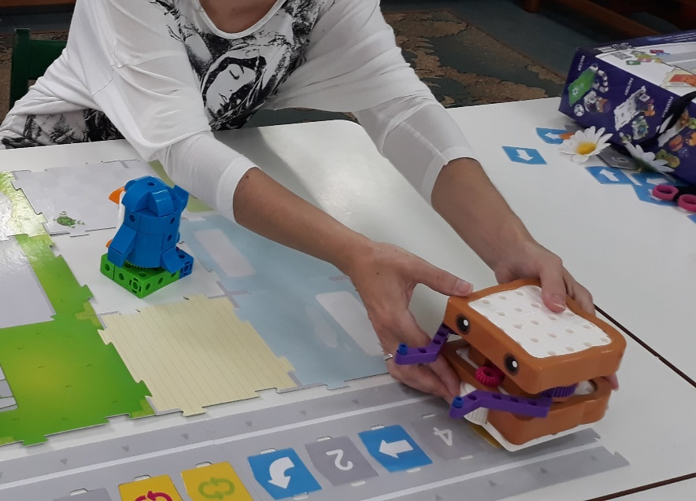
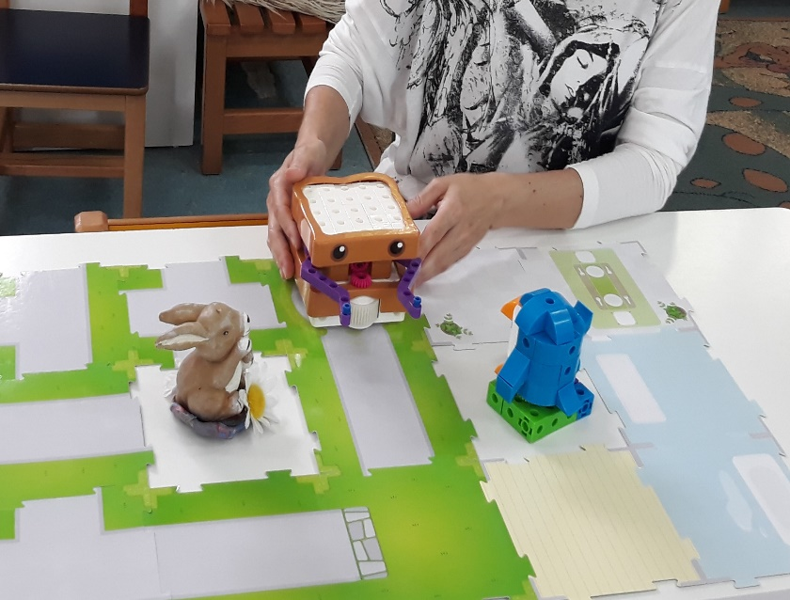
Teachers training
Notes:
Teachers training

Slide 10
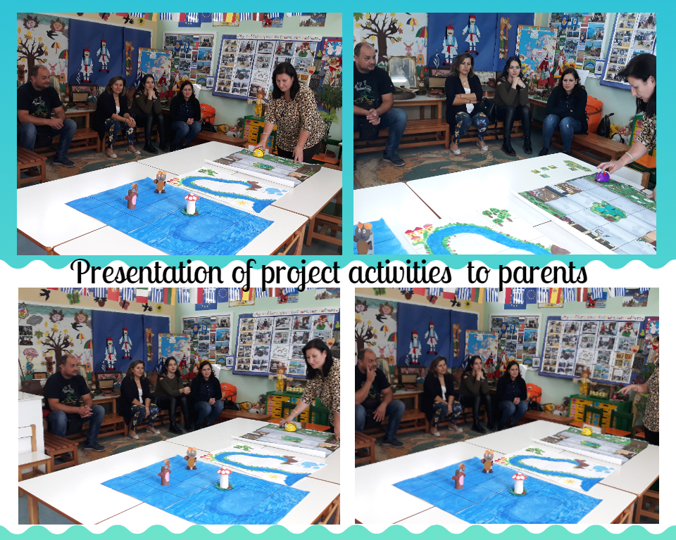

Slide 11
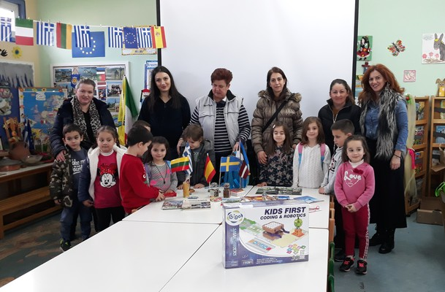

Slide 12
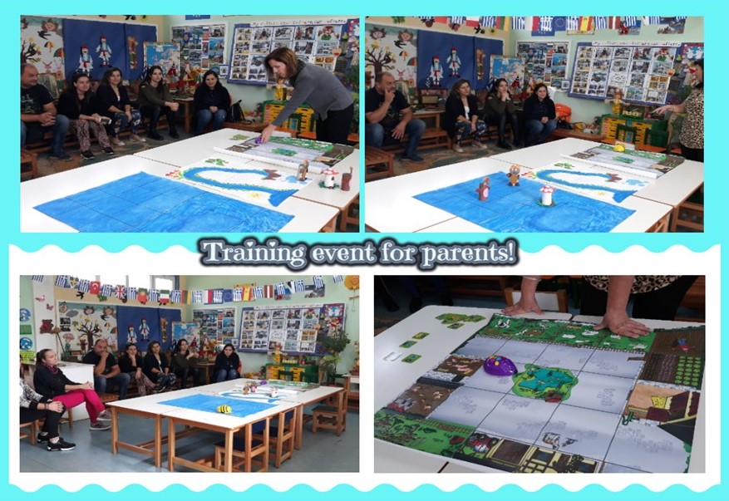

Slide 16
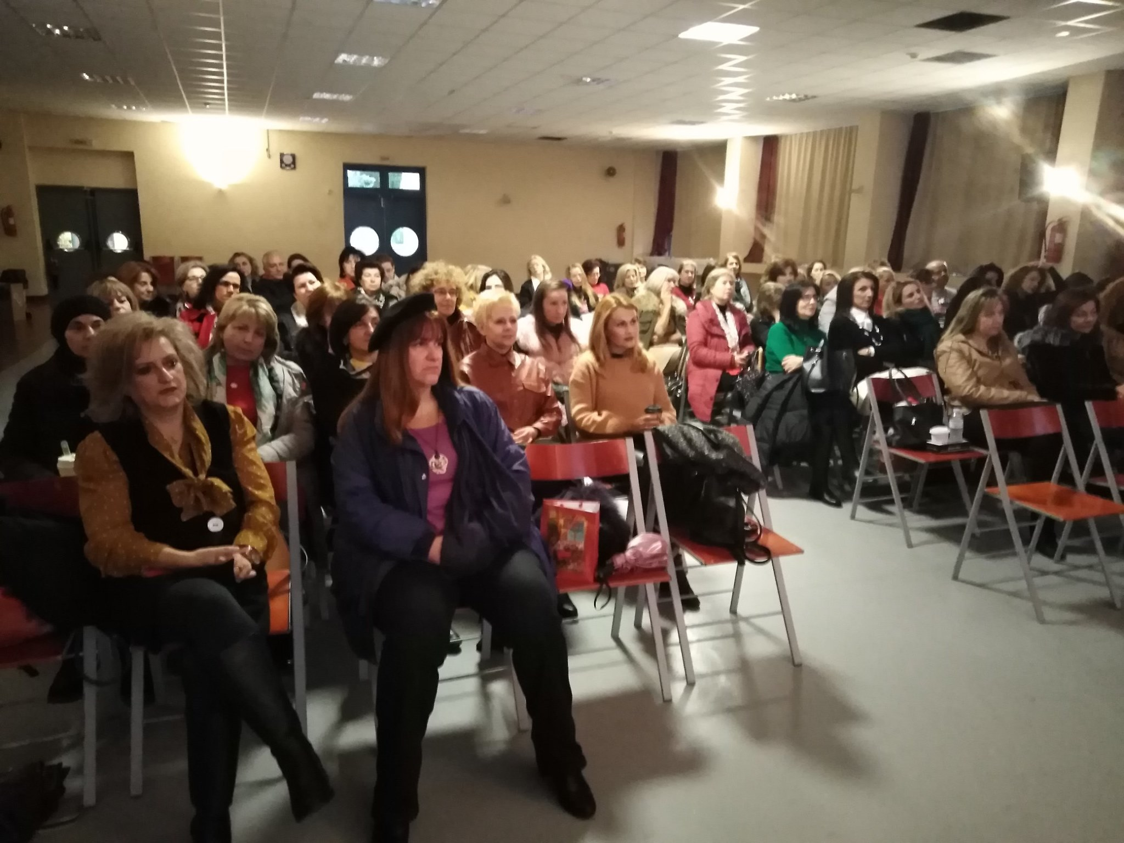

Slide 17
Project presentation in wider teachers
educational community of Thessaly
18/12/2019
Notes:
18/12/2019

Slide 18
Notes:
Local community

Slide 19
Project presentation to wider local community

Slide 20
Project presentation to teachers
of wider e twinning educational community
Notes:
Project presentation to teachers of wider e twinning educational community

Slide 21
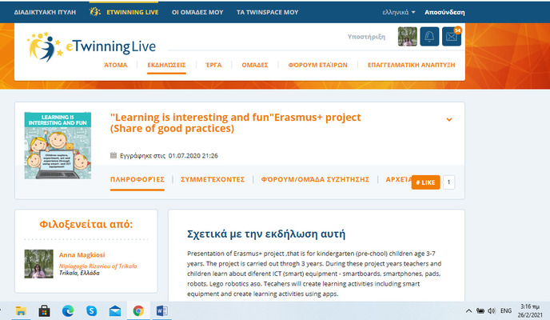

Slide 22
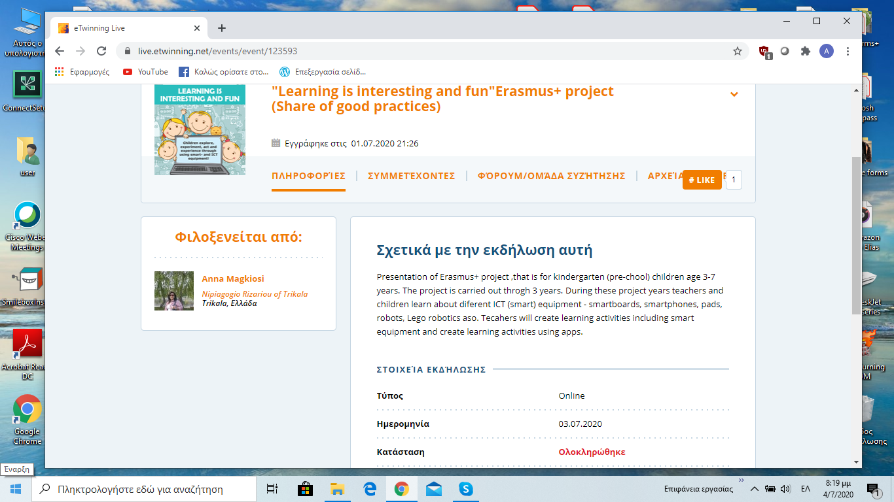

Slide 23
Our participation in Code week 2020

Slide 24
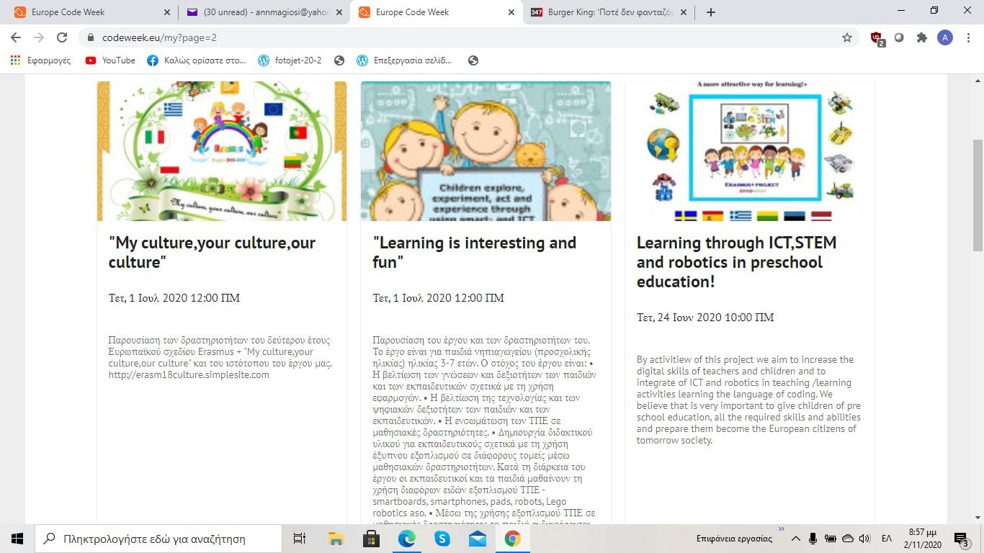

Slide 25
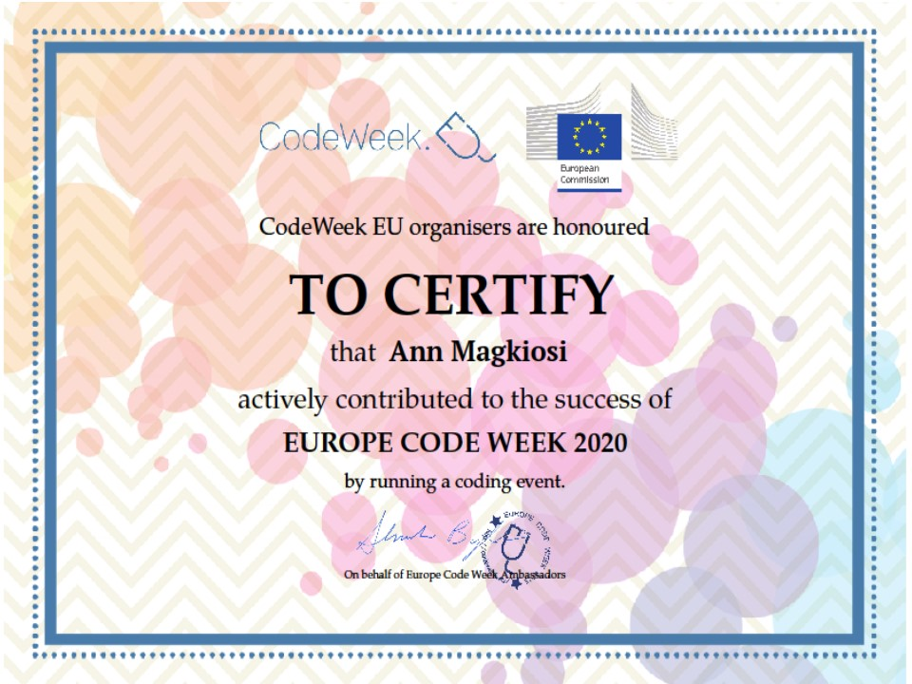

Slide 26
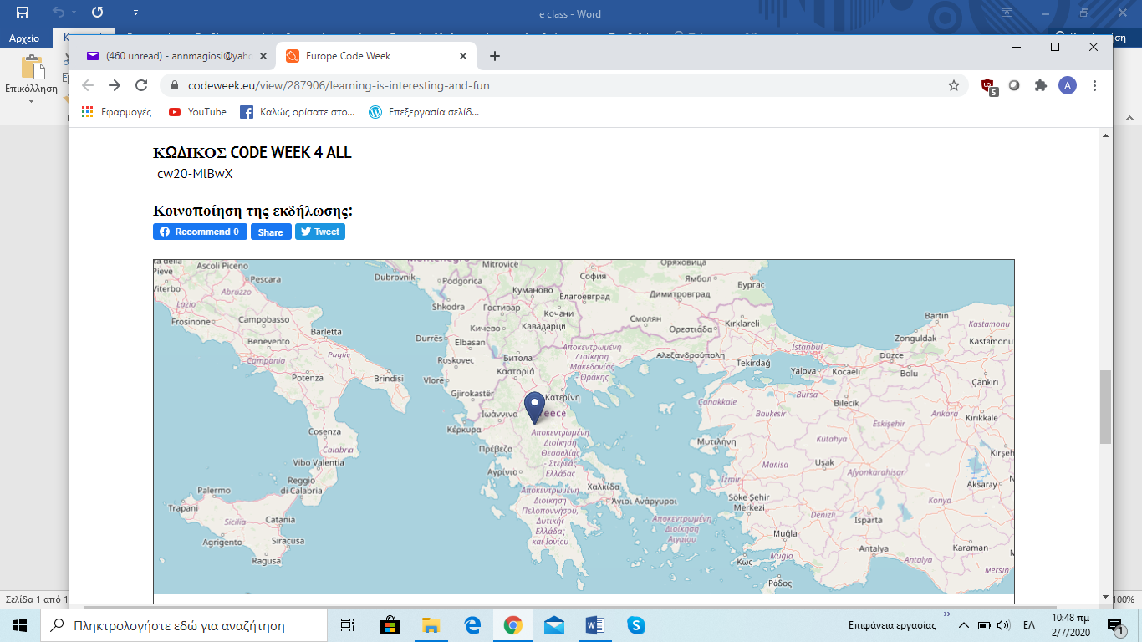

Slide 27
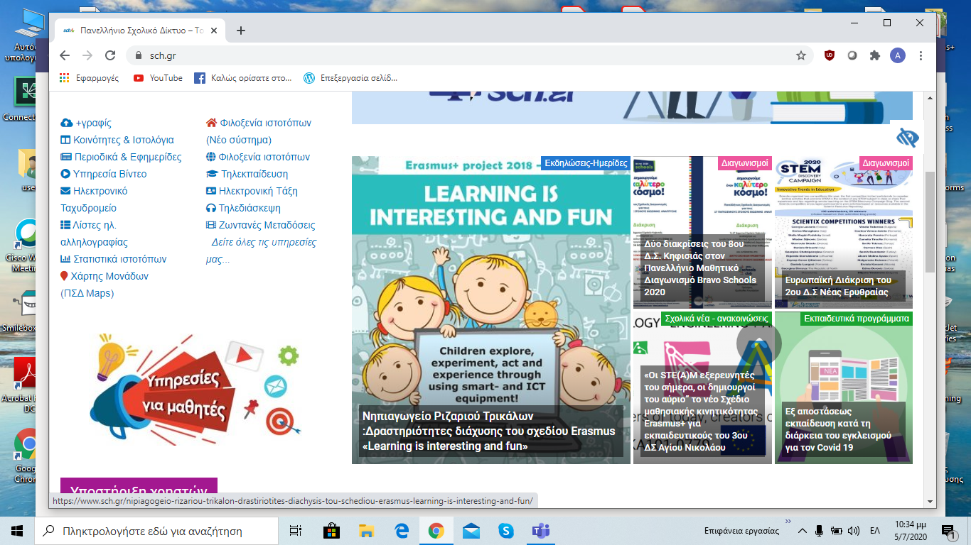
Project dissemination via wider Greek school net
Notes:
Project dissemination via Greek school net

Slide 28
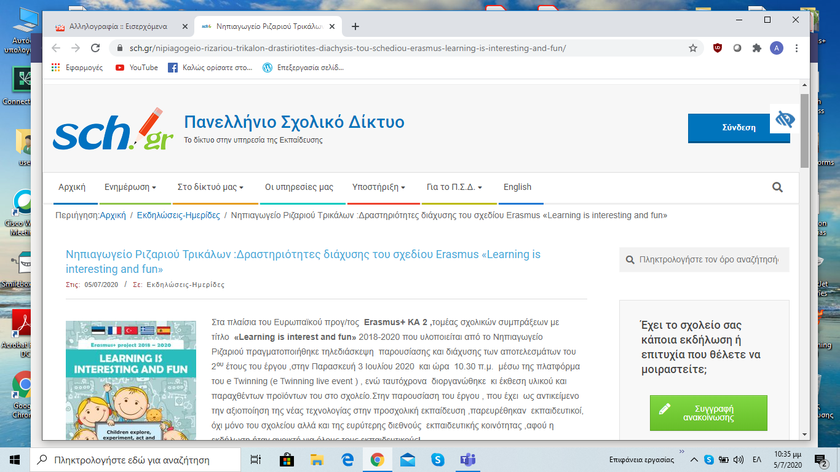

Slide 29
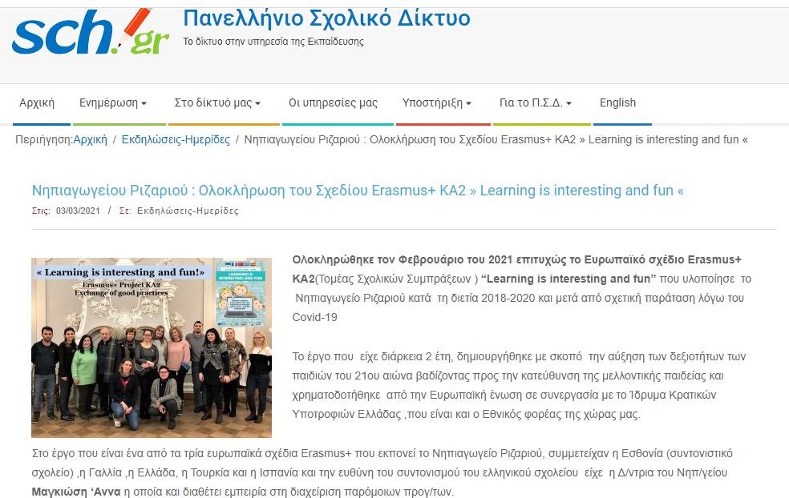

Slide 30
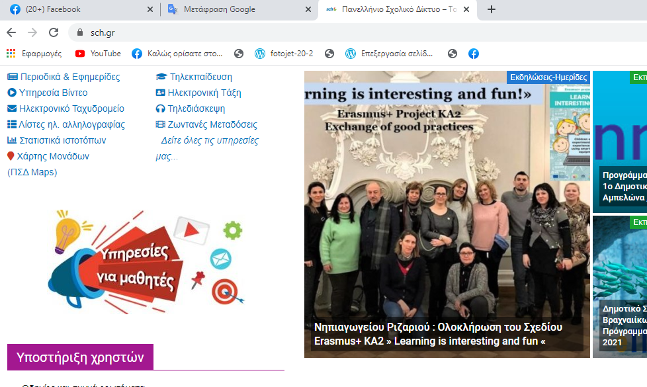

Slide 31
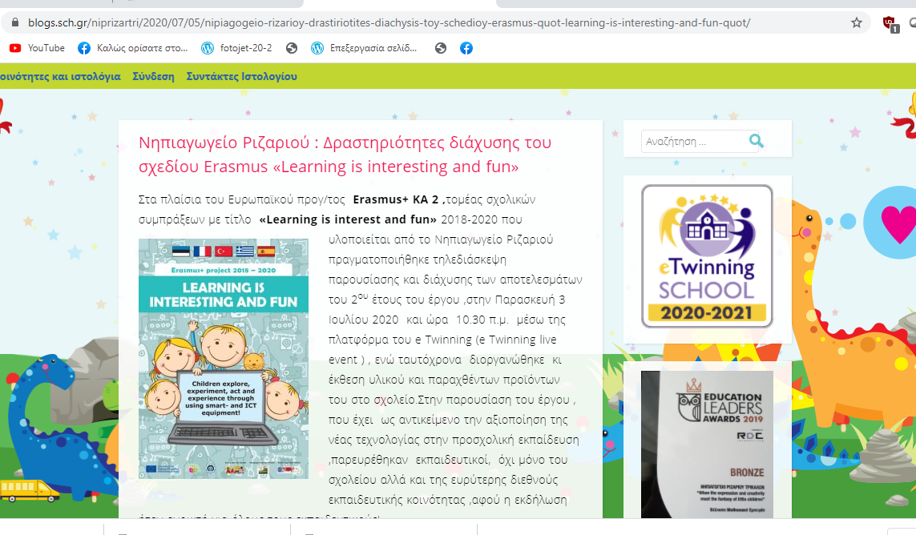
Project dissemination via school blog
https://blogs.sch.gr/niprizartri/

Slide 32
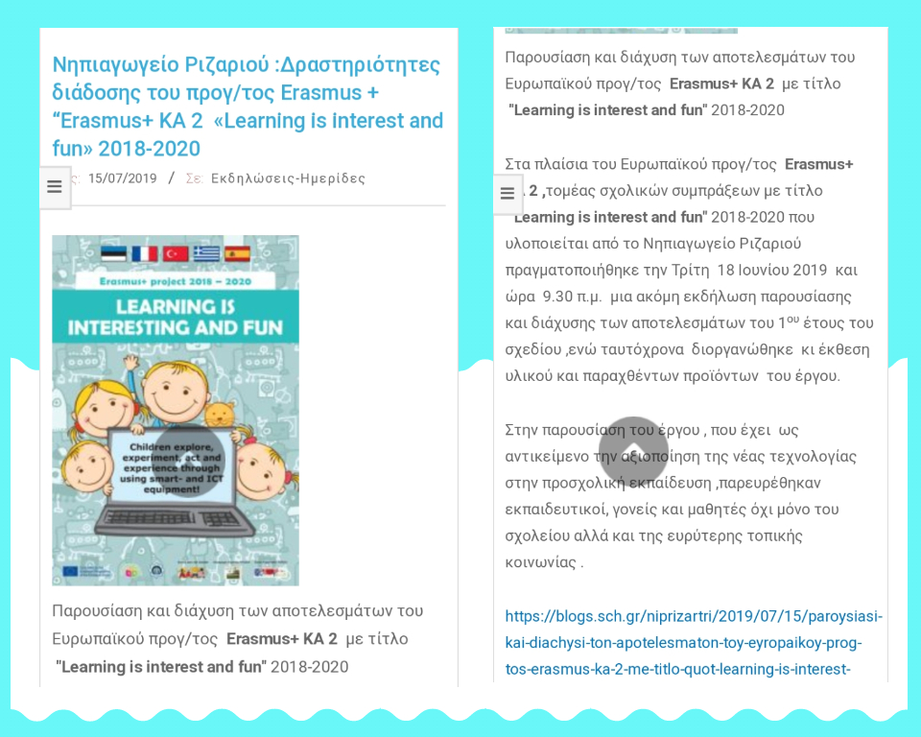

Slide 34
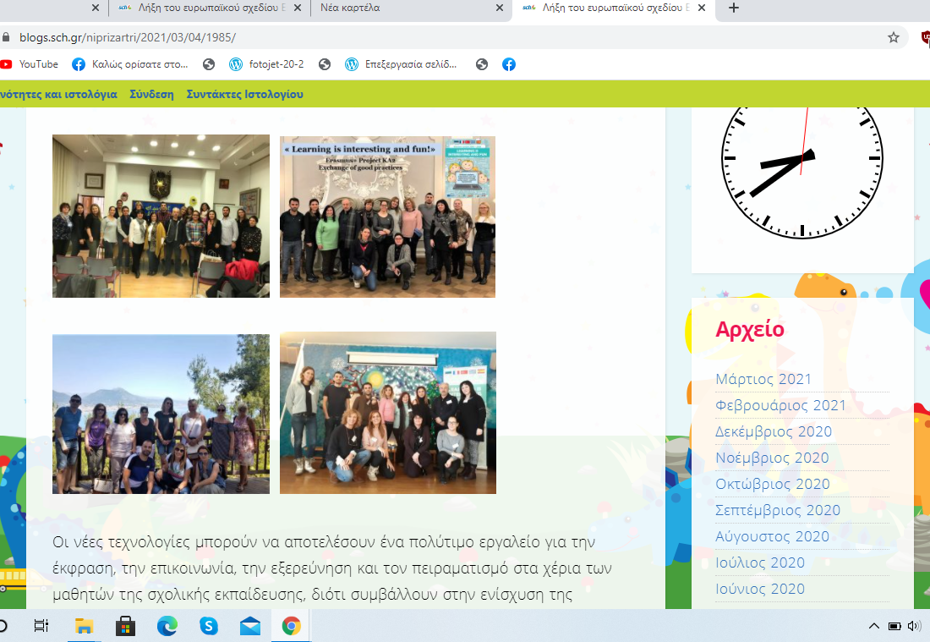

Slide 37
Newspaper announcements
and comments
about project

Slide 38
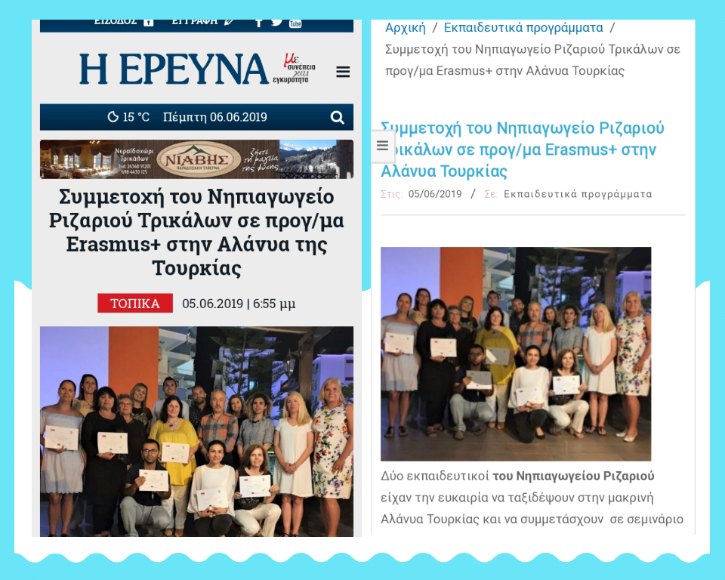
2nd training event (Alayna of Turkey )
Notes:
2nd training event in Alayna of Turkey

Slide 39
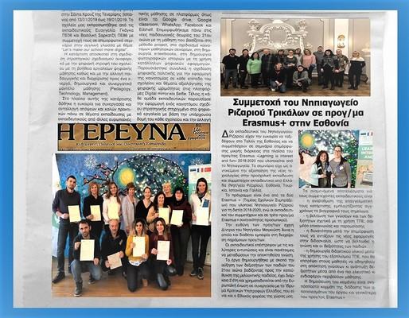
1st training event (Tallinn of Estonia )

Slide 40
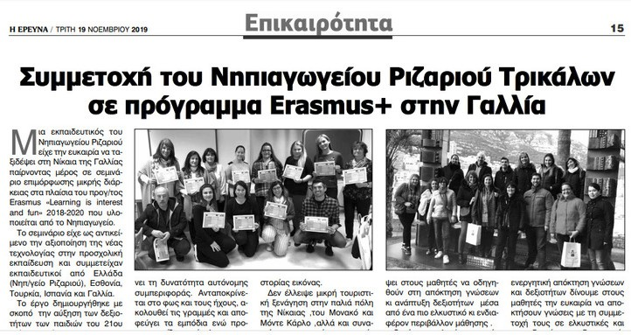
3nd training event ( Nice of France )

Slide 42
