Slide 1
Greek team workshop
Training event in Tallinn, Estonia (14/1/2019 to 17/1/2019)
Erasmus + project 2018-2019
“Learning is interesting and fun”

Slide 2
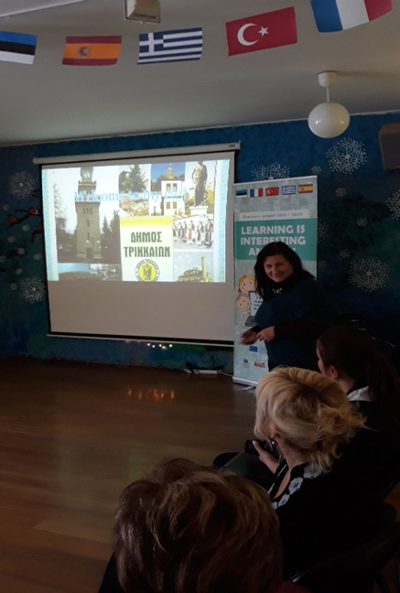
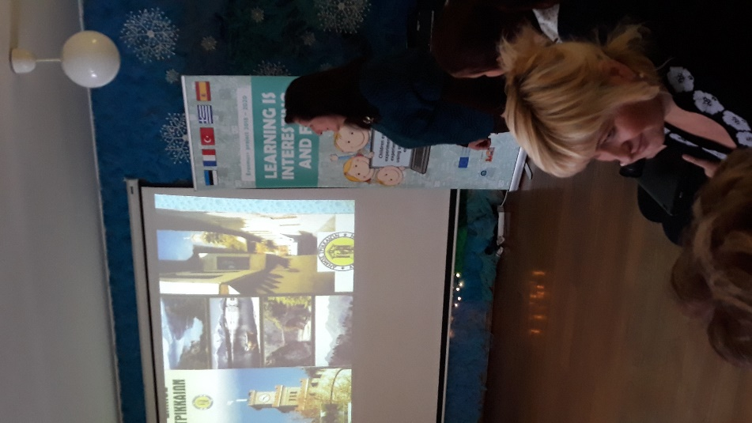
Work shop of Greek team
Presentation of our country, our city and our school
Presentation of Greek educational system

Slide 3
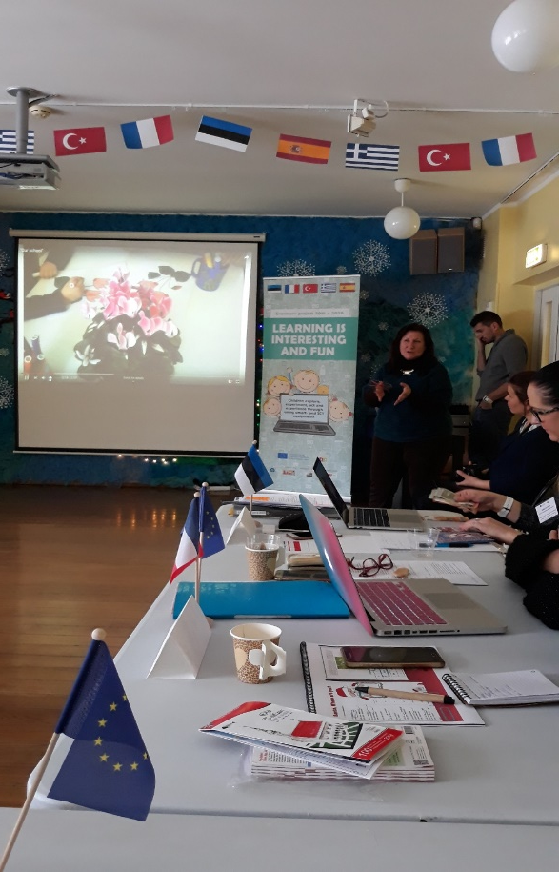
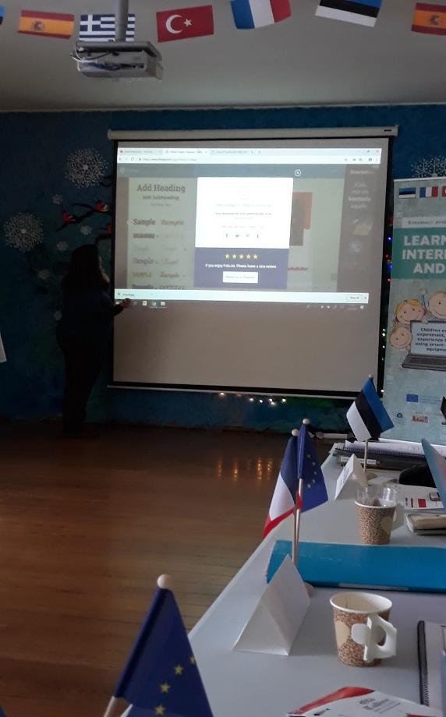
3. Presentation of the use of new web tools
a. Fotojet (for collage creations)
https://www.fotojet.com/apps/

Slide 4
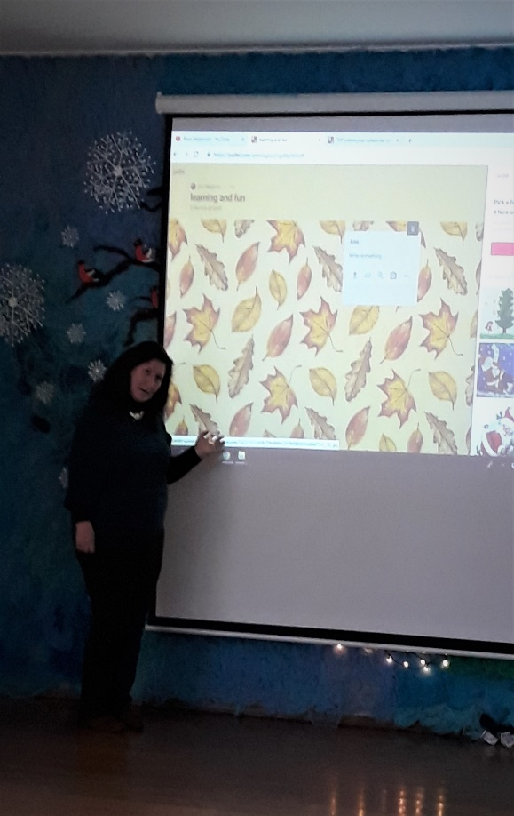
b. Padlet (for any kind of presentations
https://el.padlet.com/

Slide 5
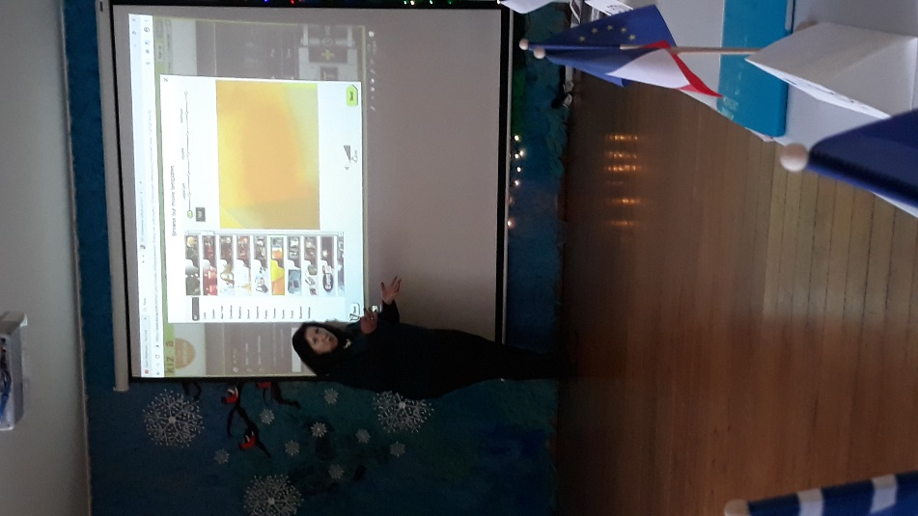
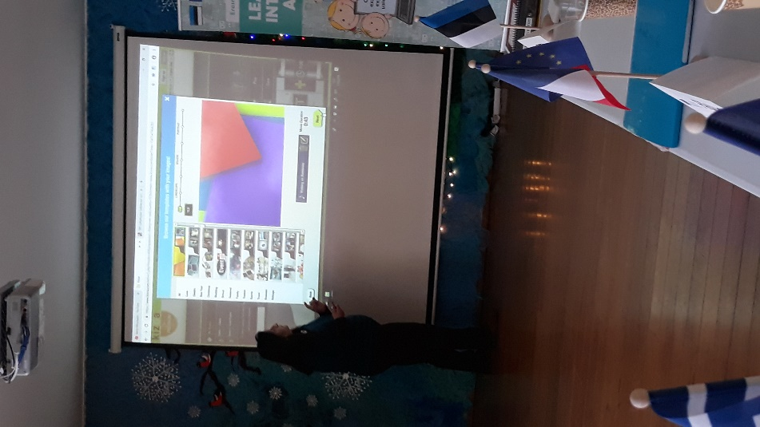
c.Kizoa ( collage and movie maker)
https://www.kizoa.com/

Slide 6
KIZOA : Online Video Maker using Photos, Videos and Music,Add Text, Special Effects, and Transitions ,Share via Email, Blogs, Facebook, and YouTube ,Burn onto DVD or download as a video file.
FOTOJET : useful web tool for any king of collage creation.
PADLET: Padlet is a digital canvas to create beautiful projects that are easy to share and collaborate on. It works like a piece of paper
for your screen. Start with an empty page and then put whatever you like on it. Upload a video, record an interview, snap a selfie, write your own text posts or upload some documents, and watch your Padlet come to life. Once others add to it, the page will update in real time.
The Greek coordinator : Ann Magkiosi

