Slide 1
Estonia practical workshop
Erasmus+ project “Learning is interesting and fun”
2. training event in Turkey
27.05.2019 – 30.05.2019

Slide 2
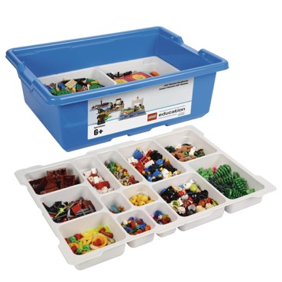
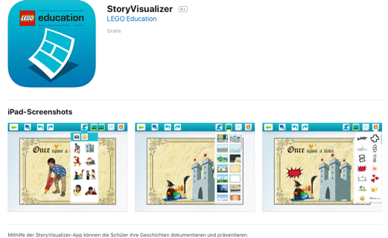
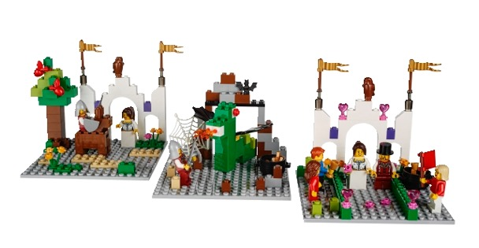
Comic book
Lego Story Starter, Lego Storyvisualizer application
Children work in teams of 5
Children create a story
Children create scenes with Legos, pictures will be made
Story will be visualized in application

Slide 5
Other options for creating comic books:
Pixton: https://www.pixton.com
ToonDoo: http://www.toondoo.com
Comic strip application
StoryboardThat: https://www.storyboardthat.com
Canva: https://www.canva.com

Slide 6
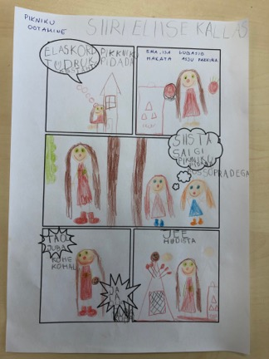
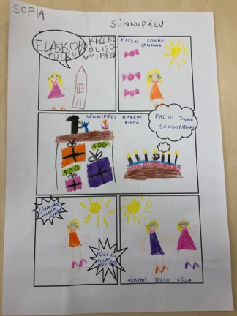
Creating comics with children on paper
Individual or team work
Creating a story
Visualizing the story
Writing
https://picklebums.com/free-printable-comic-book-templates/

Slide 7
Quizes
Puzzlemaker
http://puzzlemaker.discoveryeducation.com
It is free
You can create different educational games
Word search, crossword puzzles, math puzzles, mazes, cryptograms, number blocks.

Slide 8
Other opportunities to create quizzes
Quizizz: https://quizizz.com
Proprofs brain games: https://www.proprofs.com/games/
Hot potatoes: http://hotpot.uvic.ca/index.php
Frepy.eu: http://www.frepy.eu (ready games)
Socrative: https://socrative.com (school)
Quizlet: https://quizlet.com (school)
Boowa and kwala: http://boowakwala.uptoten.com/kids/boowakwala-games.html
(ready games)

Slide 9
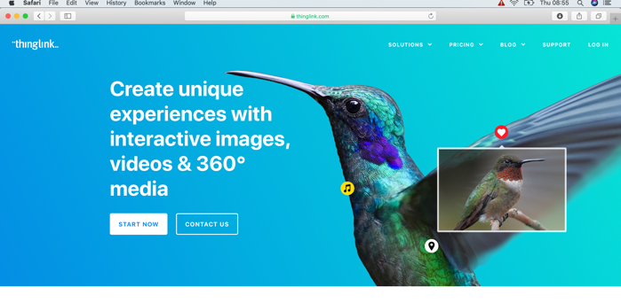
Interactive pictures
Thinglink
https://www.thinglink.com
Works with smartboards and
Tablets
Children can discover, research, answer questions
https://www.thinglink.com/scene/880832510185963521
Skitch application

Slide 10
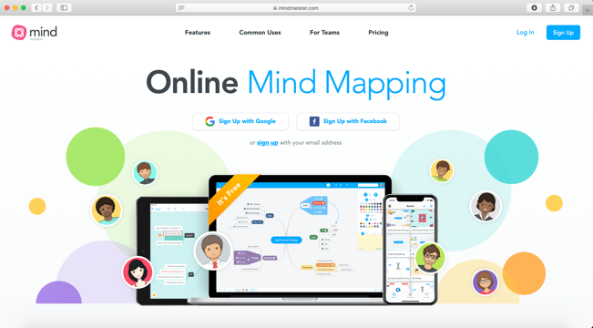
Teamwork
Mindmeister
https://www.mindmeister.com
Word mapping
Idea/meeting management
Knowledge management
Brainstorming
Note taking
Wordcloud: https://www.wordclouds.com

Slide 12
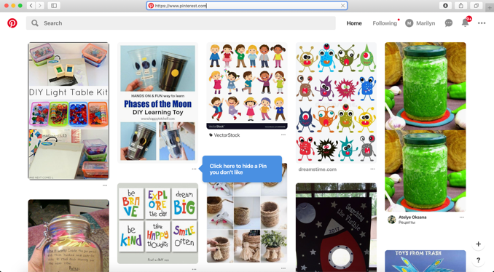
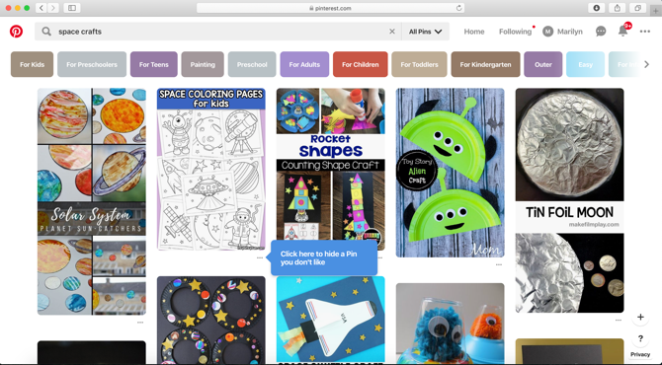
Pinterest
https://www.pinterest.com
Store pictures
Search ideas on certain topic

