Slide 1
5. Smartweek 16.11.2020 – 20.11.2020

Slide 2
On 16.11-20.11.2020 was held at Tallinn Suitsupääsupesa kindergarten Erasmus+ project 5. smartweek with children. During the week were planned different activities in every classroom and different ICT equipment, robots, internet environments and applications were used.
This time we used all the new equipment and environments we have used and learned about throughout 2 project years. All activities were held inside classrooms – no shared activities.

Slide 3
Children age 6-7 years old
Playing maze and bowling with mBot robot. A maze was built with big blocks and mBot was controlled with remote to move through the maze. Mbot was controlled with remote to drive against the bats. All bats had numbers and children counted together the numbers on the bats fall down.
Children created a story in teams and then built the story with Lego blocks.
Reading with Blue-bots. Children choose a picture. Then write the name of the animal on the picture to the lightboard. Then children searched the name on Blue-bot mat and programmed the robot to drive on the same word.
Working in pairs with Lego Learn to learn blocks and solve 5 different assignments.
Activity with Dash and Dot: children collected pictures with Dash, desided if the object on picture is animate or inanimate and place it on the right board. Activity with Sphero: children collect with Sphero robot numbers from 1 to 10 in the right order.

Slide 4
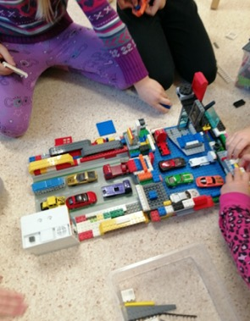
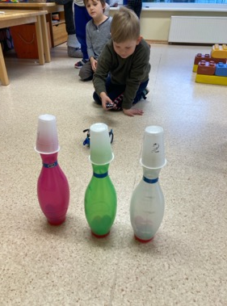
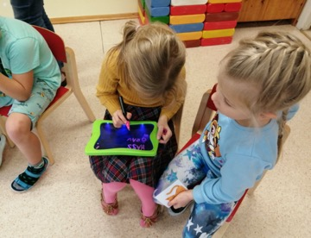

Slide 5
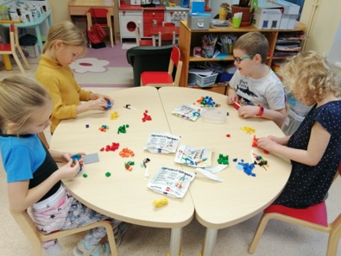
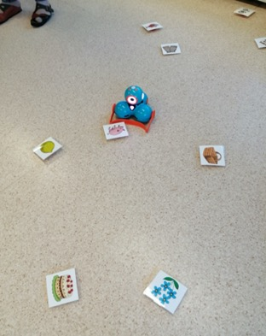
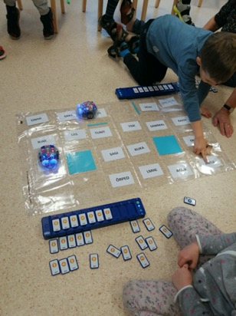
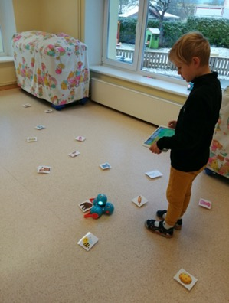

Slide 6
5-6 years old children
Interactive games on Lerningapps: count apples on tree and find the number that matches the same amount. Coloring pictures and bring them alive with Quivervision.
Every child has a 4D animal card. Children look at the animal, spell the name and look for the letter that the word begins with. Bring animals alive with tablets.
Children search animals from the sand with detectors. Name the animal, spell the name, searches for the letter the animal begins with. Children classify the animals as sea, forest, jungle or Antarctic animals.

Slide 7
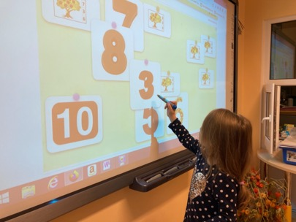
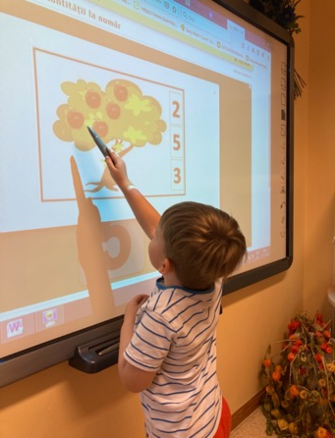
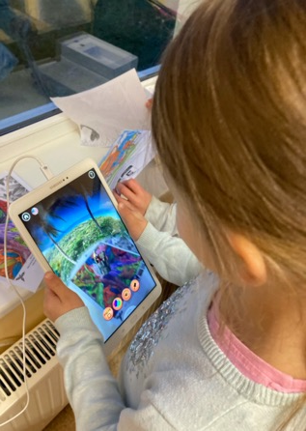

Slide 8
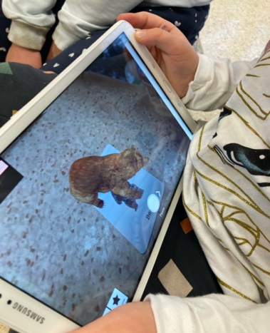
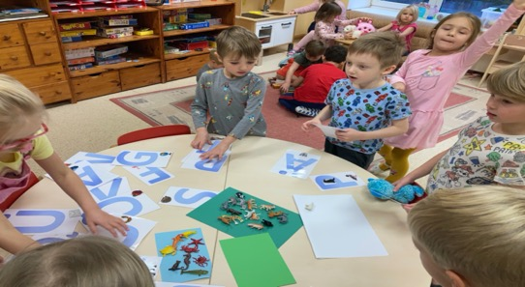

Slide 9
Children age 4-5 years old
Children programmed Blue-bot robot to drive through all 4 seasons in correct order. Children drew with robot a circle on the paper and divide it for 4 parts.
First meeting with Dash robot. Four groups were created (4 seasons) and children programmed the robot to drive through all seasons. Recording voices: typical sounds of all seasons in the nature.
Painting with Sphero robot. Children were divide to 4 groups and every group painted a tree according to the colors of one season.
Driving on a mat with Ozobot. Children see the pictures and name the season on the picture.

Slide 10
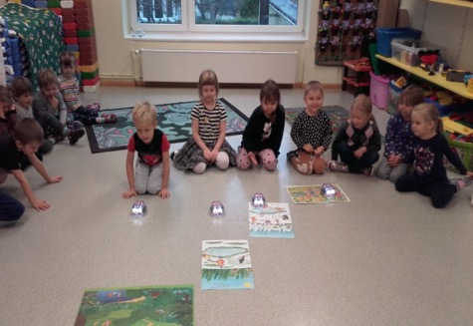
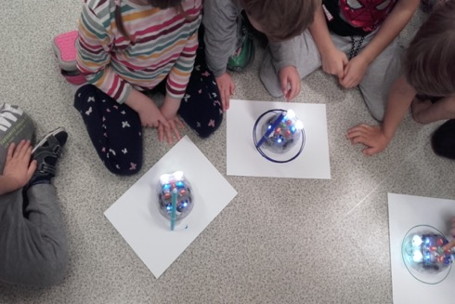

Slide 11
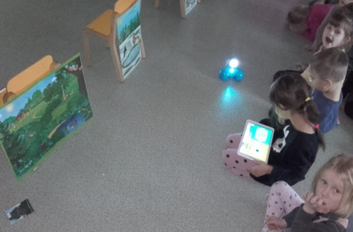
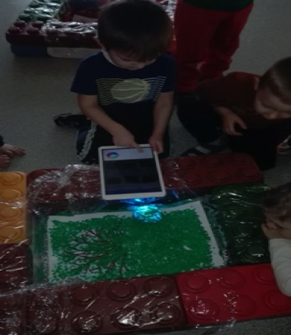

Slide 12
Children age 4-5 years old
Children listened to a story “Goldfish” and then worked in pairs and built the story with Lego “Storystarter” blocks.
Different assignments on Ozobot mat: numbers, seasons, spelling, what does not belong in this group.
Interactive games in Learningapps: knowing the seasons.
Painting a apple tree for every season with Sphero robot.

Slide 13
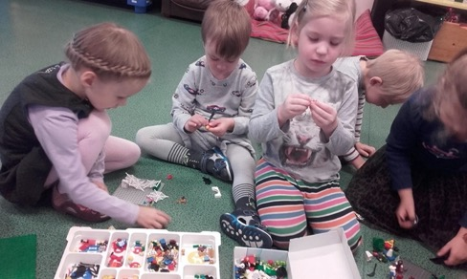
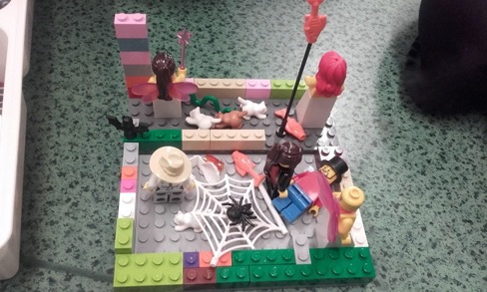
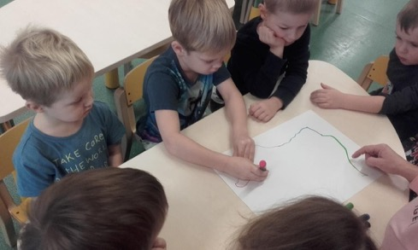
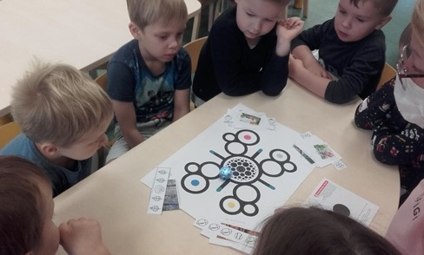

Slide 14
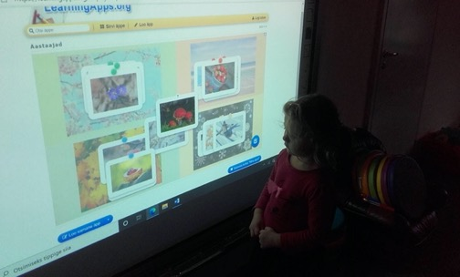
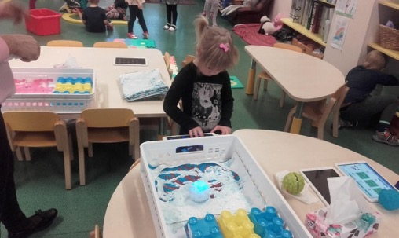
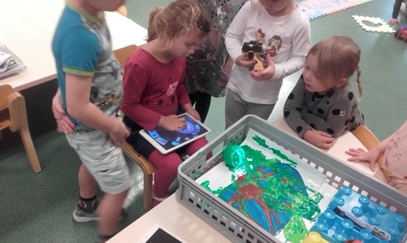

Slide 15
Children age 3-4 years old
First meeting with Dash robot. Getting to know the functions. Listening the sounds of animals with Dash – name the animal. Collecting Lego blocks with Dash on the floor – building animals from the blocks.
Programming Bee-bot to drive on a picture chosen. Rehearsing new function – turn.
Searching pictures from the sand with detectors. Classify the object on the pictures according to the shapes.
Interactive games on smart board: finding letters, counting the objects, continuing the pattern.
Coloring 4D pictures. Bringing the pictures alive with Quivervision on tablets.

Slide 16
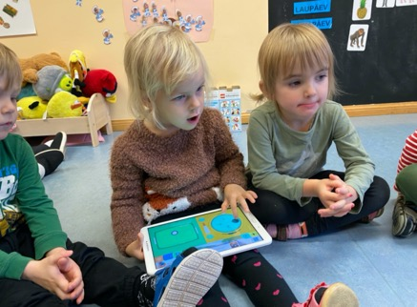
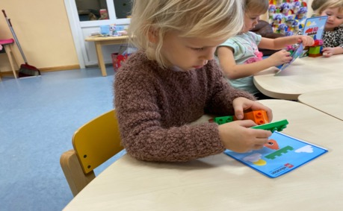
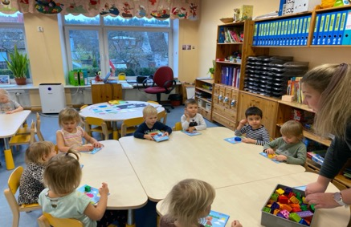

Slide 17
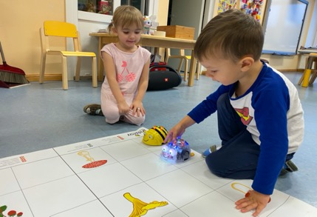
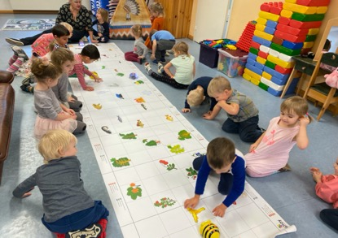
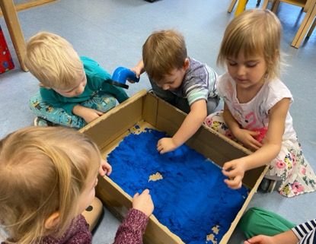

Slide 18
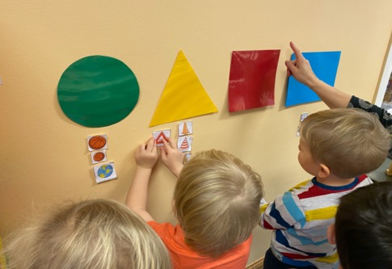
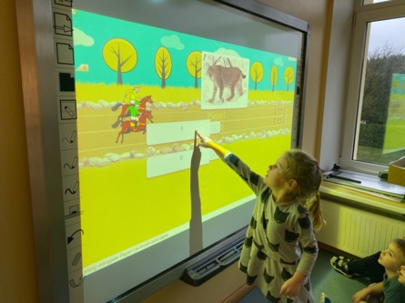
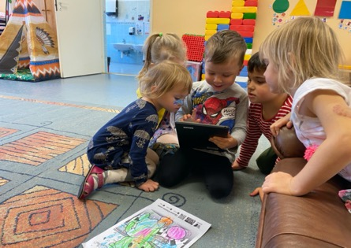

Slide 19
Children age 2-3 years old
First meeting with robot – Bee-bot. Rules were discussed. Children learned 2 functions - 1 step forward, go.
Program Bee-bot to drive to a flower (1 or 2 steps forward).
Listening a story about a bumblebee.
Painting a bumblebee.
Next week were repeating activities with Bee-bot. Rehearsing the programming (1 or 2 steps forward, go). Topic animals and their babies.

Slide 20
