Slide 1
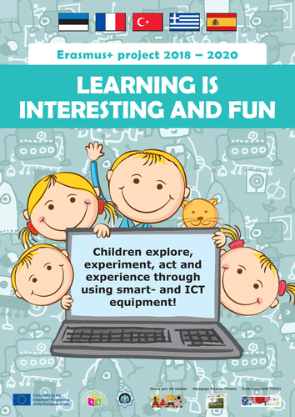
Renewal of curriculum
in Rizario Kindergarten
Trikala -Greece
Notes:
forest

Slide 2
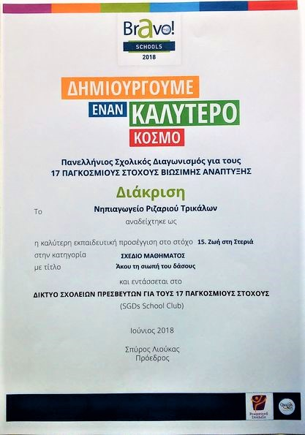
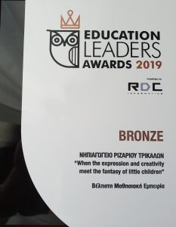

Slide 3
Pedagogical method of teaching and learning
1.The collaborative method that encourages students to engage and collaborate with one another, promotes the development of their abilities, contributes to their development process and offers opportunities for initiative, creativity and self-efficacy, seeking maximize the experiential approach of our subject.
2. We have also chosen the DEWEY (Learning by doing) child-centered approach, which prioritizes the active involvement of children and favors the development of initiatives on the part of children, and teaching is participatory and aims not only at the transmission of knowledge but also at the whole child development, which is also our overriding goal.

Slide 4
The result of this combination was amazing and this is evidenced by the number and quality of the products produced, with the child's effortless involvement in all project activities. We have used the combination of expression, thirst for learning and creativity of this age as a means of stimulating and sustaining children's interest, with excellent results.
During the project we worked in groups and individually with each child, depending on the planned activities and needs of the project.
They painted for the project's needs and some of these projects became online puzzles, learned English words enjoying every moment of this work.
Through integrating of technology in learning/teaching process we helped children to develop general skills, gain specific knowledge about technology, develop their critical knowledge ,develop their creativity and develop their self-expression and self confidence .

Slide 5
Teachers will gain new knowledge about technology and will be able to modify the curriculum of Kindergarten by incorporating new technology into daily teaching and learning by introducing new methods and good practices gained from the project.
After project we will have in our school will have materials, equipment, skills and knowledge about their using in learning activities through various applications and internet and all these will continue used in daily learning activities ,even after the project ends.
Teachers will learn to use lot of different new web tools and will implement these skills in work with children by using the new and more qualitative way of teaching.

Slide 6
1. integration of programming
4-5 years old: Children can program to move the bee-bot and the mouse –bot
5-6 years old: Children can individually move robots and they know the way each robot is being programmed.
They also can program to move the kid first coding and robotic (Sammy robot)

Slide 7
2. Constructing
4-5 years old: child can make contractions with Lego Education sets
5-6 years old: Children can individually solved assignments and make various construction and also they can construct and solve assignments with guiding with Kid first coding and robotics.

Slide 8
3. Handling the tools
4-5 years old: Children handles familiar equipment individually.
5-6 years old: child can program, set to move individually and knows all the functions for familiar equipment and with guiding for new equipment.
They can individually program robots and plan their journey according to the assignment.

Slide 9
4. Environments
4-5 years old: Simple interactive puzzles. Learning apps, Jigsawpuzzle,3D coloring pictures – quivervision. Sorting and comparing colors, shapes, interactive letters and numbers games – bamboozle
5-6 years old: child can individually solve different interactive games. Child can individually use functions of tablets and can use different environment individually. Quizzes, crosswords, learning apps games Jigsaw puzzles and coding games.

Slide 10
Benefits for the participating teachers
Upgrading their vocational training
Improving knowledge and skills related to the use
of ICT
Ability to integrate new applications in teaching Possibility of creating teaching material through the use of ICT equipment
Exchange of new approaches and good practices and the cultivation of suitable ground for future collaborations (participation in new e Twinning projects and Erasmus + programs)

Slide 11
For the participating students
The project will contribute to the promotion of children's creativity and the development of their critical and synthetic thinking, their experimentation with various smart devices, learning through play, cooperation with other children, acceptance of the diversity of others

Slide 12
. 3. At school level
The school will increase its prestige both locally and nationally and internationally through announcements and postings of project results in the local press, media and social media.

Slide 13
All teachers by the participation in this project will learn at the end of this project, to use lot of new web tools in teaching /learning activities and they will gain new practical knowledge and skills about using technology and internet applications when creating games for learning activities for
children.
They will implement their new skills in the work with children and all the new knowledge and experience will be integrated to every partners school in everyday learning activities hereafter.

Slide 14
It’s expected that systemic changes in each participant school are produced and all the teachers of every institution will improve their methodologies.
The participating teachers will acquire enough skills and they will improve the quality of their knowledge and school education so they will be able to make changes to the existing curriculum that responds to the requirements of modern times, thus achieving European added value in
the quality of education.

