Slide 1
STRESS
WAYS OF COPING WITH STRESS
By:
Maja Zaborowska
Julia Stumpf

Slide 2
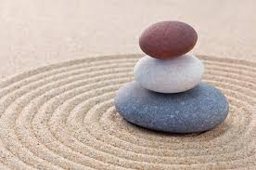
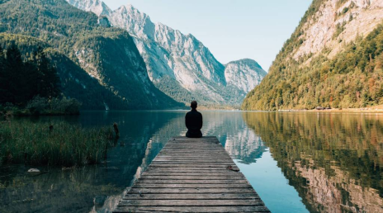
How can we deal with stress
Relax your muscles (have a hot, long shower)
Calm down (get relaxed)
Exercising (ride a bike)
Make Times for hobbies (draw the picture)
Talk about your problems (talk about your problem
with family, friends and preferably a psychologist)
Take break (Get some sleep, sleep eight hours)
Cook something (maybe something healthy)

Slide 3
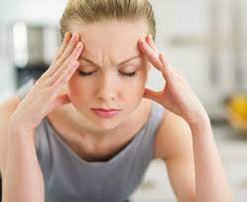
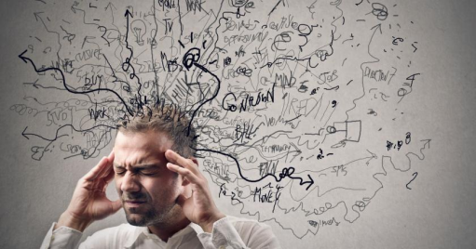
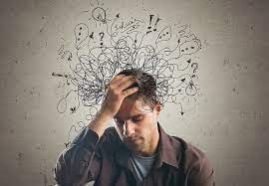
What is stress
Stress is the body's reaction to various types of experiences and events, most often unpleasant.
Stress
Stress can be mobilizing or disheartening. Long-term or extremely strong stress with a negative (demobilizing) vector has a detrimental effect on human health and the functioning of the body.

Slide 4
Reasons of stress
School
Money
Job
Family situation
Health
Friends
Changes in life
Important situations

Slide 5
THANKS FOR WATCHING

