Slide 1
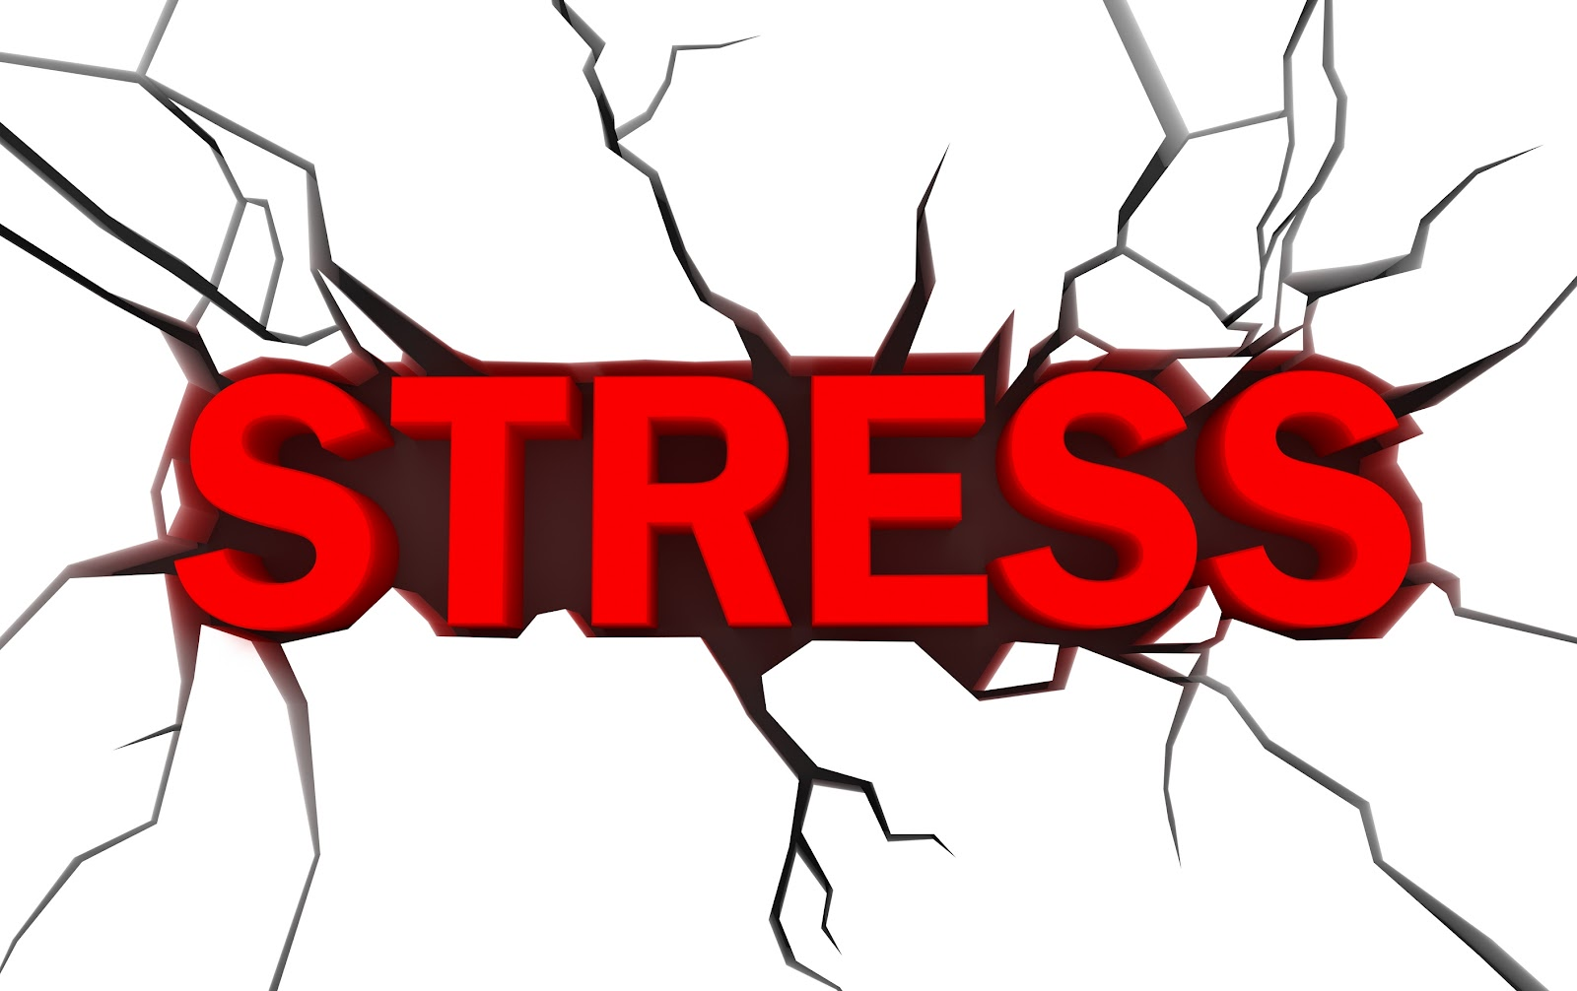
Szymon Markowski 6b

Slide 2
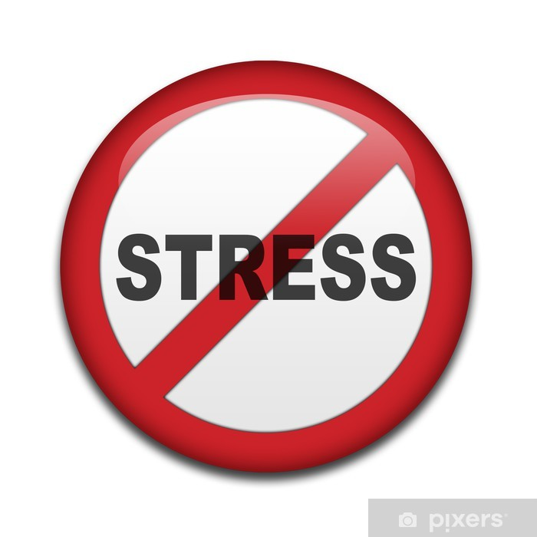
Stress accompanies all of us, but not everyone knows how to deal with it. Stress is a tough opponent, but you can beat it.

Slide 3
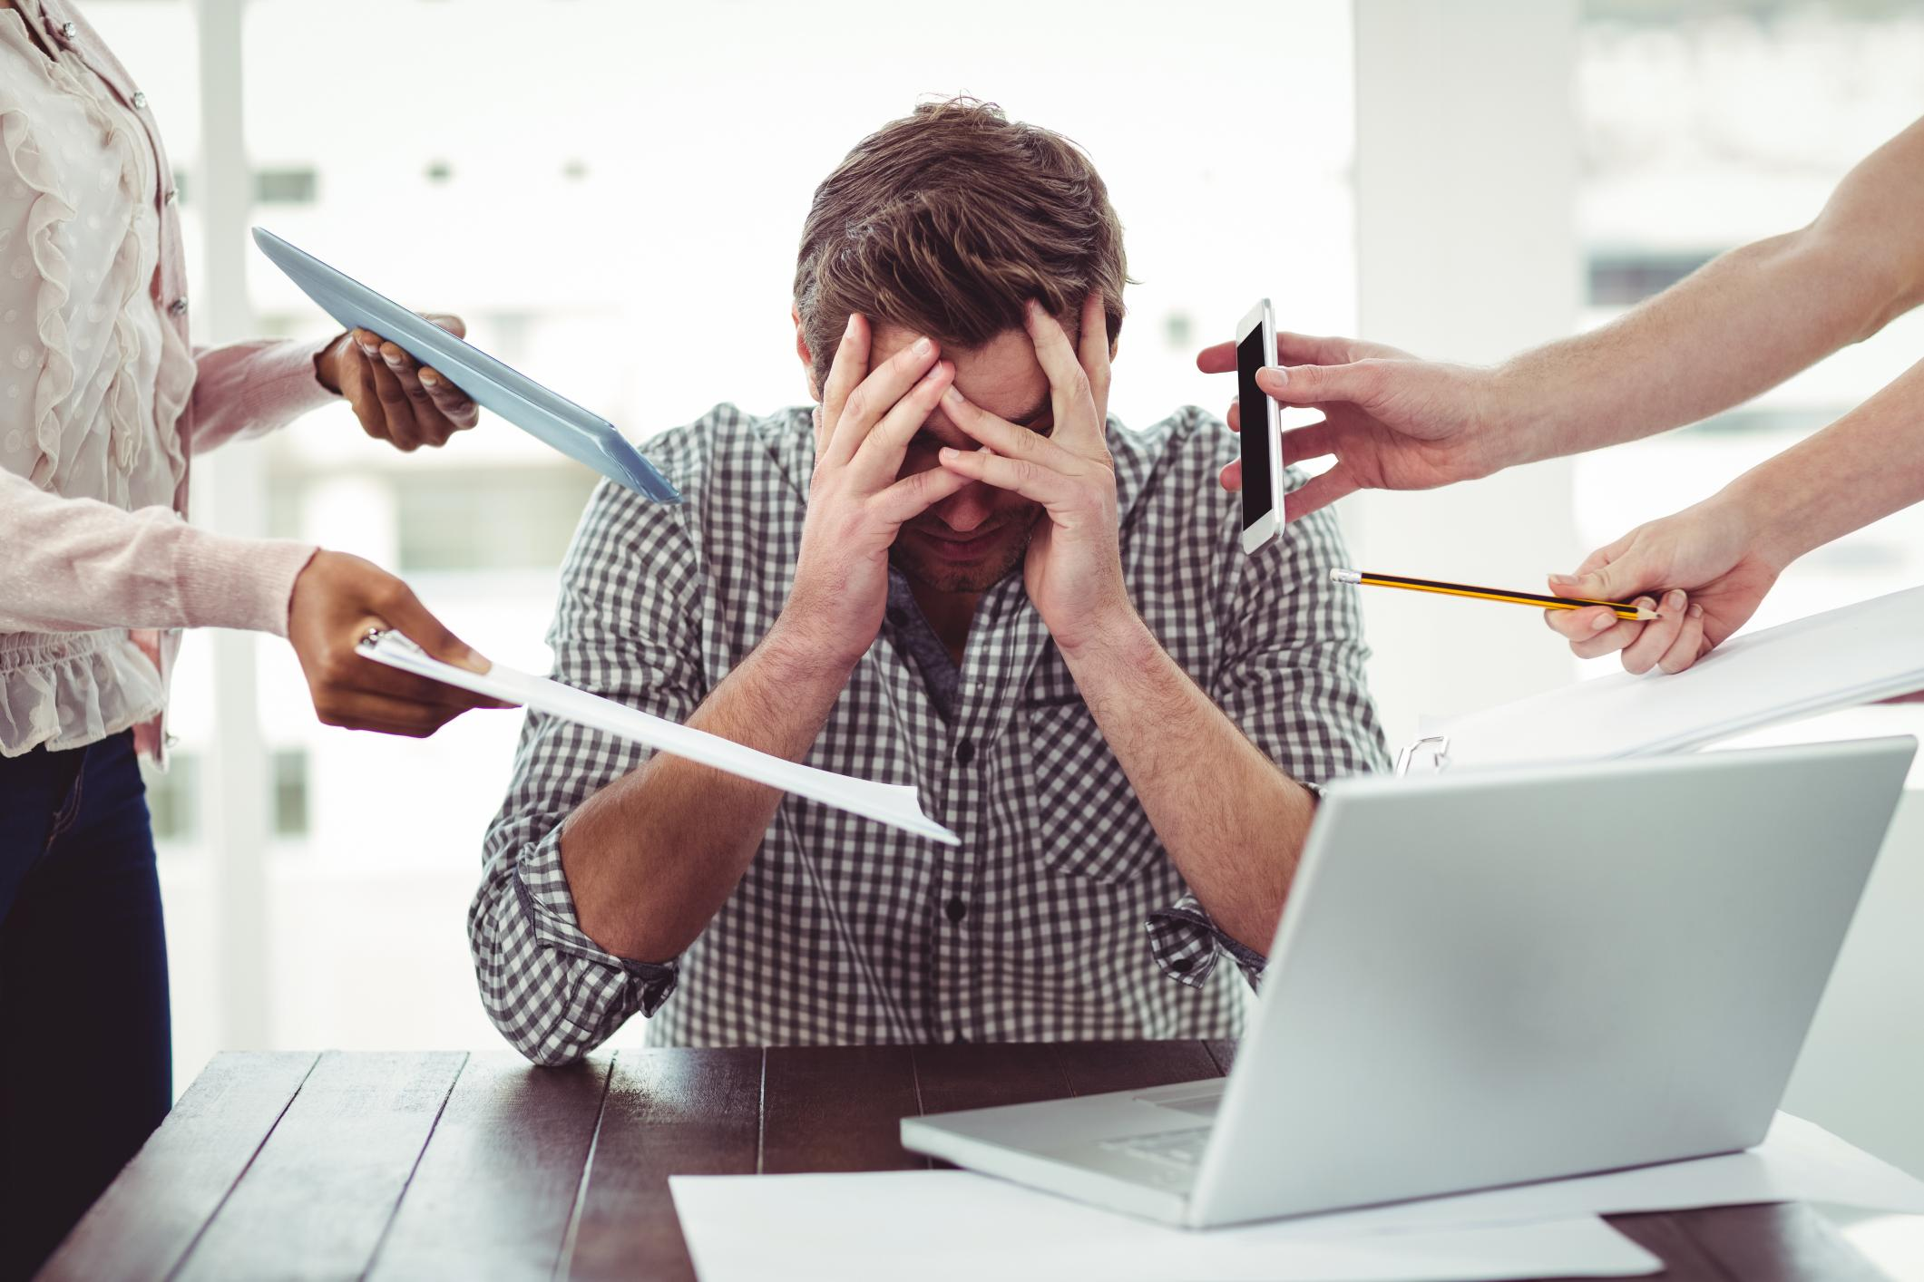
Stress has a negative effect on the human psyche and on his health

Slide 4
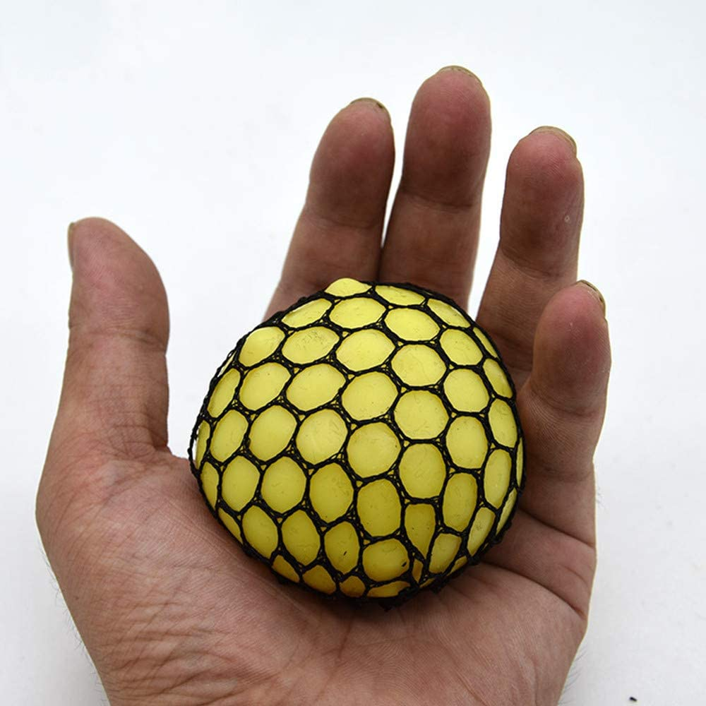
To de-stress you can use special toys or listen to peaceful music

Slide 5
Stress is a feeling of emotional or physical tension. It can come from any event or thought that makes you feel frustrated, angry, or nervous.
Stress is your body's reaction to a challenge or demand. In short bursts, stress can be positive, such as when it helps you avoid danger or meet a deadline. But when stress lasts for a long time, it may harm your health.

Slide 6
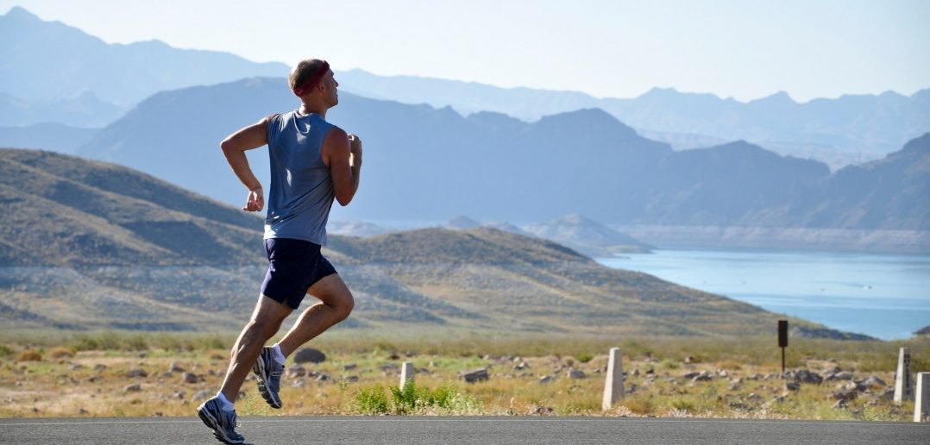
Happiness hormones are the best counterbalance to stress. It is mainly fostered by physical activity - moderate but regular movement, e.g. swimming, jogging, yoga, tennis.

Slide 7
