Slide 1
STRESS
By Natalia Pokutycka

Slide 2
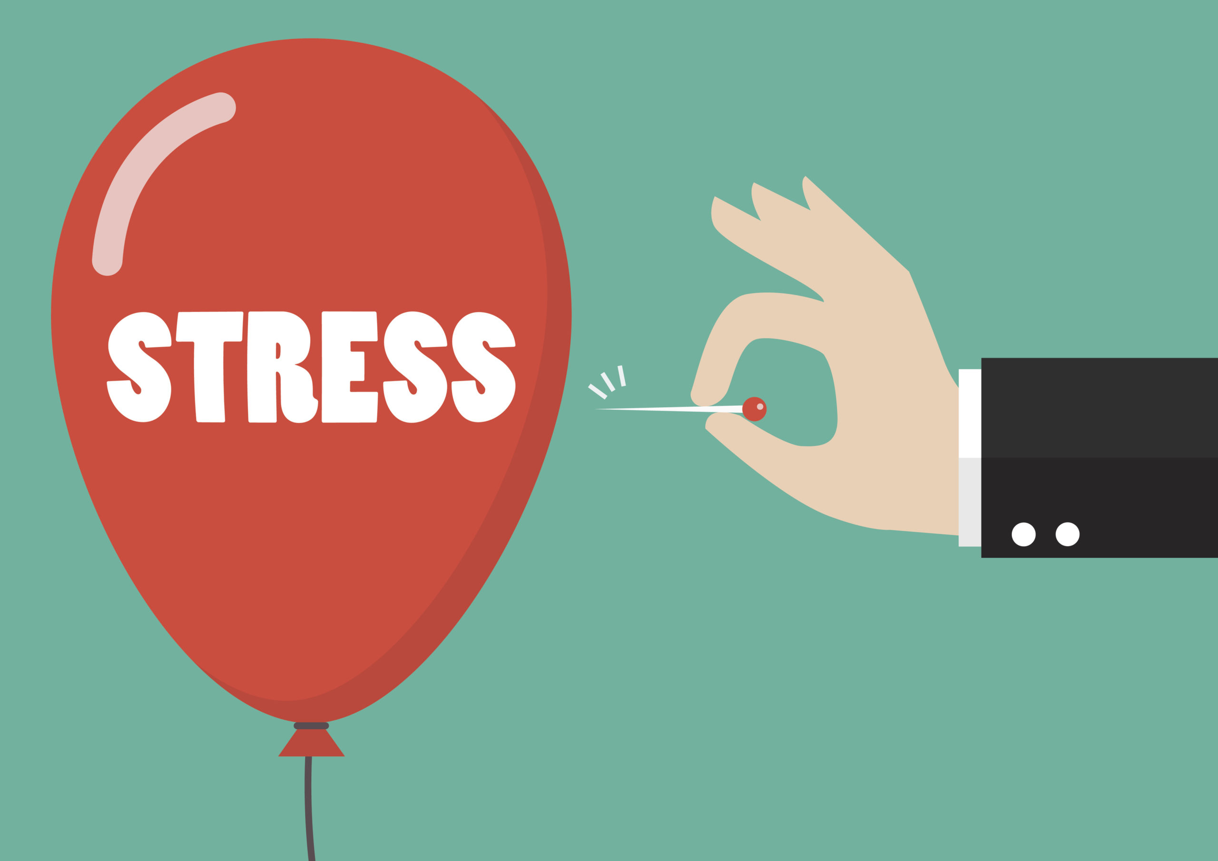
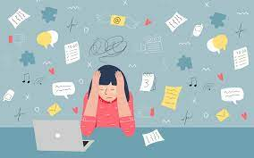
Mental healths is valid!!!
WHAT CAUSES STRESS ?
Common causes include money, illness, work and rellationships, but many significant events like the Covid-19 pandemic can also increase stress.
Constantly worrying about something,
Being under lots of pressure,
Facing big changes,
Failing something importatnt for ourselves

Slide 3
WHAT IS STRESS ?
Stress is a normal reaction our body has. It happens to everyone. It’s the feeling of being overwhelmed by a situation. It occurs when we are unable to cope with an emotional or mental problem.

Slide 4
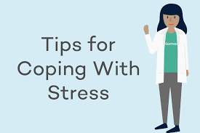
HOW CAN WE COPE WITH STRESS ?
Reducing stress is not so easy. We need to take care of ourselves because nobody else won’t.
Eating healthy, getting plenty of sleep and exercising is significant.
Share your problems and talk to others about how you truly feel with friends, parents or counselor.
Recognize when you should get more help.
Find some time everyday for relaxation and stress relieve.
Never give up and know your worth.

Slide 5
We need to remember that mental health is really important. It’s serious, don’t neglect it.
Thank you for your attention.

