Slide 1
STRESS MANAGEMENT
NAME: Yiğit
SURNAME: Uzun

Slide 2
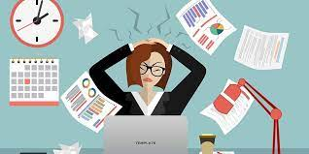
What is Stress
Stress is the body's being affected by some negative events and showing physical and psychological reactions to them. So we can think of it like this; we can think of it as a stress resistance and a mechanism that resists our body. Therefore, it affects us negatively and at important times.

Slide 3
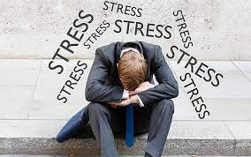
When Am I Most Stressed
I get stressed during the exam
I get stressed when speaking to a public
I get stressed when going into a crowd.

Slide 4
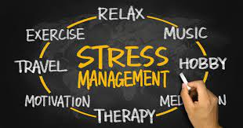
How to Manage Stress
1. Acknowledge You Are Stressed. It is not possible for you to change or control something that you do not accept to exist. ...
2. Find the Source of Stress. Yes, you admit that you are now stressed. ...
3. Ask Yourself Questions. ...
4. Take Action. ...
5. Change Your Perspective. ...
6. Change Your Lifestyle.

Slide 5
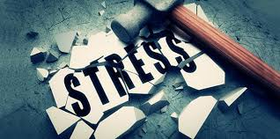
How Do I Control My Stress Inside
I play football outside with my friends
I listen to music
I read a book
I do sports

