Slide 1
STRESS MANAGEMENT PROJECT
NAME : KAAN
SURNAME : GÜLER

Slide 2
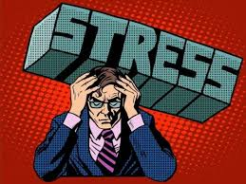
WHAT İS STRESS
Stress is a state of pressure and tension that people feel on any subject. Stress is their usual reaction when experiencing emotions such as happiness, pain, fear, and sadness.

Slide 3
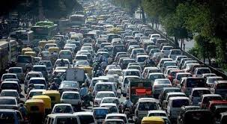
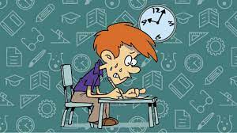
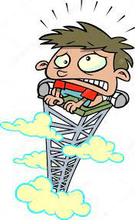
When am I most stressed?
I get stressed when I go to high ground
I get stressed when I take the exam
I get stressed in dangerous situations
I get stressed in traffic

Slide 4
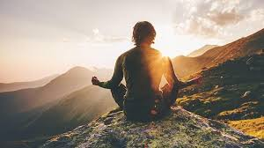
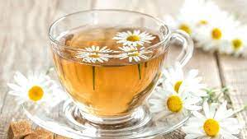
how to manage stress
Breathing exercises
do sports activities
drink herbal tea
doing relaxation exercises

Slide 5
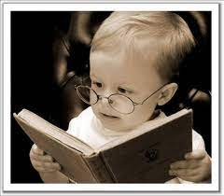
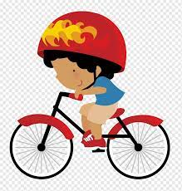
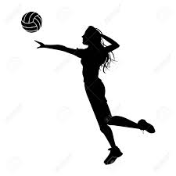
how can i control my stress
I play volleyball
I read a book
I ride a bike
I listen to music

