Slide 1
Stress
Presentation made by Piotr Blezień

Slide 2
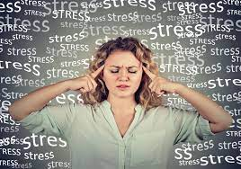
What is stress?
Stress is a reaction of the body for variety experiences and events. There are two types of stress, one is short(a short term stress) which encourages to stronger effort. This type is called „positive stress”. The second type of stress is long( chronic stress) and strong. It can last one, two or even more weeks, moths or years. It causes that someone feels sad, bad and overwhelmed. This kind of stress is called „negative stress”.

Slide 3
What impact has stress got?
Stressful situations sometimes can cause faster heartbeat, rapid breathing, muscle tension and sweating palms. There are two main hormones which take part in stressful situations. One of these two is called adrenalin. This substance causes the body to increase itself an activity. The second hormone is called cortisol. It helps to support body during the time of stressful situation.

Slide 4
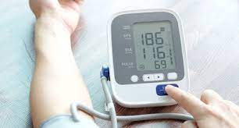
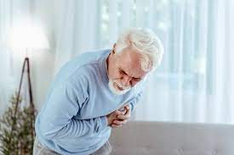
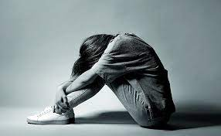
What are effects of stress?
Chronic stress can cause many diseases such as: insomania, anxiety, depression, muscle tension, high blood preasure, stroke heart disease, diabetes and many others.,

Slide 5
How to cope with stress and when it occures?
There are many ways how to cope with stress.
Many people try to predict some stressfull situations.
They can go outside to relax and stay calm or talk to someone about feelings and problems.
In school or in the work there are some situations that make someone stressfull.
Then I take three big breaths,
try to calm down and
think how to solve the problem.

Slide 6
Thanks for watching

