Slide 1
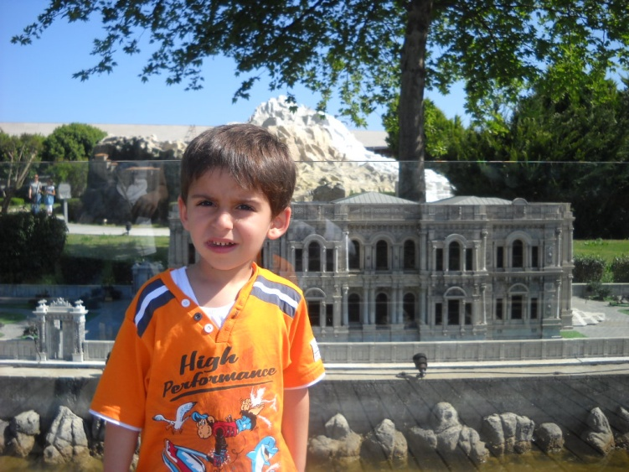
HELLO
I’m Yiğit Uzun,
12 years old.
My father name is Kadir,
my mother name is Zeliha.
They are teachers.
I have a sister her name is Derin.

Slide 2
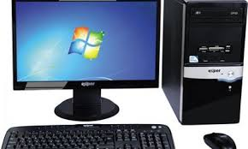
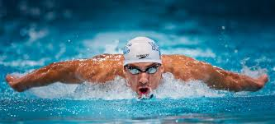
I love to play computer, fishing, swiming, play soccer and read books.

Slide 3
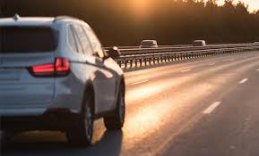
I don't like only traveling.

Slide 4
My target is to win a good high school.
My future profession is pharmacist. The reason is I want to help people get treated.

Slide 5
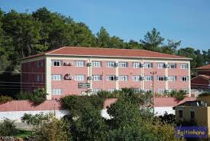
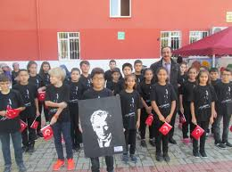
My School Okurcalar Berat Hayriye Cömertoğlu Secondary School
My Class is 7 / A
Address: Okurcalar District Alarahan Street No: 56 / B
Tel & Fax: 0242 527 40 85

Slide 6
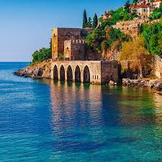
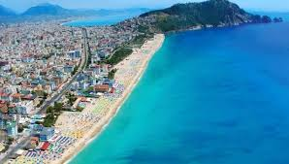
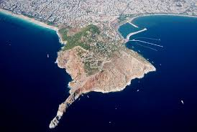
Alanya
Antalya

Slide 7
GOOD

