Slide 1
My name is Zuzia and I am 13 years old. I am in 7-th grade.

Slide 2
I am a brown haired girl with hazel eyes. I have really long lashes. People often ask me are they real, and yes they are real. I wear glasses. I am of average height.

Slide 3
I like my personality, but not all the traits, because I am really, really too vulnerable. I’m nice, but I can be nasty too. I often get stressed about everything. Sometimes I am shy. I’m crazy, but this is a good kind of craziness. I love to laugh. I also love to meet new people and make new friends. When someone is mean to me, usually I don’t care, but sometimes I can get really hurt. I like to help people and make them happy. I like to be with nice, upbeat people.

Slide 4
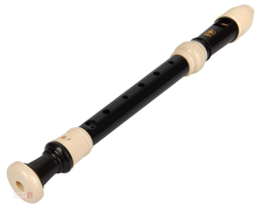
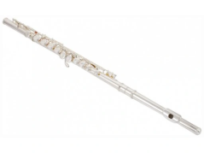
I have a lot of hobbies: music, gymnastic, horse riding, playing on instruments, rollerblading. I play on 3 instruments: piano, flute and on a recorder. In free time I love to hang out with my friends, do shopping, be with my family, watch Netflix and eat unhealthy food :). I like reading books as well. I really love to travel and explore another countries.

Slide 5
I live in a house with five people and four animals. My family: mom, dad, grandma, younger brother, two cats, two dogs and me.
My mom’s name is Kasia. She wears glasses. She loves to read, so we have like tones of books in our house. My dad’s name is Marcin. He is a dental technican. He has short, brown hair and green eyes. My grandma’s name is Anna. She is a lecturer. She is really hardworking. My brother’s name is Antek. He is 8 years old. He likes to play computer games. He is very zippy. My cats’ names are Nessa and Szkot. They are very cute. They are 1 year old. My dogs’ names are Shira and Rasko. They are 6 years old.
I love my family and animals very much.

Slide 6
This year I changed my class. Not because I didn’t like my previous class, just because I wanted to be in bilingual class. I think, my new class is ok. I have seen this people in my school many times before, but I didn’t know them well. I made friends with girls in my new class. I think theese girls are nice. English is very important to me. I really like this language and I want to speak English fluently.

Slide 7
THANK
YOU
FOR
Watching

