Slide 1
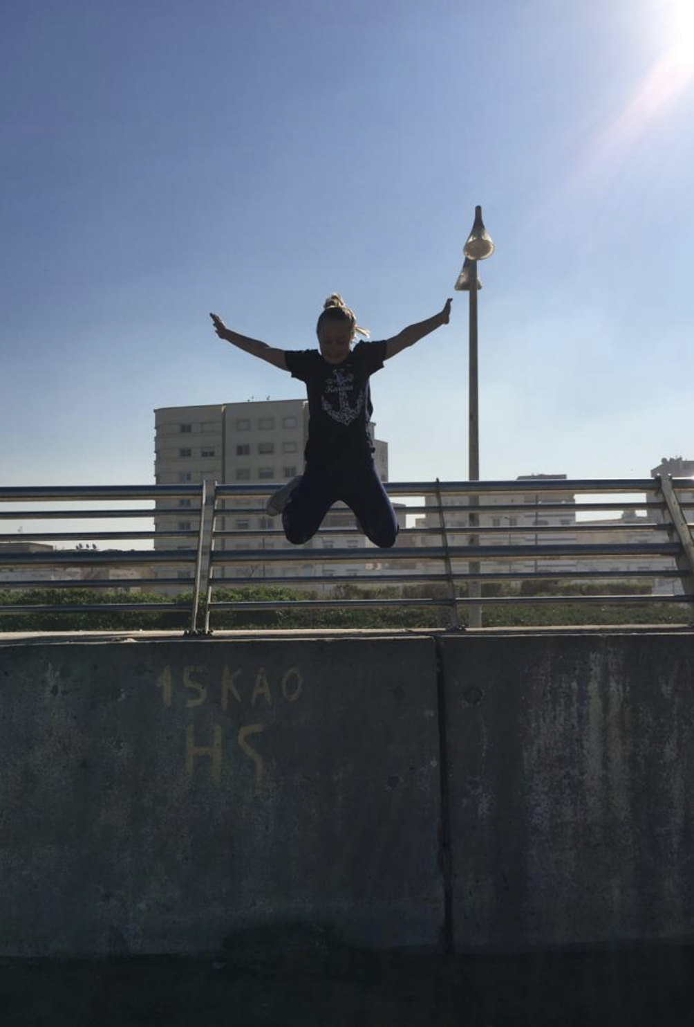
ERAZMUS+
ALL ABOUT ME
OLA OKIEŃCZYC

Slide 2
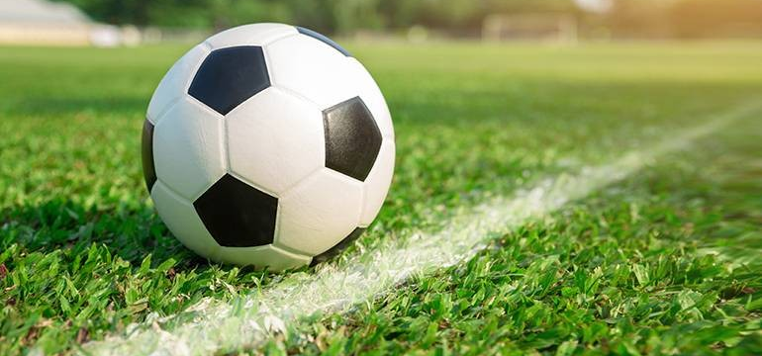
Hi my name is Ola and I’m 12.
I have got three brothers: Janek, Kuba and Tomek. I play football with them.
We love playing football in our garden.
We watch football matches together.
Our favorite team is Manchester United.

Slide 3
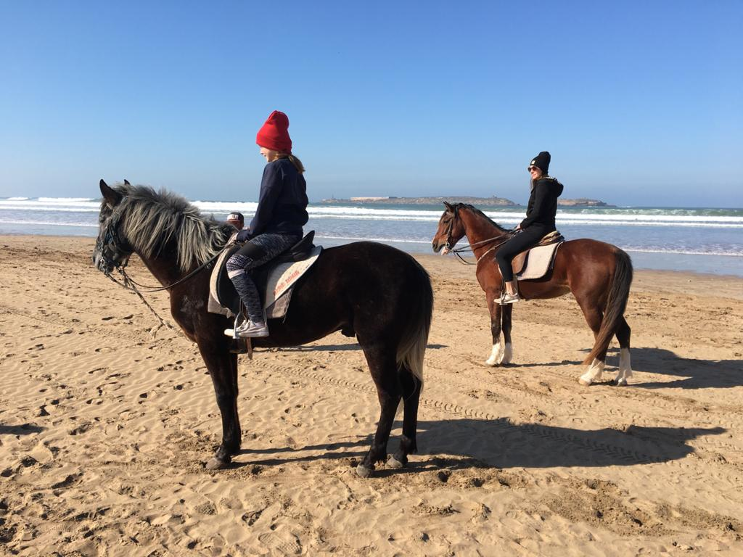
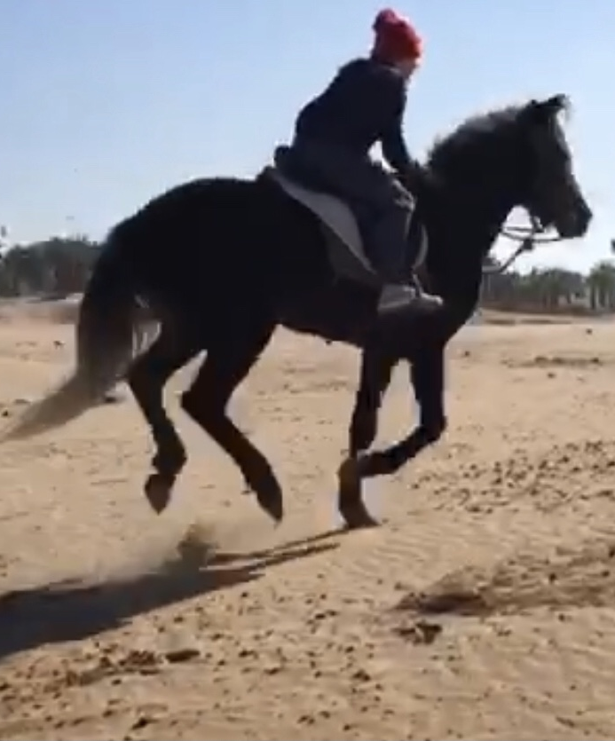
I love horse riding. These photos were taken in Marocco where we spent last New Year’s Eve with my family and friends. My favourite place with horses is Stable Stanisławów, near Warsaw where my lovely horse Migdał is.

Slide 4
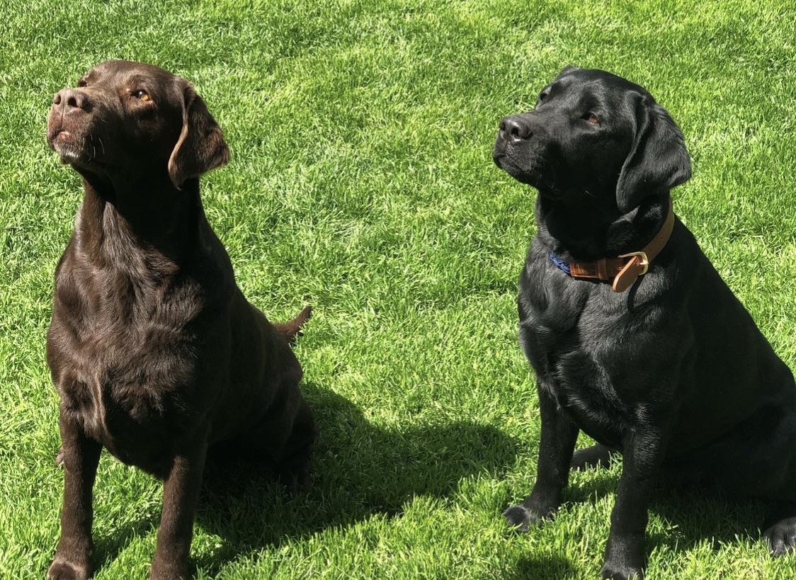
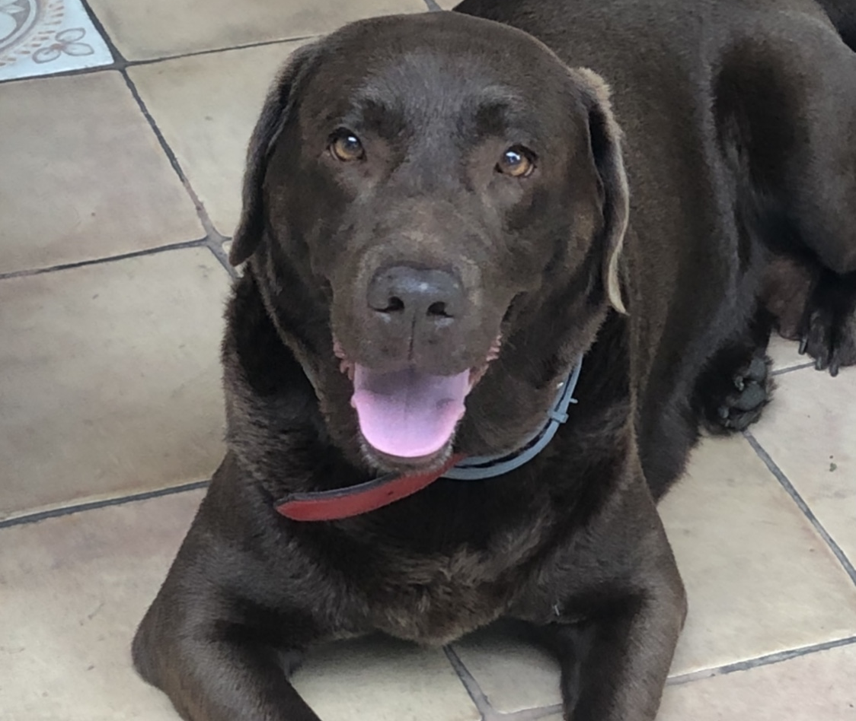
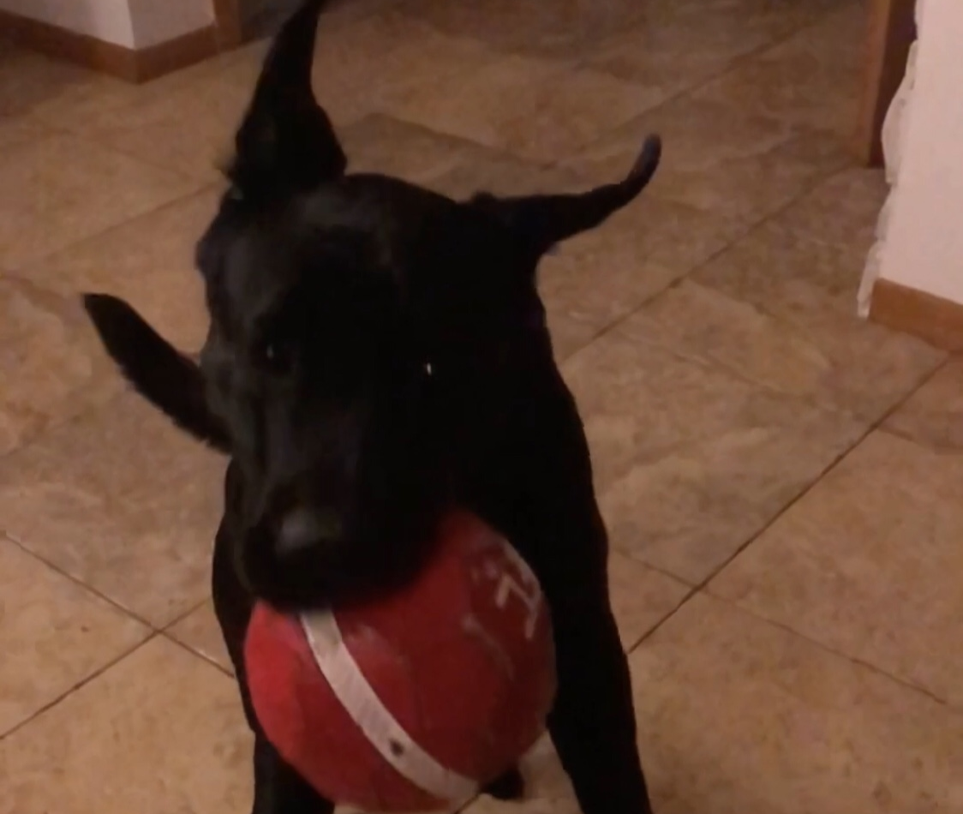
I love animals! My favorite ones are dogs. I have two Labradors: the black one is Lexy, she’s one year old and the brown one is Monti. She’s eight years old. I love spending time with them, walking in the woods but our favorite place to walk is the beach in Karwia.

Slide 5
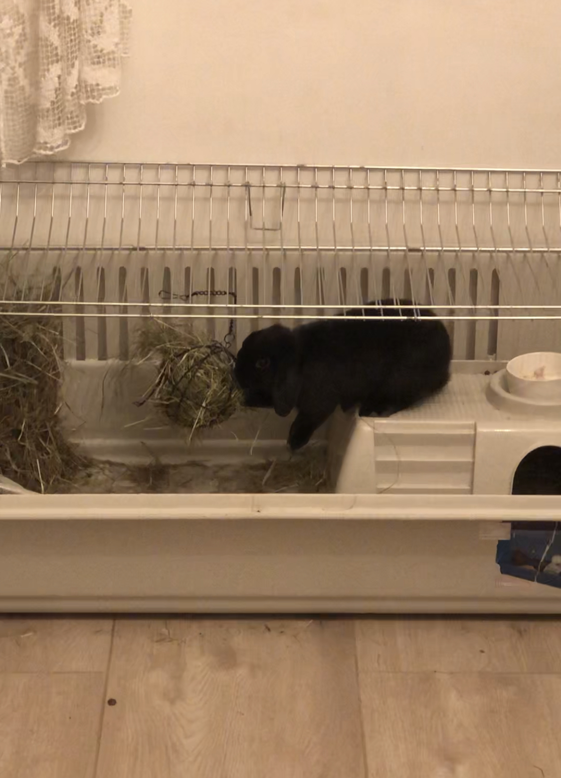
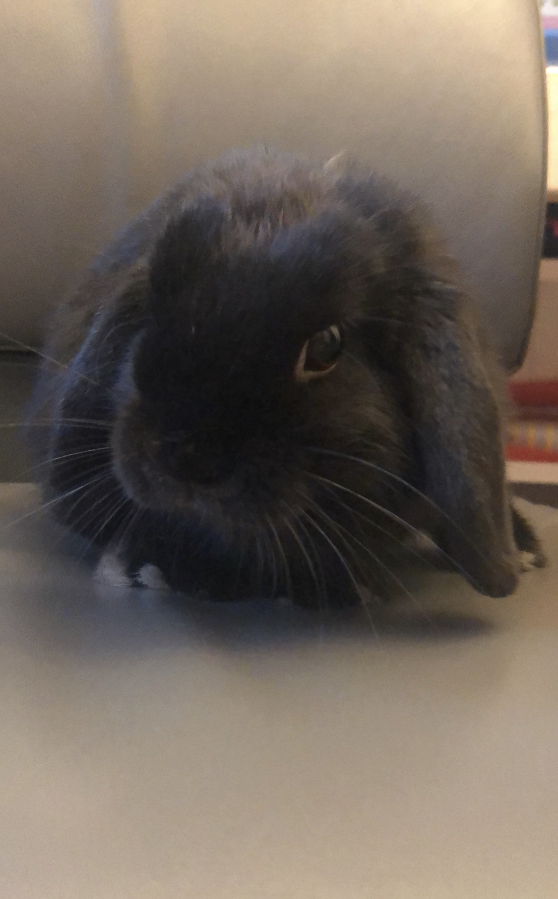
I have a black rabbit Tosia. She is a Mini Lop. She’s sweet and funny. She’s 5 months. She gets along with our dogs very well. She runs away when she sees them:) She eats hay and special rabbit food and drinks water.

Slide 6
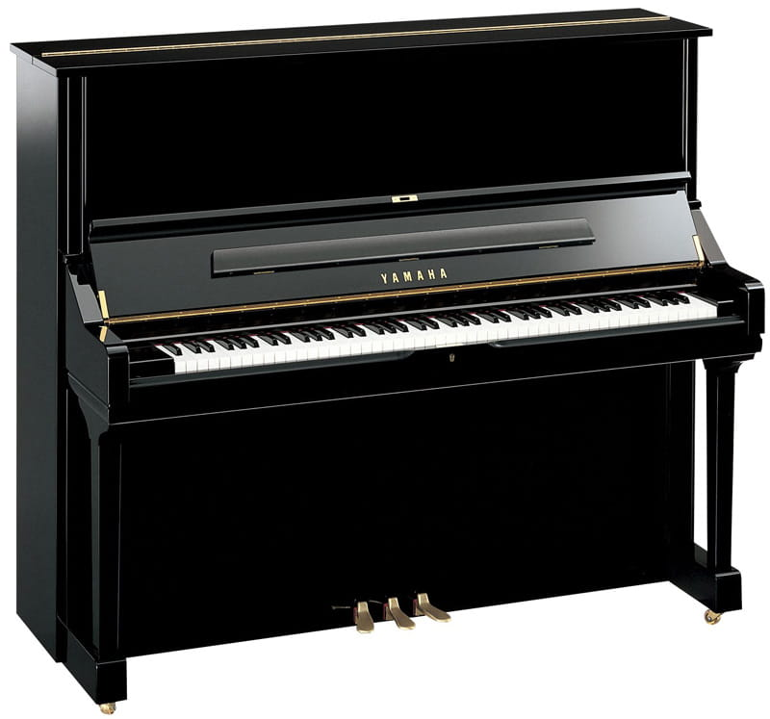
I play the piano well. I’m a student of a music school. This year I’m graduating from music school and I will take an exam. I play pieces of famous composers such as Ludwig van Beethoven or Johann Sebastian Bach.

Slide 7
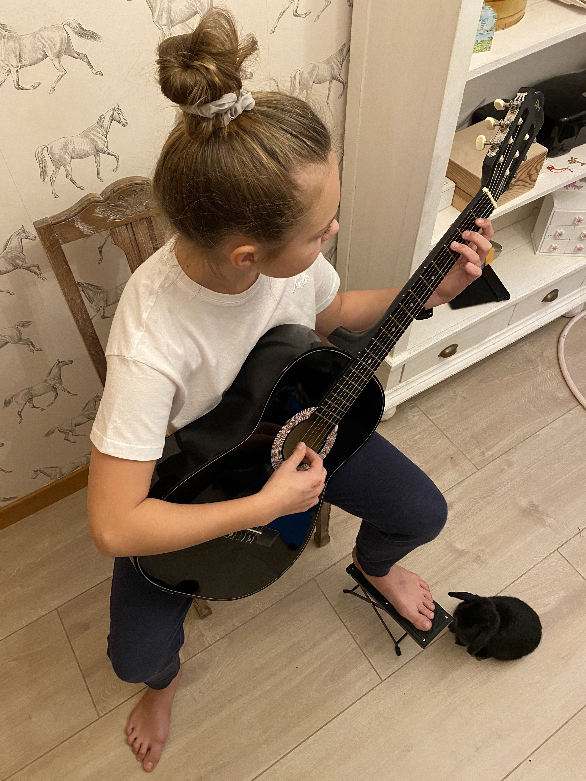
I play the guitar too. I like it very much. I have my own black guitar. I play famous songs. I also sing while playing.

Slide 8
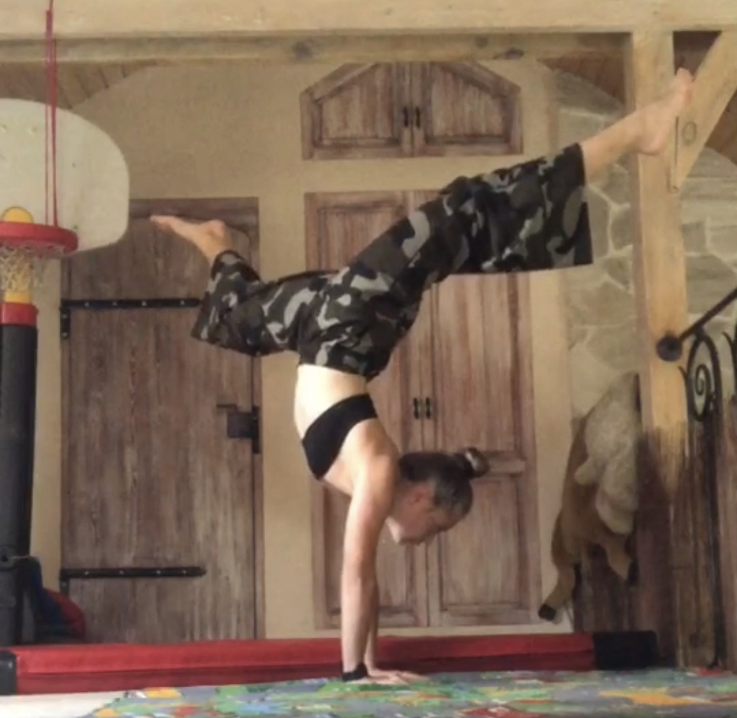
I train acrobatics. I love doing air acrobatics. I study at a sports club. Some acrobatic excercises are dangerous so I have to be careful. I practice new acrobatics only with my coach.

Slide 9
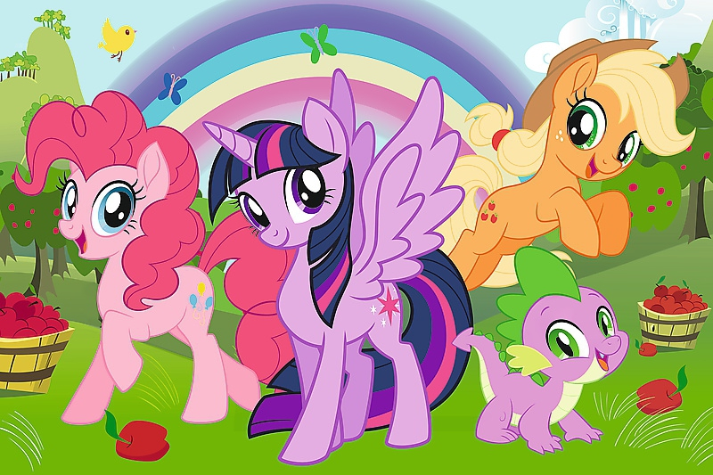
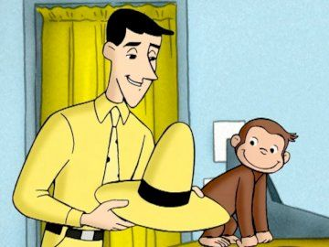
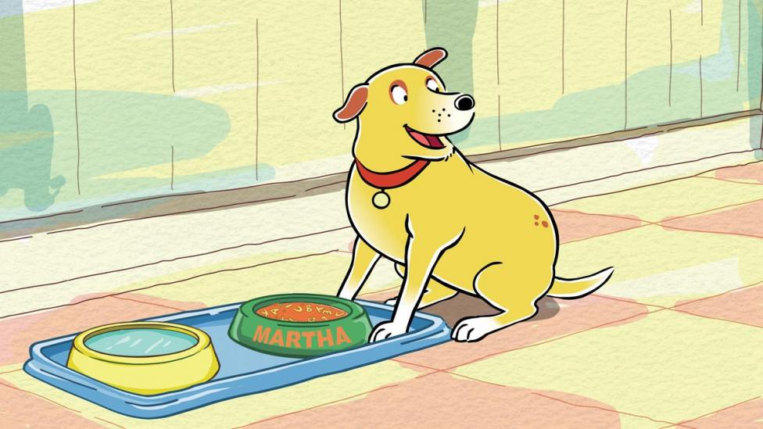
My favorite childhood cartoons are: My Little Pony, Martha Speaks and Curious George. I really like them and I like watching them even now. They are very interesting and cool.
My little ponny
Marta mówi
Ciekawski George

Slide 10
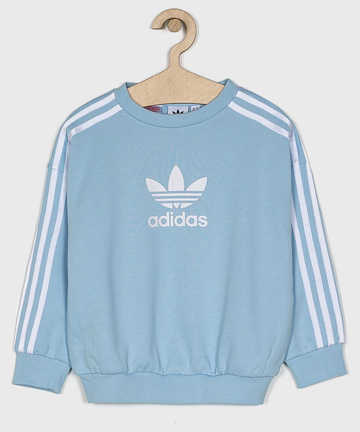
My favourite colour is baby blue.

Slide 11
Thank you

