Slide 1
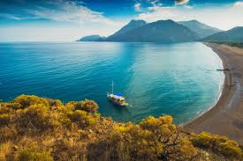
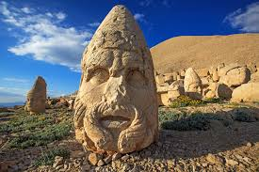
AUTOBIOGRAPHY
My name is Gözde and my surname is Görmez.I’m 13 years old.I have a sister.Her name is Gizem.My mother’s name is Makbule.Also my father’s name is Ahmet.My mother is a housewife.My father is a technical manager.I live in Turkey

Slide 2
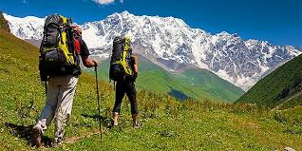
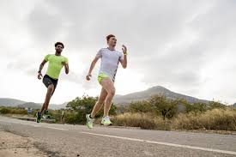
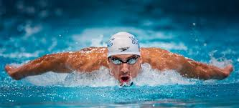
MY HOBBIES
HIKING
RUNNING
SWIMMING

Slide 3
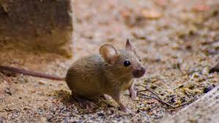
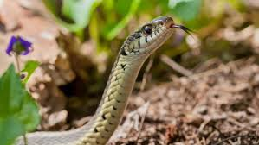
MY PHOBIAS
LOUD SOUND
MOUSE
SNAKE

Slide 4
FUTURE ME
When I grow up I want to be a general surgeon.And I know I have to work hard for this .I think I should be a general surgeon as it is a profession suıtable for my interests.

Slide 5
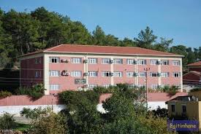
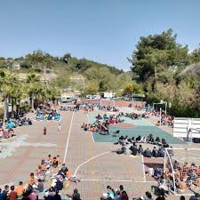
SCHOOL
My 8th grade at BERAT HAYRİYE CÖMERTOĞLU Elemantary School
CLASS: 8-A
SCHOOL ADDRESS:Okurcalar Mah. Alara Yolu NO:56 ALANYA/ANTALYA

Slide 6
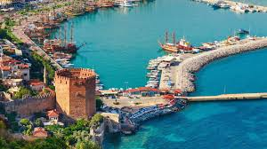
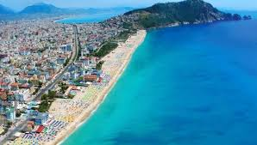
WHERE DO I LIVE?
I live in Alanya district of Antalya.Where I live is a touristic place.It’s population is very large.
POPULATION: 50003

Slide 7
GOOD BYE……
STAY HEALTHY

