Slide 1
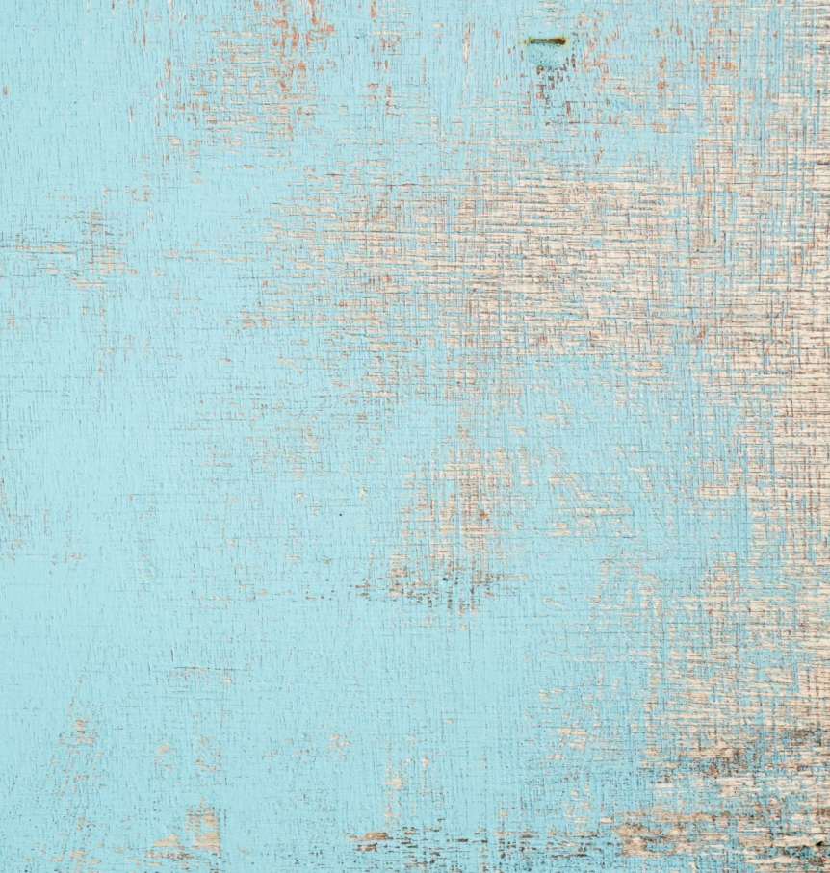
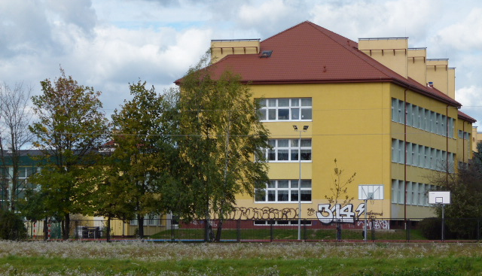
Hi !
My name is Marysia. I am 11 years old. I am a 6th grade student in a primary school in Stare Babice. I have straight, thin, quite long, dark blonde hair, brown eyes and I wear glasses.

Slide 2
I live on the west side of Warsaw, in the Stare Babice commune, in a small village called Koczargi Stare. Our house is very close to the Kampinos Forest. My house is a semi-detached house in a white color with a dark gray roof and a very tiny garden.

Slide 3
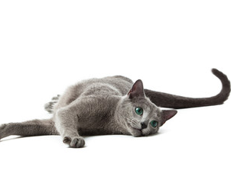
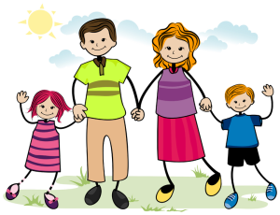
My family is - my mother Agnieszka, my father Maciej and my younger brother, whose name is Marek. We also have a cat called Ruśka, because it is Russian blue breed. We don't have any other pets - parents don't agree. I would like to have another dog or a bunny. My Mom likes reading books. She is an employee of the human resources department. At work, she deals with calculating salaries for work for employees. My Dad is an engineer in the ultrasound service department.

Slide 4
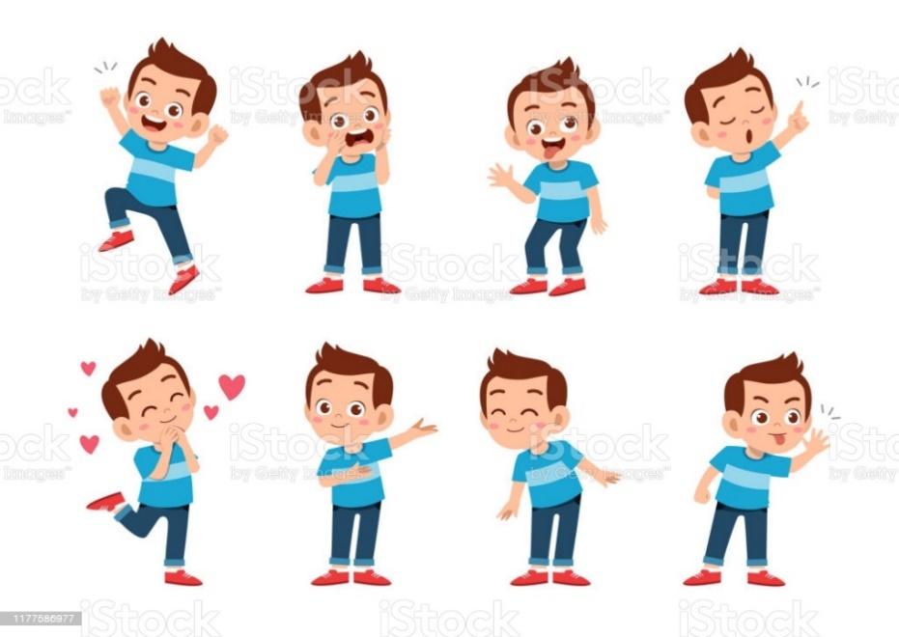
My brother is 6 years old. He is in a kindergarden and he is very happy that he will start attending real school soon. He really likes cars and talks only about them. He doesn't want to play other games with me, because they’re „girlish”.

Slide 5
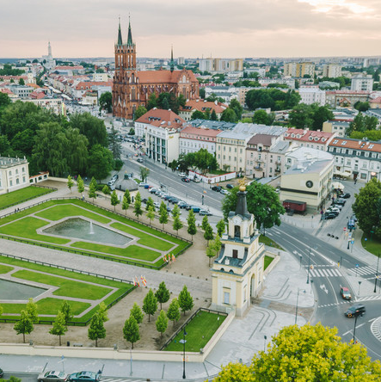
My grandparents live far away from us and I see them not so often. I try to call them regularly. My mother's parents live near Białystok, and my father's parents live in Sanok.

Slide 6
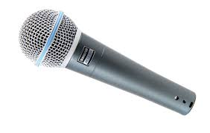
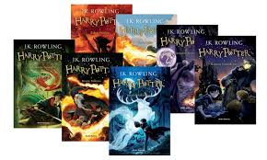
I am quiet and calm. I rarely like to visit my friends. I like spending time in my room. I like laughing, listening to music and I love singing. After school I go to singing lessons. I read a lot, especially fantasy books. I also watch programmes about interior design. I go horseback riding during summer holidays. I don't like spiders and other bugs – blah... They are terrible. When I grow up, I would like to be a pharmacist and I can't wait to have chemistry lessons in school. But it's still a lot of time - it can change for me. See you 😊

