Slide 1
Bringing life skills into the classroom
Students´survey result report

Slide 2
Methodology
The aim of the survey was to assess the level of students´compentence in various fields of practical English usage, ICT and life skills. The same survey will be completed by the students at the end of the program in order to measure their progress.
Questionnaires were created in MS forms and distributed to students in participating countries.
The survey comprises 2 parts:
The 1st part is focused on life skills of students
The 2nd part deals with the ICT and life skills of participating students
The responses were gathered and evaluated in a graph

Slide 3
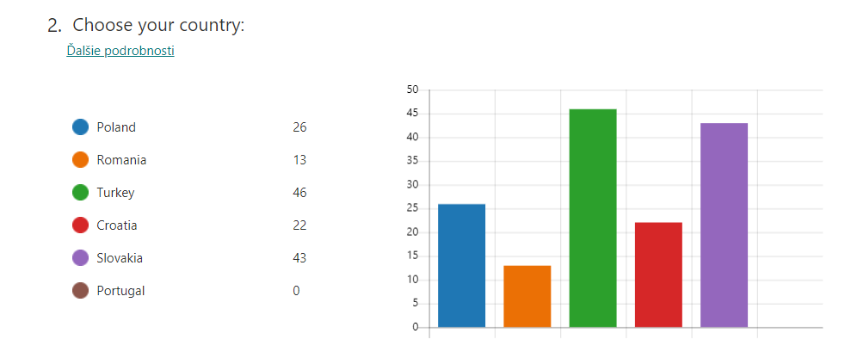
1st part: Life skills survey - participants

Slide 4
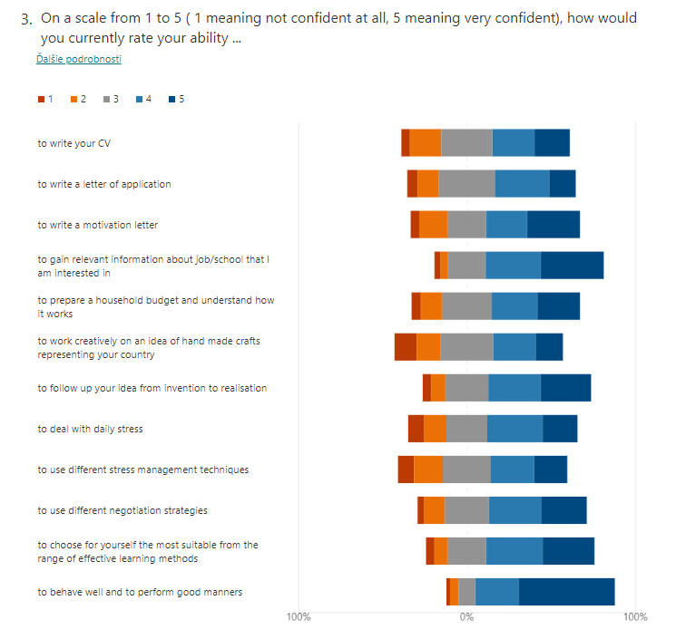

Slide 5
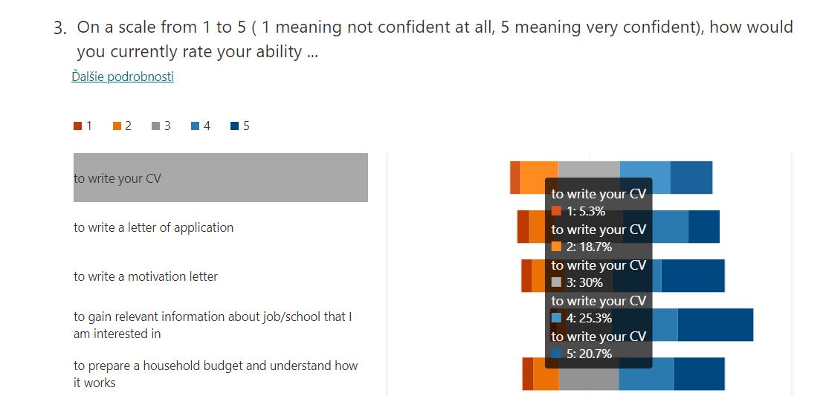

Slide 6
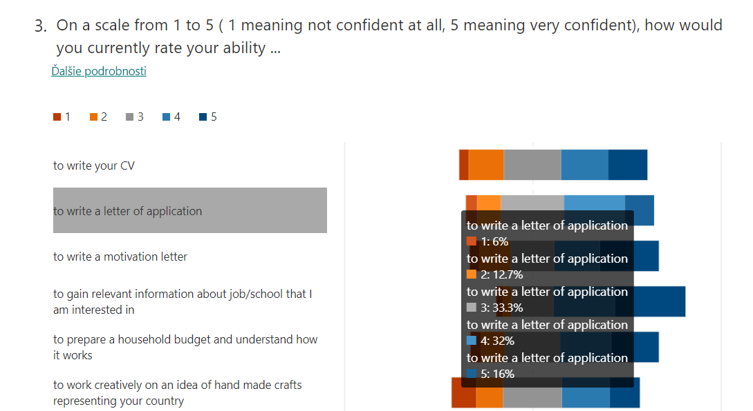

Slide 7
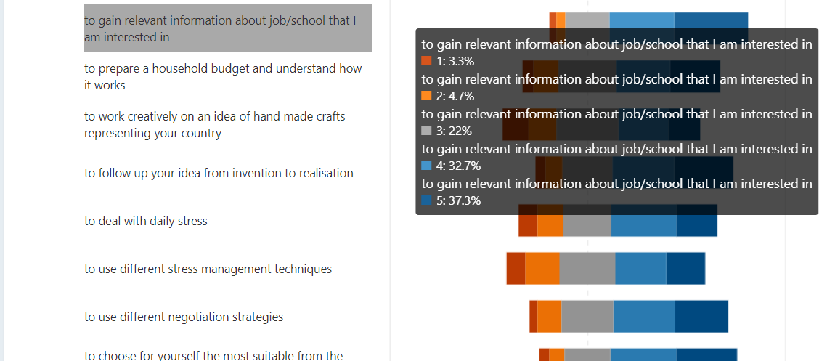

Slide 8
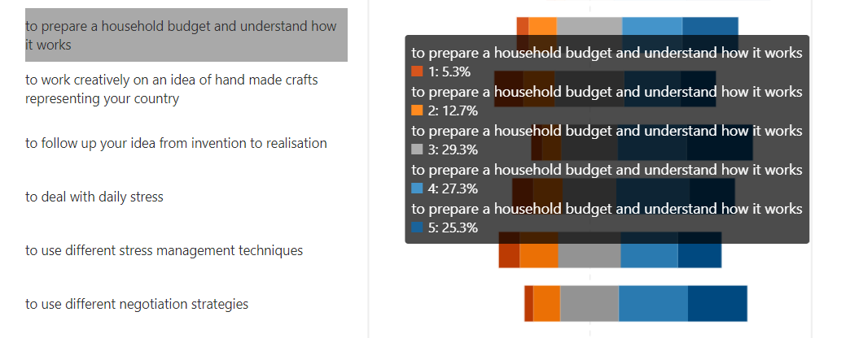

Slide 9
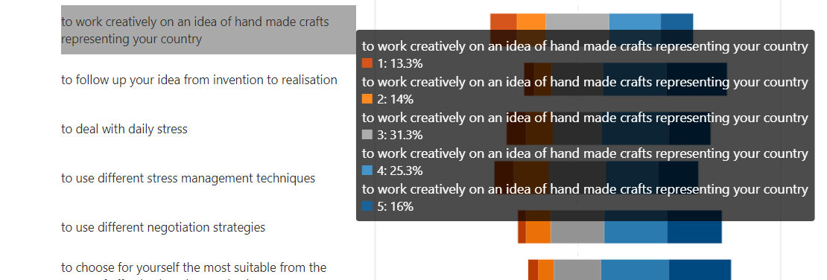

Slide 11
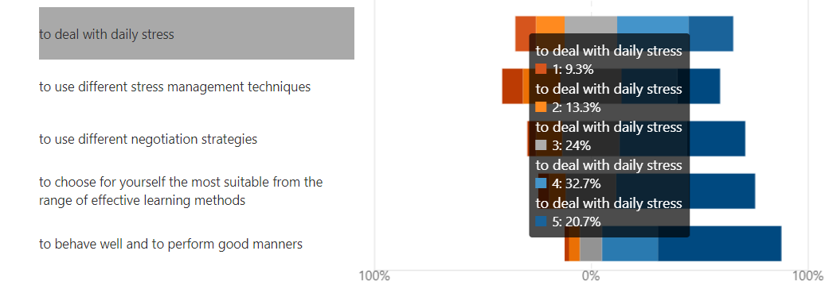

Slide 12
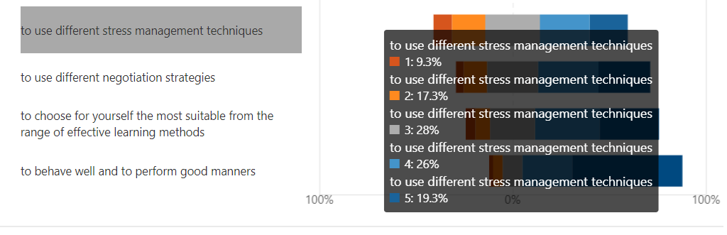

Slide 16
Part II.
ICT and language skills

Slide 17
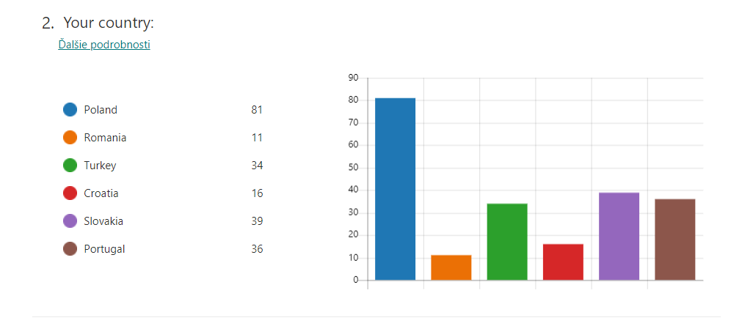
2nd part: ICT and language skills - participants

Slide 18
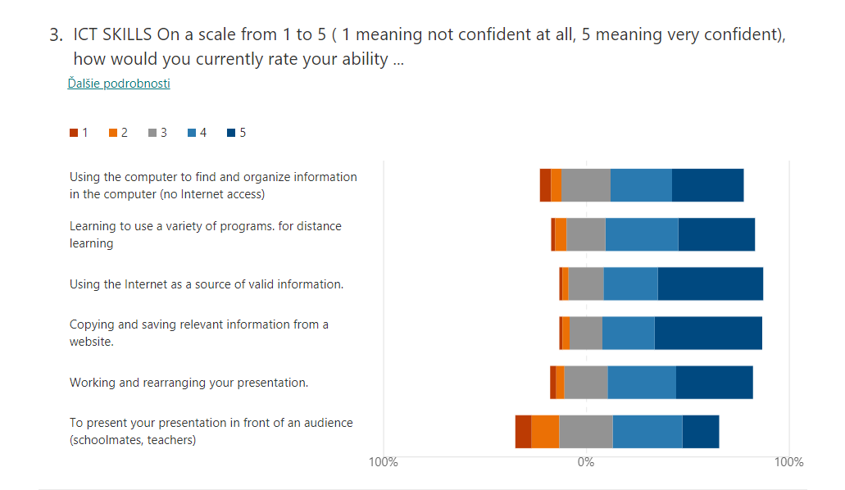

Slide 19
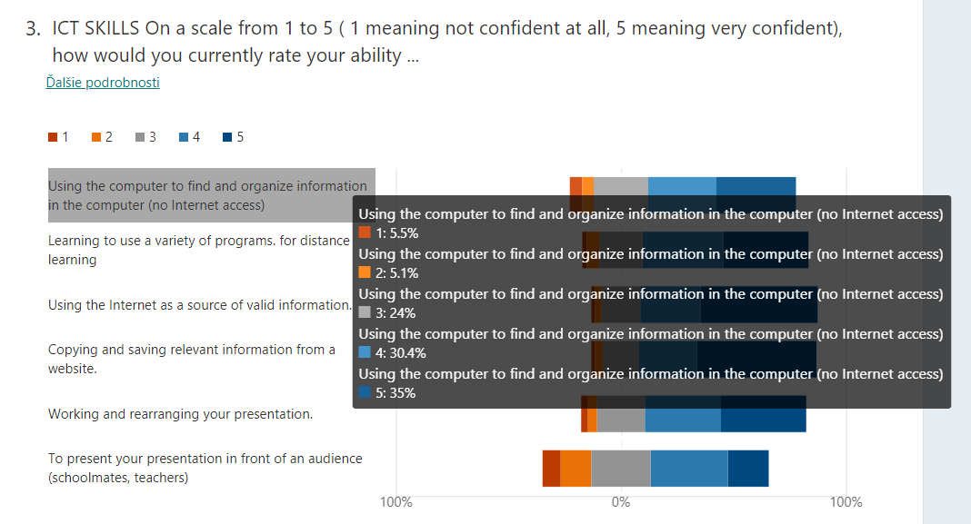

Slide 20
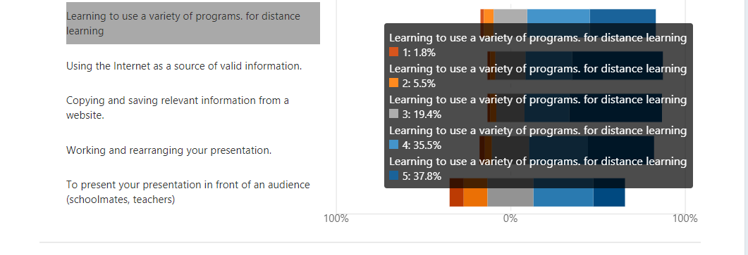

Slide 23
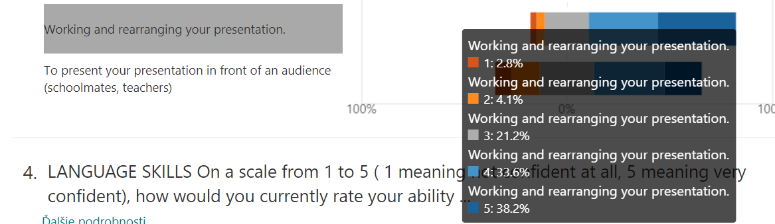

Slide 25
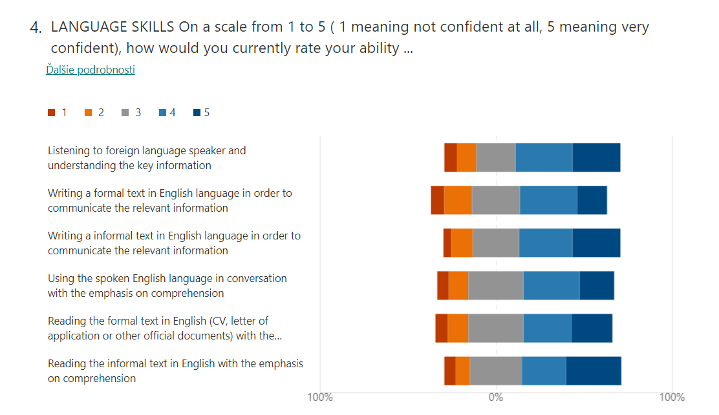

Slide 26
